Slide 1
DeepFiji Beta

Slide 2
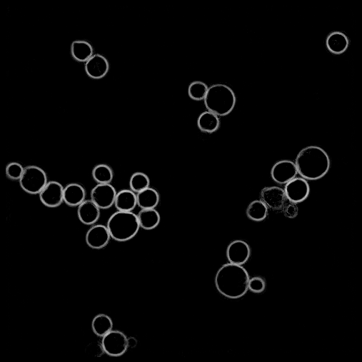
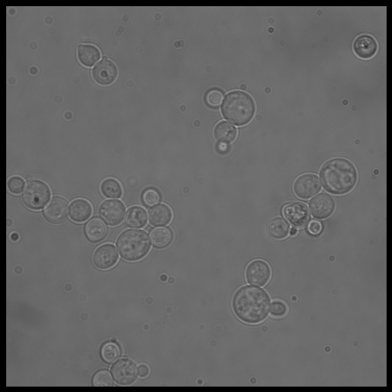
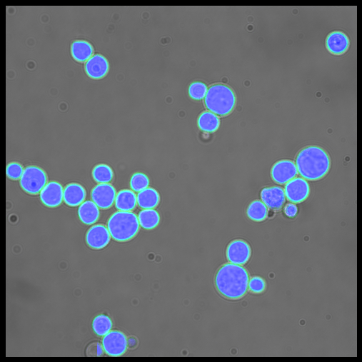
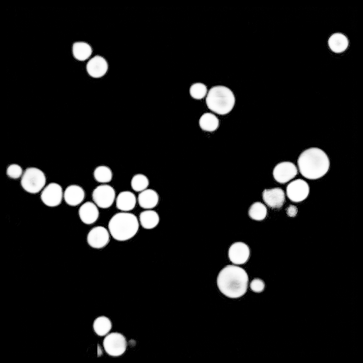

Slide 3
Steps (can be run any machine >60GB)
Annotate 2 sets of images using ROI Manager
Training.tif ---> Training.zip (lots of data)
Validation.tif ---> Validation.zip (very small amount)
Run Trainer.ijm
Watch training as it happens, wait for completion
Put new data to process in Data folder
Run Infererpt1.ijm
Wait for data files to show up in “Data_output”
Run Infererpt2.ijm
Results in “Final”
Retrain as necessary using Retrainer.ijm

Slide 4
Annotate
Trainer.ijm
Inferer.ijm
Re-annotate
Retrainer.ijm
Training set
Validation set
Watch results in web page
Use images that Inferer failed on

Slide 5
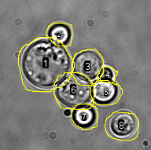
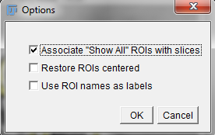
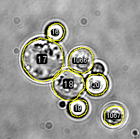
Annotating Training
Compile series of images into a single Training.tif file OR put individual images into a folder called “Training”
Choose these images to span the variety of things you will encounter in the final data
Different intensities, different backgrounds
Images with shapes other than the ones you are interested in
Do not try to make this a realistic ratio of positive to negative: enrich for positive
Open file(s) in Fiji
Draw along the inside of the objects, not right on the edge or just outside the edge
Add to manager with t key
RoiManager->More->Options:
Save as .zip when done, if using single images
in “Training” folder, save .zip files with the same name as the image (for now,
DO NOT use images that have 1 or 0 objects in them, use the single Training.tif instead)
BAD:
GOOD:

Slide 6
Annotating Validation
Validation is what will be used to grade the results
Validation usually only needs to be a single 512x512 with something in it
Validation should NOT be something from in Training.tif
Annotate same way as Training
MUST HAVE AT LEAST 3 IMAGES IN VALIDATION
This is not a problem if your Validation.tif image is larger than your window size (see slide 8), but if Validation.tif is the SAME as window size it will need more data

Slide 7
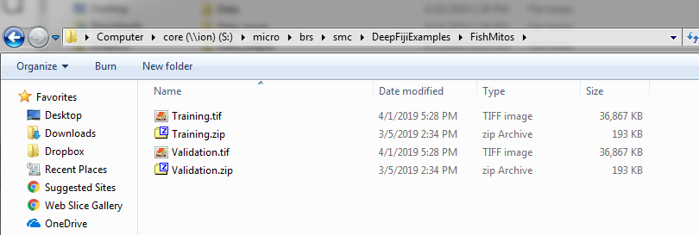
Training: What it should look like
ALWAYS put on s: drive (core)

Slide 8
Selecting a window size:
Your images are going to be windowed to a size, usually smaller than the original data
If you have anything 512 or larger: do 256 unless you have large objects (in which case you should probably shrink your images beforehand)
REMEMBER THIS NUMBER: You will want to know this number later for retraining

Slide 9
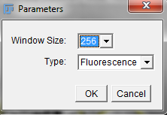
Running Trainer.ijm
Choose a window size, tell it whether fluorescence or EM
This will window and make rotated/shifted versions of training data
Must be on reasonable machine: >32GB RAM
U:\smc\Fiji_2016.app\macros\Trainer.ijm
A webpage will open: Tensorboard

Slide 10
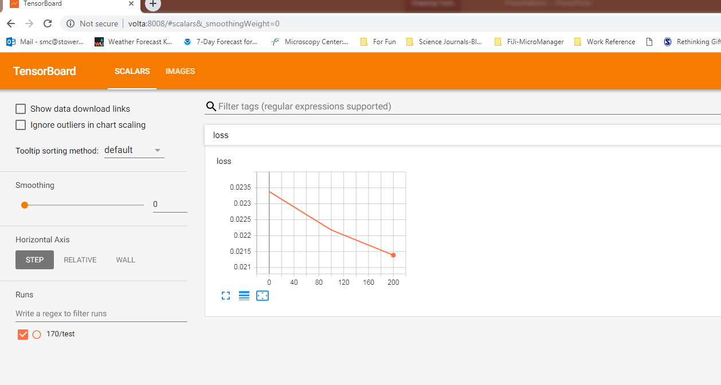
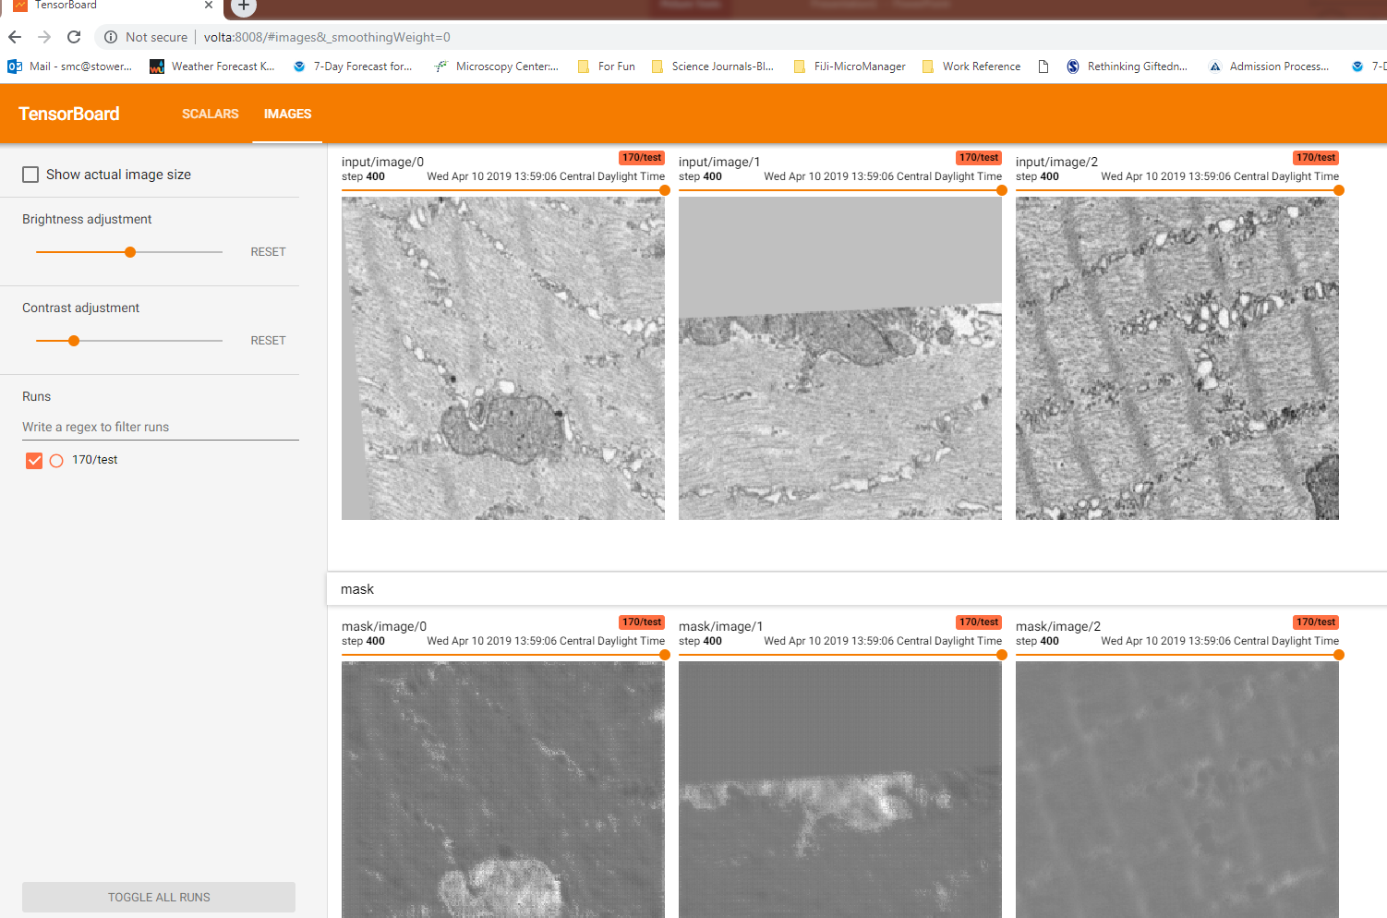
Using tensorboard
At first it will show nothing, wait a minute and reload
On Images tab you will be able to watch the progress of the training
Use slider to scroll through past iterations
Mask is the mask, click outlines to see the outlines channel
Training is done when you are at 2100 iterations
When it is finished SCROLL THROUGH THE ITERATIONS, pick the best one (find the “step” number associated with it) and write it down

Slide 11
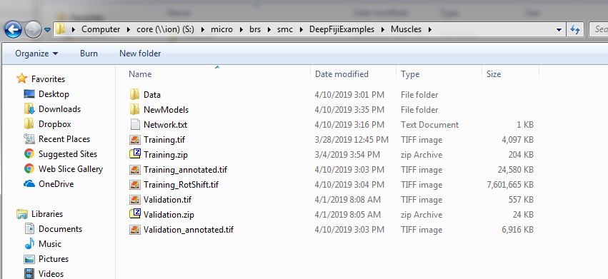
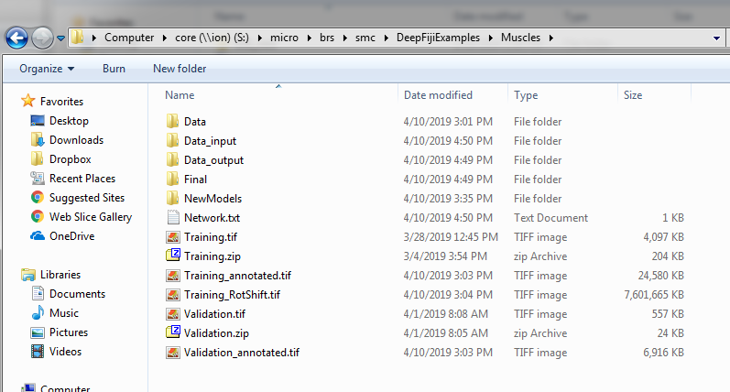
InfererPt1.ijm
Add data files to a folder you create called Data
Macro will ask you if you want to override the “best” model, if so provide the number of the iteration (“step”) you thought did the best job, otherwise just leave it -1
Once run, check Data_output folder to see when all processed files are done, then run InfererPt2.ijm

Slide 12
InfererPt2.ijm
InfererPt2.ijm converts the windowed inputs back to their original versions and saves to the “Final” folder

Slide 13
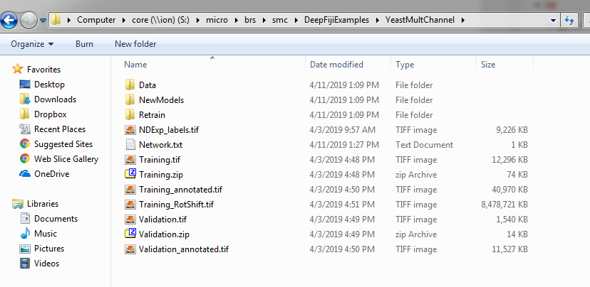
Retraining
If there is a patch of a final image that does not look right, draw a box around it of size WINDOW_SIZE and duplicate it
Save this as a tiff, then annotate it like you would Training/Validation and save an ROI list WITH THE SAME NAME as image
Do this for as many regions as you want: each region should be its own image
If >1 roi: save an XXX.zip file
If =1 roi: save as .zip.roi file
If =0 roi: save nothing
These images/roi files should be put into a new folder: Retrain

Slide 14
Run Retrainer.ijm
This should open tensorboard again
When complete, re-run InfererPt1.ijm and InfererPt2.ijm to see if results improved

