Slide 1
HTMX to Improve ASP.NET Core
Chris Woodruff

Slide 2
“In the beginning was the hyperlink, and the hyperlink was with the web, and the hyperlink was the web. And it was good.”
- Rescuing REST From the API Winter
https://intercoolerjs.org/2016/01/18/rescuing-rest.html

Slide 3
Let’s go back to 1963
The terms “hypertext” and “hypermedia” were coined in 1963 by Ted Nelson, who would go on to work on the Hypertext Editing System at Brown University and who later created the File Retrieval and Editing System (FRESS)

Slide 4
Let’s go back to 1991
HTML was released in 1991 by Tim Berners-Lee
18 elements in the first release
The most important element was and still is the Anchor tag
<a href="https://hypermedia.systems/">
Hypermedia Systems
</a>

Slide 5
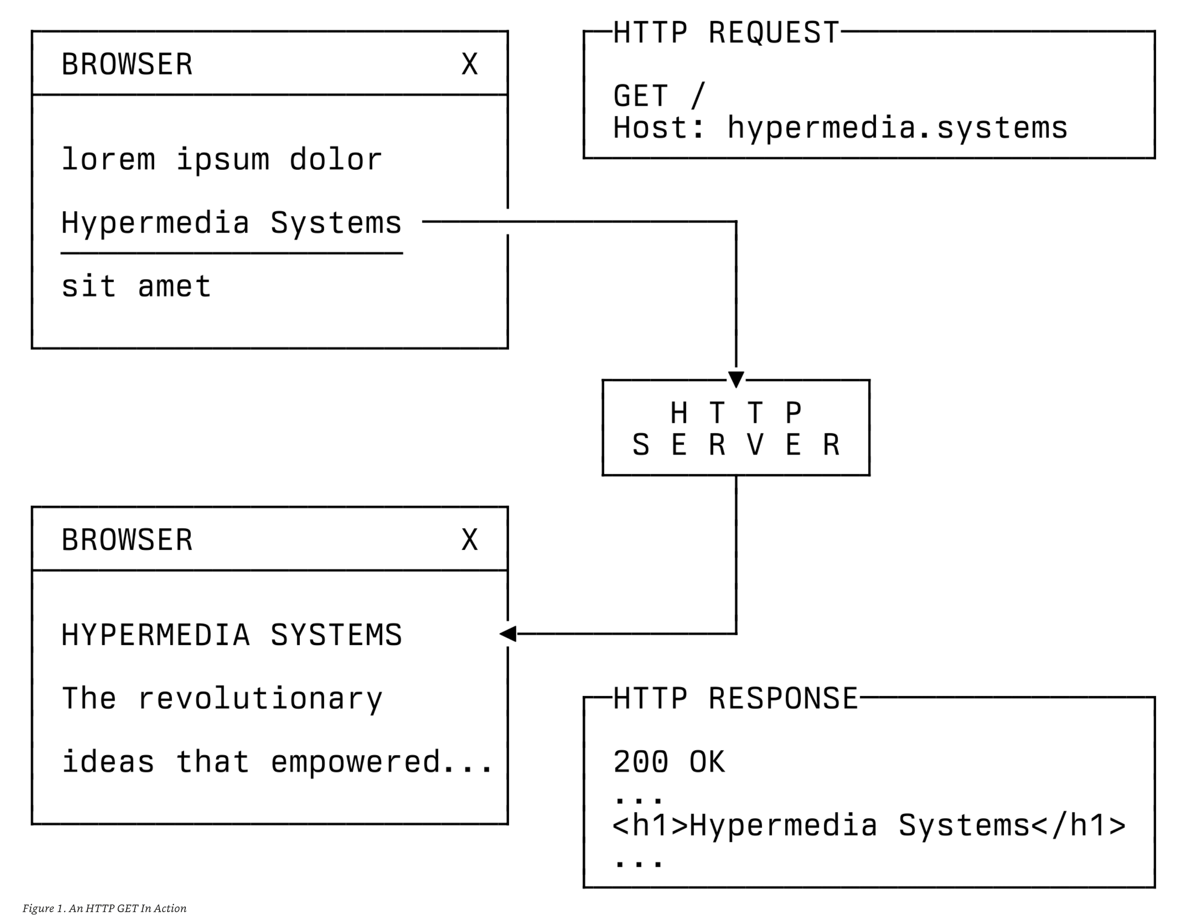

Slide 6
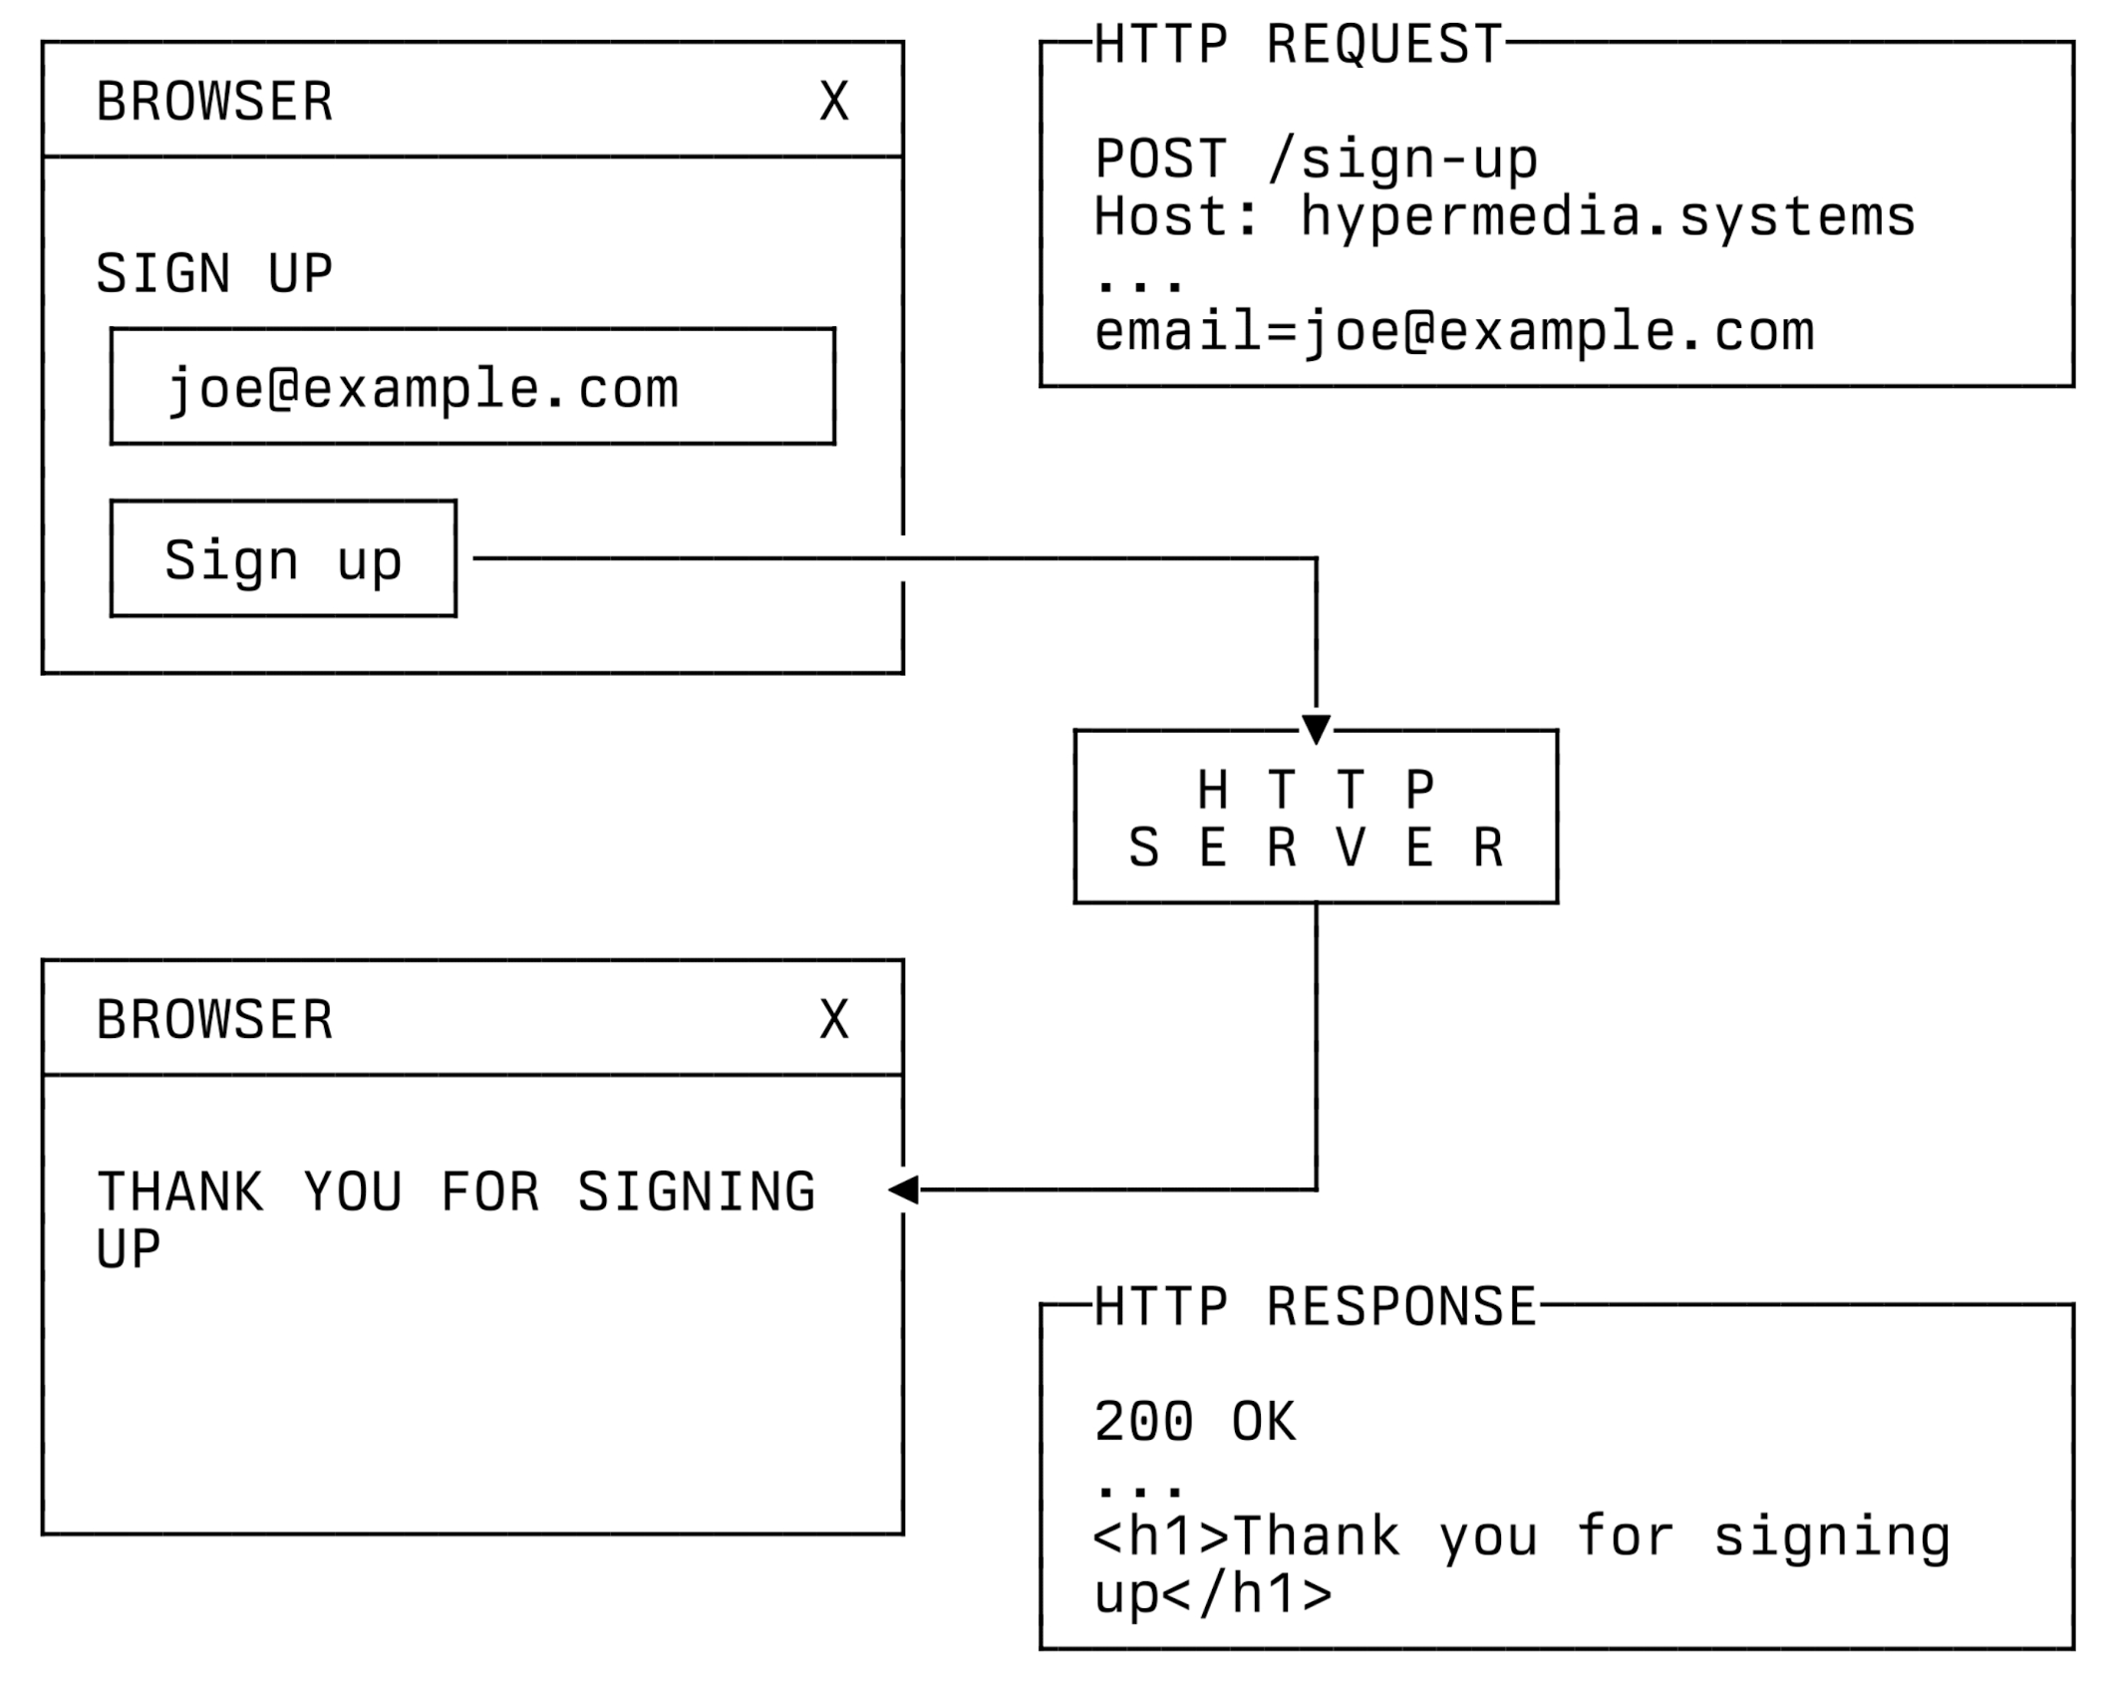

Slide 7
What is HTMX?
htmx is a javascript library that extends HTML for better hypertext abilities.
htmx gives you access to AJAX, CSS Transitions, WebSockets and Server Sent Events directly in HTML, using attributes, so you can build modern user interfaces with the simplicity and power of hypertext
htmx extends and generalizes the core idea of HTML as a hypertext, opening up many more possibilities directly within the language:
Now any element, not just anchors and forms, can issue an HTTP request
Now any event, not just clicks or form submissions, can trigger requests
Now any HTTP verb, not just GET and POST, can be used
Now any element, not just the entire window, can be the target for update by the request

Slide 8
Triggering HTMX
hx-get - issues an HTTP GET request.
hx-post - issues an HTTP POST request.
hx-put - issues an HTTP PUT request.
hx-patch - issues an HTTP PATCH request.
hx-delete - issues an HTTP DELETE request.

Slide 9
Targets in htmx (hx-target)
<div id="main">
<button hx-get="/contacts" hx-target="#main">
Get The Contacts
</button>
</div>
<div id="main">
<ul>
<li><a href="mailto:joe@example.com">Joe</a></li>
<li><a href="mailto:sarah@example.com">Sarah</a></li>
<li><a href="mailto:fred@example.com">Fred</a></li>
</ul>
</div>

Slide 10
Swapping in HTMX (hx-swap)
<div id="main">
<button hx-get="/contacts" hx-target="#main" hx-swap="outerHTML">
Get The Contacts
</button>
</div>
<ul>
<li><a href="mailto:joe@example.com">Joe</a></li>
<li><a href="mailto:sarah@example.com">Sarah</a></li>
<li><a href="mailto:fred@example.com">Fred</a></li>
</ul>

Slide 11
Swapping in HTMX (hx-swap)
innerHTML - The default, replace the inner html of the target element. ​
outerHTML - Replace the entire target element with the response. ​
beforebegin - Insert the response before the target element. ​
afterbegin - Insert the response before the first child of the target element. ​
beforeend - Insert the response after the last child of the target element. ​
afterend - Insert the response after the target element. ​
delete - Deletes the target element regardless of the response. ​
none - No swap will be performed.

Slide 12
Events in HTMX (hx-trigger)
<div id="main">
<button hx-get="/contacts" hx-target="#main" hx-swap="outerHTML" hx-trigger="mouseenter">
Get The Contacts
</button>
</div>

Slide 13
HTMX with Forms
<div id="main">
<label for="search">Search Contacts:</label>
<input id="search" name="q" type="search" placeholder="Search Contacts">
<button hx-post="/contacts" hx-target="#main" hx-include="#search">
Search The Contacts
</button>
</div>

Slide 14
Why use HTMX with ASP.NET Core?
Build client-side experience using HTML for better server-side development
Can use Partial() in Razor Pages to leverage Ajax programming
Trying to balance the code between client and server
Allowing ASP.NET Core to have improved UX without Javascript

