Slide 1
Test
Multi-threading & MPI
Thoai Nam
Faculty of Computer Science and Engineering
HCMC University of Technology

Slide 2
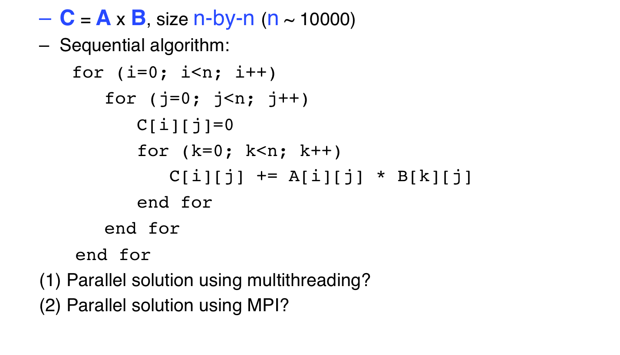
Parallel matrix multiplication
CSE-HCMUT

