Slide 1
LogP and BSP models

Slide 2
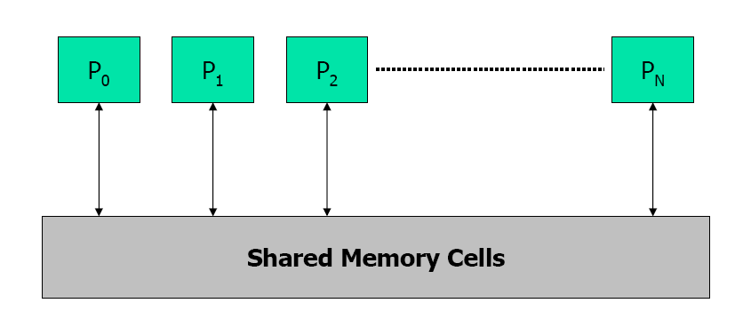
LogP model
PRAM model: shared memory
M
M
M
Common MPP organization: complete machine connected by a network.
LogP attempts to capture the characteristics of such organization.
°°°
P
P
P
network

Slide 3
Deriving LogP model
° Processing
– powerful microprocessor => P
° Communication
+ significant latency => L
+ limited bandwidth => g
+ significant overhead => o
  - on both ends
  no consensus on topology
  => should not exploit structure
– no consensus on programming model
  => should not enforce one

Slide 4
LogP
P ( processors )
P
M
P
M
P
M
° ° °
o (overhead)
o
g (gap)
L (latency)
Limited Volume
Interconnection Network
(
L/ g
to or from
a proc)
Latency in sending a (small) mesage between modules
overhead felt by the processor on sending or receiving msg
gap between successive sends or receives (1/BW)
Processors

Slide 5
Using the model
Two processors send n words to each other:
  2o + L + g(n-1)
Assumes no network contention
Can under-estimate the communication time.
o
L
o
o
L
o
g
time

Slide 6
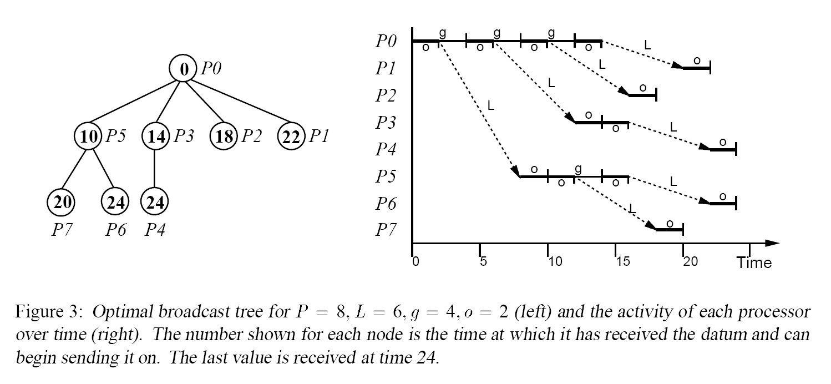
Develop efficient broadcast algorithm based on the LogP model
Broadcast a single datum to P-1 processors

Slide 7
Strengths of the LogP model
Simple, 4 parameters
Can easily be used to guide the algorithm development, especially algorithms for communication routines.
  This model has been used to analyze many collective communication algorithms.

Slide 8
Weaknesses of the LogP model
Accurate only at the very low level (machine instruction level)
  Inaccurate for more practical communication systems with layers of protocols (e.g. TCP/IP)
  Many variations.
    LogP family models: LogGP, logGPC, pLogP, etc
      Making the model more accurate and more complex

Slide 9
BSP (Bulk synchronous Parallel)
The BSP abstract computer is a bridging model for designing parallel algorithms
  Something between hardware and programming model.
A BSP computer consists of
  A set of processor-memory pairs
  A communication network that delivers messages in a point-to-point manner
  Mechanism for the efficient barrier synchronization for all or a subset of the processes

Slide 10
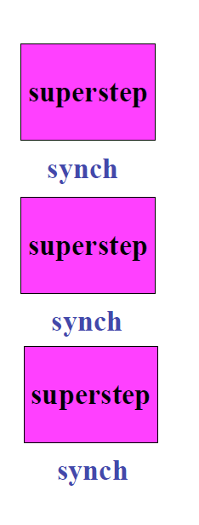
BSP programs
BSP programs composed of supersteps
  In each superstep consists of three ordered stages:
    Computation (up to a certain unit)
    Communication
    Barrier synchronization

Slide 11
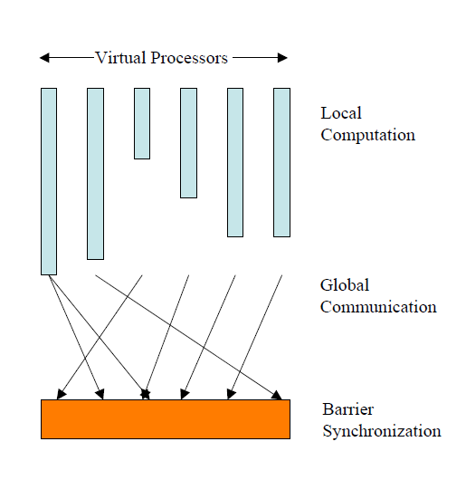
BSP programs
Vertical structure
  A sequence of supersteps
    Local computation
    Communication
    Barrier synchronization
Horizonal structure
  Concurrency among a fixed number of virtual processors
  Processes do not have a particular order
  Locality plays no role
  P = number of processors

Slide 12
BSP programming style
Properties
  Simple to write programs
  Independent of target architecture
  Performance of the model is predictable
Considers computation and communication at the level of the entire program and executing computer instead of individual processes
Renounces locality as an optimization issue.
  May not be ideal when locality is critical.

Slide 13
BSP communications
BSP considers communication en masse
  bound the total time to deliver the whole set of data in a superstep.
    h-relation: the maximum number of incoming or outgoing messages per processor
    Parameter g measures the permeability of the network to continuous traffic addressed to uniformly random destinations
      Defined such that it takes hg time to deliver an h-relation
    BSP does not distinguish between sending 1 message of length m, or m messages of length 1.
      Both cost mgh

Slide 14
BSP barrier synchronization
The cost has two parts:
  Variation in completion time of computation step
  The cost of reach globally consistent state in all processors
Cost is captured by parameter l
  Lower bound on l is a function of the diameter of the networks

Slide 15


Predictability of the BSP model
A BSP computer is modeled by:
  P: number of processors
  S: processor computation speed (flops/s), used to calibrate g and l
  l: synchronization periodicity; minimal number of time steps between successive synchronization operations
  g: the cost of communication so that an h-relation is realized within gh steps.
Cost of a super step (standard cost model)
Cost of a superstep (overlapping cost model)

Slide 16
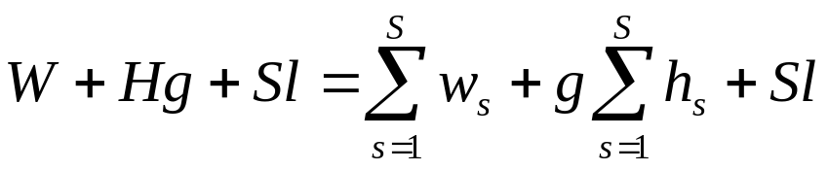
Cost of a BSP algorithm
The sum of the costs of all S supersteps
Strategies used in writing efficient BSP programs
  Balance the computation in each superstep between processes
    W is the maximum of all computation times in different processors
  Balance the communication between processes
    H is the maximum of the fan-in/fan-out of data
  Minimize the number of supersteps
    Determine the number of barriers in the program

Slide 17
BSP and PRAM
BSP is a generalization of PRAM
  Processes in a superstep can have different computation time
  Communication and synchronization costs are explicitly taken into consideration
  PRAM does not result in a programming model while BSP has some implementations.

Slide 18
BSP and LogP
Communication in LogP has a “local” view, based on per pair performance, communication in BSP has a “global” view, based on the performance for the whole program
LogP has a term (o) for the communication overhead.
LogP + barriers – overhead = BSP
Both models can efficiently simulate the other.

Slide 19
PRAM, BSP, LogP summary
All are fairly simple and can be used to guide parallel algorithm development.
Simplicity is necessary to be useful for guiding algorithm development, but results in inaccuracy for performance modeling.
  Many extensions have proposed to refine the models: trade simplicity for accuracy.

