Slide 1
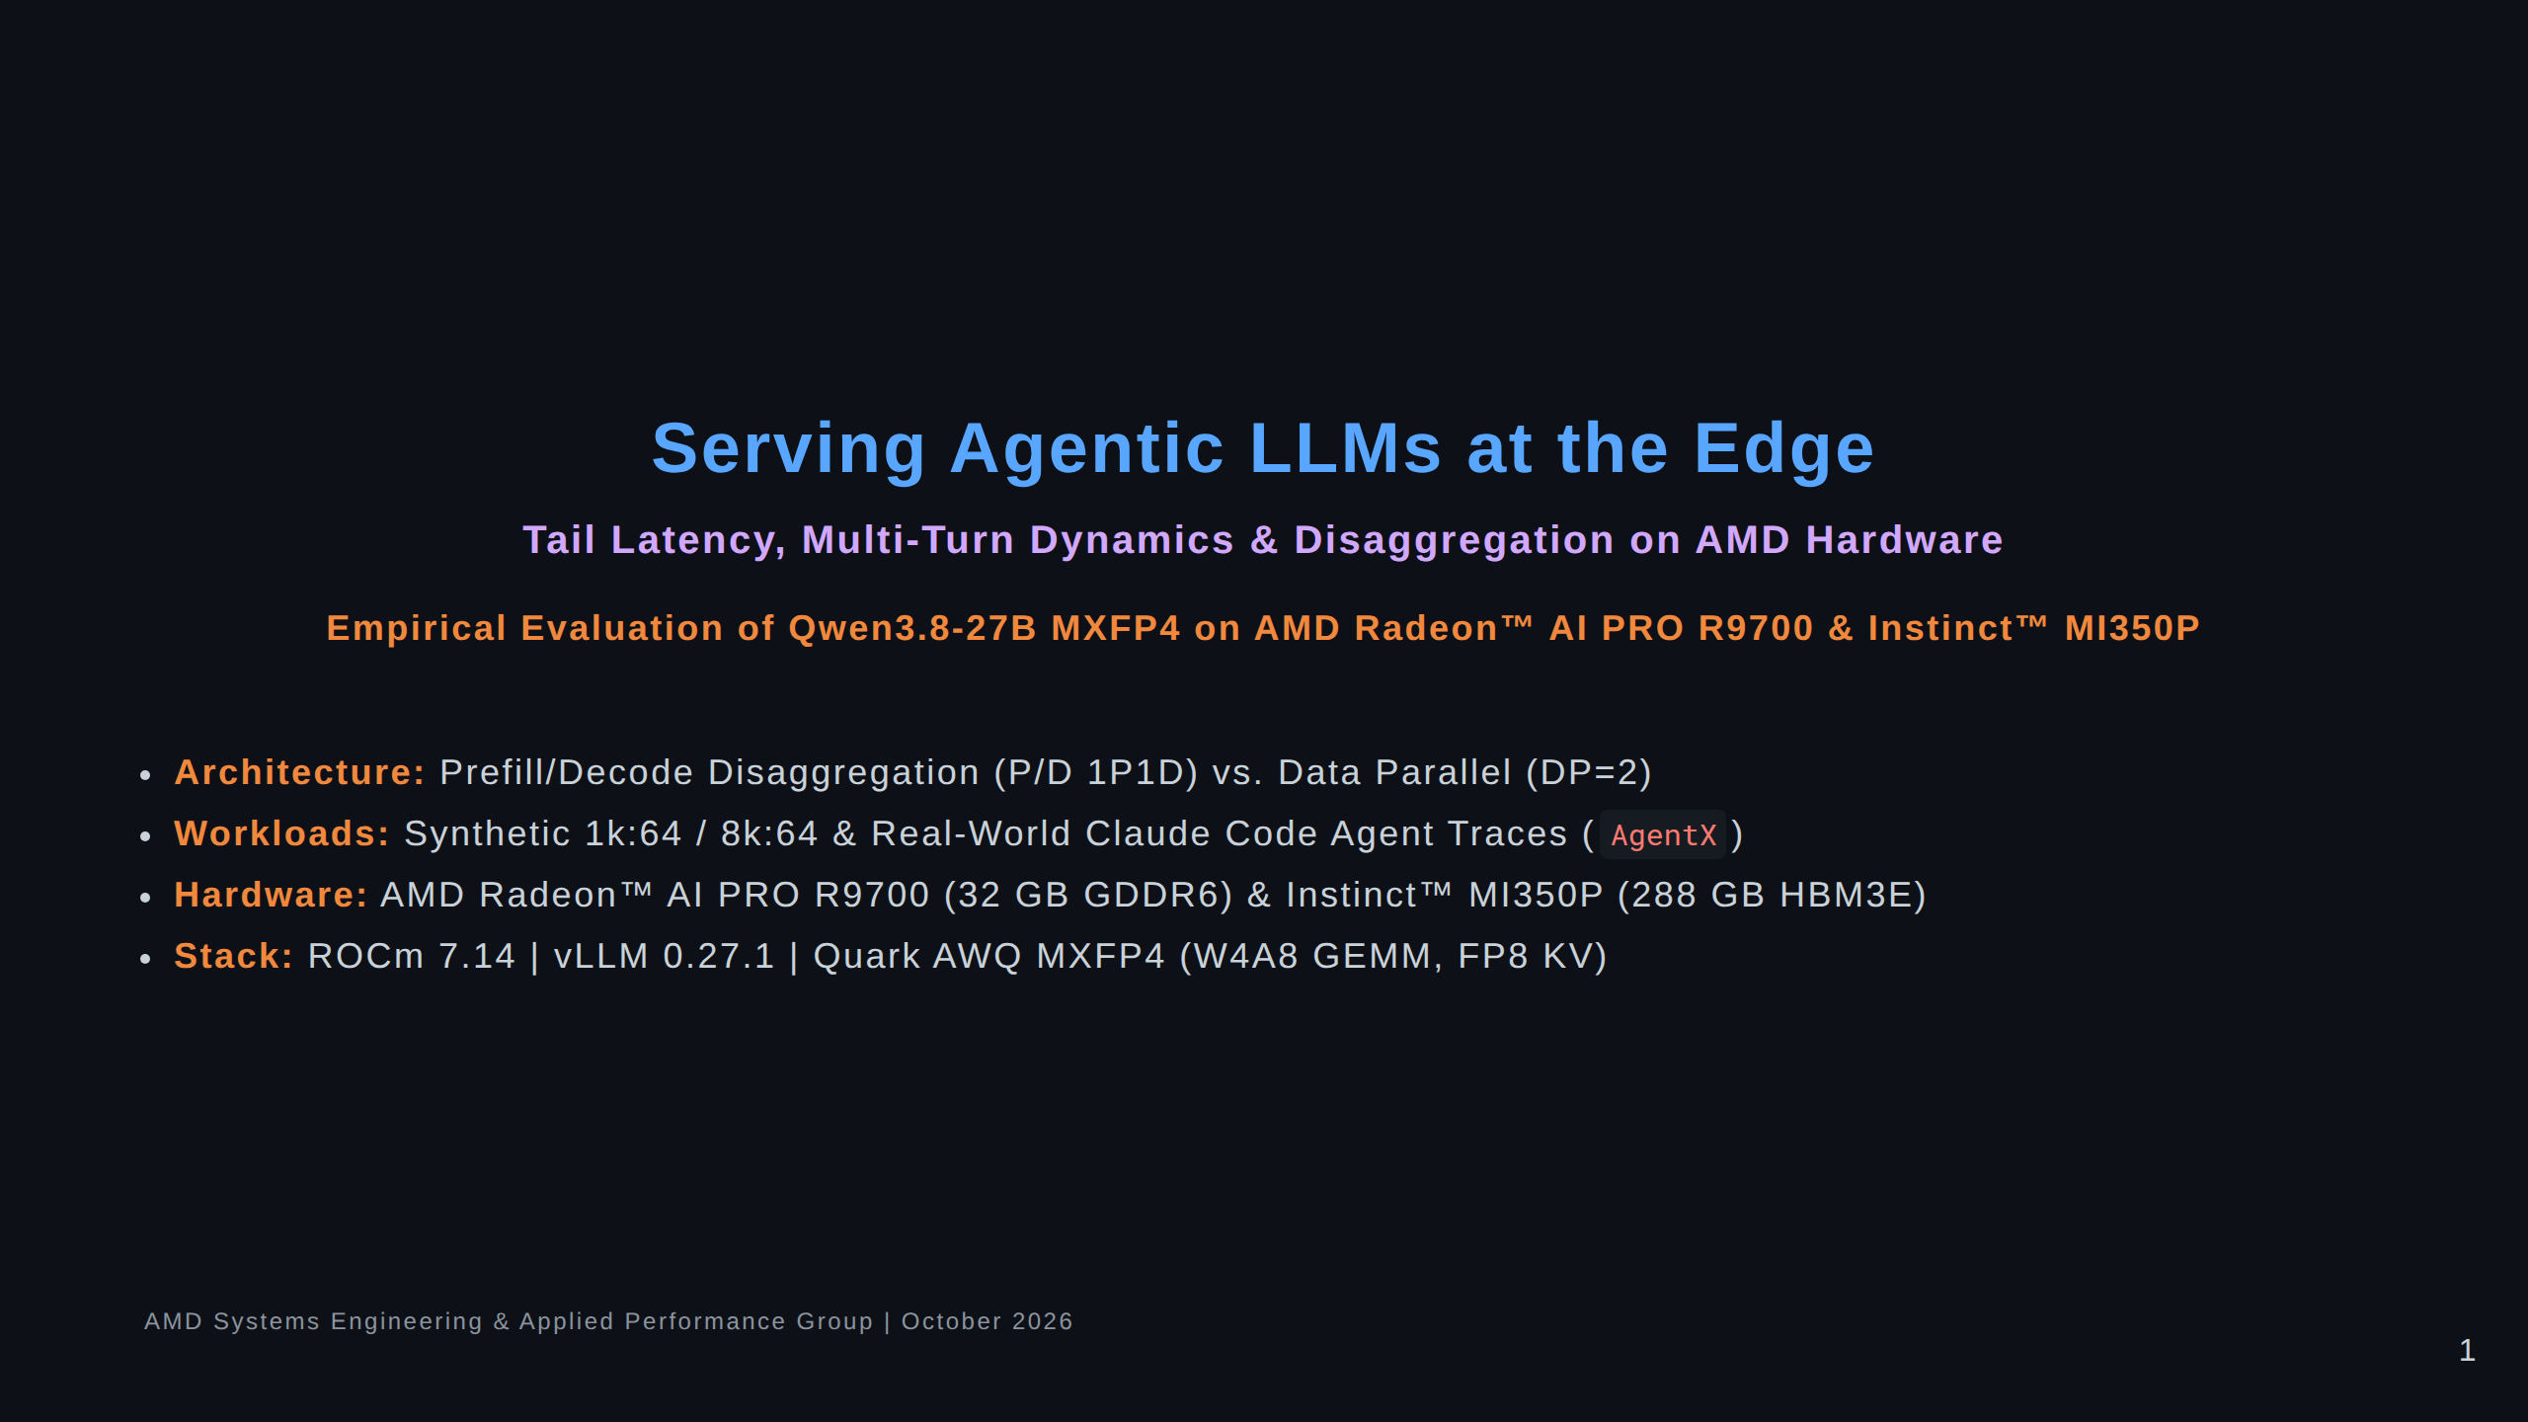
Notes:
Speaker Notes:
Welcome everyone. Today we are presenting empirical results on serving agentic LLMs on AMD hardware.
Rather than asking standard benchmark questions like "What is the peak theoretical tokens per second?",
we evaluate the actual interactive experience of coding agents: what happens when cold prompts arrive during
active generation, how prefix caching degrades under multi-turn pressure, and whether prefill/decode
disaggregation truly delivers higher useful goodput on PCIe-connected GPUs.

Slide 2
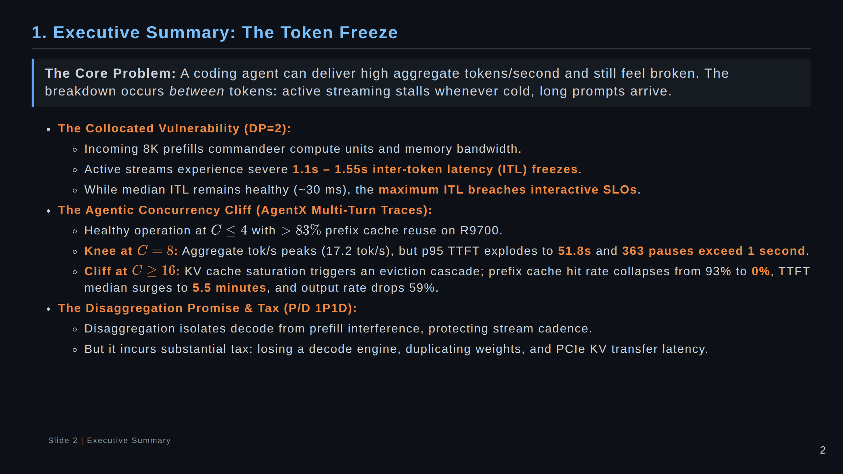
Notes:
Speaker Notes:
Key point to emphasize here: Average tokens per second is a deceptive vanity metric.
In a coding agent workflow, a user streaming code doesn't care if the GPU emits 30 tokens/sec on average
if it randomly pauses for 1.5 seconds right in the middle of writing a function.
Disaggregation is an architecture designed specifically to solve this tail latency problem.

Slide 3
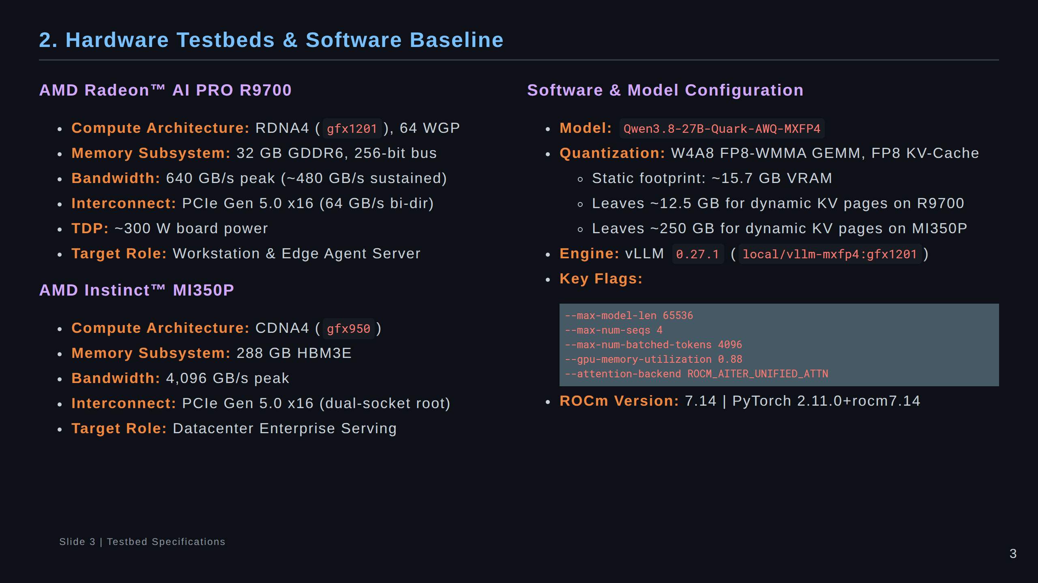
Notes:
Speaker Notes:
Notice the two distinct hardware classes:
The R9700 is an edge accelerator with 32 GB GDDR6 and 640 GB/s bandwidth.
The MI350P is a datacenter accelerator with 288 GB HBM3E and over 4 TB/s bandwidth.
Both run Qwen3.8-27B in native MXFP4 quantization with W4A8 GEMMs and FP8 KV cache.
On R9700, weights take 15.7 GB, leaving 12.5 GB for KV cache.

Slide 4
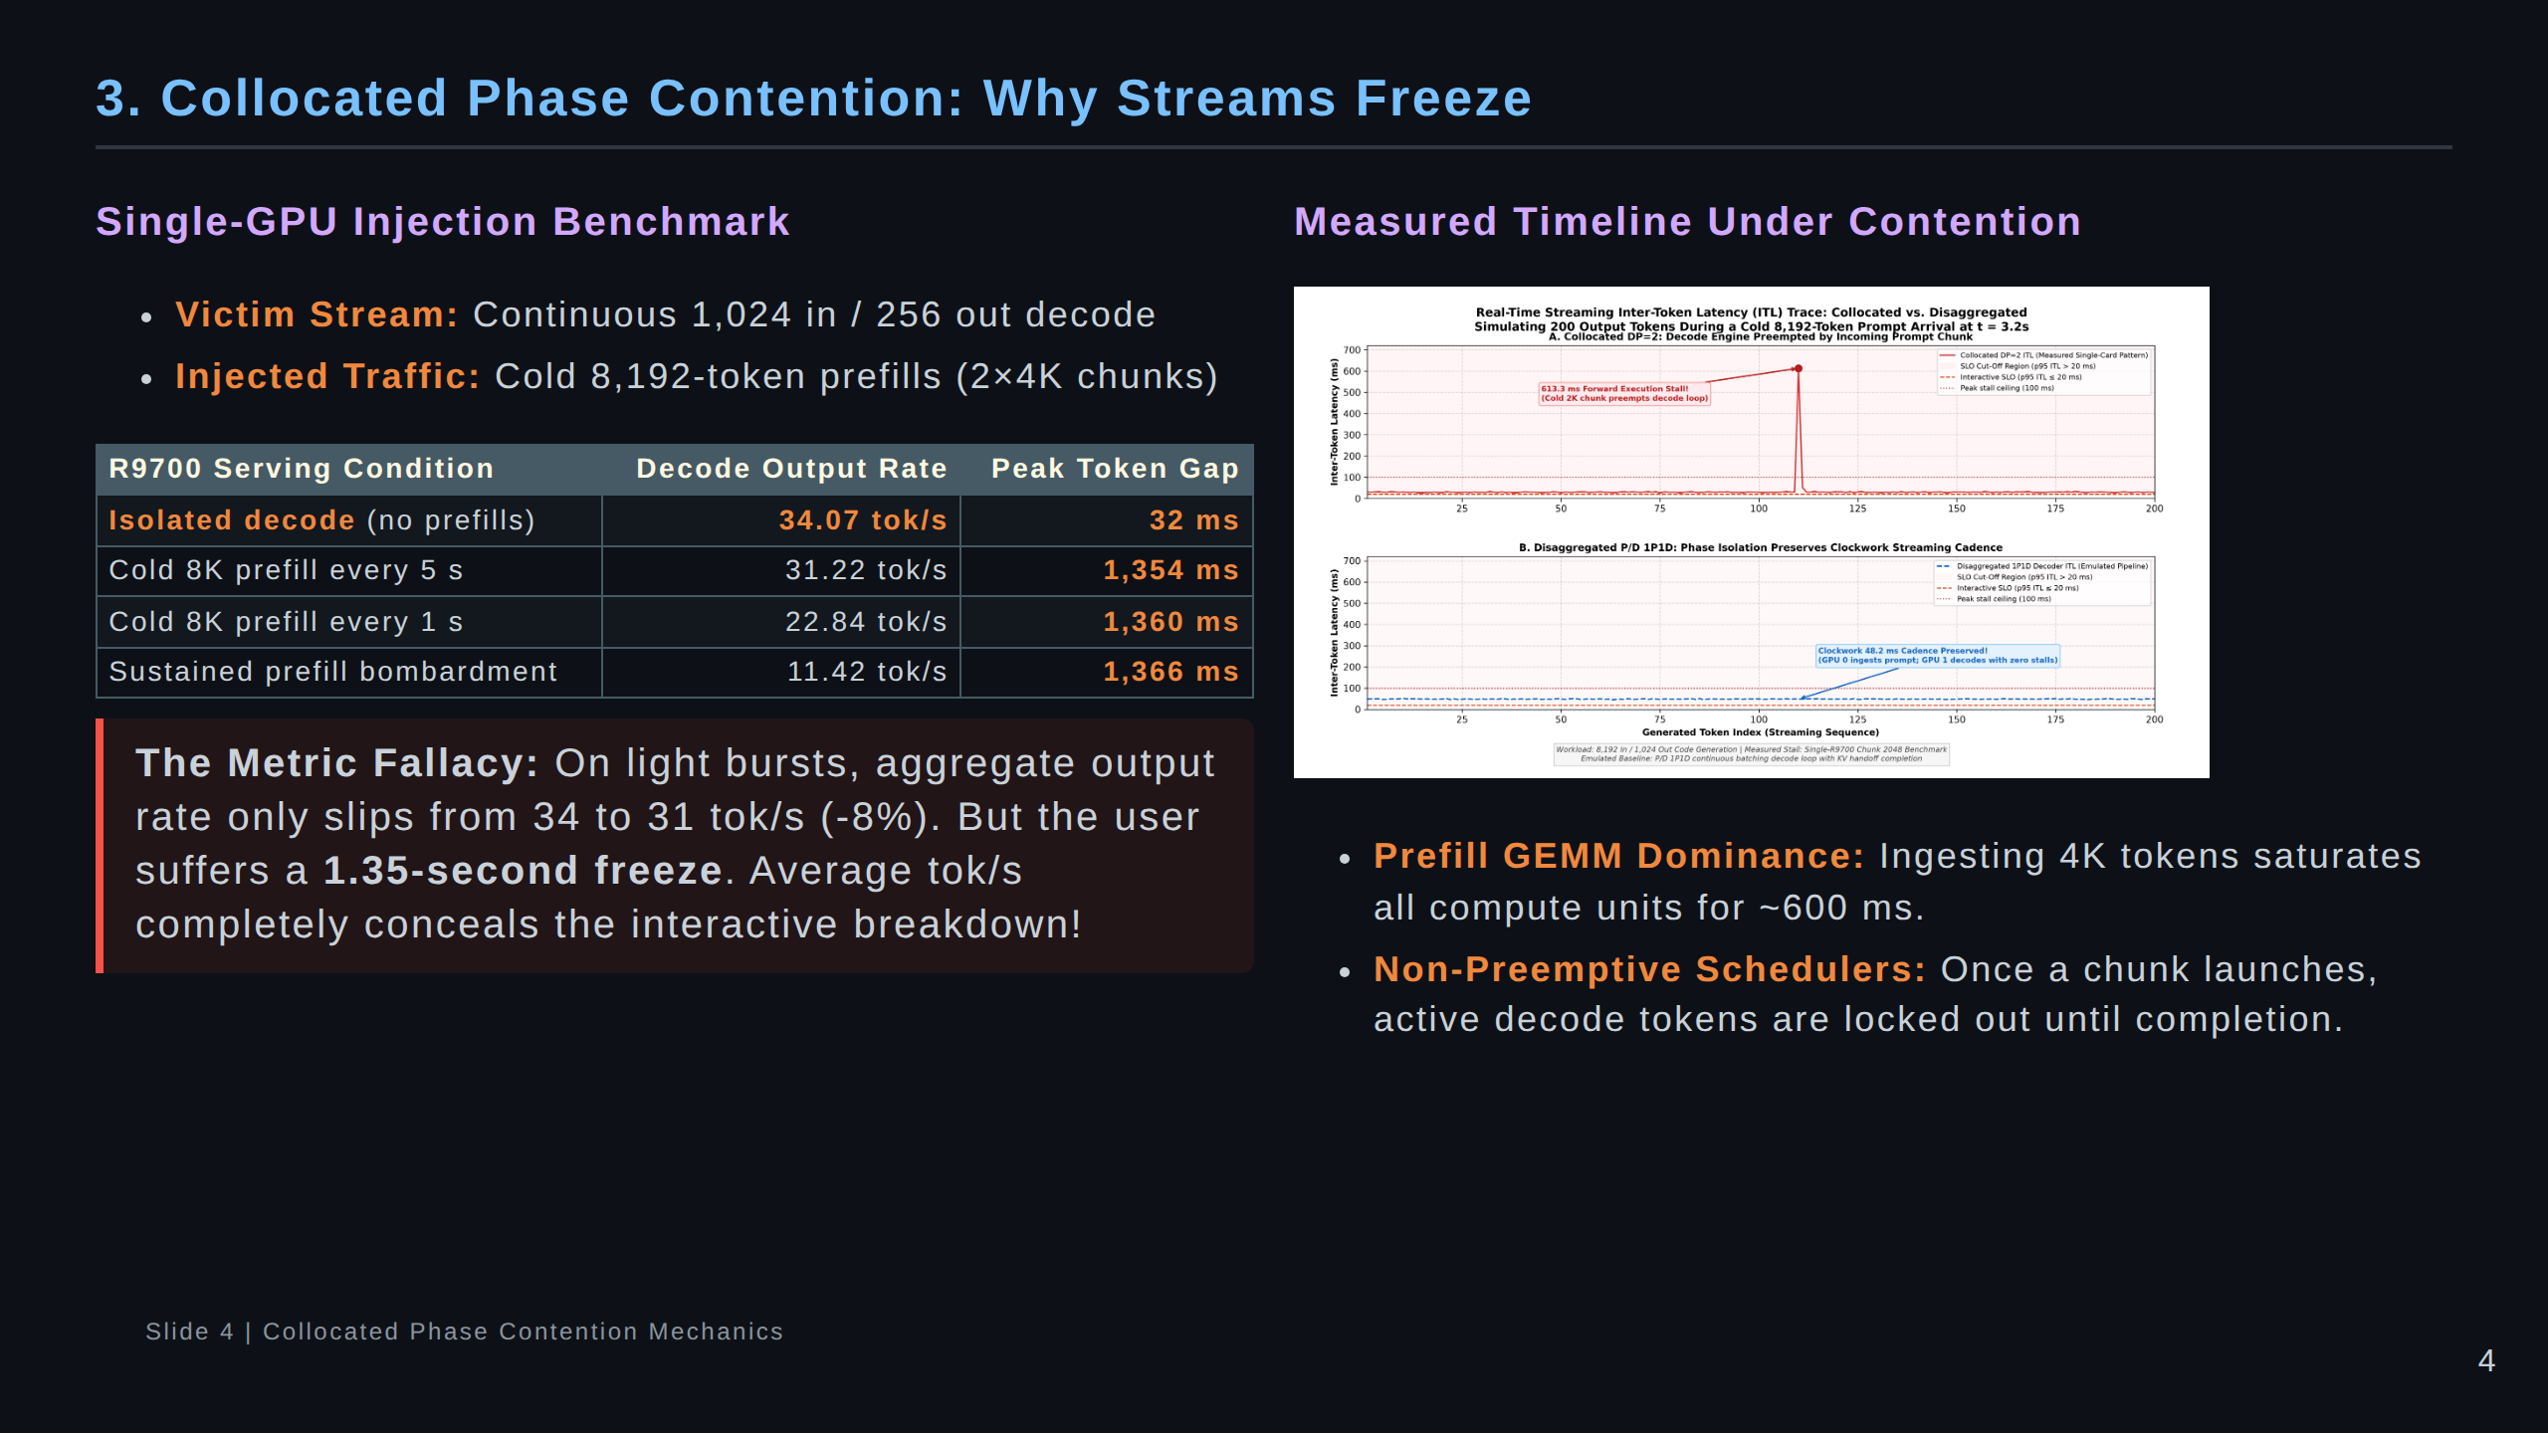
Notes:
Speaker Notes:
This slide contains the foundational empirical measurement of phase interference.
Look at the second row in the table: injecting one cold 8K prefill every 5 seconds only drops
the average token rate from 34 to 31 tokens/sec. On a standard dashboard, everything looks fine.
Yet the worst-case token gap spikes from 32 ms to 1,354 ms!
The right-hand plot shows the empirical timeline of these freeze events.

Slide 5
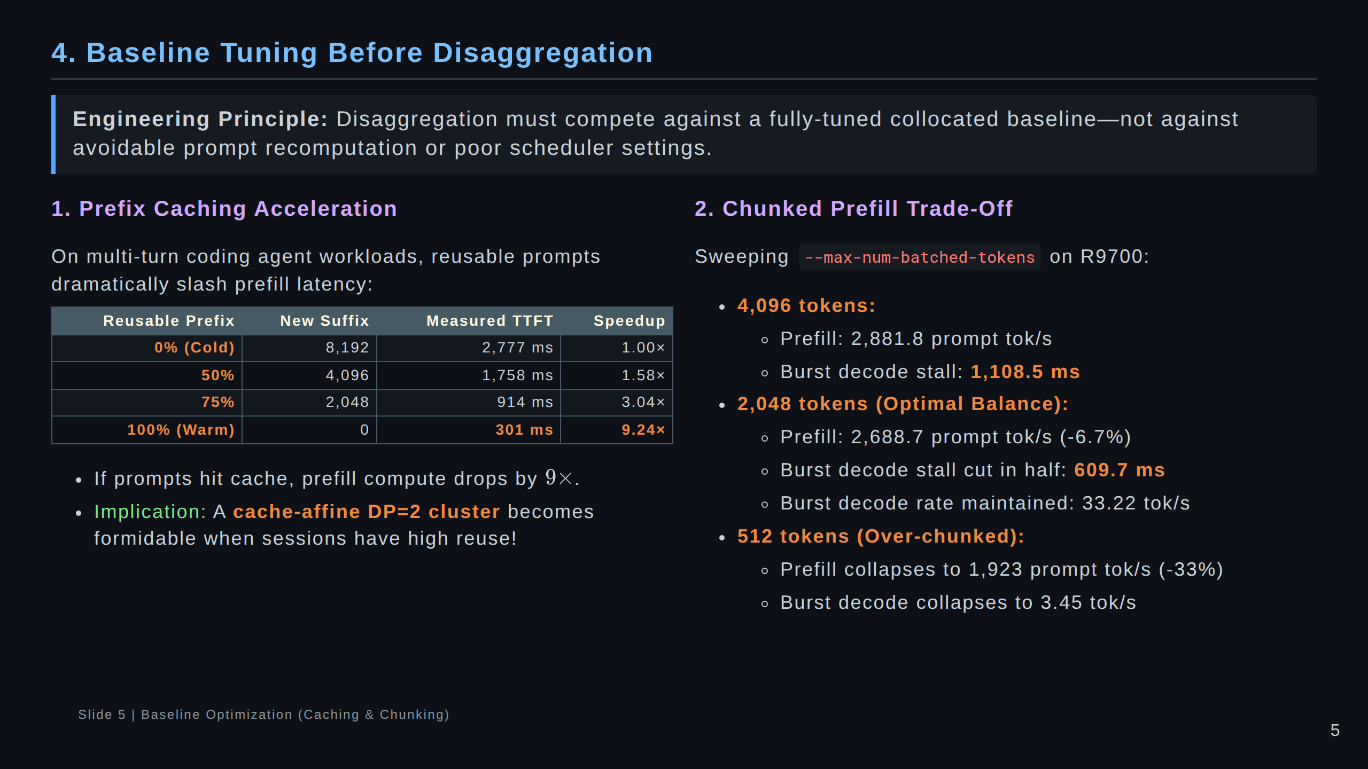
Notes:
Speaker Notes:
Before proposing complex architectural disaggregation, we must exhaust collocated tuning.
First: Prefix caching gives a 9x speedup on warm turns (301 ms vs 2.78 s).
Second: Chunked prefill at 2048 tokens halves the decode pause from 1.1s to 609 ms
while losing only 6.7% prompt throughput.
However, over-chunking (e.g. 512 tokens) is disastrous because small GEMMs fail to saturate the CUs.

Slide 6
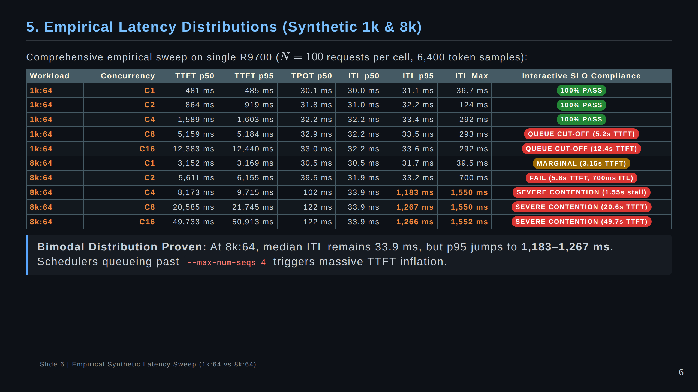
Notes:
Speaker Notes:
This table proves two vital statistical phenomena:
First: Look at TTFT from C4 to C8. TTFT jumps from 1.6s to 5.2s on 1k, and 8.2s to 20.6s on 8k.
Why? Because --max-num-seqs is set to 4. Any request past C=4 must wait in the vLLM scheduler queue.
Second: Look at ITL at 8k:64. Median ITL is 33.9 ms, but p95 is 1,267 ms.
This proves that decoding latency is bimodal: most tokens are fine, but periodic prefills inject huge freezes.

Slide 7
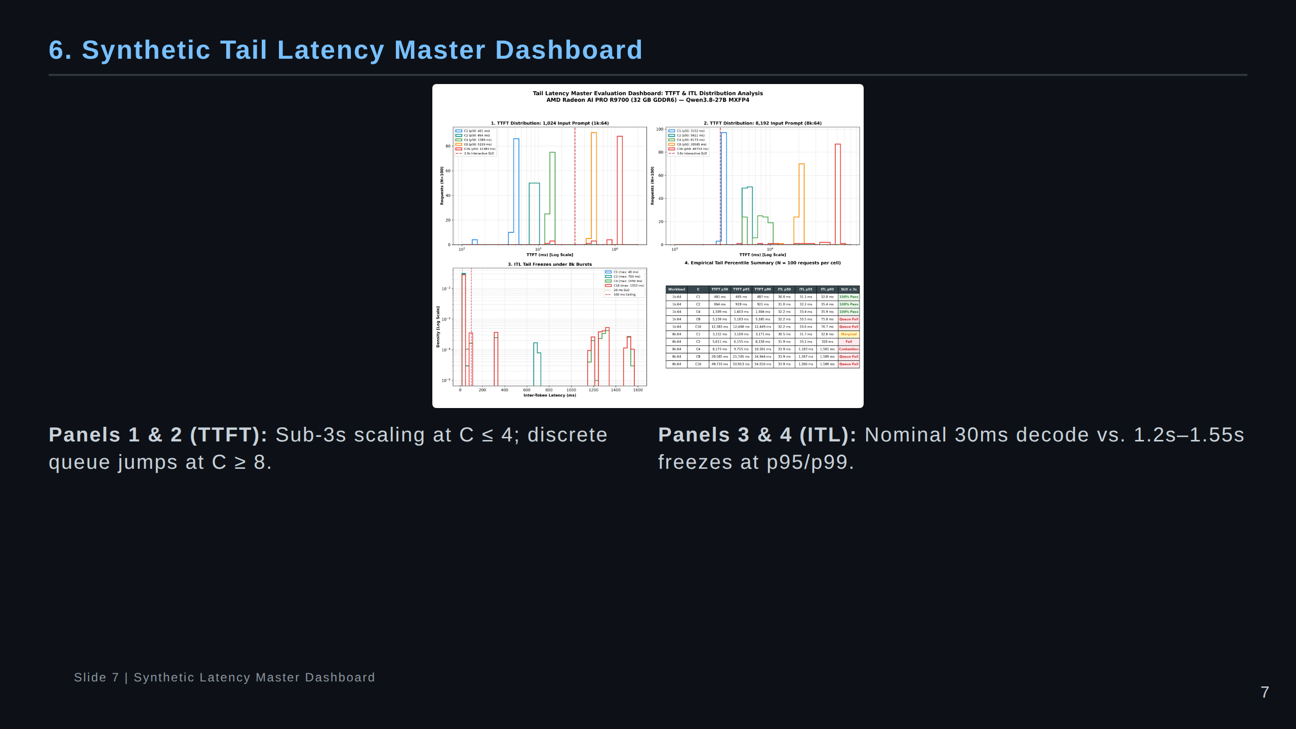
Notes:
Speaker Notes:
Here is the 4-panel master dashboard summarizing the synthetic sweep.
Panels 1 and 2 show TTFT on a log scale for 1k and 8k prompts. Notice the vertical red line at 3.0s,
which is our interactive SLO limit.
Panels 3 and 4 show the Inter-Token Latency density and CDF. In the CDF (Panel 4), notice how the
curves stay flat at 30 ms until the 90th percentile, and then suddenly bend sharply toward 1,500 ms.

Slide 8
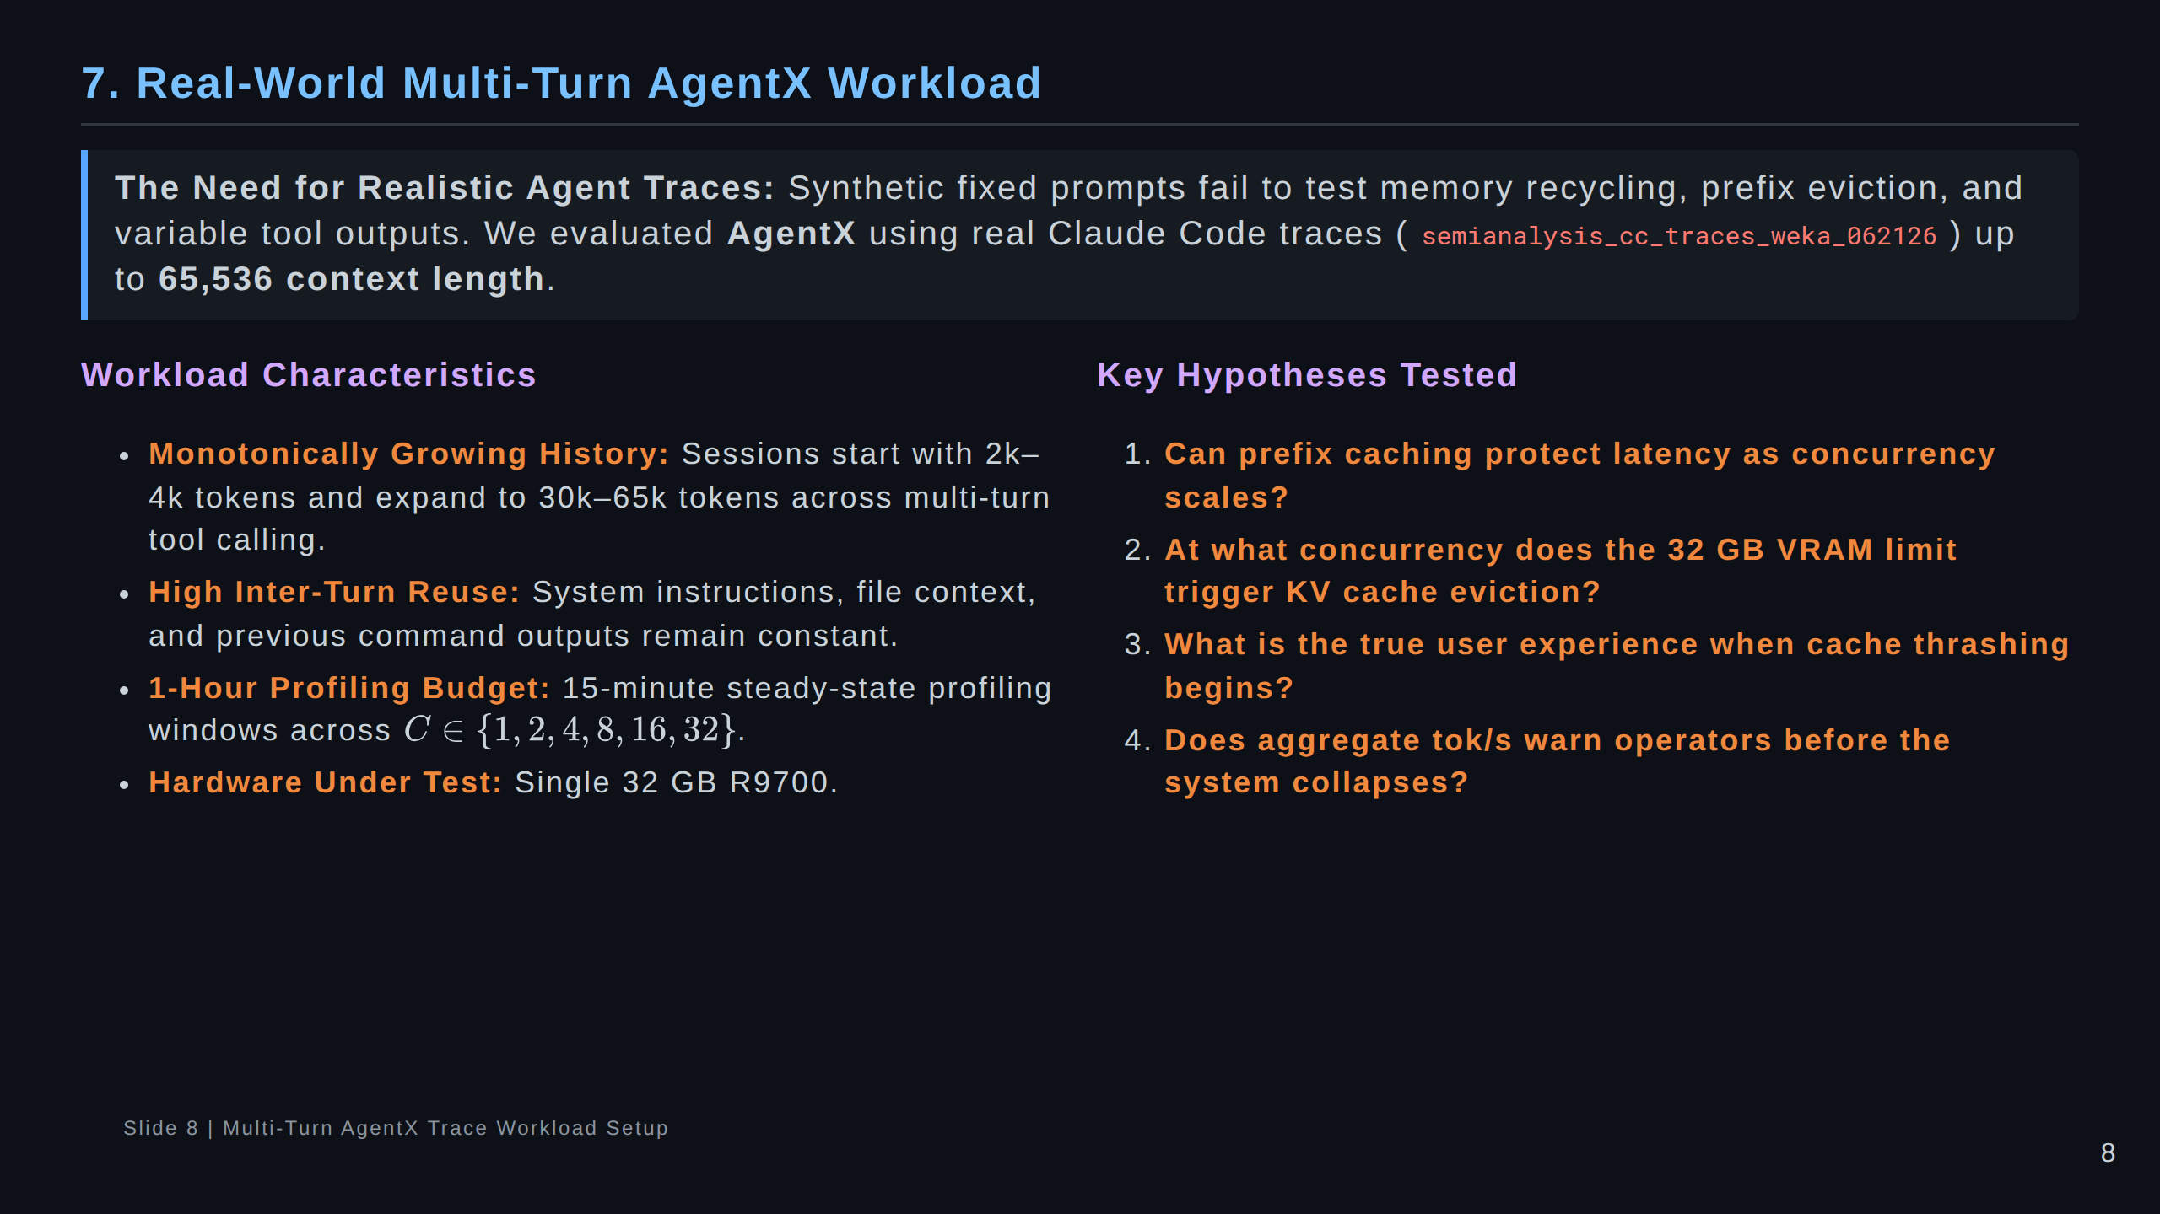
Notes:
Speaker Notes:
Moving from synthetic tests to real agentic workloads.
We ran the AgentX benchmark using real Claude Code traces.
These traces feature multi-turn conversations where the context starts small and expands up to 65k tokens.
Between turns, the agent runs shell commands, views files, and receives tool outputs.
This workload tests prefix caching and KV memory pressure under authentic, non-uniform traffic.

Slide 9
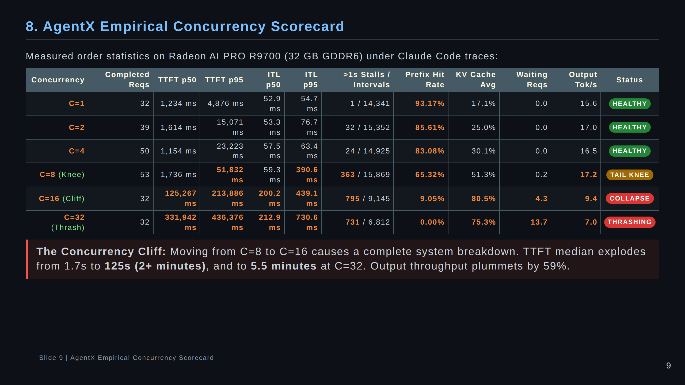
Notes:
Speaker Notes:
This scorecard is one of the most critical exhibits in the presentation.
At C=1 to C=4, the system is healthy: prefix hit rate is 83-93%, and waiting queue is zero.
At C=8, output tok/s hits its highest value: 17.2 tok/s! But look closely:
p95 TTFT is 51.8 seconds, p95 ITL is 390 ms, and 363 token stalls exceed 1 second!
At C=16, the system falls off a cliff: TTFT explodes to 125 seconds median, and throughput drops to 9.4 tok/s.

Slide 10
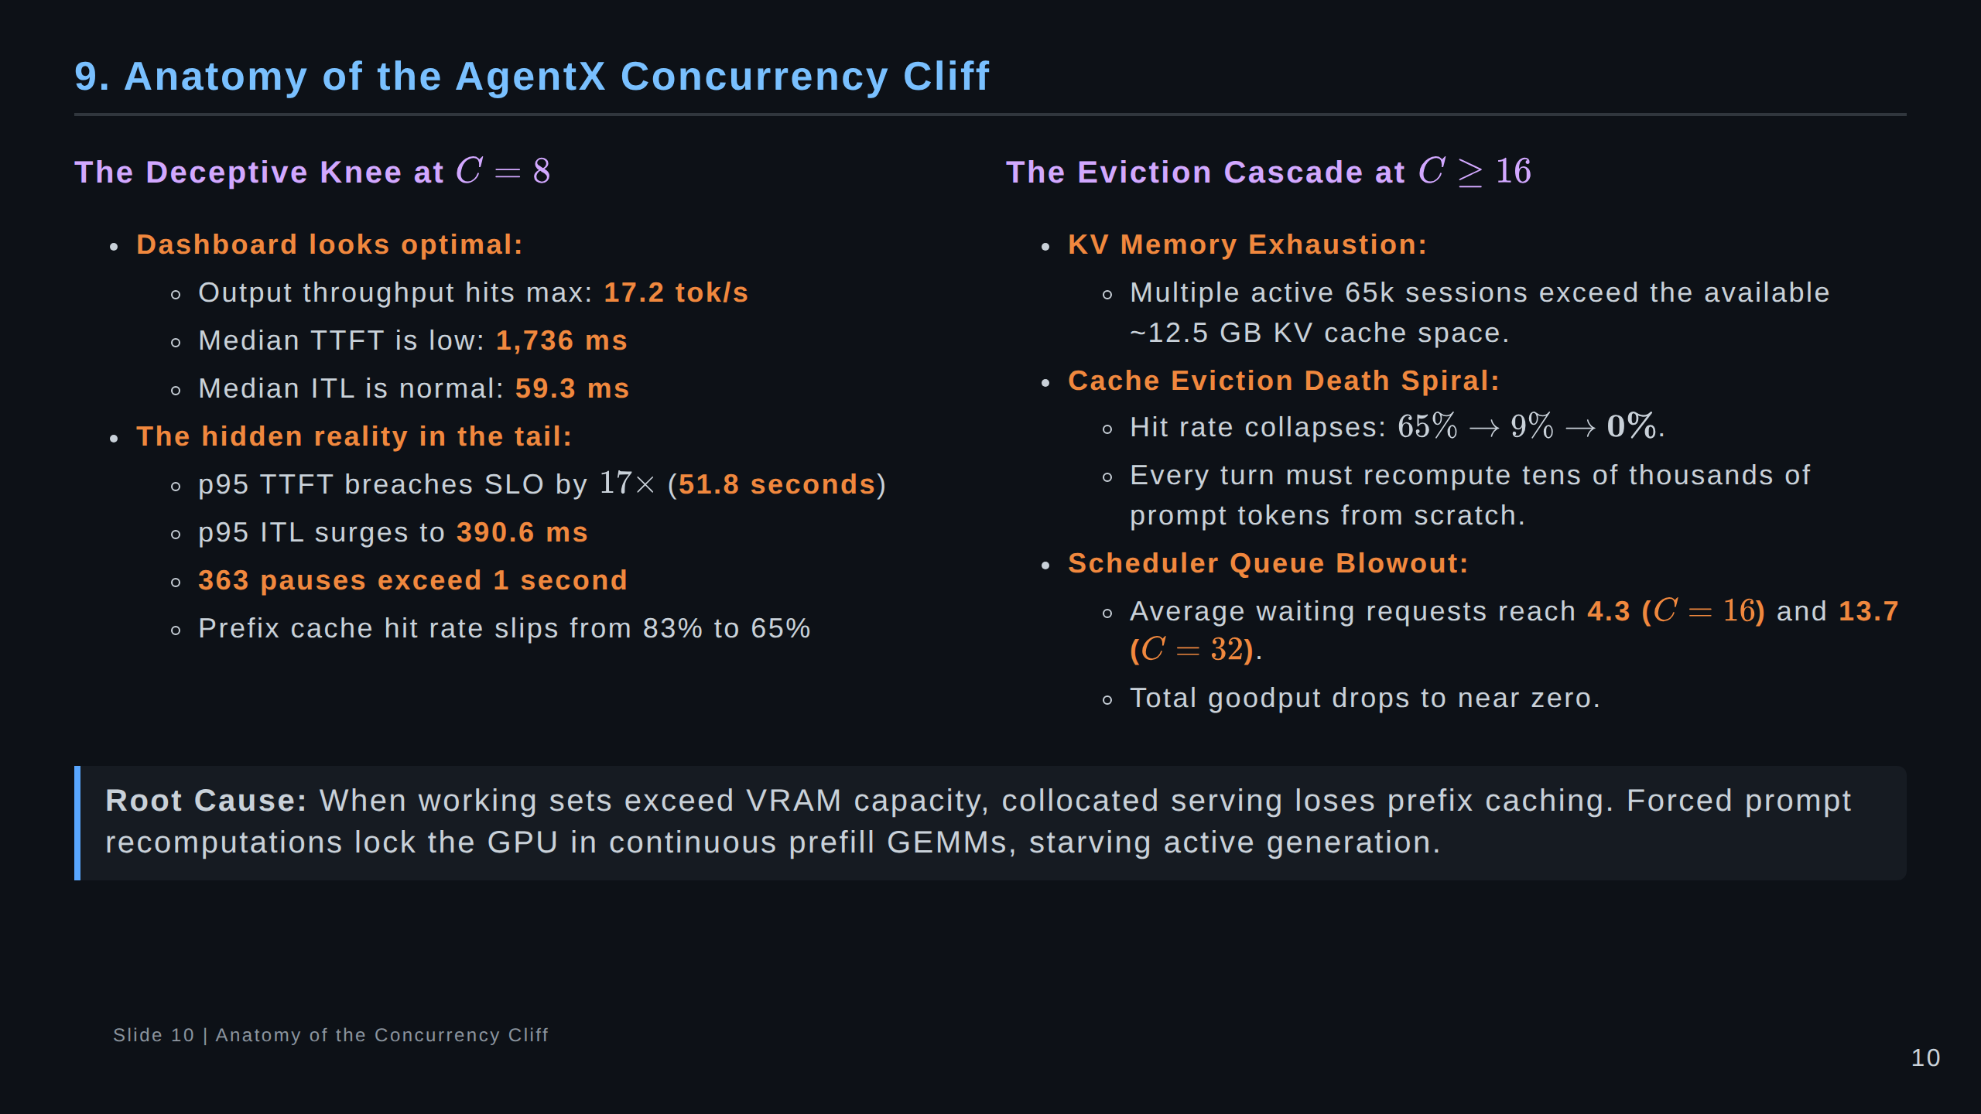
Notes:
Speaker Notes:
Why does this cliff happen?
It is an eviction death spiral:
When the KV cache fills up to 80%, vLLM must evict cached prefixes to make room for active decodes.
Once prefixes are evicted, every new turn has to be recomputed from token 0.
Recomputing 20k to 50k tokens takes tens of seconds of dense GEMM computation.
While that GEMM runs, decode is starved. Schedulers queue up. Everything collapses.

Slide 11
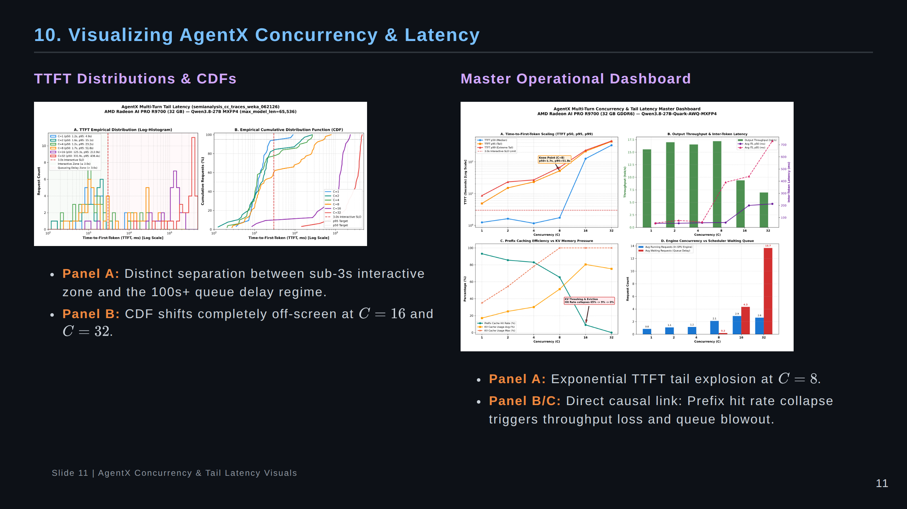
Notes:
Speaker Notes:
Here are the empirical figures from the AgentX sweep.
On the left, the TTFT histogram clearly illustrates the bifurcation: C=1 to C=4 cluster neatly below 3 seconds.
At C=16 and C=32, the distribution shifts entirely to the far right, past 100 seconds.
On the right dashboard, look at Panel C: prefix hit rate collapses from 93% to 0%, exactly mirroring
the surge in waiting requests in Panel D.

Slide 12
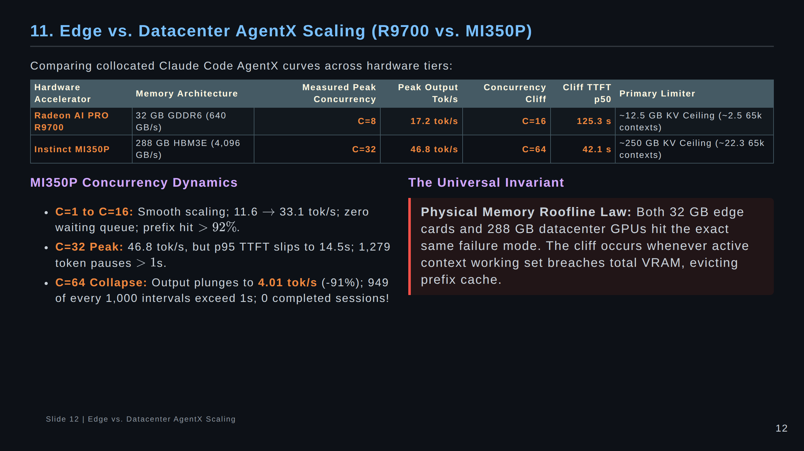
Notes:
Speaker Notes:
This is a brand new comparison enabled by recent runs on MI350P.
Notice that the MI350P, with its massive 288 GB HBM3E memory, scales much further:
Its throughput peaks at C=32 (46.8 tok/s) instead of C=8 (17.2 tok/s).
However, at C=64, MI350P hits the EXACT same cliff: output rate collapses by 91% down to 4 tok/s!
This proves that throwing more memory at the problem delays the cliff, but doesn't eliminate it.
Architectural disaggregation is necessary to fundamentally solve phase contention.

Slide 13
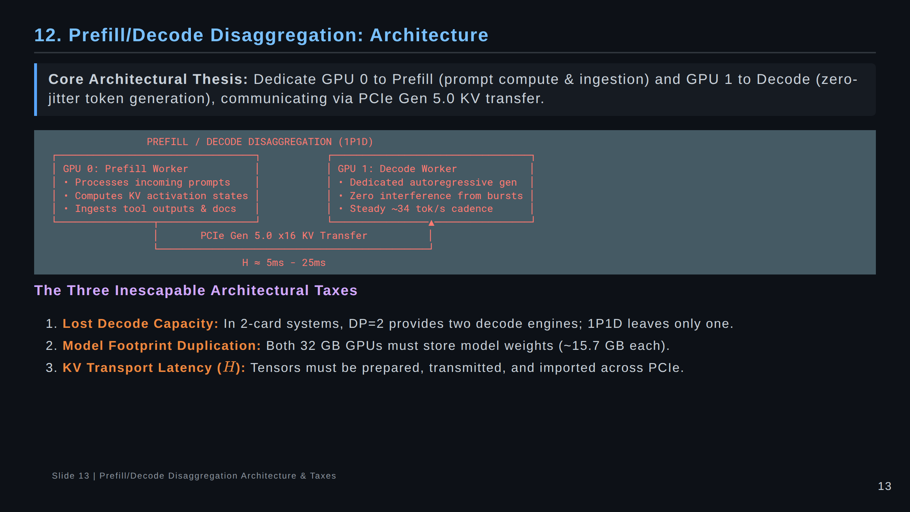
Notes:
Speaker Notes:
Now let's examine the architectural alternative: Prefill/Decode Disaggregation, or 1P1D.
Instead of having both GPUs do both phases, we specialize them:
GPU 0 does only prompt prefill. GPU 1 does only token decode.
We must be honest about the trade-offs:
1. In DP=2, you have two GPUs generating tokens. In 1P1D, only one GPU generates tokens.
2. Weights are duplicated on both GPUs.
3. You introduce a new hop: transferring the KV cache over PCIe.

Slide 14
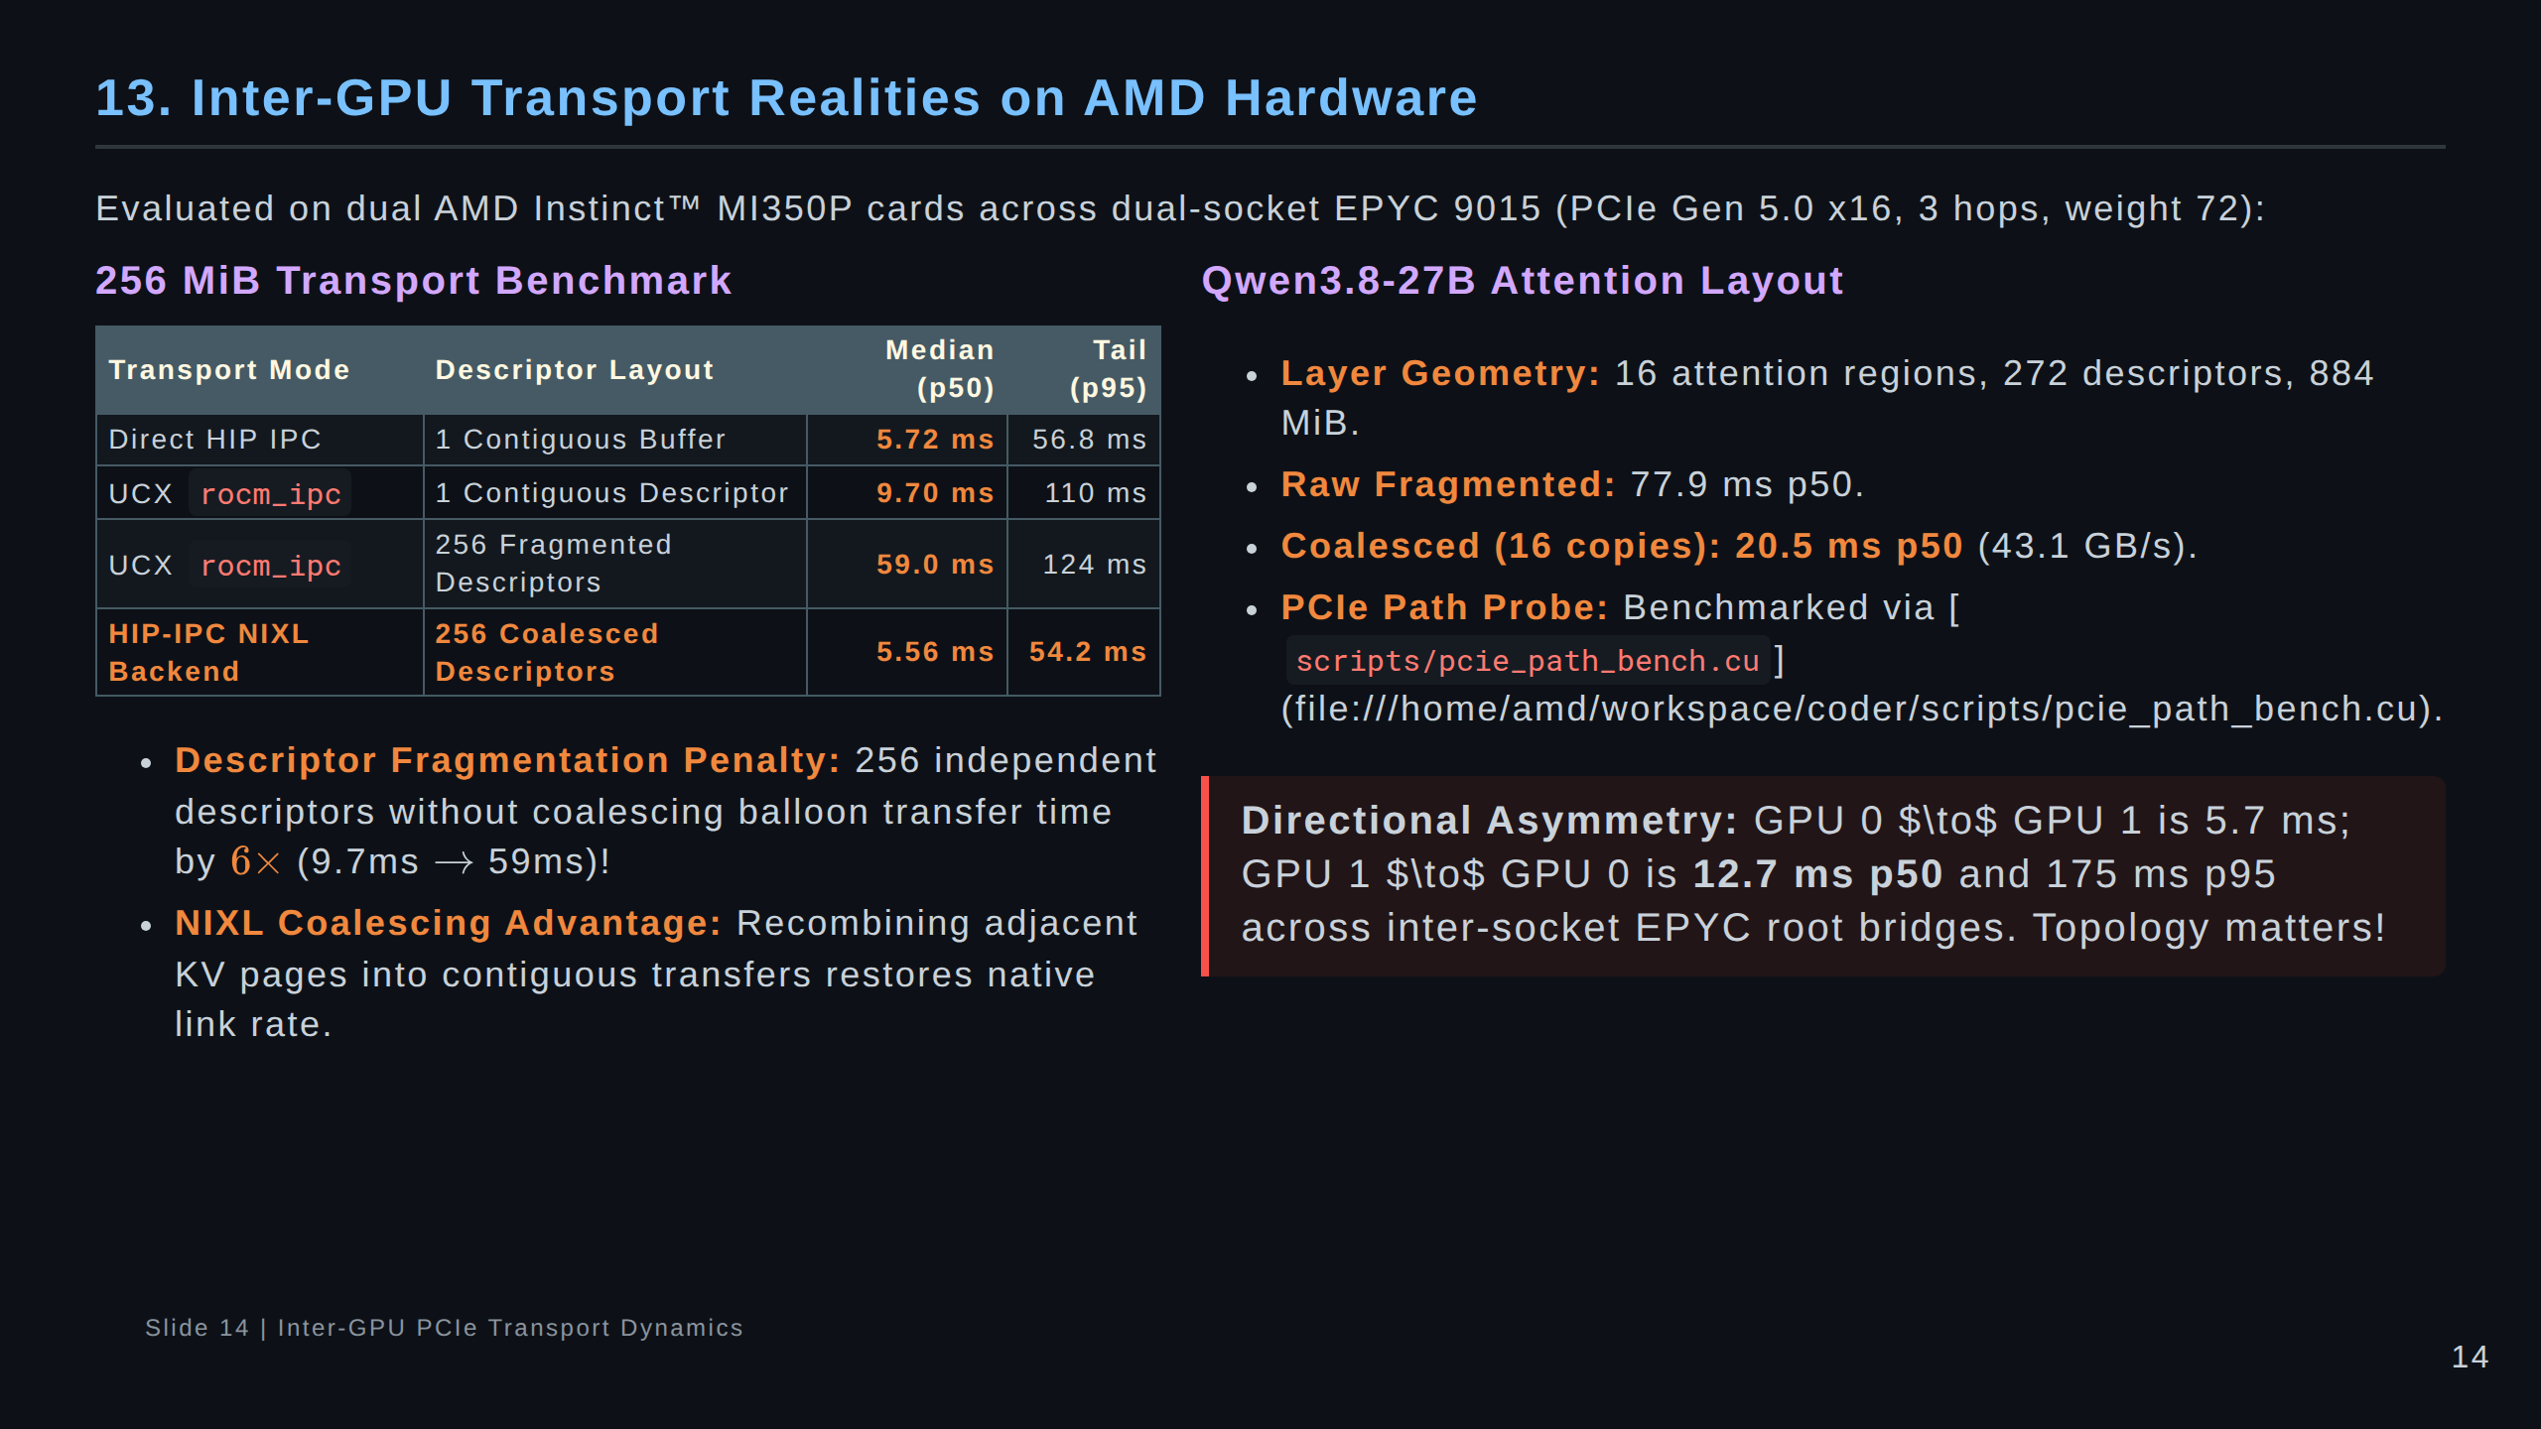
Notes:
Speaker Notes:
Moving KV across PCIe sounds simple in theory, but hardware reality introduces nuances:
Look at the third row in the table: If you send 256 separate memory descriptors over UCX,
latency surges from 9.7 ms to 59.0 ms due to DMA descriptor overhead!
Our native HIP-IPC NIXL backend solves this by coalescing contiguous pages into single DMA transfers,
bringing it back to 5.56 ms.
Also notice directional asymmetry: going cross-socket in one direction took 5.7 ms, but 12.7 ms in reverse.

Slide 15
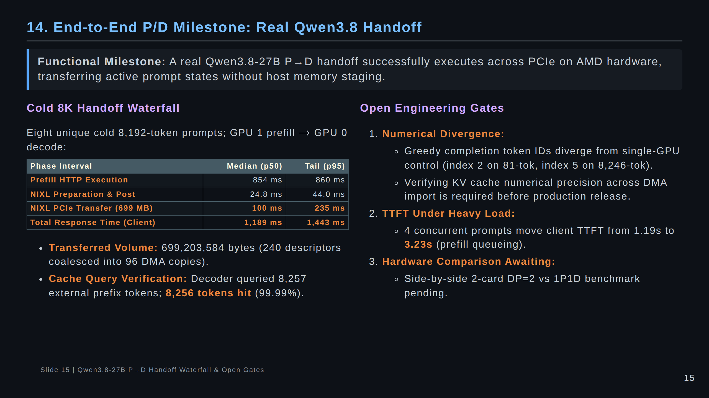
Notes:
Speaker Notes:
This slide reports our end-to-end milestone.
We successfully transferred 699 MB of KV cache for an 8K prompt in 100 ms flat.
Client total response time was 1.19 seconds, and the decoder recorded an external cache hit rate of 99.99%.
However, we must maintain engineering integrity and point out open gates:
Greedy token IDs currently diverge from the single-GPU control after a few tokens.
We must verify numerical alignment before claiming production readiness.

Slide 16
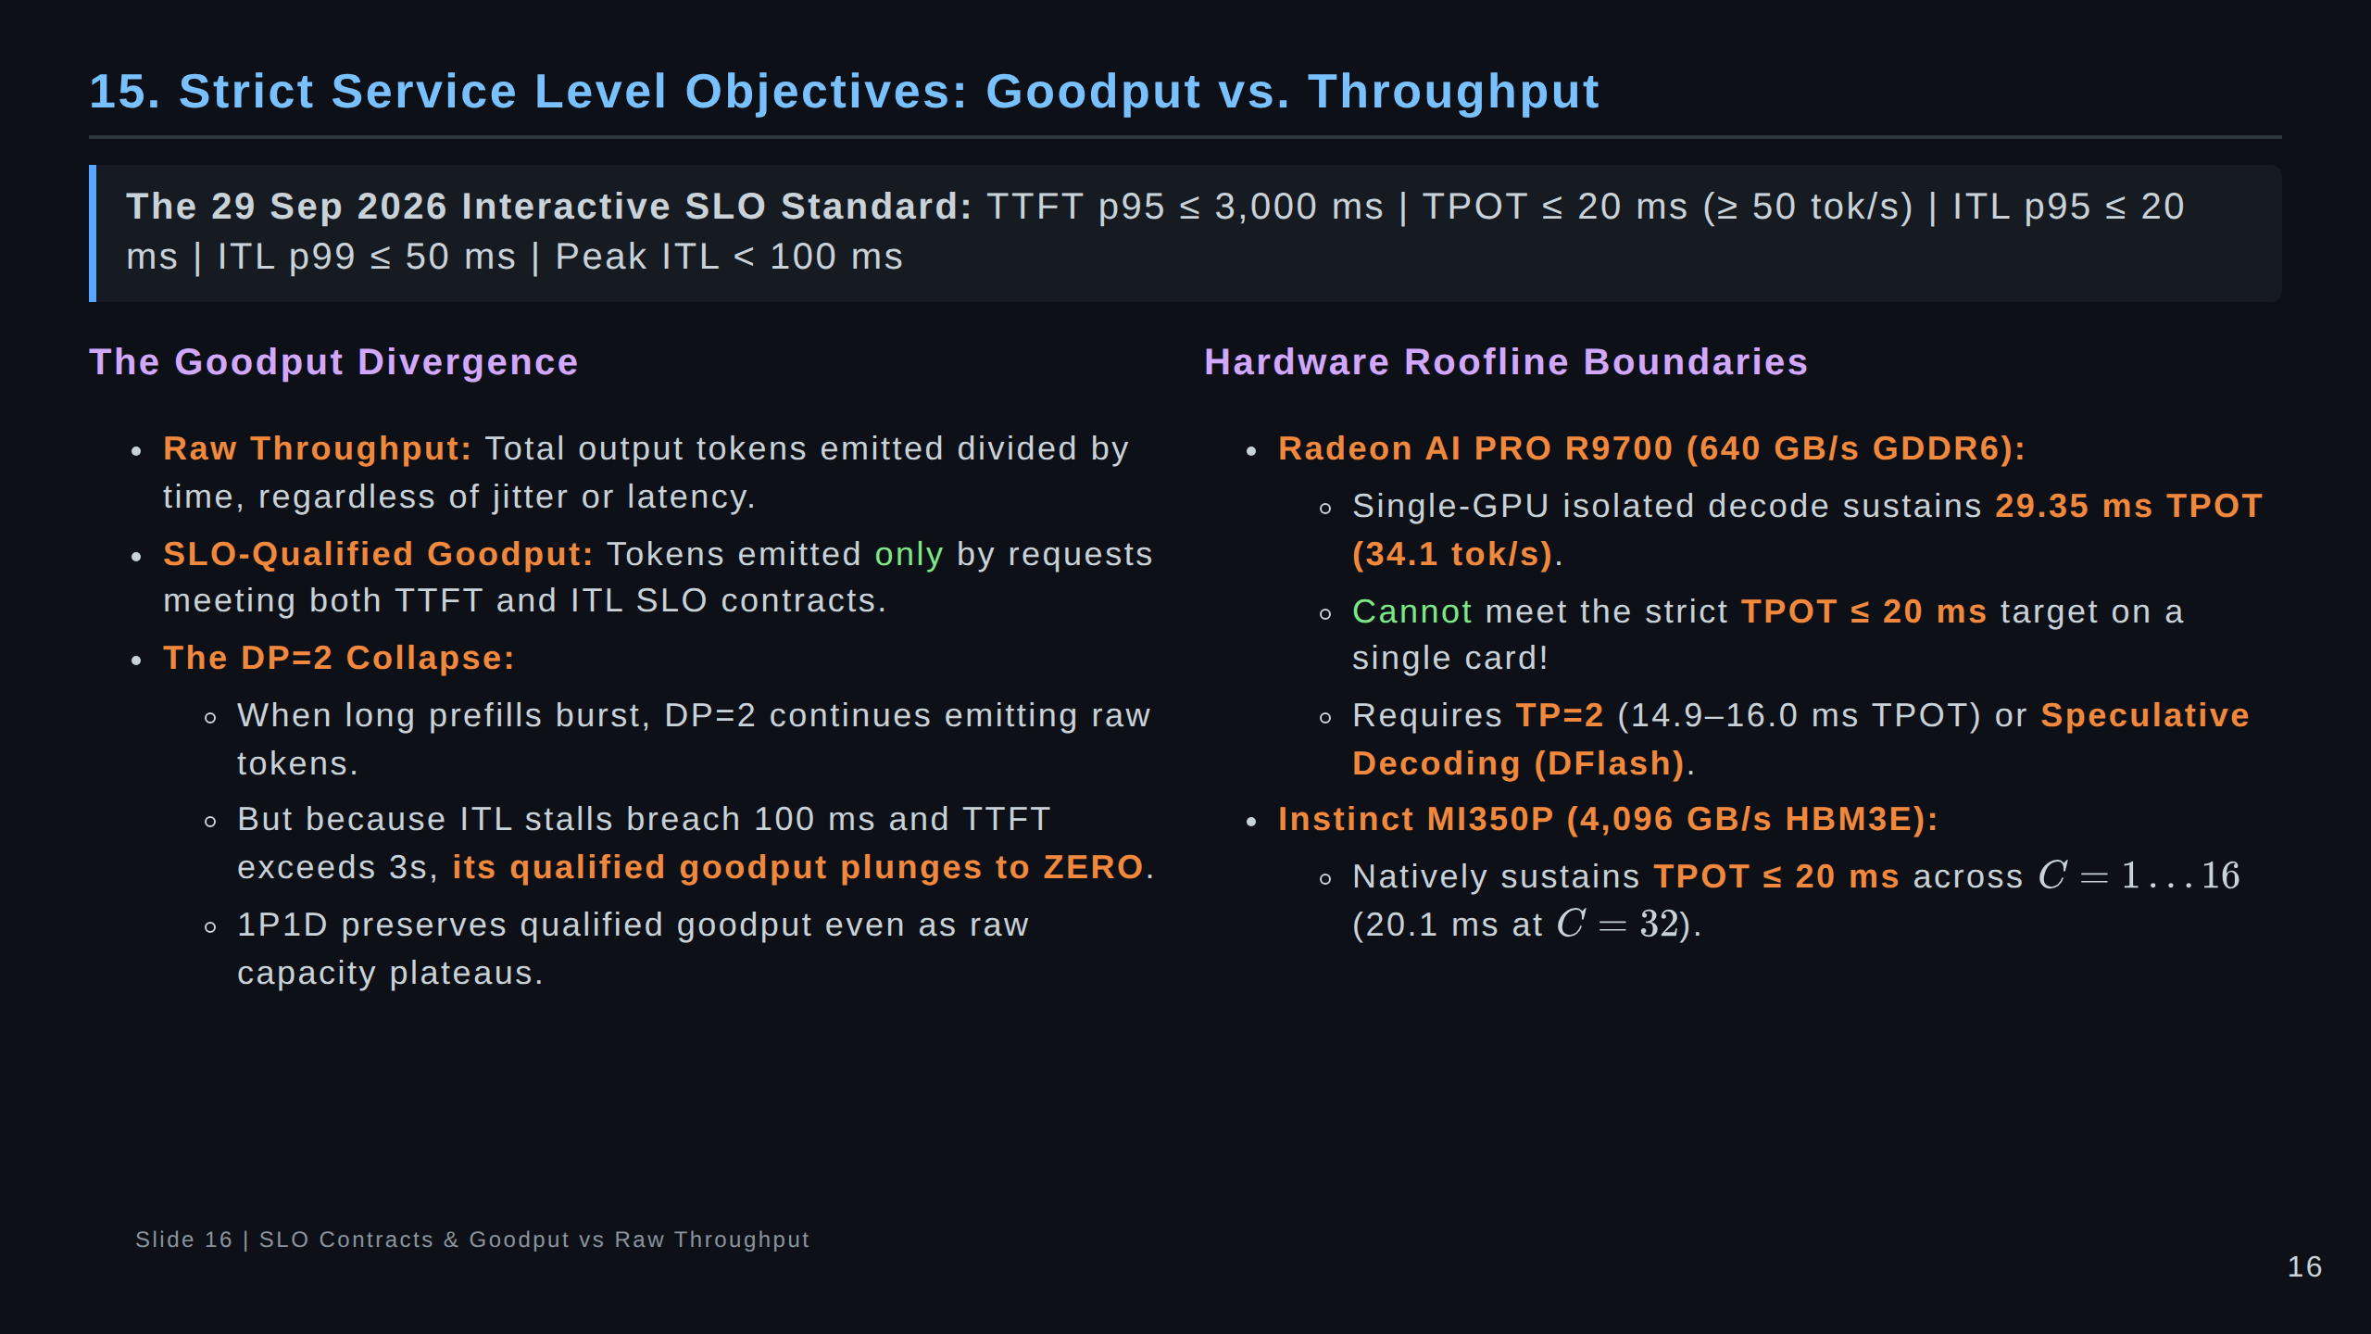
Notes:
Speaker Notes:
Let's talk about SLO contracts.
If an application defines an interactive SLA where first token must arrive in 3s and generation must not pause
longer than 100 ms, then under heavy prefill bursts, collocated DP=2 qualified goodput drops to zero.
Even though DP=2 is burning power and generating tokens, those tokens fail the user SLA.
Also note hardware rooflines: On R9700, single-GPU decode hits a physical memory bandwidth roofline at ~29 ms.
To hit 20 ms TPOT, you must use TP=2 or Speculative Decoding.

Slide 17
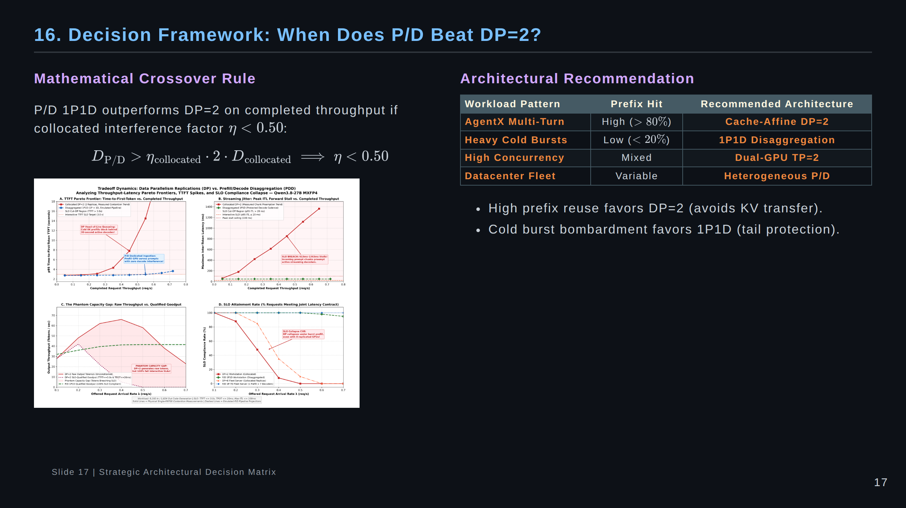
Notes:
Speaker Notes:
Here is our strategic architectural decision framework.
When does PDD beat DP=2?
Mathematically, since DP=2 has two decode engines, 1P1D only wins on raw throughput if collocated interference
destroys more than 50% of DP capacity (eta < 0.50).
However, on SLO-qualified goodput, 1P1D wins much earlier whenever cold prompt bursts threaten the 3s/100ms SLO.

Slide 18
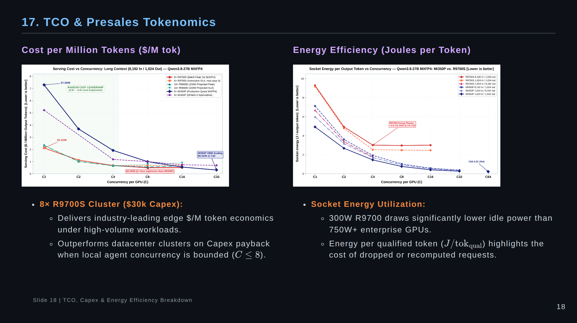
Notes:
Speaker Notes:
Tokenomics and TCO:
An 8-card R9700 system costs around $30,000, delivering exceptional cost per token at the edge.
However, operators must respect the concurrency boundaries:
Keep concurrency per GPU at C <= 4 for R9700, and C <= 16 for MI350P, to stay within the optimal
energy efficiency envelope (2.5 to 3.0 Joules per token).

Slide 19
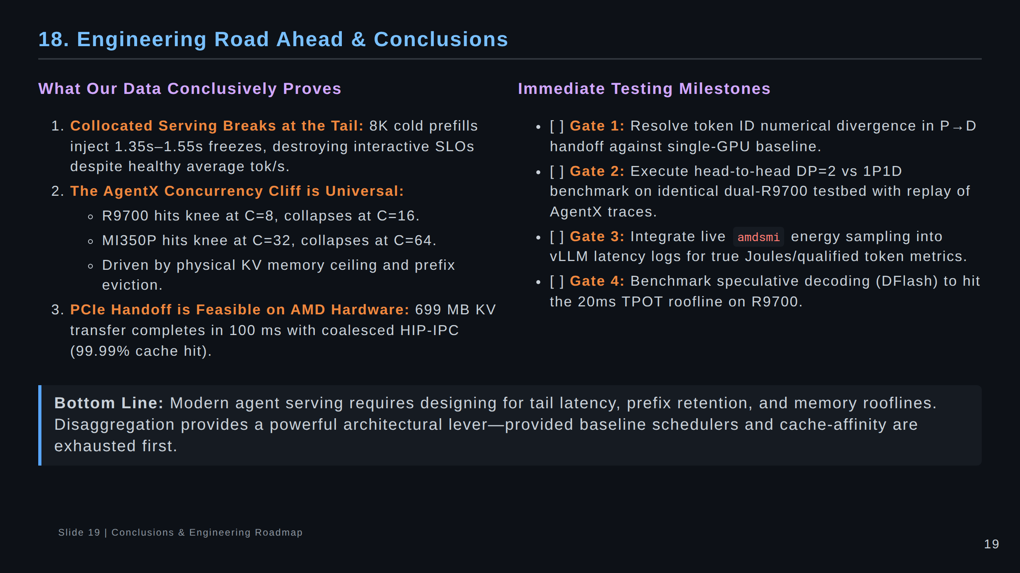
Notes:
Speaker Notes:
To wrap up:
We have established empirical proof of collocated token freezing, uncovered the universal AgentX concurrency cliff
across both edge and datacenter AMD hardware, and validated end-to-end PCIe KV handoff.
Our next immediate priorities are closing the numerical divergence gate and running side-by-side DP=2 vs 1P1D tests.
Thank you, and I look forward to your questions.

Slide 20
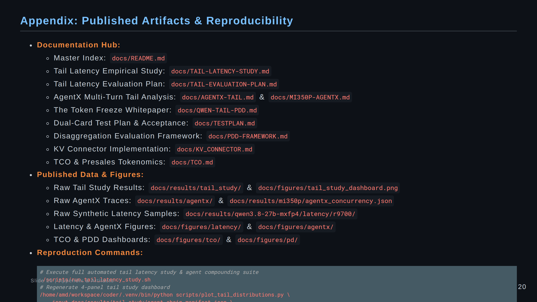
Notes:
Speaker Notes:
All code, raw traces, benchmark harnesses, and figure generators are open and reproducible within this repository.

