Slide 1
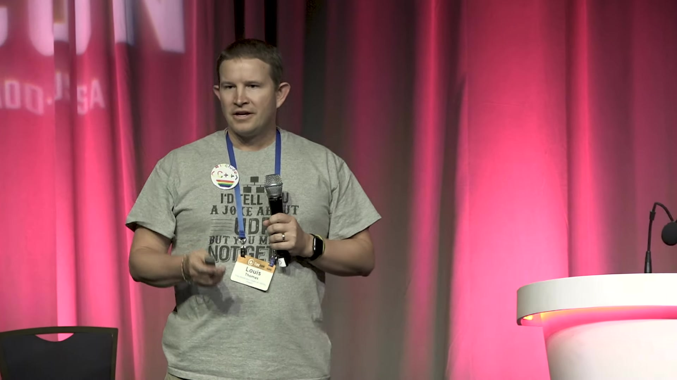
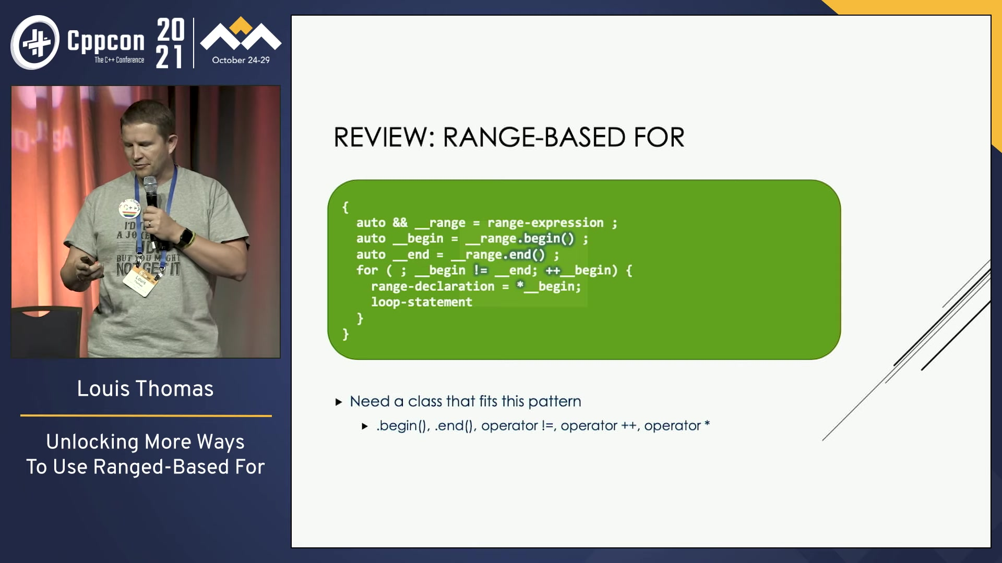
Non-silent regions
Clean transcription
Raw transcription
audio file
OpenAI whisper
OpenAI ChatGPT
pandoc
pydub
ffmpeg
URL
yt-dlp
ffmpeg
Video file
Final document
Screenshots

