Slide 1
Feed-Forward Networks and Gradient-Based Training
ECE408 / CS483 / CSE 408
Fall 2017
Carl Pearson
pearson@illinois.edu

Slide 2
Recap: Machine Learning
An important way of building applications whose logic is not fully understood.
Use labeled data – data that come with the input values and their desired output values – to learn what the logic should be
Capture each labeled data item by adjusting the program logic
Learn by example!

Slide 3
Machine Learning Tasks (1)
Classification
Which of k categories an input belongs to
Ex: object recognition
Regression
Predict a numerical value given some input
Ex: predict tomorrow’s temperature
Transcription
Unstructured data into textual form
Ex: optical character recognition

Slide 4
Machine Learning Tasks (2)
Translation
Convert a sequence of symbols in one language to a sequence of symbols in another
Structured Output
Convert an input to a vector with important relationships between elements
Ex: natural language sentence into a tree of grammatical structure
Others
Anomaly detection, synthesis, sampling, imputation, denoising, density estimation

Slide 5
Why Machine Learning Now?
GPU computing hardware and programming interfaces such as CUDA has enabled very fast research cycle of deep neural net training
Computer Vision, Speech Recognition, Document Translation, Self Driving Cars, Data Science…
Most involve logic that were previously not effectively constructed with imperative programming
Using big labeled data to train and specialize DNN based classifiers
Deriving a large quantity of quality labeled data is a challenge

Slide 6
Classification
Formally: a function that maps an input to k categories
f : R^{n} → {1, …, k},
Our formulation: a function f parameterized by ϴ that maps input vector x to numeric code y
y = f(x, ϴ)
ϴ encapsulates the structure and weights in our network

Slide 7
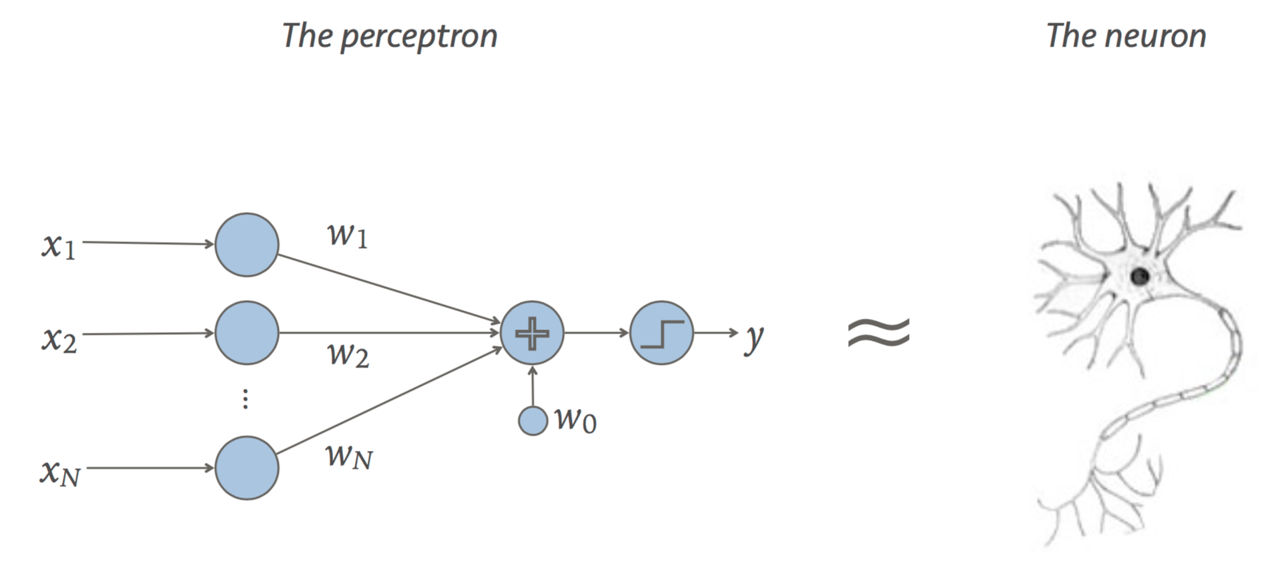

Linear Classifier (Perceptron)
Recall our formulation:
Dot product:
Scalar addition:
y = f(x, ϴ)
y = sign(W • x + b)
ϴ = {W, b}
output
y = W • x
input
+ b
weight
bias

Slide 8
Multi-Layer Perceptron
What if a linear classifier can’t learn a function?
XOR
AND
OR
?
=
+

Slide 9
Multi-Layer Perceptron
XOR
AND
OR
?
=
+
A | B | OR | AND | XOR
0 | 0 | -1 | -1 | -1
0 | 1 | 1 | -1 | 1
1 | 0 | 1 | -1 | 1
1 | 1 | 1 | 1 | -1

Slide 10
A | B | OR | AND | XOR
0 | 0 | -1 | -1 | -1
0 | 1 | 1 | -1 | 1
1 | 0 | 1 | -1 | 1
1 | 1 | 1 | 1 | -1
AND = sign(x[0] + x[1] - 1.5)
XOR = sign(2 * OR - AND - 2)
OR = sign(x[0] + x[1] - 0.5)
OR Perceptron
x[0]
1
+
1
x[1]
1
-0.5
+
y
x[0]
1
+
-2
-2
x[1]
1
-1.5
AND Perceptron

Slide 11
Generalize to Fully-Connected Layer
y[0]
y[1]
y[2]
y[3]
y[4]
x[0]
x[1]
x[2]
x[0]
x[1]
x[2]
y
Linear Classifier:
Input vector x×weight vector w to produce scalar output y
Fully-connected:
Input vector x×weight matrix w to produce vector output y

Slide 12
Multilayer Terminology
Weight matrices: Entry i,j is weight between i^{th} input and j^{th} output
x[0] x[1] x[2] x[3]
Input Layer
W₁[i, j] is [4x4]
b₁[j] is [4x1]
Hidden Layer(s)
W₂[i, j] is [4x3]
b₂[j] is [3x1]
“nodes”
Output Layer
k[0] k[1] k[2]
Probability that input is class k[i]
Argmax
y

Slide 13
How to determine the weights?
Fully connected layer with 784 inputs, 1024 outputs:
[784 x 1024] weight matrix
[1024 x 1] bias vector
Look at observational data to determine the weights.
With enough input data and corresponding desired outputs, we can model the relationship between inputs and outputs.

Slide 14
Forward and Backward Propagation
Forward (inference)
Given parameters ϴ and input x, produce label y
Backward (training)
Given input data and target label t, determine ϴ

Slide 15
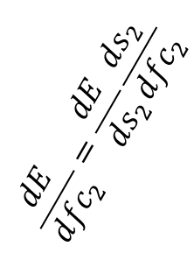
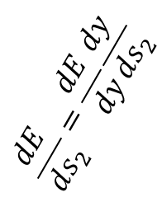
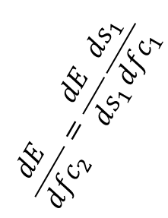
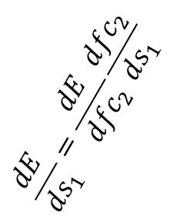
Forward and Backward Propagation
s₁ = sigmoid(fc₁)
s₂ = sigmoid(fc₂)
Forward:
fc₁ = W₁ • x + b₁
fc₂ = W₂ • s₁ + b₂
y = argmax(s₂)
x
dE/dy
Backward:
$$\frac{dE}{d{fc}_{2}}=\frac{dE}{ds_{1}}\frac{ds_{1}}{d{fc}_{1}}$$
$$\frac{dE}{ds_{1}}=\frac{dE}{d{fc}_{2}}\frac{d{fc}_{2}}{ds_{1}}$$
$$\frac{dE}{d{fc}_{2}}=\frac{dE}{ds_{2}}\frac{ds_{2}}{d{fc}_{2}}$$
$$\frac{dE}{ds_{2}}=\frac{dE}{dy}\frac{dy}{ds_{2}}$$

Slide 16
Ingredients for Gradient-Based Supervised Training
One labeled dataset (large)
Example: 60,000 28x28 grayscale images of handwritten numbers, each labeled
One network architecture
Example: perceptron
y = W • x + b
One error function
For target label t, network output y,
Example: E = ½ (y – t)²
Recall: ϴ = {W, b}

Slide 17
Stochastic Gradient Descent
For each labeled image:
Read data to initialize input layer
Evaluate network to get y (forward)
Compare with target label t to get error E
Backpropagate error derivative to get parameter updates
Adjust parameters ϴ in a direction that reduces total E over entire training set.
ϴ_{i+1} = ϴ_{i} - εΔϴ
Each gradient update happens from most accurate minima estimation

Slide 18
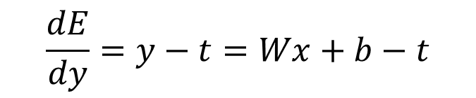
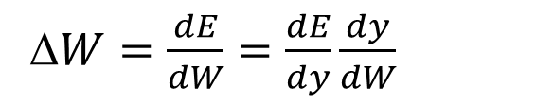

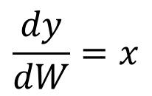
Computing the Gradient Update
ϴ_{i+1} = ϴ_{i} - εΔϴ
W_{i+1} = W_{i} - εΔW
Parameter Update
y = W • x + b
Network function
$$\frac{dy}{dW}=x$$
Network weight gradient
E = ½ (y – t)²
Error function
$$\frac{dE}{dy}=y−t=Wx+b−t$$
Error function gradient
Δ$W=\frac{dE}{dW}=\frac{dE}{dy}\frac{dy}{dW}$
Full weight update expression
$$\text{W}\text{i}\text{+1 = }\text{W}\text{i}\text{ – }\text{ε}\text{(}\text{W}\text{x}\text{+}\text{b}\text{−}\text{t}\text{)}\text{x}$$
Full weight update term

Slide 19
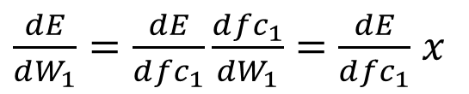
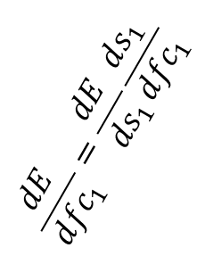
Parameter Updates and Propagation
fc₁ = W₁ • x + b₁
dE/dy
$$\frac{dE}{d{fc}_{1}}=\frac{dE}{ds_{1}}\frac{ds_{1}}{d{fc}_{1}}$$
$$\frac{dE}{ds_{1}}=\frac{dE}{d{fc}_{2}}\frac{d{fc}_{2}}{ds_{1}}$$
$$\frac{dE}{d{fc}_{2}}=\frac{dE}{ds_{2}}\frac{ds_{2}}{d{fc}_{2}}$$
$$\frac{dE}{ds_{2}}=\frac{dE}{dy}\frac{dy}{ds_{2}}$$
Need propagated error gradient (from backward pass)
Weight update
$\frac{dE}{dW_{1}}=\frac{dE}{d{fc}_{1}}\frac{d{fc}_{1}}{dW_{1}}=$ $\frac{dE}{d{fc}_{1}}$ $x$
Need input (from forward pass)

Slide 20
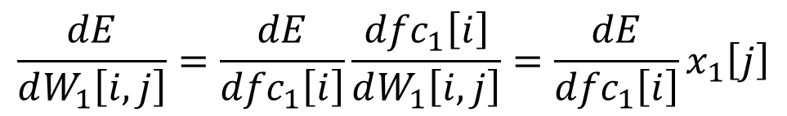
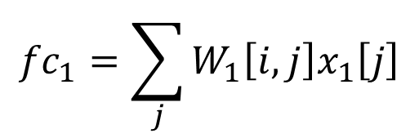
Fully-Connected Gradient Detail
i^{th} entry in fc₁
i^{th} row in W₁
j^{th} entry in x₁
fc₁[0]
fc₁[1]
fc₁[2]
…
W₁[0,:] W₁[1,:] W₁[2,:]
…
x₁[0]
x₁[1]
x₁[2]
x₁[3]
…
=
$${fc}_{1}=\sum_{j}{W_{1}\left[i,j\right]x_{1}\left[j\right]}$$
Computed from previous layer
$$\frac{dE}{dW_{1}\left[i,j\right]}=\frac{dE}{{dfc}_{1}\left[i\right]}\frac{{dfc}_{1}\left[i\right]}{dW_{1}\left[i,j\right]}=\frac{dE}{{dfc}_{1}\left[i\right]}x_{1}\left[j\right]$$
Need input to this layer

Slide 21
Batched Stochastic Gradient Descent
A training epoch (a pass through whole training set)
Set Δϴ = 0
For each labeled image:
Read data to initialize input layer
Evaluate network to get y (forward)
Compare with target label t to get error E
Backpropagate error derivative to get parameter updates
Accumulate parameter updates into Δϴ
ϴ_{i+1} = ϴ_{i} - εΔϴ
Aggregate gradient update most accurately reflects true gradient

Slide 22
Mini-batch Stochastic Gradient
For each batch in training set
For each labeled image in batch:
Read data to initialize input layer
Evaluate network to get y (forward)
Compare with target label t to get error E
Backpropagate error derivative to get parameter updates
Accumulate parameter updates into Δϴ
ϴ_{i+1} = ϴ_{i} - εΔϴ
Balance between accuracy of gradient estimation and parallelism

Slide 23
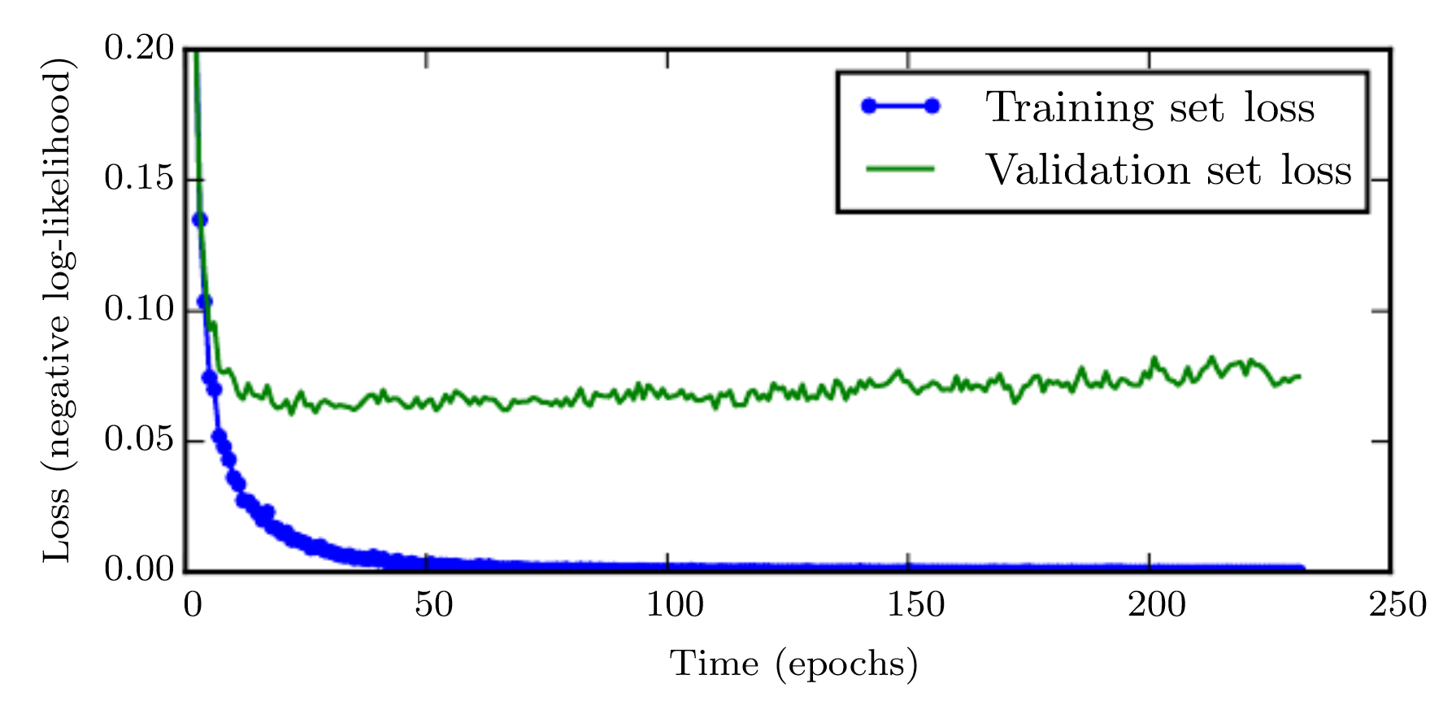
When is training done?
Split labeled data into training and test sets.
Training data to compute parameter updates.
Test data to check how model generalizes to new inputs (the ultimate goal!)
The network can become too good at classifying training inputs!

Slide 24
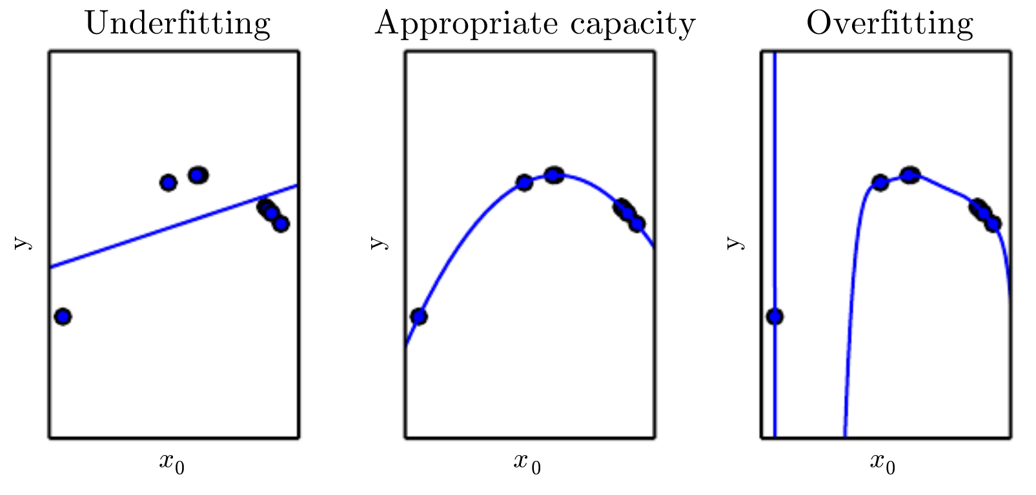
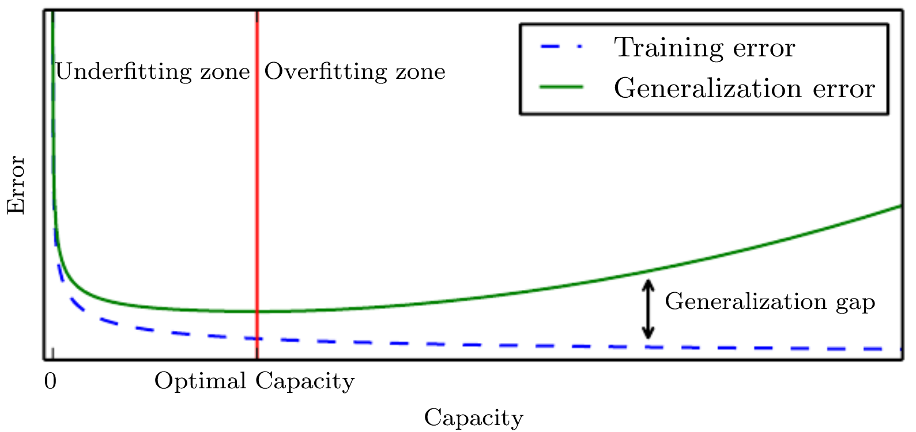
How Complicated Should a Network Be?
Intuition: like a polynomial fit. More higher-order terms make a better fit, but add huge unpredictable swings as input changes
If network is too good at training data, new inputs cause big unpredictable output changes.

Slide 25
No Free Lunch Theorem
Every classification algorithm has the same error rate when classifying previously unobserved inputs when averaged over all possible input-generating distributions.
Even neural networks must be tuned for specific tasks

Slide 26
Summary (1)
Classification:
f : R^{n} → {1, …, k},
y = f(x, ϴ)
Current ML work driven by cheap compute, lots of available data
Perceptron as a trivial deep network
y = sign(W • x + b)
Forward for inference, backward for training

Slide 27
Summary (2)
Chain rule to compute parameter updates
Stochastic gradient descent for training

