Slide 1
Predicting sleep quality using accelerometer data from wearable devices
Casandra Philipson

Slide 2
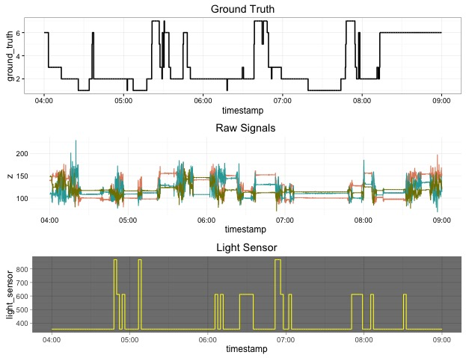
Visualizing Raw Data

Slide 3
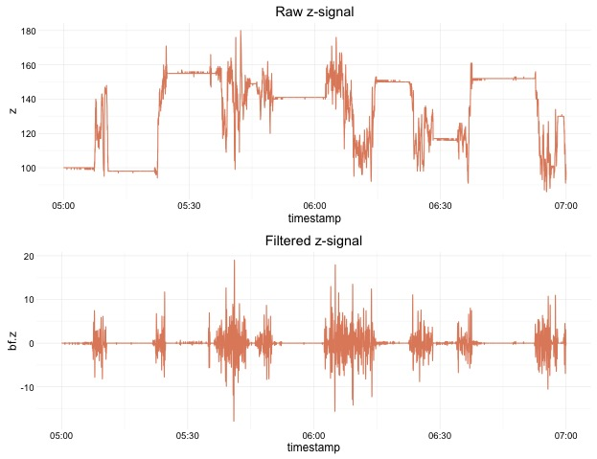
Digital Signal Processing
100Hz wrist-worn data-logging device
Applied a 1st order Butterworth IIR filter
Bandwidth 3-11 Hz
Remove noise present in the data set and to normalize raw x, y, and z measurements.

Slide 4
More Feature Engineering
run.sd – Running Standard Deviation (always double the metric feature window)
int_mean – Interval mean
int_max – Interval maximum
int_min – Interval minimum
int_sd – Standard deviation within the interval
range – Interval range (max – min)
ratio – Interval ratio (max / min)
int_RMS – Root mean squared of the interval
bfz.absolute – Absolute value vector of the normalized uniaxial z axis data (bf.z)
Fast Fourier transform (frequency and magnitude)
Baseline activity predictions based on movement

Slide 5
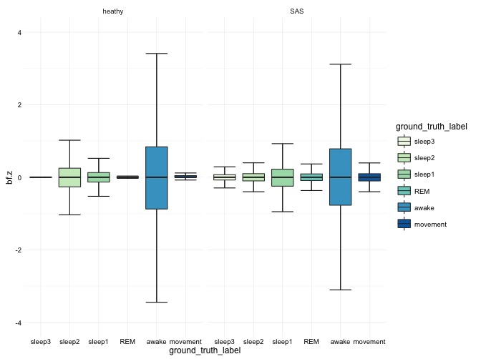
Sleep Disorders and Signal
Sleep disorders don’t increase variability!
REM (as expected) little movement since you’re body is paralyzed

Slide 6
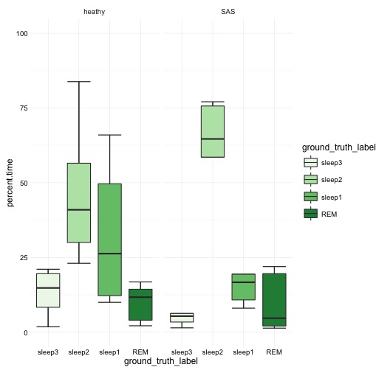
Sleep Disorders and Sleep Quality
Time spent in different sleep phases does not appear to be affected by sleep disorder

Slide 7
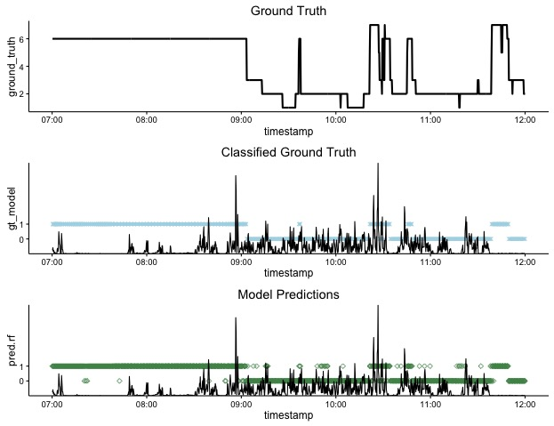
Predicting Sleep/Wake Cycles
Personalized predictions have >80% accuracy!

Slide 8
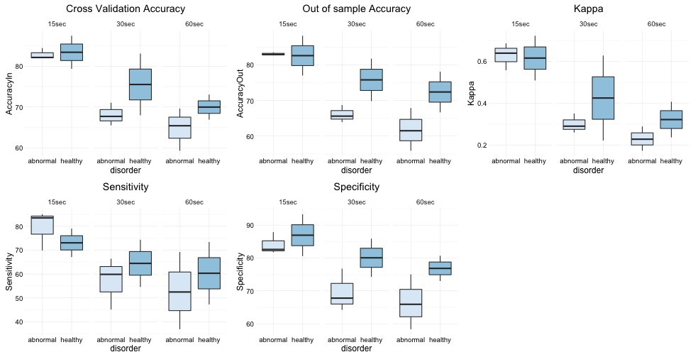
Model Performance Diminishes as Window Time Increases
Assessing features in short time frames lends better predictive value

