Slide 1
CTF Introduction

Slide 2
Start the Downloads
Ghidra
Java 11 64-bit JDK
Example Binaries

Slide 3
Ghidra
https://ghidra-sre.org/InstallationGuide.html#Install
Requires Java JDK >= 11
Make sure it is in your PATH
Download the latest release from:
https://ghidra-sre.org/
Extract the download where you want Ghidra to be installed.
Ghidra is self contained in this folder and uses relative paths, so you can move the folder around and it will work just fine!
On Linux/Mac
cd /path/to/ghidra_9.1_PUBLIC/
./ghidraRun
On Windows
Run ghidraRun.bat

Slide 4
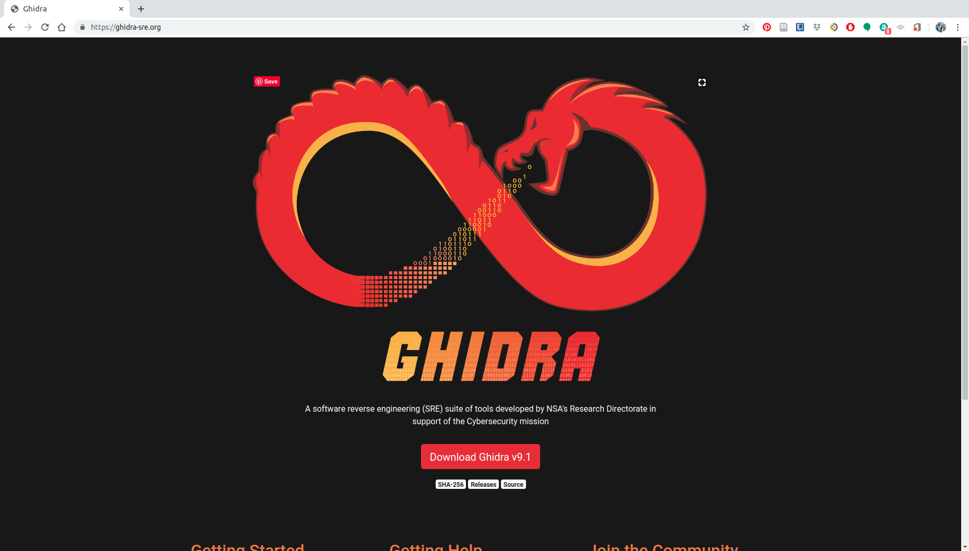

Slide 5
Example Binaries
We will use some simple binaries from the beginning challenges on root-me.org
https://github.com/cwright7101/ctf_intro
Either git clone the above or go to the website and download a zip

Slide 6
What is CTF
Capture the Flag
Security Competition
Usually educational
Requires several skills and use of multiple tools
Solve challenges that involve RE, Memory Corruption, Cryptography, etc to “capture the flag”, a secret string that can be exchanged for points

Slide 7
Why?
Fun
Get better at programming
Money
Multiple companies and governments sponsor challenges and pay money! ($2 million US for the winning team for DARPA CGC)
Jobs

Slide 8
CTF Styles
Jeopardy
Multiple categories, earn the most points in the given timeframe
Attack-Defense
Defend and attack on an isolated network
DEFCON
DARPA CGC
Solve and Progress
Requires solving challenges in order, but similar to Jeopardy

Slide 9
Getting Started
Many websites online that are free
root-me.org
capturetheflag.withgoogle.com
trailofbits.github.io - this has some more background reading and some tutorials along the way
Download some of the tools
Ghidra
angr
avatar2
Firmadyne
Panda
QEMU
etc...

Slide 10
Exercise
Hands on Demo

