Slide 1
I. 클라우드 컴퓨팅
신라대학교 노철우 교수

Slide 2

목차
클라우드 컴퓨팅
1
클라우드 특성
2
클라우드 플랫폼 서비스

Slide 3
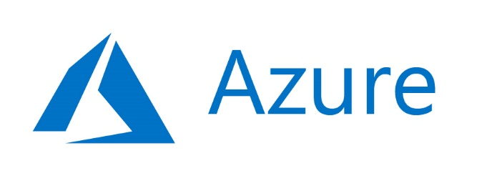

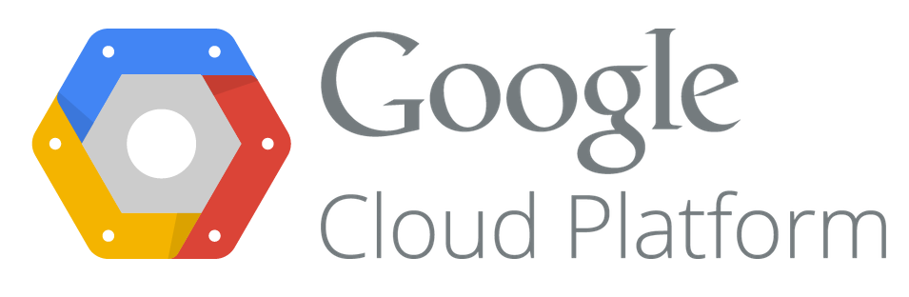

Cloud Platform
MS Azure
AWS
GCP
IBM Bluemix
SILLA UNIVERSITY

Slide 4

Cloud 특성

Slide 5
클라우드 정의
On-demand self-service
Ubiquitous network access
Location transparent resource pooling
Rapid elasticity
Source: MS Azure Fundamentals AZ-900.pdf

Slide 6
클라우드 특성
High Availability
Elasticity
Source: MS Azure Fundamentals AZ-900.pdf

Slide 7
C loud 특성 High Availability
A High Availability system is one that is designed to be available 99.999% of the time, or as close to it as possible. Usually this means configuring a failover system that can handle the same workloads as the primary system.
A Fault Tolerant system is extremely similar to HA, but goes one step further by guaranteeing zero downtime. HA still comes with a small portion of downtime, hence the ideal of a perfect HA strategy reaching “five nines” rather than 100% uptime. The time it takes for the intermediary layer, like the load balancer or hypervisor, to detect a problem and restart the VM can add up to minutes or even hours over the course of yearly runtime.
Disaster Recovery goes beyond FT or HA and consists of a complete plan to recover critical business systems and normal operations in the event of a catastrophic disaster like a major weather event (hurricane, flood, tornado, etc), a cyberattack, or any other cause of significant downtime. HA is often a major component of DR, which can also consist of an entirely separate physical infrastructure site with a 1:1 replacement for every critical infrastructure component, or at least as many as required to restore the most essential business functions.
Source : https://microsoftlearning.github.io/AZ-900T0x-MicrosoftAzureFundamentals/

Slide 8
Elastic Computing
Elastic computing is the ability to quickly expand or decrease computer processing, memory, and storage resources to meet changing demands without worrying about capacity planning and engineering for peak usage. Typically controlled by system monitoring tools, elastic computing matches the amount of resources allocated to the amount of resources actually needed without disrupting operations. With cloud elasticity, a company avoids paying for unused capacity or idle resources and doesn't have to worry about investing in the purchase or maintenance of additional resources and equipment.)
Source : https://microsoftlearning.github.io/AZ-900T0x-MicrosoftAzureFundamentals/

Slide 9
cloud platform service

Slide 10
Cloud Platform Service
IaaS (Infra as a Service).
IaaS is the most basic level of cloud-based solutions, which refers to renting an IT infrastructure as a fully outsourced service. In this category, the cloud provider lets you rent servers, VMs, storage, network and operating systems on a pay-as-you-go basis.
Examples: Amazon EC2 and S3, Google Compute Engine, Windows Azure VM.
PaaS (Platform as a Service). PaaS is the cloud solution where, apart from providing an infrastructure, cloud providers also issue an on-demand computing environment to develop, test, run and collaborate with components such as web servers, database management systems, and software development kits (SDKs) for various programming languages.
Examples: AWS Elastic Beanstalk, Heroku, Windows Azure, Force.com, Google App Engine.
SaaS (Software as a Service).
SaaS providers offer fully functional web-based application softwares tailored to a variety of business need such as project tracking, web conferencing, marketing automation or business analytics.
Examples: Google Apps, Microsoft Office 365, Gmail, Yahoo and Facebook.
.
Source : https://microsoftlearning.github.io/AZ-900T0x-MicrosoftAzureFundamentals/

Slide 11
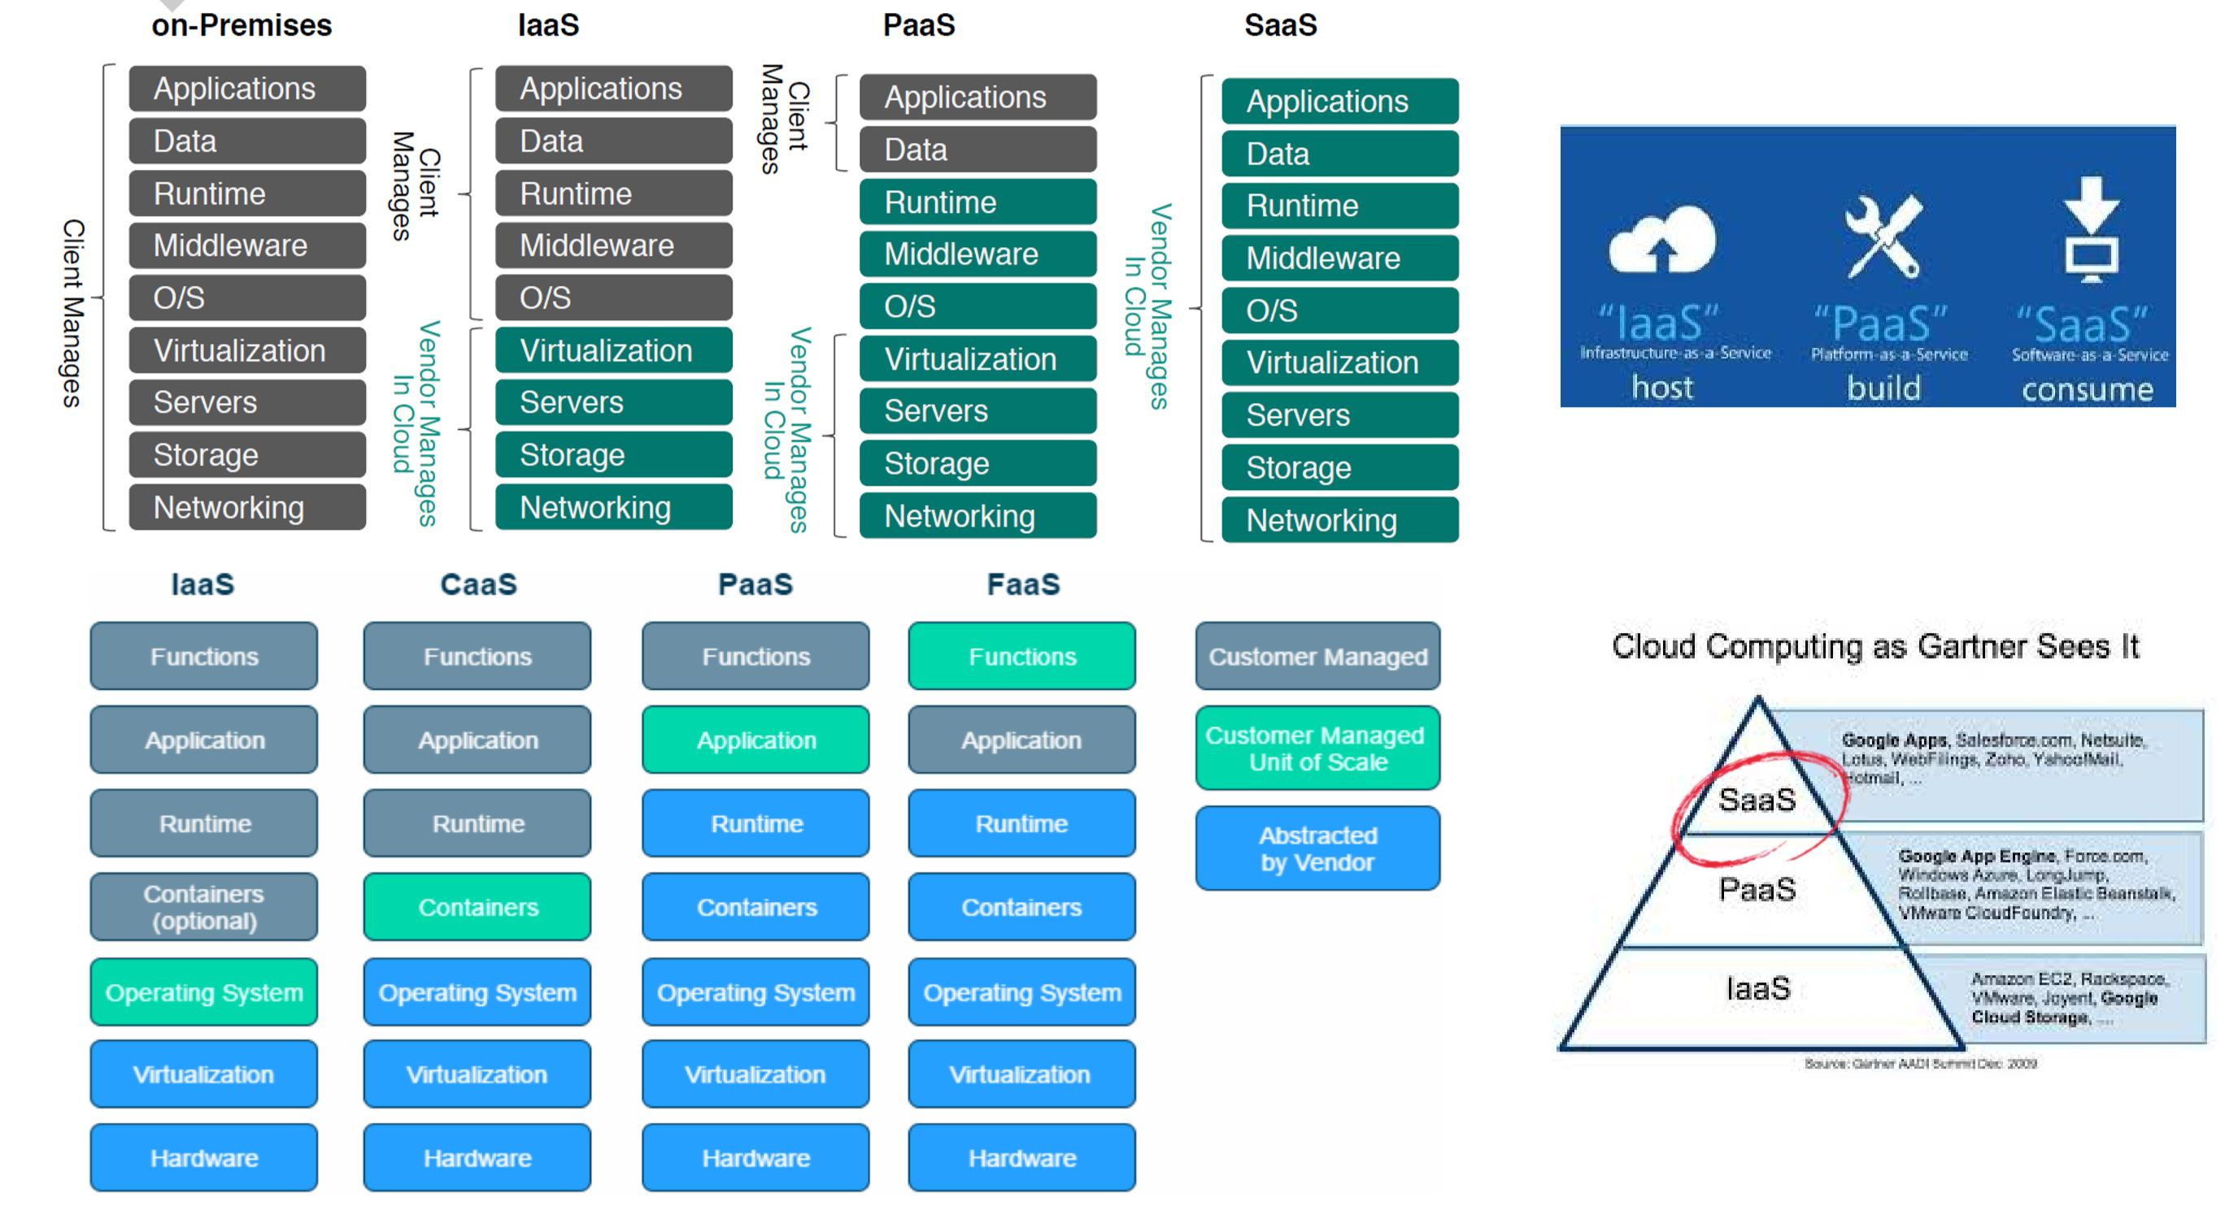
Infrastructure as a Service (IaaS),Platform as a Service (PaaS), Software as a Service (SaaS)
Containers as a Service (CaaS)
Notes:
CaaS : Container as a Service

Slide 12
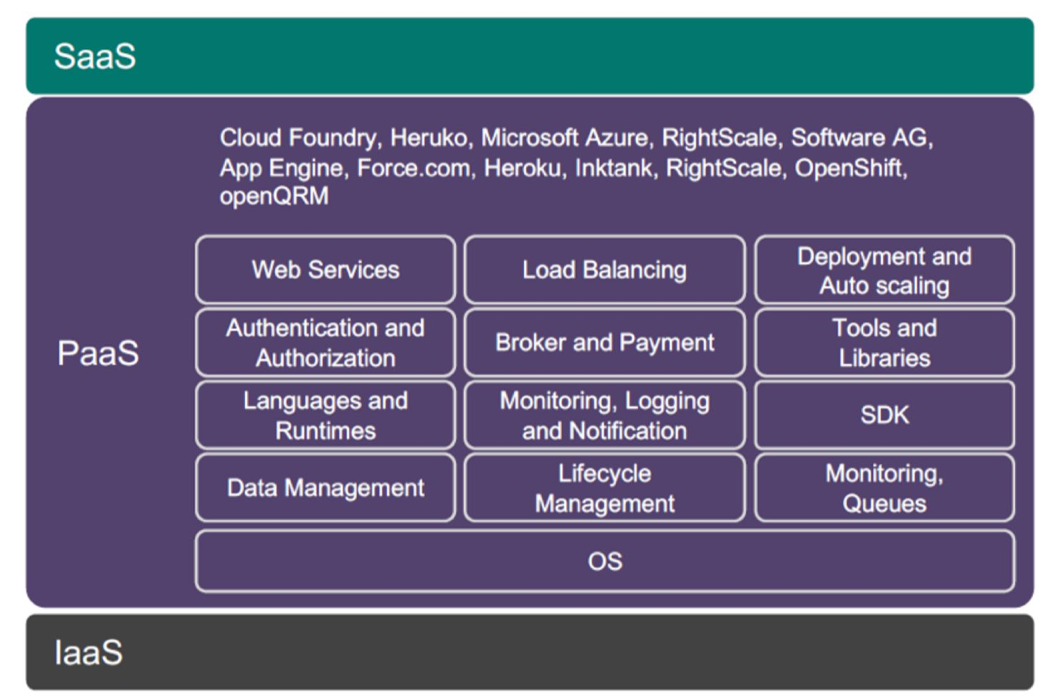
PaaS Platform

Slide 13
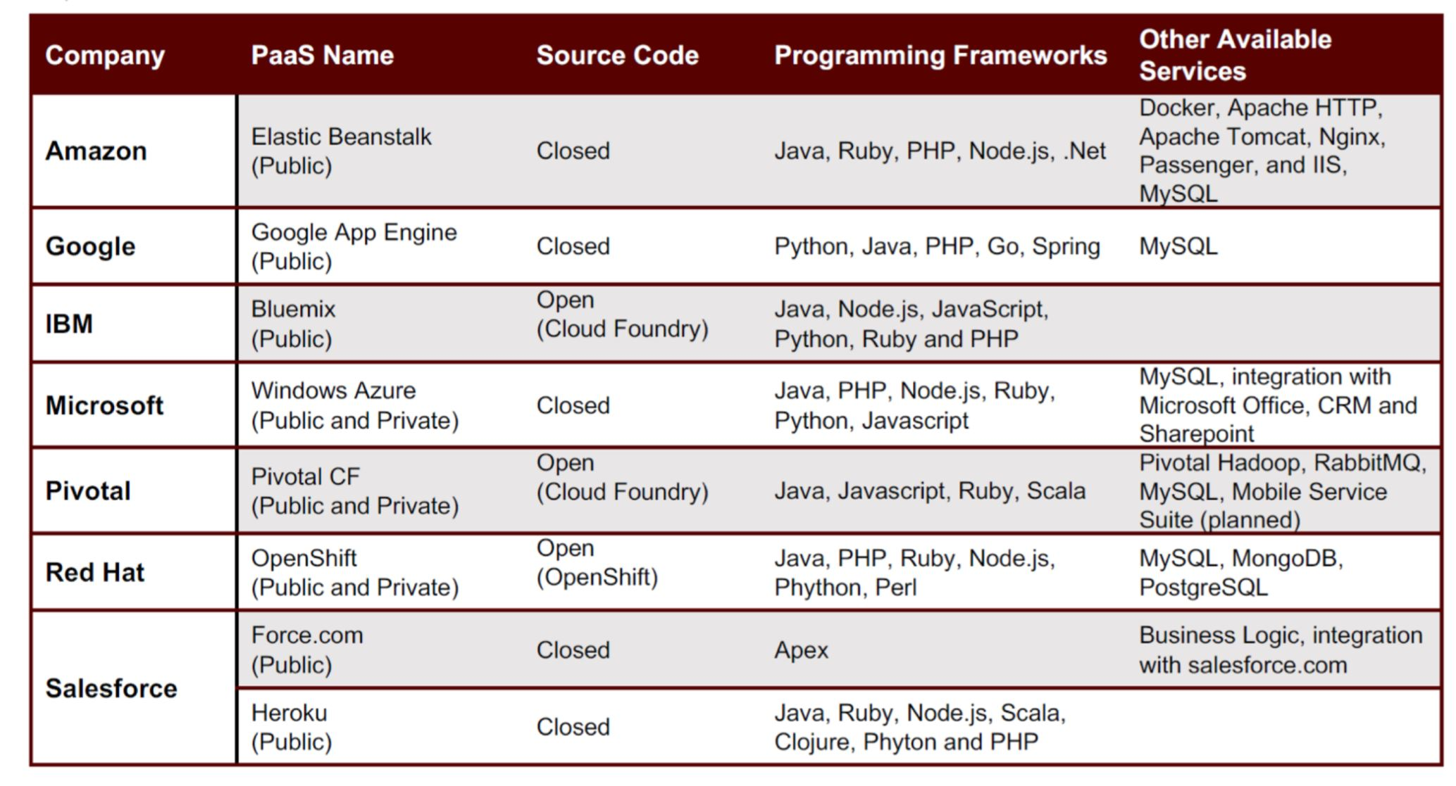
PaaS Platform

Slide 14
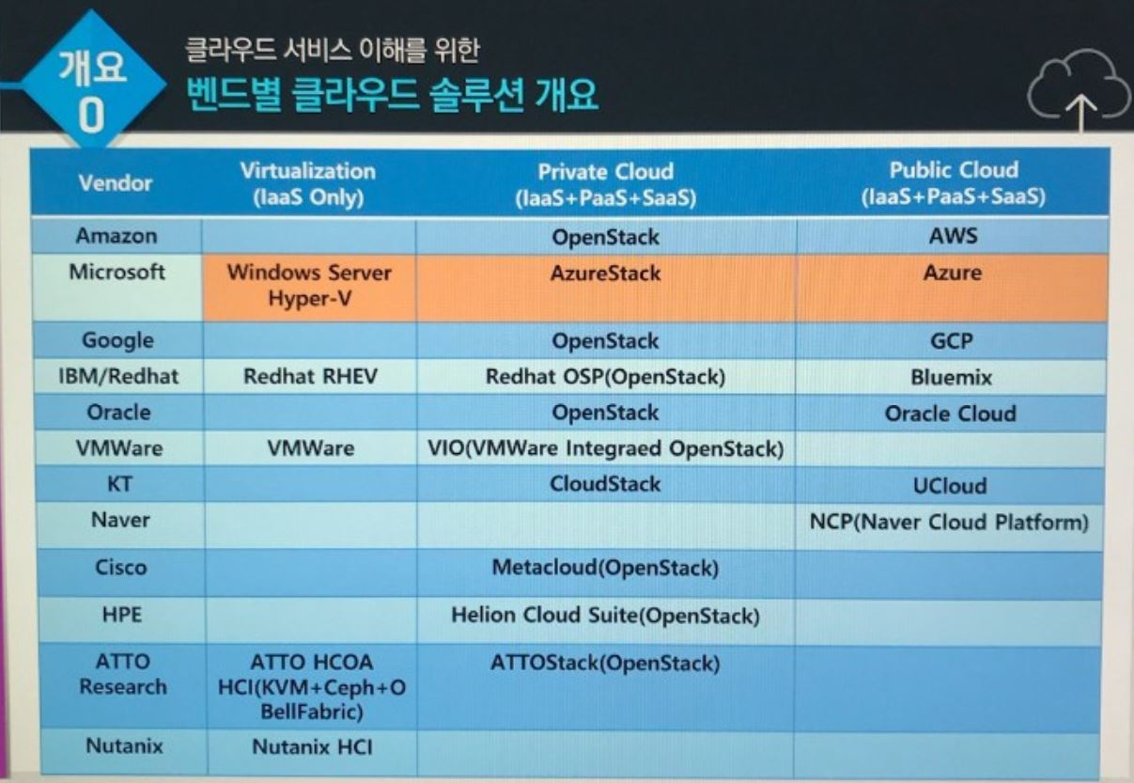

Slide 15
public, private and hybrid cloud
Private cloud is a type of cloud computing that delivers similar advantages to public cloud, including scalability and self-service, but through a proprietary architecture. Unlike public clouds, which deliver services to multiple organizations, a private cloud is dedicated to the needs and goals of a single organization.
As a result, private cloud is best for businesses with dynamic or unpredictable computing needs that require direct control over their environments, typically to meet security, business governance or regulatory compliance requirements.
There are three general cloud deployment models: public, private and hybrid.
A public cloud is where an independent, third-party provider, such as Amazon Web Services (AWS) or Microsoft Azure, owns and maintains compute resources that customers can access over the internet. Public cloud users share these resources, a model known as a multi-tenant environment.
By comparison, a private cloud is created and maintained by an individual enterprise. The private cloud might be based on resources and infrastructure already present in an organization's on-premises data center or on new, separate infrastructure. In both cases, the enterprise itself owns and operates the private cloud.
A hybrid cloud is a model in which a private cloud connects with public cloud infrastructure, allowing an organization to orchestrate workloads across the two environments. In this model, the public cloud effectively becomes an extension of the private cloud to form a single, uniform cloud. A hybrid cloud deployment requires a high level of compatibility between the underlying software and services used by both the public and private clouds.
When an organization properly architects and implements a private cloud, it can provide most of the same benefits found in public clouds, such as user self-service and scalability, as well as the ability to provision and configure virtual machines (VMs) and change or optimize computing resources on demand. An organization can also implement chargeback tools to track computing usage and ensure business units pay only for the resources or services they use.
Source : https://microsoftlearning.github.io/AZ-900T0x-MicrosoftAzureFundamentals/

Slide 16
public, private and hybrid cloud
Private clouds are often deployed when public clouds are deemed inappropriate or inadequate for the needs of a business. For example, a public cloud might not provide the level of service availability or uptime that an organization needs. In other cases, the risk of hosting a mission-critical workload in the public cloud might exceed an organization's risk tolerance, or there might be security or regulatory concerns related to the use of a multi-tenant environment. In these cases, an enterprise might opt to invest in a private cloud to realize the benefits of cloud computing, while maintaining total control and ownership of its environment.
However, private clouds also have some disadvantages. First, private cloud technologies, such as increased automation and user self-service, can bring some complexity into an enterprise. These technologies typically require an IT team to rearchitect some of its data center infrastructure, as well as adopt additional management tools. As a result, an organization might have to adjust or even increase its IT staff to successfully implement a private cloud. This is different than public cloud, where most of the underlying complexity is handled by the cloud provider.
Another potential disadvantage of private clouds is cost. A benefit of public cloud is cost mitigation through the use of computing as a "utility" -- customers only pay for the resources they use. When a business owns its private cloud, however, it bears all of the acquisition, deployment, support and maintenance costs involved.
Source : https://microsoftlearning.github.io/AZ-900T0x-MicrosoftAzureFundamentals/

Slide 17
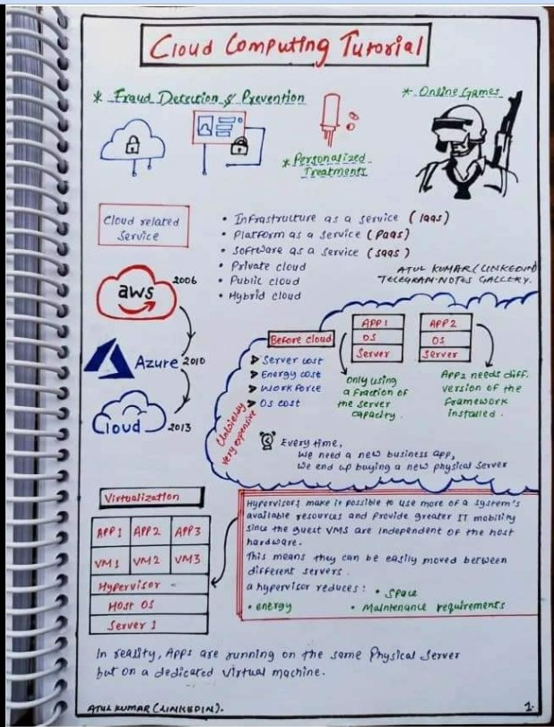
Mohana Priya
https://www.facebook.com/groups/490461811514094/user/100056259270470

Slide 18
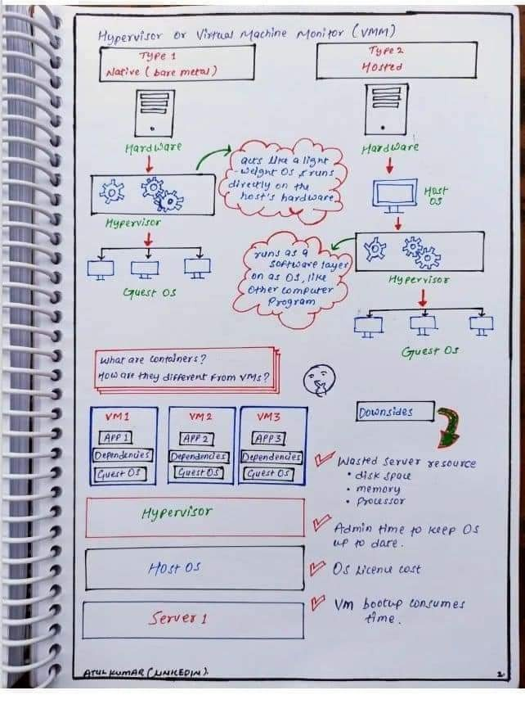
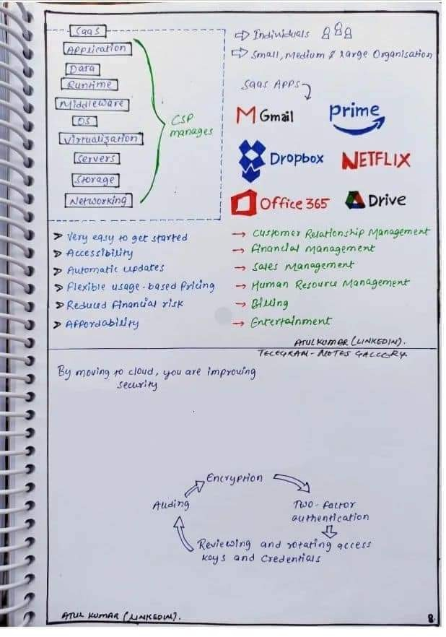

Slide 19
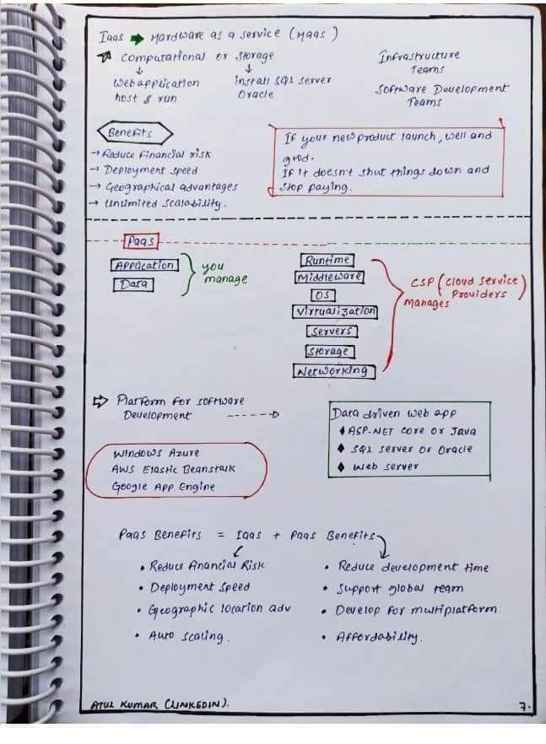
Mohana Priya
https://www.facebook.com/groups/490461811514094/user/100056259270470

Slide 20
