Slide 1
BRU TEXTILES NV
Total Value
$1.0M
Customer Intelligence Report
Total Qty
142K m
3-Year Customer Profile · 2023 – 2025 Export Customer · Customer #20000920
Repeat Rate
62%
Avg Price / m
$7.37
Top Collection
PANDORA
D'Decor Home Fabrics · Data & Automation

Slide 2
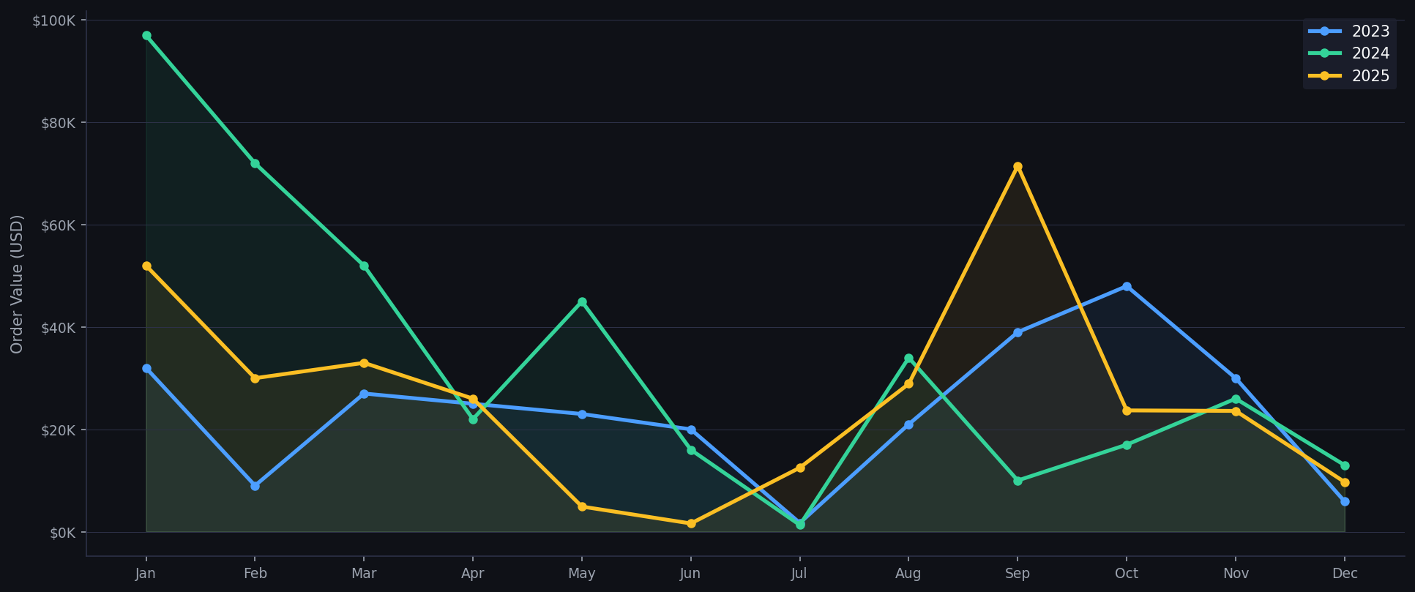
Purchase History
Monthly order value (USD) · 2023 vs 2024 vs 2025

Slide 3
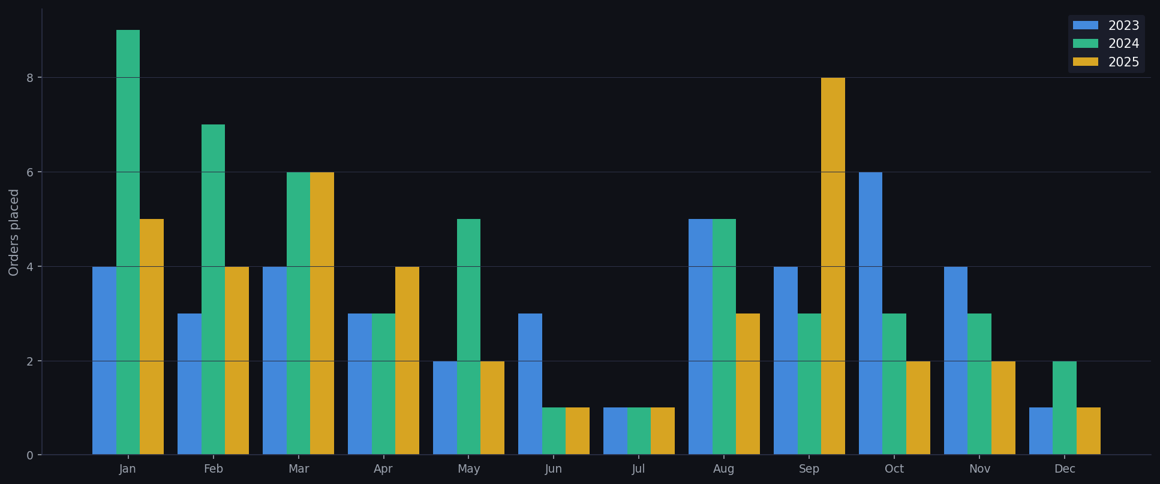
Buying Frequency
Orders placed per month across all years

Slide 4
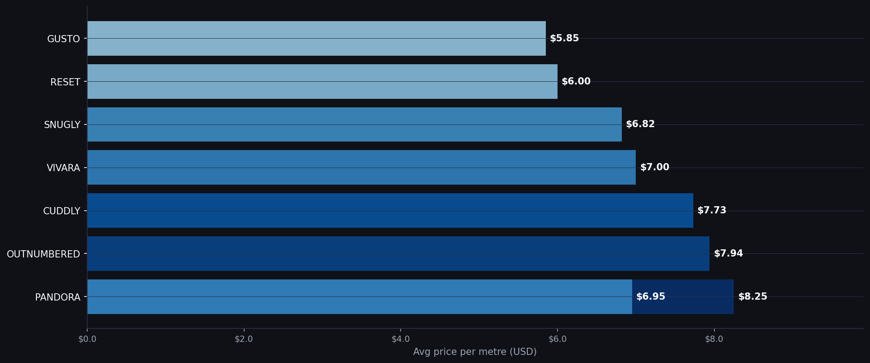
Price Range
Average Nett price per metre (USD) — top collections

Slide 5
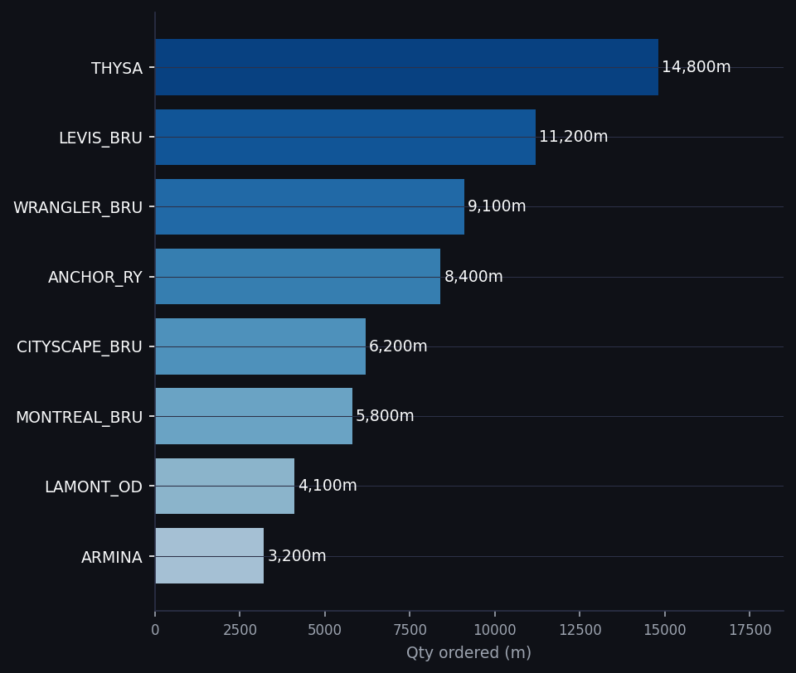
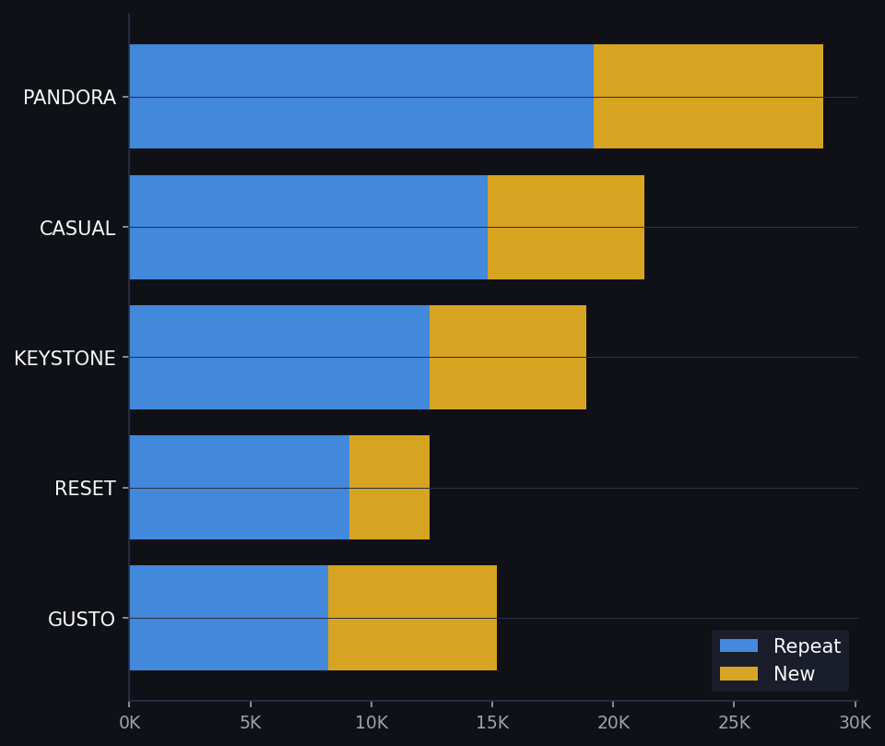
Product Usage Patterns
Top HF qualities and collection loyalty
TOP HF QUALITY — QTY ORDERED (m)
REPEAT vs NEW — TOP COLLECTIONS

Slide 6
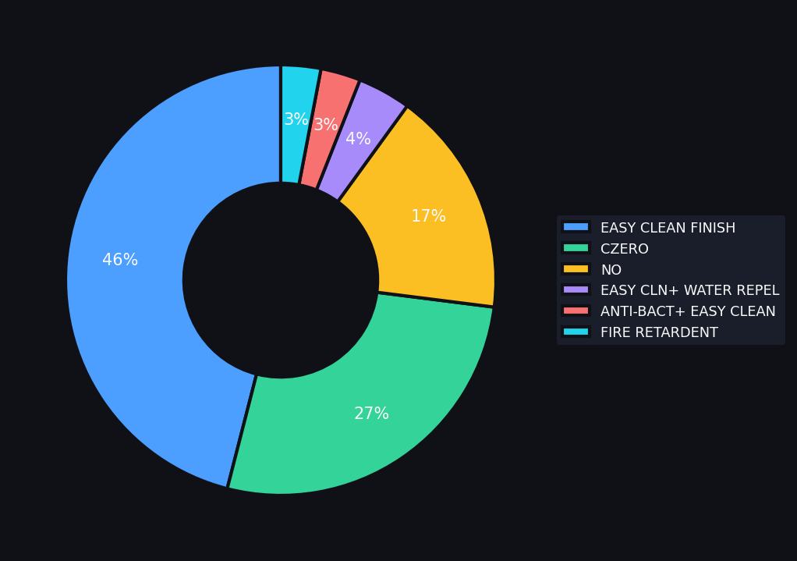
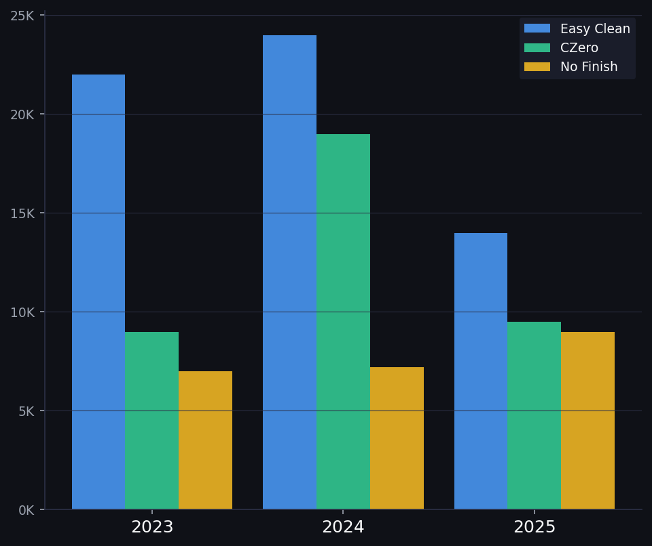
Special Finish Analysis
Finish preferences and year-on-year trend
FINISH MIX — SHARE OF TOTAL QTY
FINISH TREND — QTY PER YEAR (m)

Slide 7
Key Insights
What the data tells us about BRU Textiles NV
📈 Purchase Trend
🔁 High Loyalty
✨ Finish Preference
Total value $1.0M across 3 years. Peak spend in Q1 and Q3 — aligning with BRU's spring and festive buying cycles.
62% of all orders are repeat orders. PANDORA, CASUAL and RESET are BRU's most loyal collections.
Easy Clean Finish dominates at 46% of volume. BRU's end market likely requires performance fabric — hospitality or contract.
💰 Premium Buyer
📦 Product Focus
🗓 Seasonal Pattern
Average price $7.37/m. BRU consistently chooses mid-to-premium collections and pays above-average prices.
Upholstery (UPH-PDY and UPH-YDY) accounts for majority of volume. BRU is primarily an upholstery buyer.
Q1 (Jan-Mar) is the most active buying quarter consistently. Best follow-up window: December to January.

