Slide 1

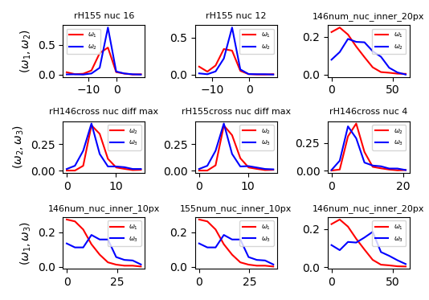
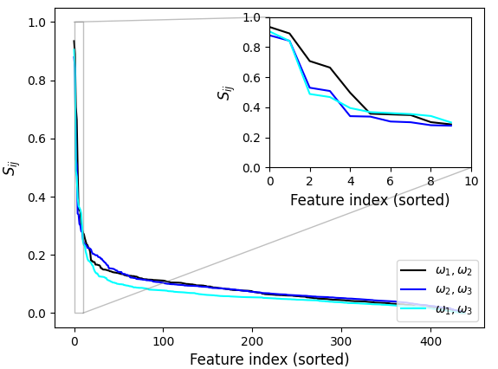
Feature Selection with Symmetric KL-Divergence
Data is sparse in high dimensions, need to identify a feature subspace where the cells may be classified
Algorithm: Compute KL-Divergence of conditional class distributions of each feature, select top N features
Caveat: Considers only changes in distribution along feature axes and excludes higher order e.g., pairwise changes

