Slide 1
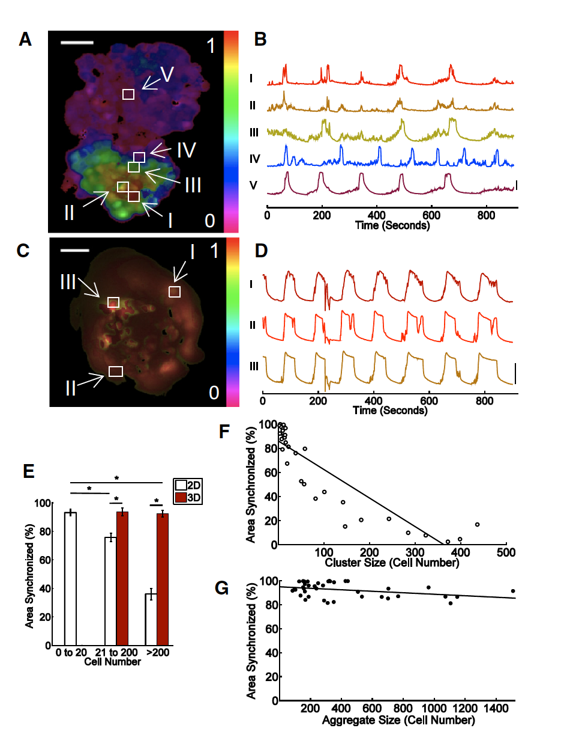
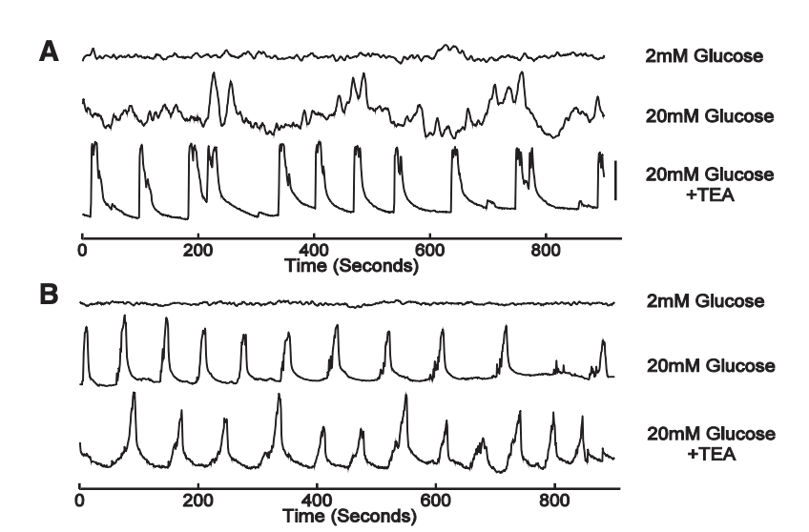
Dimension and size dependence of [Ca2+] synchronization
2D: ~4000 cells/mm^2 (MIN6)
3D: ~520,000 cells/cm^2 in hydrogel microwell arrays
[Ca2+] readout using Fluor4
50um
2D
3D
High-glucose + TEA
~5 cell synchronization radius in 2D
Synchronization is scale-dependent
in 2D but not in 3D
Dimensionality and size scaling of coordinated Ca2+ dynamics in MIN6 beta-cell clusters. Biophysical Journal. 2014

Slide 2
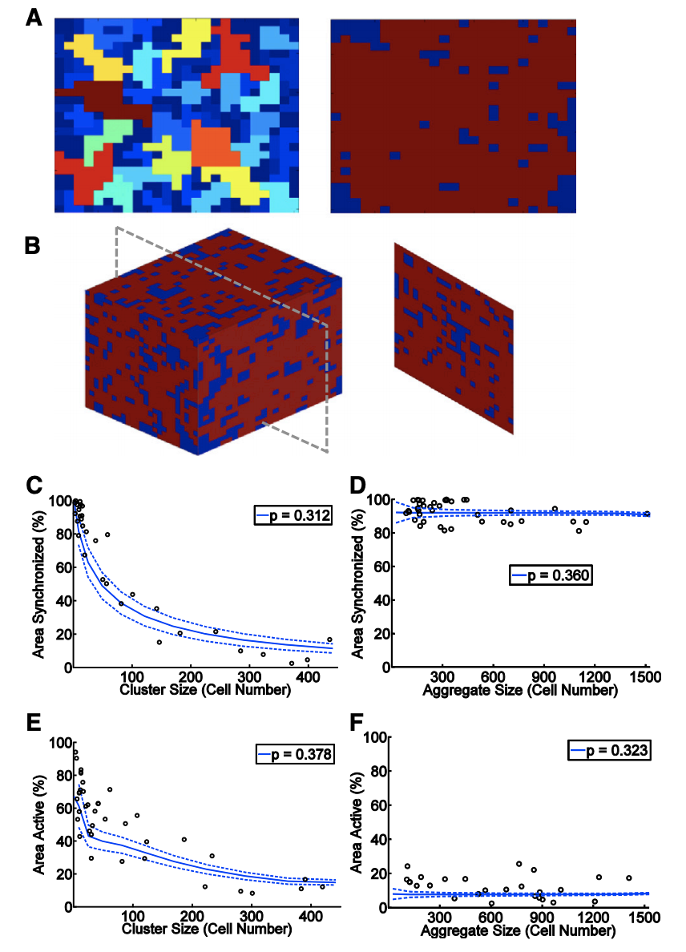
Coupled-resistor network model
p represents the probability for two neighboring cells to be functionally coupled to synchronize their oscillations
or suppress spontaneous calcium
p<0.5
p>0.5
2D
3D
2D
Synchronization (high glucose)
3D
Suppression
(low glucose)
Dimensionality and size scaling of coordinated Ca2+ dynamics in MIN6 beta-cell clusters. Biophysical Journal. 2014

Slide 3
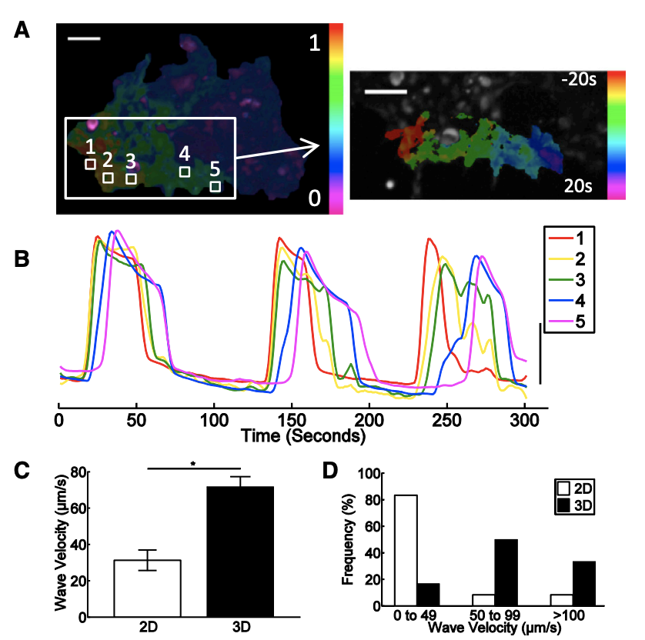
Wave velocity under 2D/3D coupling
2D
P<0.001
Dimensionality and size scaling of coordinated Ca2+ dynamics in MIN6 beta-cell clusters. Biophysical Journal. 2014

