Slide 1
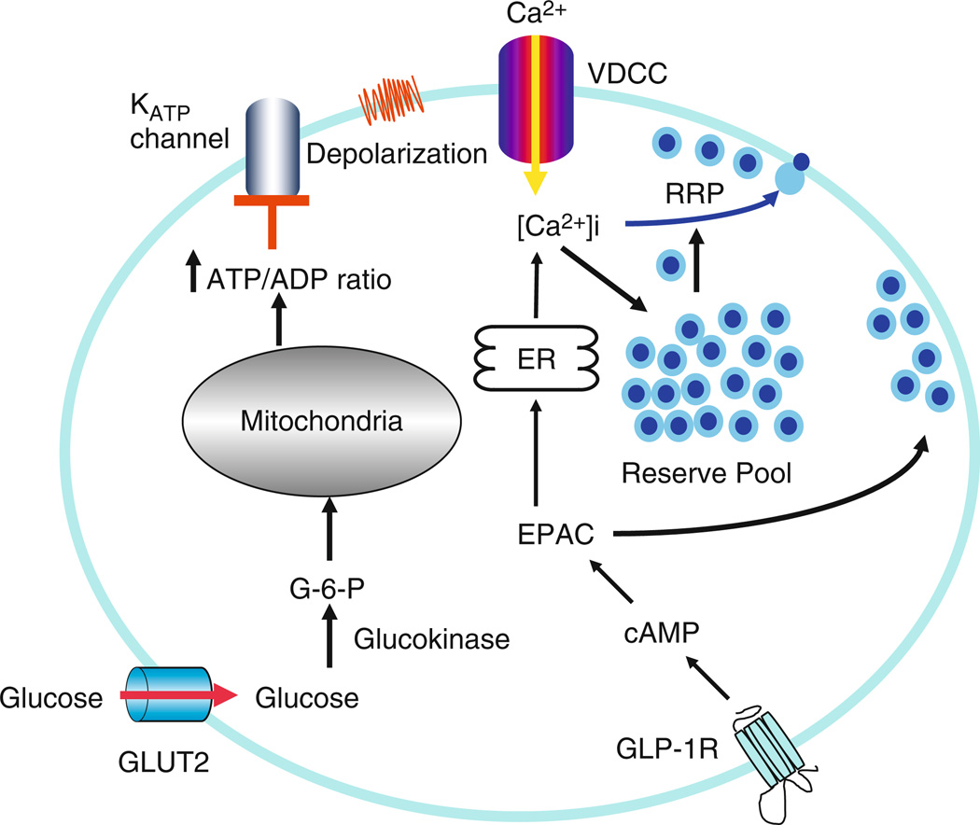
Intracellular Ca²⁺ is involved in Insulin Granule Exocytosis
ATP-sensitive K⁺ channels open and depolarize the cell in response to glucose metabolism
Voltage-gated Ca²⁺ open and increase in [Ca²⁺] triggers insulin granule exocytosis
Gap junctions allow communication of glucose stimuli to neighboring beta cells
Insulin Granule Biogenesis, Trafficking, and Exocytosis. Vitam Horm 2009

Slide 2
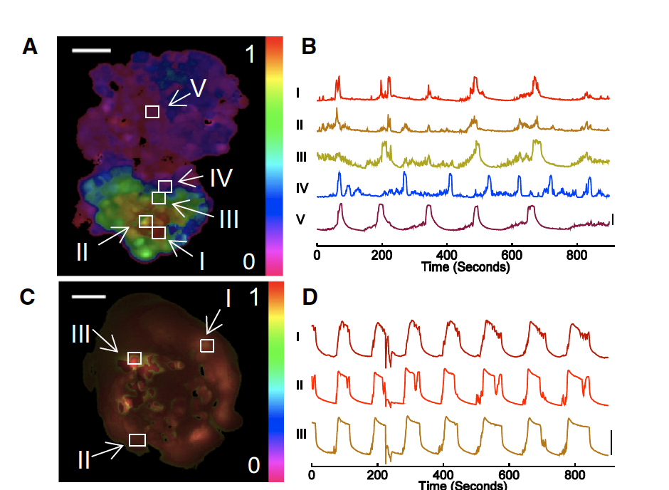
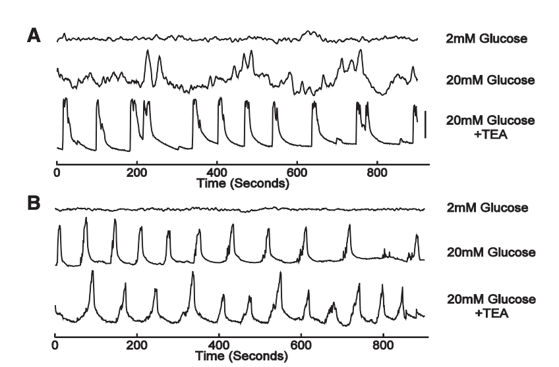
Synchronization of [Ca2+] oscillations is dependent on growth geometry
Ca2+ oscillations appear to be more tightly controlled in pseudo-islets relative to monolayers
MIN6 monolayers show reduced synchronization of [Ca2+] oscillations relative to pseudo-islets
50um
2D
[Ca2+]
Monolayer
3D
[Ca2+]
Pseudo-islet
Dimensionality and size scaling of coordinated Ca2+ dynamics in MIN6 beta-cell clusters. Biophysical Journal. 2014
Notes:
2

Slide 3
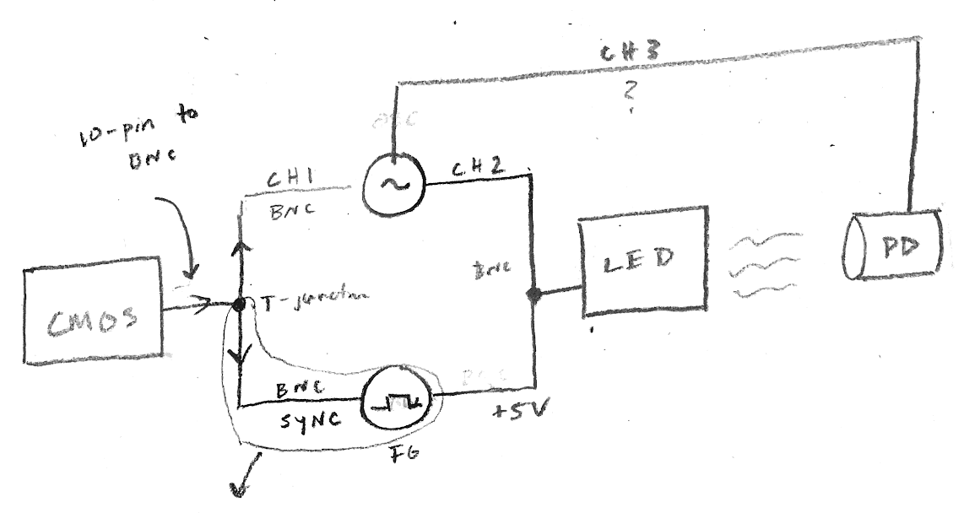

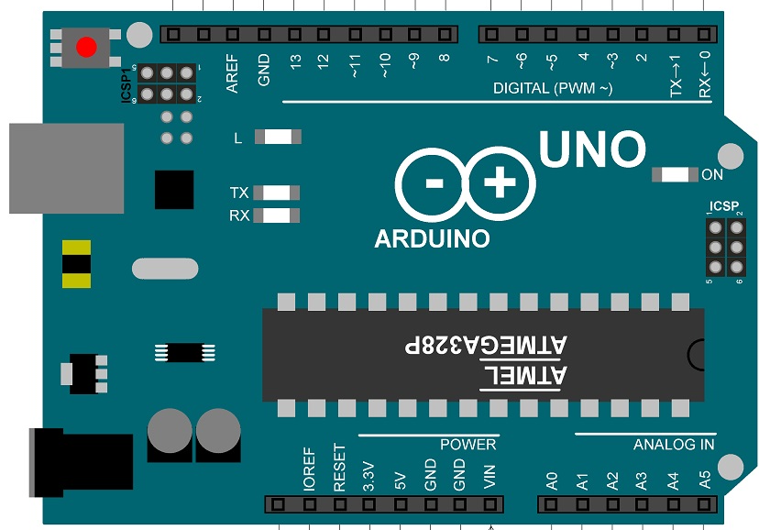
Photobleaching Imposes Constraints on Observable [Ca2+] Dynamics
PD
Fluorescent calcium indicators have a finite photon budget before photobleaching
High frame rates over short times or low frame rates over long times
High quantum efficiency and signal to noise ratio (SNR)
40X Water
LED
DM
UNO TTL
READOUT
Detector
M
CMOS TTL

Slide 4
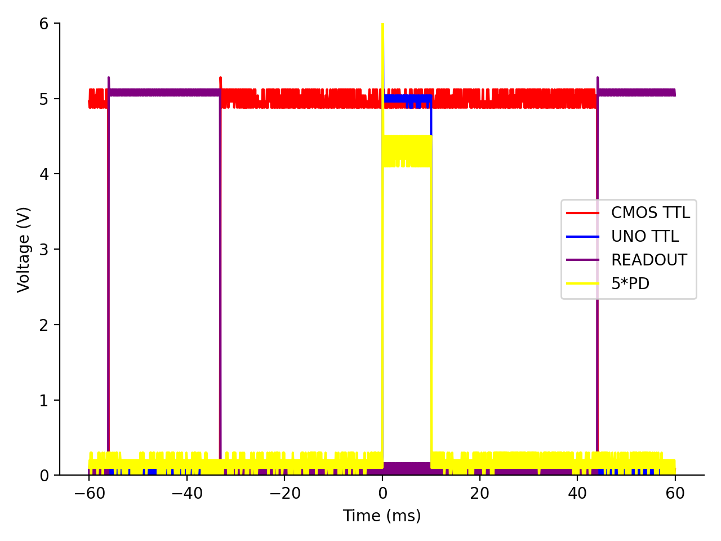
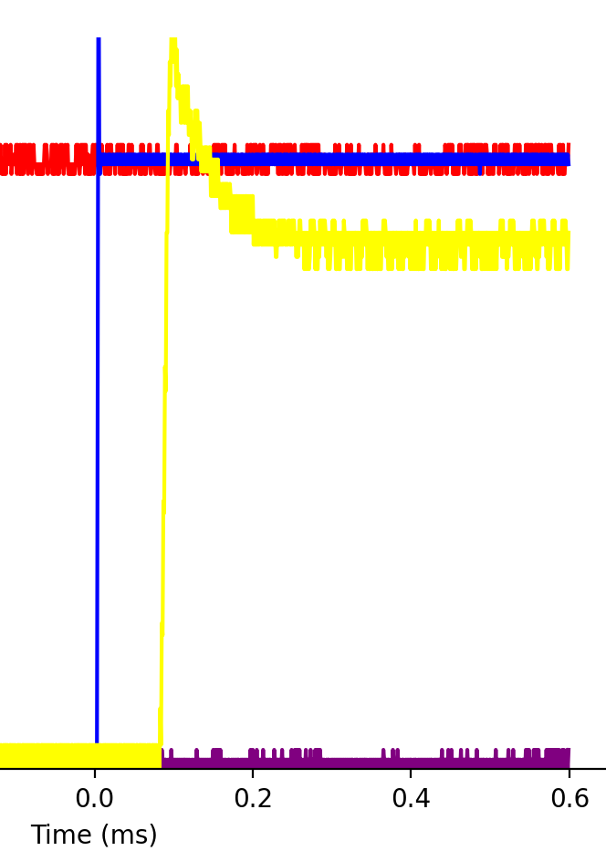
Transistor-Transistor Logic (TTL) Allows Precisely-Timed Pulsatile Excitation
Brief excitatory pulses during sensor exposure limits photobleaching at low frame rates
Global shuttering mechanism prevents collection bias over the CMOS sensor

Slide 5
Calcium Experiments

