Slide 1
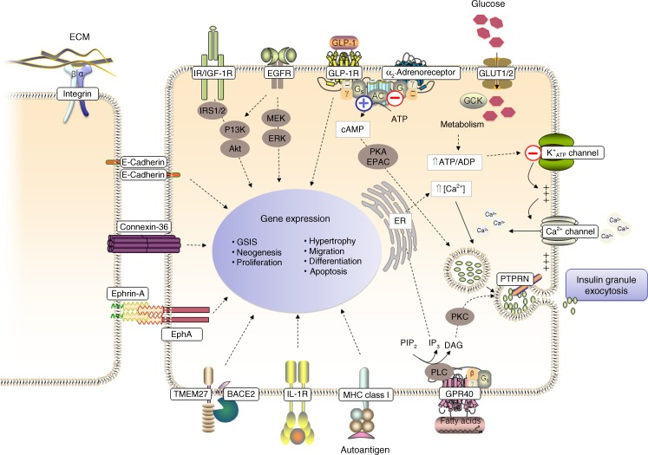
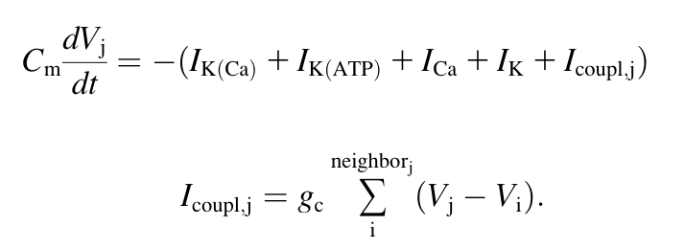
Intracellular Ca²⁺ is involved in Insulin Granule Exocytosis
ATP-sensitive K⁺ channels open and depolarize the cell in response to the availability of glucose
Voltage-gated Ca²⁺ open and increase in [Ca²⁺] triggers insulin granule exocytosis
Gap junctions allow communication of glucose stimuli to neighboring beta cells
The pancreatic beta cell surface proteome. Diebetologia. 2012

Slide 2
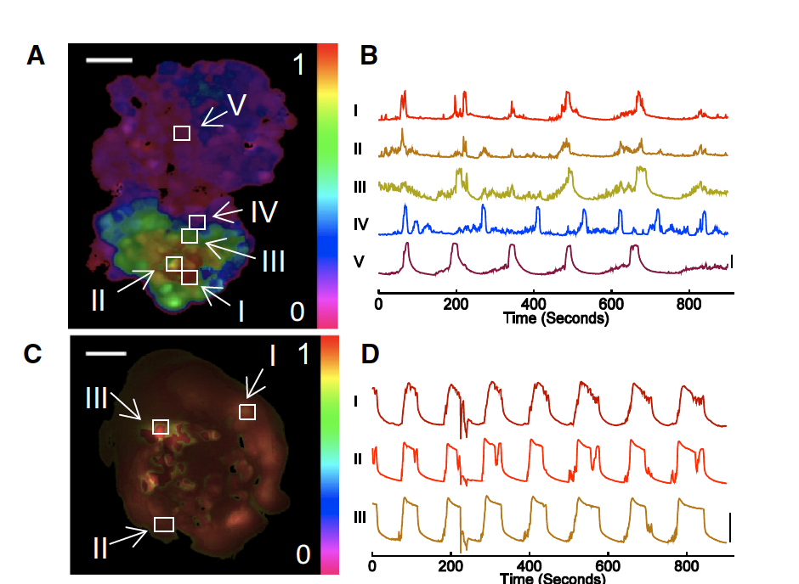
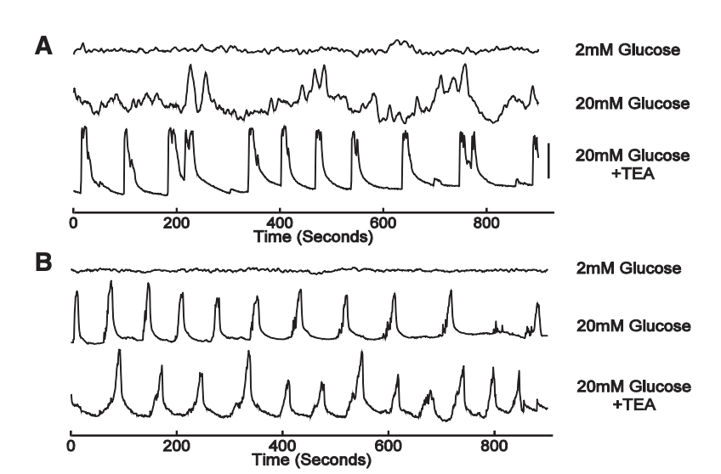
Synchronization of [Ca2+] oscillations is dependent on growth geometry
MIN6 monolayers show reduced synchronization of [Ca2+] oscillations relative to pseudo-islets
Calcium-dependent fluorescent dyes such as Fluor4 allow us to measure steady-state synchronization of [Ca2+] oscillations
50um
2D
3D
Dimensionality and size scaling of coordinated Ca2+ dynamics in MIN6 beta-cell clusters. Biophysical Journal. 2014
Notes:
2

Slide 3
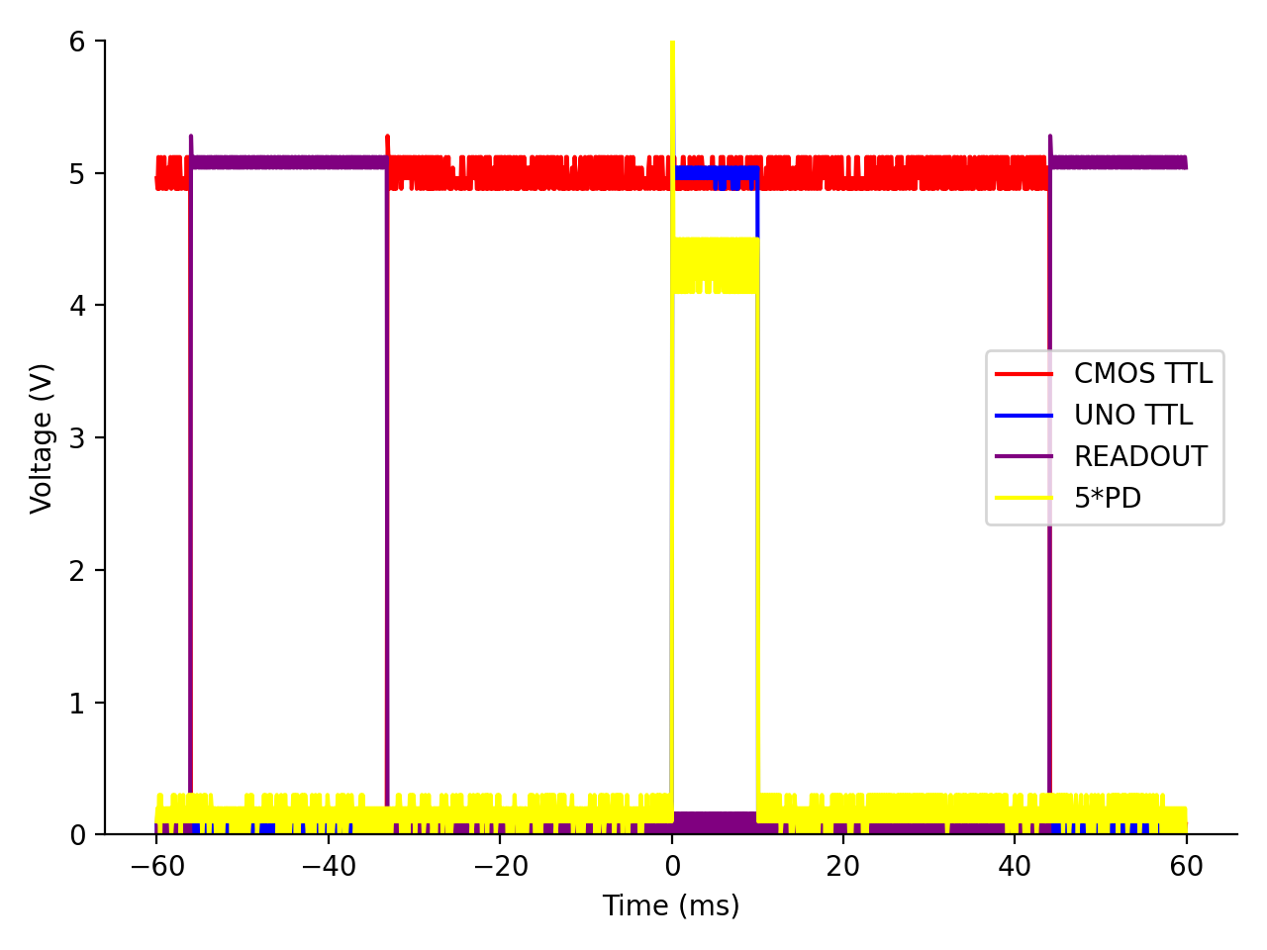
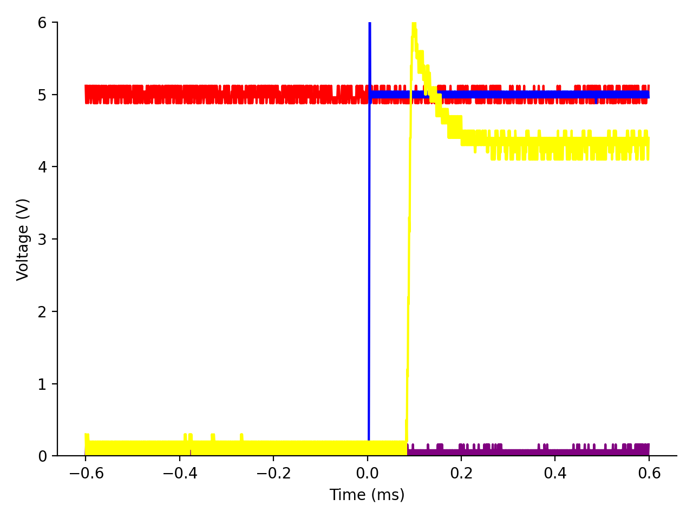

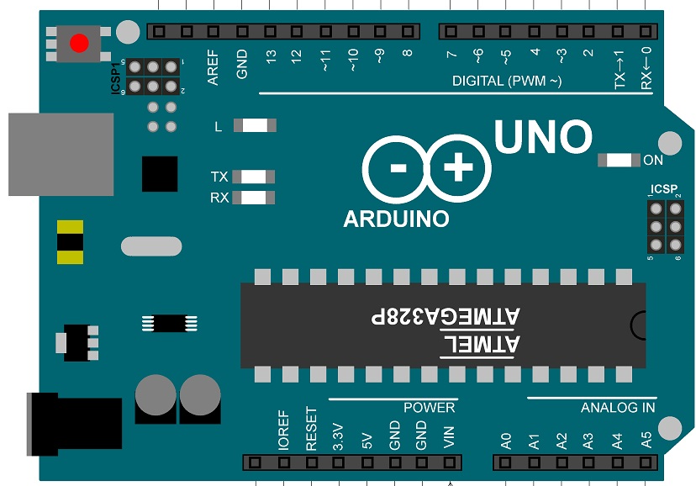
PD
40x
L1
LED
DM
UNO TTL
READOUT
CMOS
M
CMOS TTL

Slide 4
Calcium Experiments

Slide 5
Voltage Experiments

