Slide 1
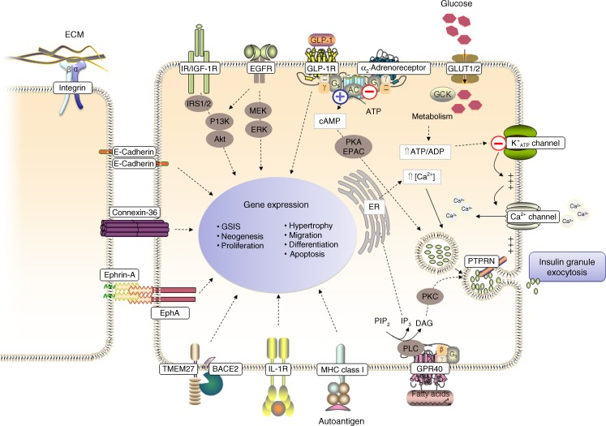
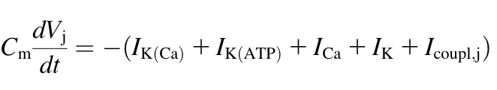
Intracellular Ca²⁺ is involved in Insulin Granule Exocytosis
ATP-sensitive K⁺ channels open and depolarize the cell in response to glucose metabolism
Voltage-gated Ca²⁺ open and increase in [Ca²⁺] triggers insulin granule exocytosis
Gap junctions allow communication of glucose stimuli to neighboring beta cells
annotate
The pancreatic beta cell surface proteome. Diabetologia. 2012

Slide 2
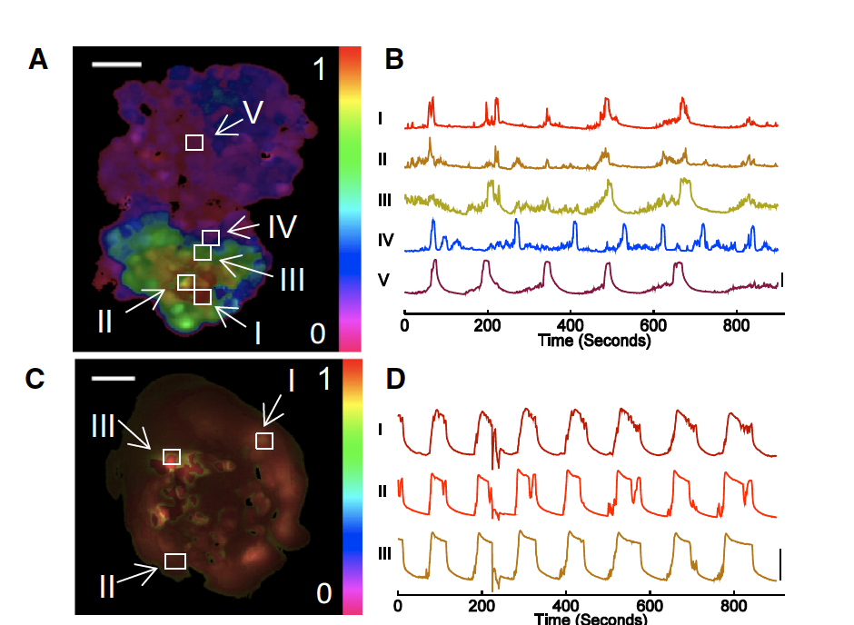
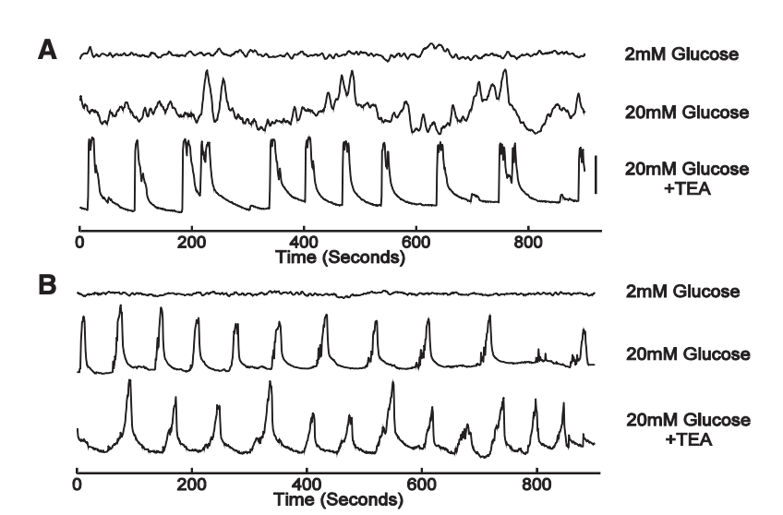
Synchronization of [Ca2+] oscillations is dependent on growth geometry
Ca2+ oscillations appear to be more tightly controlled in pseudo-islets relative to monolayers
MIN6 monolayers show reduced synchronization of [Ca2+] oscillations relative to pseudo-islets
50um
2D
[Ca2+]
Monolayer
3D
[Ca2+]
Pseudo-islet
Dimensionality and size scaling of coordinated Ca2+ dynamics in MIN6 beta-cell clusters. Biophysical Journal. 2014
Notes:
2

Slide 4
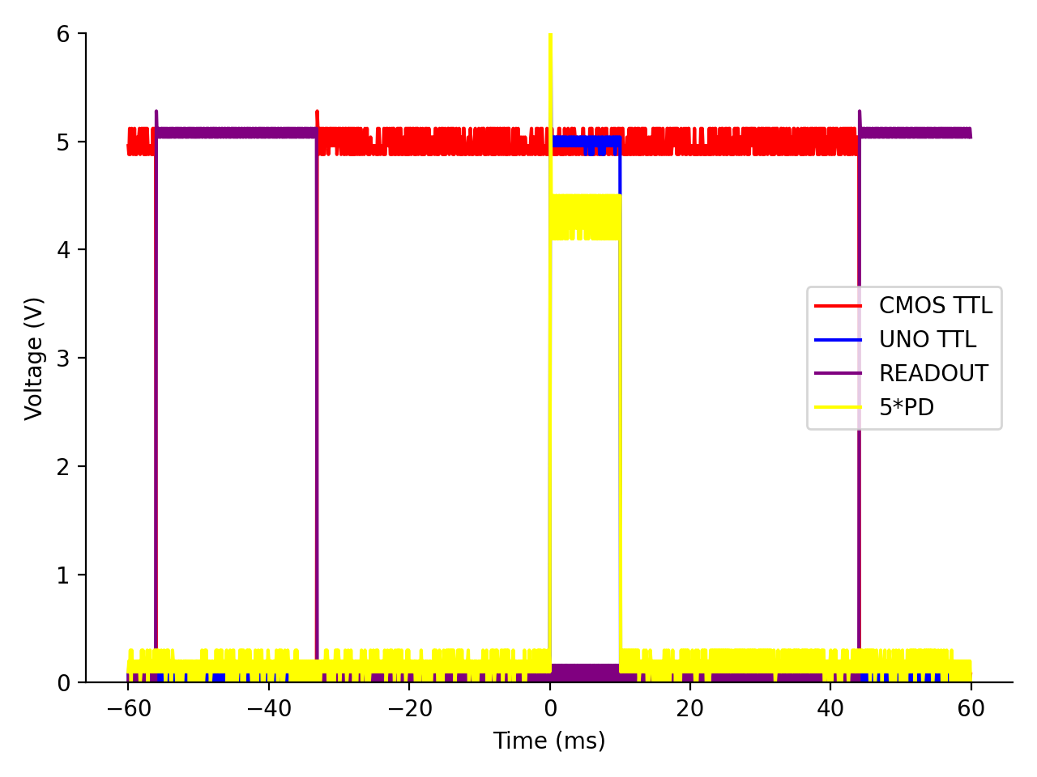
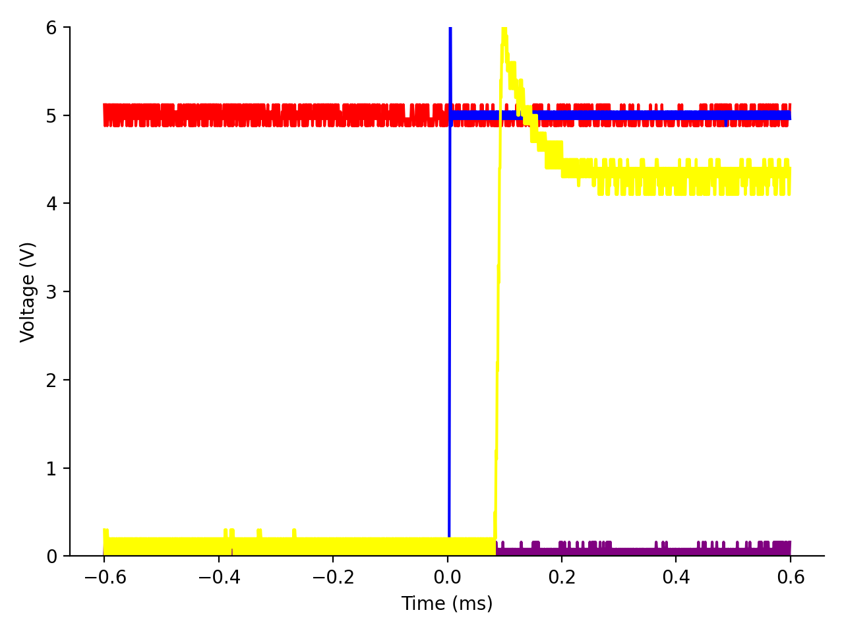
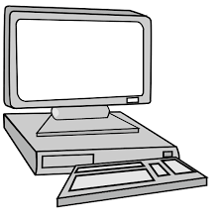
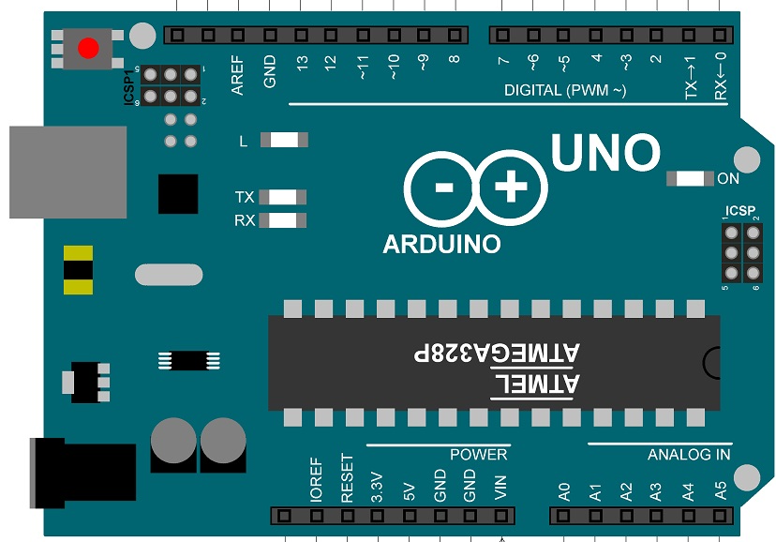
PD
Legend Here
40x
LED
DM
UNO TTL
READOUT
CMOS
M
CMOS TTL

Slide 5
Calcium Experiments

Slide 6
Voltage Experiments?

