Slide 1
Texas Covid-19 Spread and Vaccine
Christopher Stromer

Slide 2
Introduction
The COVID-19 outbreak has caused many US states to shut down most economic activity which is severely hurting our economy. Politicians and leaders in office are under pressure to open the country back up again or face a severe lasting economic crisis and potential long-term hardship. The goal of this project is to track the spread of coronavirus through Texas starting from a specific city and also to find the shortest path from Corpus Christi, where a potential vaccine from another country is being imported, to a city with the greatest need for a vaccine.

Slide 3
Data
The main data we will be using is coming from The University of Texas at San Antonio Computer Science department. I will also be using some location data from Foursquare.
This data contains city and distance information for all of the cities in Texas.
The data will be used for various search algorithms.

Slide 4
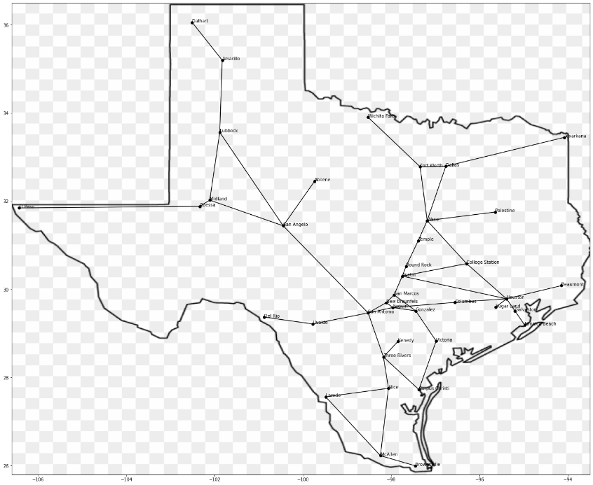
Data Preview – Map of Texas Cities and their connections

Slide 5
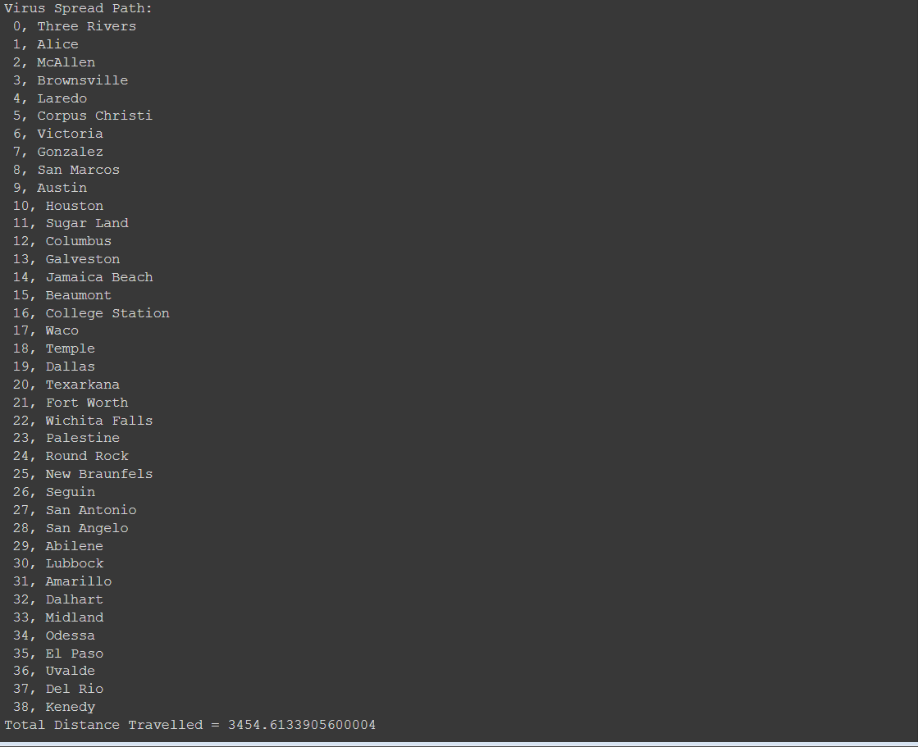
Depth First Search – Spread of Covid-19 starting from Three Rivers

Slide 6
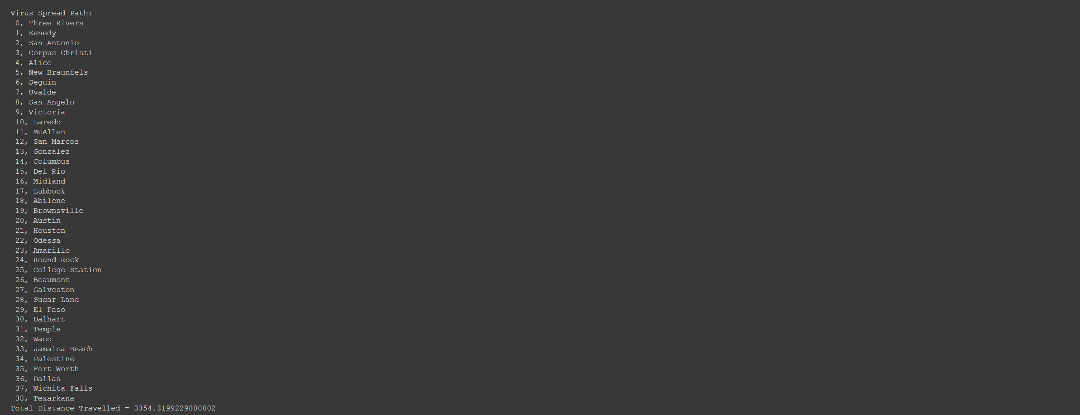
Breadth First Search – Spread of Covid-19 starting from Three Rivers

Slide 7
Discussion of DFS and BFS results
We first tried our function starting from Three Rivers and we used Depth First Search. This gave us our total distance calculation to spread from Three Rivers to every other city in Texas in the shortest path using Depth First Search. However, we ran the same function again using Breadth First Search and ended up with a shorter distance and a different path.
For our uninformed search, we can see different paths and different distances calculated as a result of those different paths. The reason for this is because Breadth First Search visits each of its child nodes before exploring deeper, whereas Depth First Search is the opposite. This causes our algorithm to pick a different order of cities to visit even though the data is the same. For our current data set, we have determined that the best fitting algorithm for uninformed searching is Breadth First Search.

Slide 8
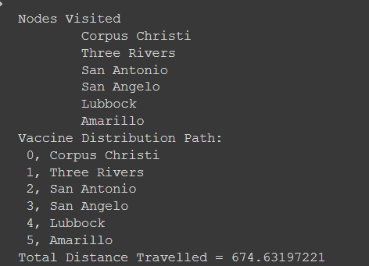
Greedy Best First Search – Vaccine Distribution from Corpus Christi to Amarillo

Slide 9
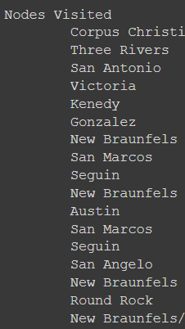
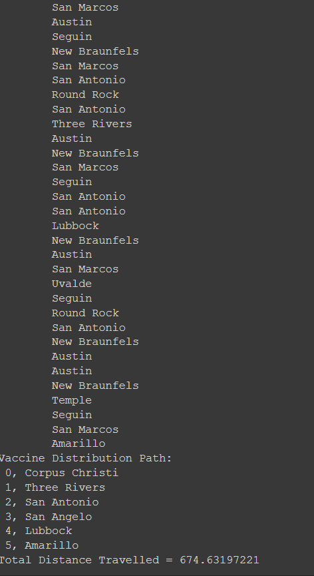
A* Search – Vaccine Distribution from Corpus Christi to Amarillo

Slide 10
Discussion of GBFS and A* results
We started at Corpus Christi and ended in Amarillo. The goal of this was to determine the shortest path from Corpus Christi to Amarillo. We started by performing a Greedy Best First Search on the data and came up with a total distance of 674.63. Then, we performed an A* search on the same data and came up with the same total distance. The only difference between the two search algorithms is that the A* checked every node to make sure it was taking the best path, while the Greedy Best First Search only chose nodes with the best immediately available path.
We can see that the “Nodes Visited” section of the output is very different, while the total distance travelled remained the same. This is due to A* search being extremely thorough. It searches through every possible node so it can check every possible path to make sure you are getting the lowest possible total distance calculation. It just so happens that our data was set up in such a way that the Greedy Best First Search was able to produce the correct results in a shorter and quicker time.

Slide 11
Conclusion
Covid-19 is a rapidly spreading virus that the world was not fully prepared to handle, but we are doing the best we can. It spreads rapidly, so containing it is very difficult. In my project, I gave a few demonstrations on how the coronavirus could spread throughout Texas, and how we could potentially distribute a vaccine throughout Texas, prioritizing the most affected cities first. Seeing as the virus has already spread well throughout the country, we need to focus on the vaccine to prevent more people from falling ill and try to lessen the pressure on our healthcare system. In my project, I demonstrated how some search algorithms could be useful to determine the best path for distributing a vaccine for Covid-19.

