Slide 1


Creating a gratifying experience for
MOM
During Pregnancy
Project By:
Tausif Ul Rahman
Sameen Tariq
Shabir Ahmad

Slide 2
Problem
Maternal Mortality Deaths
WHO Report
 | Pakistan | World Wide
Daily | 50+ | 900+
Yearly | 20K | 328K

Slide 3
Causes
Lack of Education
Un-Trained Mid Wives
Lack of access to medical HELP
Child Marriages & Family Planning

Slide 4
Solution
Education & Awareness
Contact Support
Timely Alerts

Slide 5
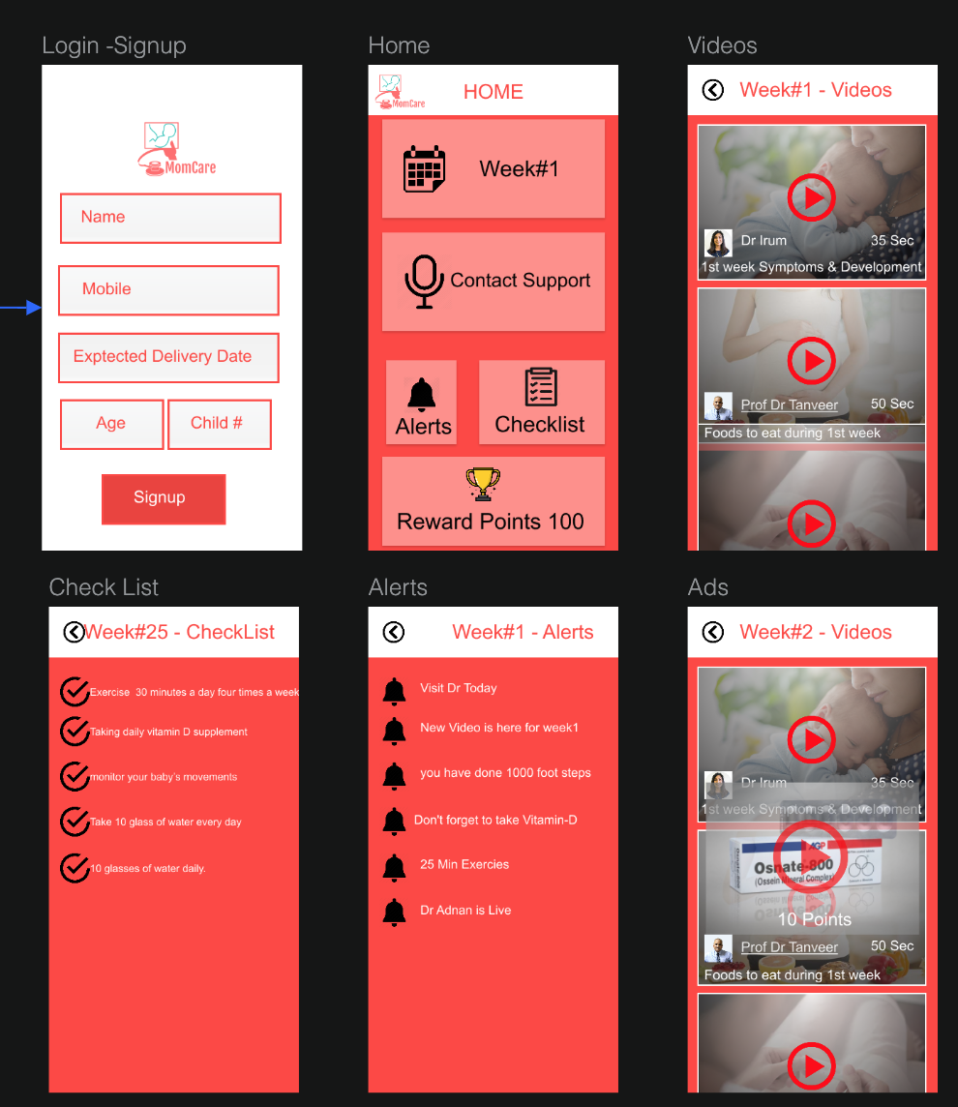
Product
Videos
Voice Contact Support
Alerts

Slide 6
Progress & Future Plan
Surveys during Hackathon
Mobile Application Prototype
Post Pregnancy Support
Child Care

Slide 7

Sustainability
Reward System
Subscriptions
Pharmaceutical products
Doctors

Slide 8

Positive MIND healthy Pregnancy
Thank You

