Slide 1
Formalising Automata Theory in Agda
Computer Science
University of Birmingham

Slide 2
Project Objectives
Translating from regular expressions to automata in Agda
Regex -> NFA (Thompson’s Construction)
Remove ε-steps
Powerset construction
Quotient construction
Proving their correctness in Agda
e.g. ∀e. L(e) = L(regexToDFA e)
Formalising Myhill-Nerode Theorem

Slide 3
Agda
Dependently typed programming language
Dependent type
A type that is indexed by a value of a type
Vec Nat n e.g. Vec Nat 1 , Vec Nat 10
Gives more precise types
e.g. Binary search tree
Corresponds to quantification in logic
Notes:
Similar to Haskell, but provide more expressive types, Haskell -> Binary tree, Agda -> BinarySearchTrees
Different use of dependent types, represents logic

Slide 4
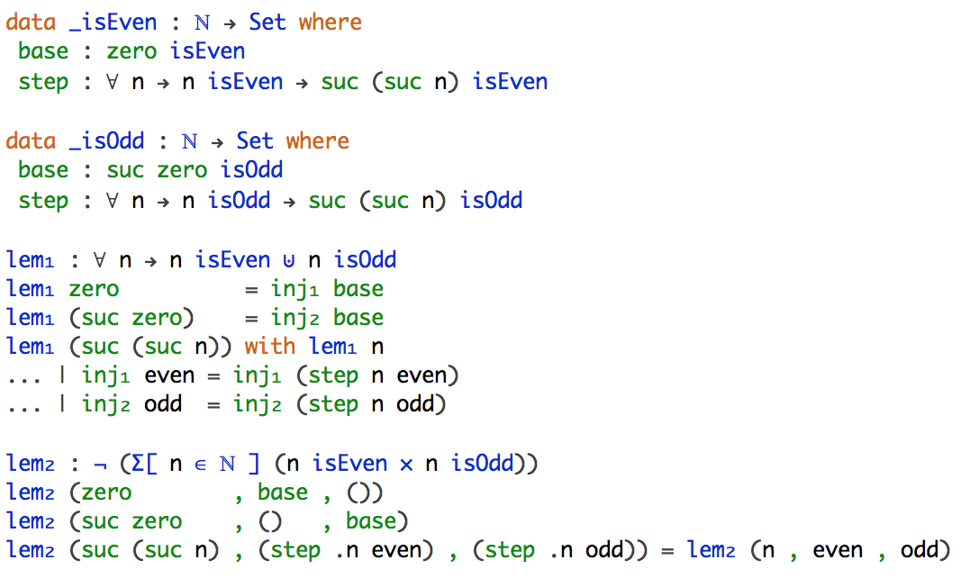
Agda
Encoding predicate logic

Slide 5
Agda
Dependently typed programming language
Dependent type
A type that is indexed by a value of other type
Vec Nat n e.g. Vec Nat 1 , Vec Nat 10
Gives more precise types
e.g. Binary search tree
Corresponds to quantification in logic
Proof assistant
Write programs
Prove their correctness
Notes:
Similar to Haskell, but provide more expressive types, Haskell -> Binary tree, Agda -> BinarySearchTrees
Different use of dependent types, represents logic

Slide 6
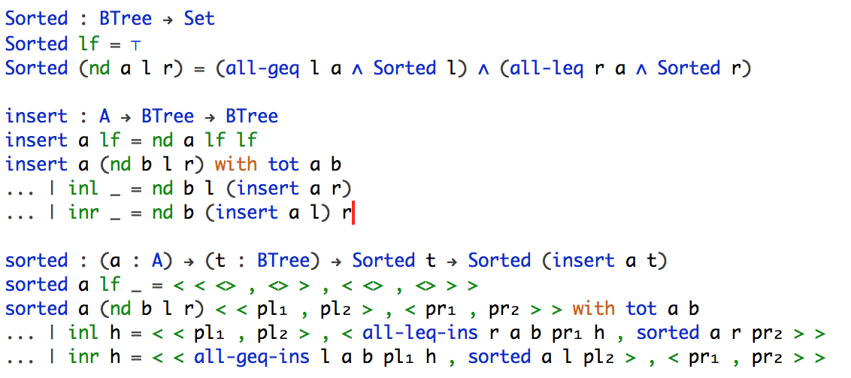
Agda
Encoding specification of program

Slide 7
Project Objectives
Formalising the translation of regular expressions to automata in Agda
Regex -> NFA (Thompson’s Construction)
Remove ε-steps
Powerset construction
Quotient construction
Proving their correctness in Agda
e.g. ∀e. L(e) = L(regexToDFA e)
Formalising Myhill-Nerode Theorem

Slide 8
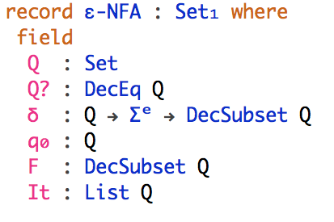
Our Approach
Definitions follow tightly to the book written by Aho, A. and Ullman, J. (1972)
DecSubset
i.e. Q -> Bool

Slide 9
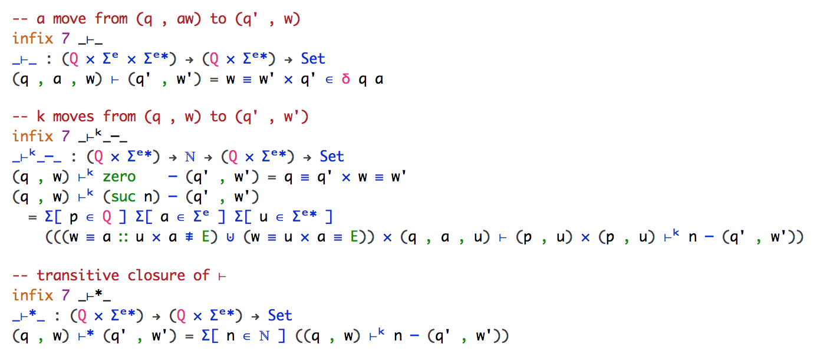
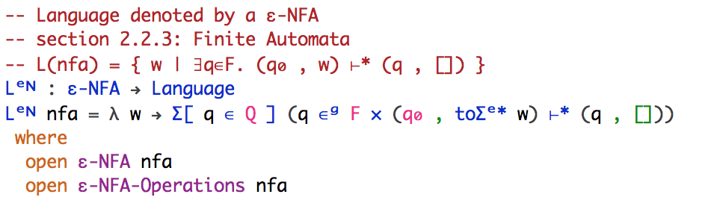
Our Approach
Notes:
more natural, mathematical way, follows closely the literature on formal languages

Slide 10
Our Approach
Regex to ε-NFA
ε-NFA to NFA
NFA to DFA
DFA to MDFA
Prove L(Regex) = L(ε-NFA) = L(NFA) = L(DFA) = L(MDFA)

Slide 11
Progress
Formalising Regular Expression and Automata
Define Subset and its operations ✓
Define Regular Expression and Automata ✓
Define the language specified by them ✓
Define the translation
Regex to ε-NFA ✓
Remove ε-step ✓
Powerset construction ✓
Minimisation 10%
Prove L(Regex) = L(DFA)
L(Regex) = L(ε-NFA) ✓
L(ε-NFA) = L(NFA) ✓
L(NFA) = L(DFA) ✓
L(DFA) = L(MDFA) 0%
Formalising Myhill-Nerode Theorem 10%

Slide 12
Evaluation
Project management

Slide 13
Evaluation

Slide 14
References
[1] Firsov, D. and Uustalu, T. (2013). Certified Parsing of Regular Languages. In: Gonthier, G. and Norrish, M. Certified Programs and Proofs. Melbourne: Springer International Publishing. p98-113.
[2] Aho, A. and Ullman, J. (1972). The Theory of Parsing, Translation and Compiling. Volume I: Parsing. United States of America: Prentice-Hall, Inc.
[3] Bove, A. and Dybjer, P. (2009). Dependent Types at Work. In: Bove, A., Barbosa, L., Pardo, A. and Pinto, J. Language Engineering and Rigorous Software Development. Berlin: Springer Berlin Heidelberg. p57-99.
[4] Norell, U. and Chapman, J. (2009). Dependently Typed Programming in Agda. In: Koopman, P., Plasmeijer, R. and Swierstra, D. Advanced Functional Programming. Berlin: Springer Berlin Heidelberg. p230-266.

Slide 15
Q & A

