Slide 1
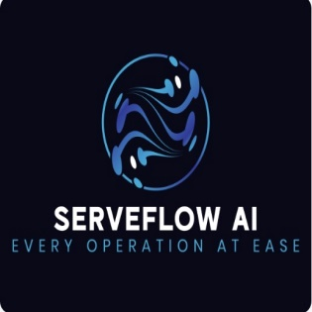

SERVEFLOW AI
Supervisor: Faisal Ahmed
Zain Ali Kamal Hussain Naushad Ahmed Muhammad Muawia

Slide 2
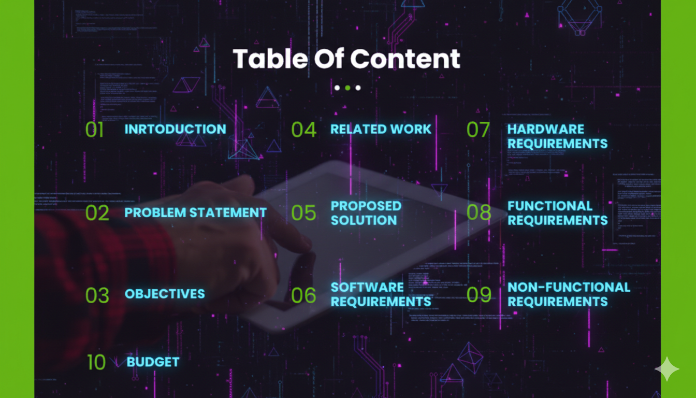

Slide 3
PROBLEM STATEMENT
Traditional service platforms rely on static listings and keyword matching, resulting in irrelevant recommendations and delayed hiring processes. Users are required to manually filter results, increasing frustration and reducing trust in digital service systems.

Slide 4
INTRODUCTION
ServeFlow AI is a next-generation intelligent service aggregation platform designed to bridge the contextual gap between service seekers and providers. By utilizing AI-driven analysis and geospatial intelligence, the platform enhances service accuracy, response time, and user satisfaction.

Slide 5
RELATED WORK
Existing service marketplace platforms primarily rely on keyword-based search, static service categories, and user ratings to connect service seekers with providers. While some platforms employ basic AI-driven recommendation techniques, these systems lack contextual understanding and fail to distinguish between similar service requests with different technical scopes. Text-only natural language processing approaches improve intent extraction but remain insufficient for accurately interpreting real-world service conditions, especially in on-site and maintenance-based services.
Recent advancements in multimodal artificial intelligence and geospatial systems have enabled more intelligent context analysis by combining visual data, textual input, and location intelligence. Vision-language models enhance problem understanding through image analysis, while geospatial algorithms improve provider selection based on proximity and availability. However, existing research and platforms rarely integrate these capabilities into a unified service marketplace framework. ServeFlow AI addresses this limitation by combining multimodal AI with context-aware geospatial matching to improve accuracy and reduce service response time.

Slide 6
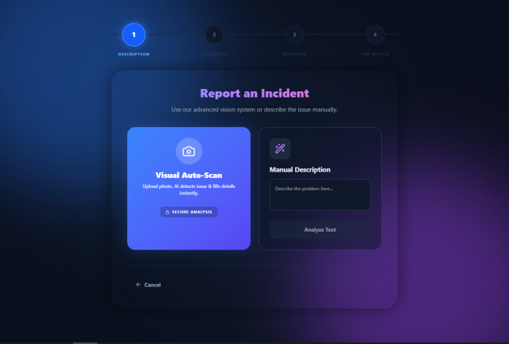
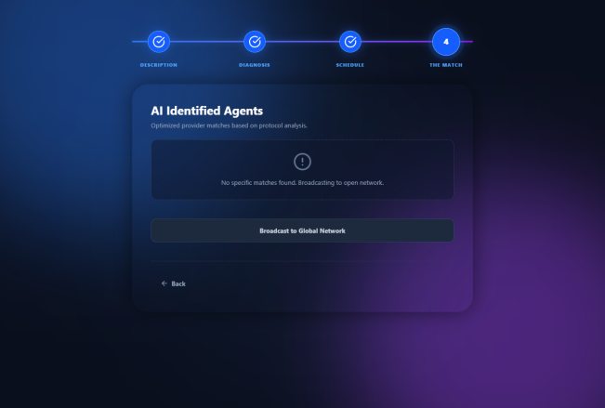
PROPOSED SOLUTION
Develop an intelligent service marketplace that uses multimodal AI (text + images) to accurately understand the technical context of service requests.
Implement AI-based visual analysis to extract problem details from user-uploaded images and generate structured technical directives.
Design a context-aware geospatial matching engine that ranks service providers based on proximity, skill relevance, availability, and reputation.
Integrate real-time communication using WebSockets to enable instant notifications and live job status tracking.
Employ a scalable service-oriented architecture to ensure system reliability, performance, and future extensibility.

Slide 7
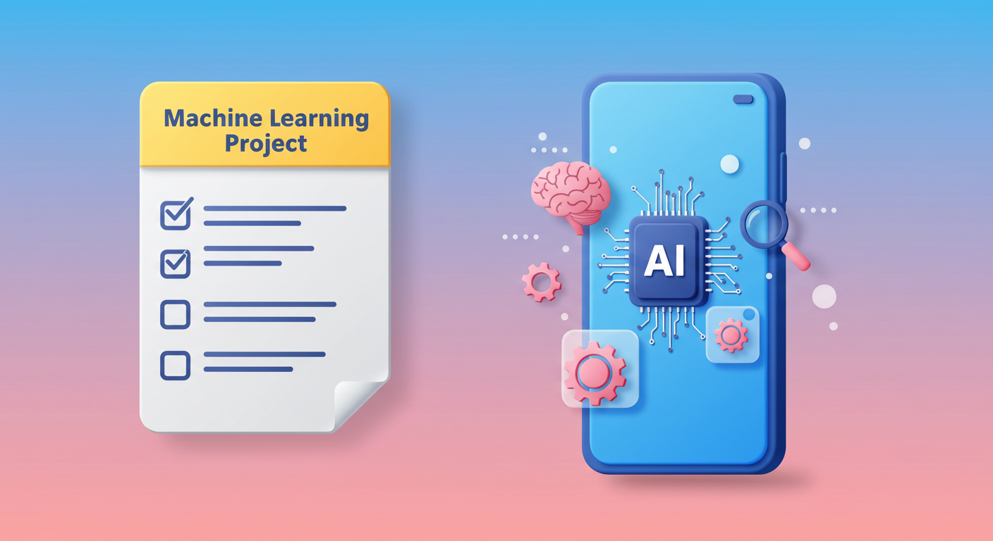
OBJECTIVES
To design an AI-driven service matching system
To reduce service hiring time using contextual intelligence
To integrate multimodal AI for visual and textual understanding
To improve trust and accuracy in service recommendations

Slide 8



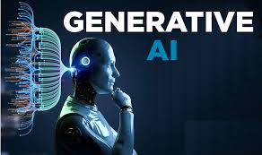
SOFTWARE REQUIREMENTS
Frontend Languages:
HTML5
CSS3
JavaScript (ES6+)
Frontend Frameworks & Libraries:
React.js
Tailwind CSS
Framer Motion
Database Technologies:
PostgreSQL
PostGIS (Geospatial Extension)
Mapping & Geospatial Tools:
Haversine Distance Algorithm
Backend Languages:
Python
Backend Frameworks:
Django REST Framework
FastAPI
Real-Time Communication:
Django Channels (WebSockets)
Artificial Intelligence Technologies:
Google Gemini API (Text and Vision Models)
Multimodal Generative AI

Slide 9



HARDWARE REQUIREMENTS
Mobile phone (3GB RAM, 1.8GHz)
Laptop (Intel i5, 8GB RAM)
5MP camera module
4G internet for backend sync

Slide 10
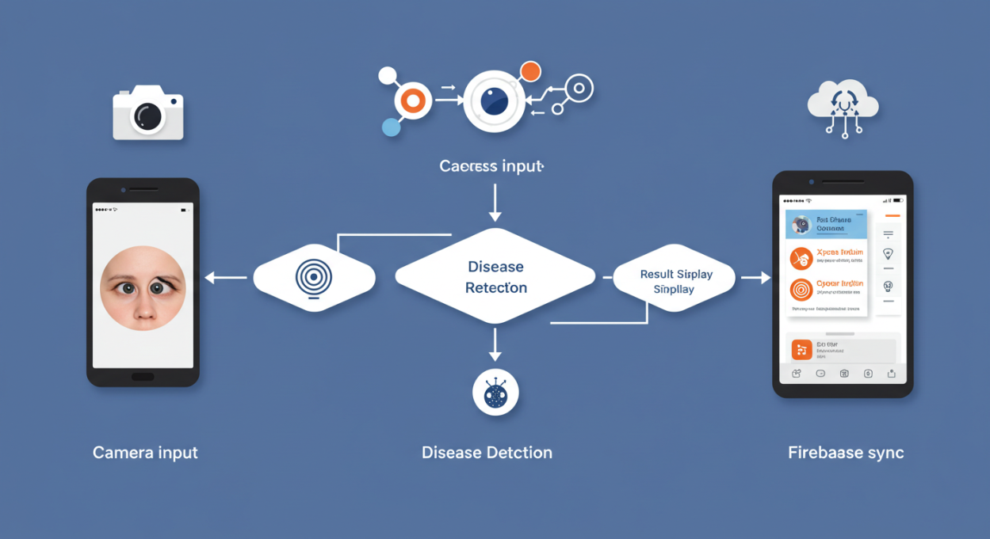
FUNCTIONAL REQUIREMENTS
User registration and authentication
AI-based service request analysis
Provider matching and ranking
Real-time notifications via WebSockets
Job status tracking

Slide 11
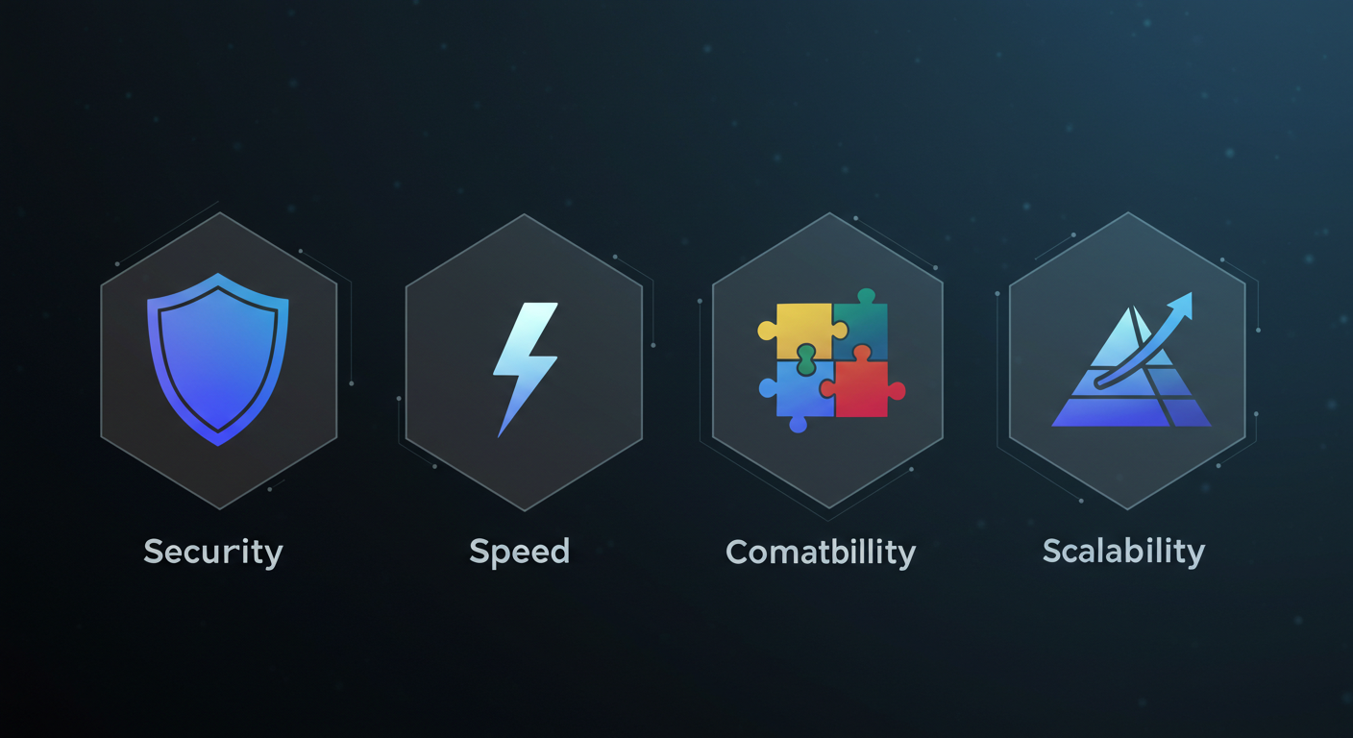
NON-FUNCTIONAL REQUIREMENTS
High system availability
Low response latency
Secure data handling
Scalability and fault tolerance

Slide 12
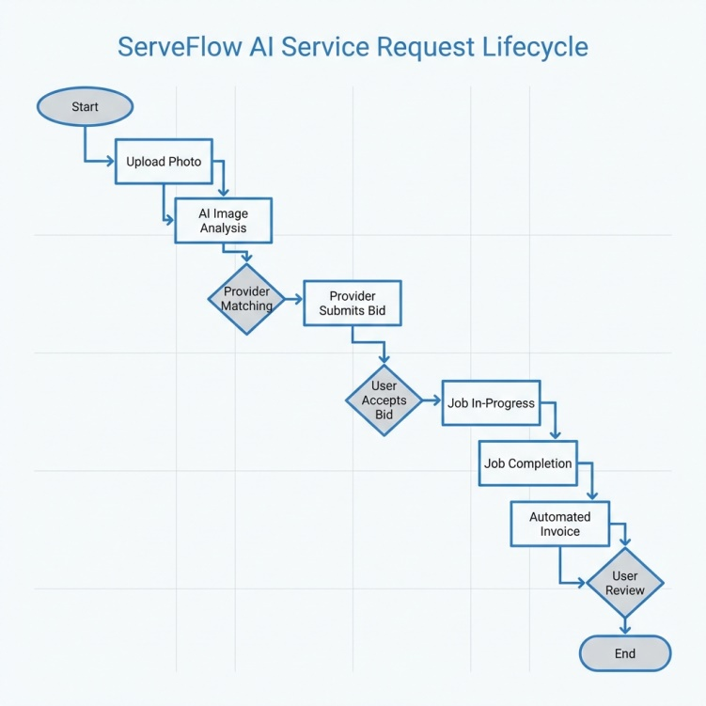
WORKFLOW DIAGRAM

Slide 13
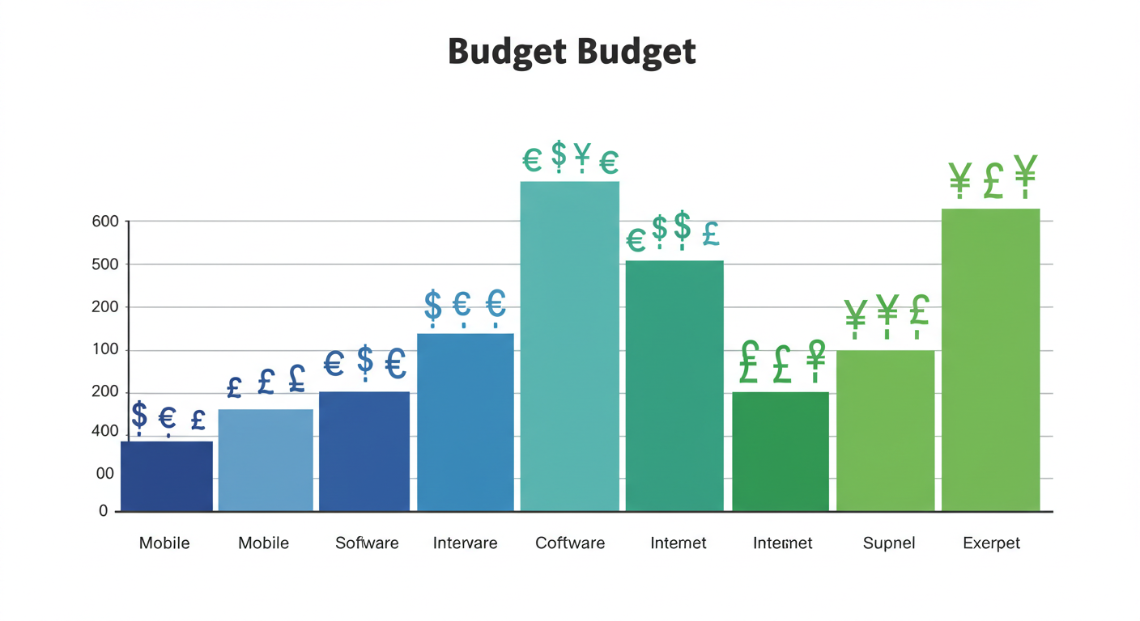
BUDGET
Mobile Device: Rs. 25,000
Laptop (already available)
Internet & Misc.: Rs. 5,000
Total Estimated Budget: Rs. 30,000

Slide 14
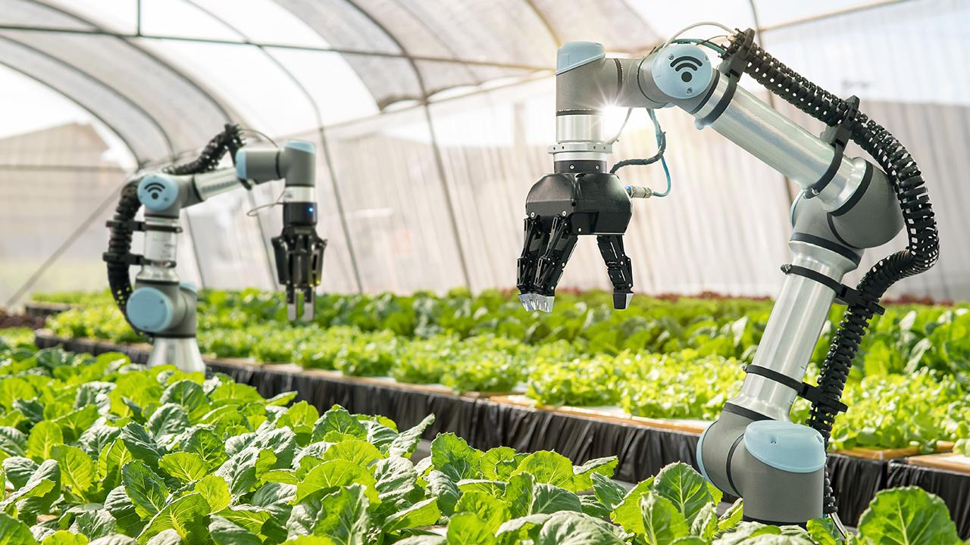
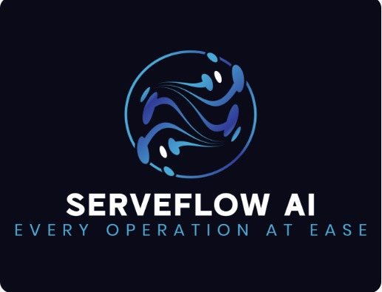
Thank You

