Slide 1
Example Presentation
Body Fat Project

Slide 2
Some Notes
These slides are only meant to show one example of presenting your materials.
You do not have to follow the organization below to get full credit.
Many students in the past have deviated from this layout and have also received full credit.
The slides below are meant to get you started on how to organize your material for a presentation.
Ultimately, what we are looking for is whether you have clear, convincing argument for your final model
Clear → Easy-to-follow slides; people with some quantitative background can understand your model and how you arrive at your model
Convincing → You should only present the right set of statistical evidence to convince the listener that the your final model is reasonable.

Slide 3
Summary of Data Cleaning
We impute individual BLANK’s due to BLANK
We deleted two individuals (BLANK and BLANK) due to BLANK
Final Cleaned Data: n=250 (from n=252) with p = BLANK predictors
Predictors: BLANK, BLANK, BLANK,…,
Individual (IDNO) | Original Obs. | Imputed Obs. | Imputation Method
BLANK | Some number | Some number | Used BLANK
Individual (IDNO) | Original Obs.
BLANK | Some number
BLANK | Some number

Slide 4
Finding Best Model for Body Fat
Metric for Model Performance: We’ll define the “best” model based on the following criteria
(BLANK, e.g. RMSE, R^2, etc.)
(BLANK)
Candidate Models: Linear models with at most BLANK predictors
Y ~ age
Y ~ BLANK
Y ~ BLANK
OR maybe just Y ~ exhaustive BLANK-var combination (e.g. all 3-variable models)
We used greedy stepwise regression/convex optim/etc. and evaluated each candidate model’s performance

Slide 5
Results
Model | Rsquared | Other metrics for performance | Other metrics for performance
Y ~ BLANK | 0.42
Y ~ BLANK | 0.60
Y ~ BLANK | 0.68
Y ~ BLANK | 0.71
Y ~ BLANK | 0.72

Slide 6
Discussion of Results
You can go into more details about how you found your best model and/or the strengths/weakness of each model in words
Example 1: BLANK model is comparable to other BLANK models; the r-squared only increases by 3% at most.
Example 2: They are equally complex
You can also make some comments about the numerical or visual results above
Example 1: While model BLANK is better than model BLANK in terms of R^2, model BLANK has better than model BLANK in terms of BLANK.
Example 2: The predictor BLANK is significant across all models evaluated.

Slide 7
Final Model
BodyFat% = Intercept + BLANK
Some description of the final model in words
Example 1: As men get older by one year, he is expected to gain BLANK % in body fat.
Example 2: As men’s waist increases by one inch, he is expected to gain BLANK % in body fat.
Some example usage of model
Example 1: Average American (CDC, 39inch waist): 23% with 95% PI (13.9%,31.6%)
Example 2: Usain Bolt (HealthCeleb, 33inch waist): 13.7% with 95% PI (5.1%,22.8%)
Example 3: By men’s pants size
Athletes | Fit | Average | Obese
6~14% | 14%~18% | 18% ~25% | 25%+
28 <= x < 30 | 30 <= x < 32 | 32<= x < 34 | 34 <= x < 36 | 36 <= x < 40
7.4% | 10.6% | 13.7% | 16.8% | 21.5%

Slide 8
A Visual Description of Your Final Model

Slide 9
Statistical Properties of Final Model
Describe some important, statistical properties of the model
Example 1: Coef waist all significant at 0.05 based on two-sided t-test with p-values BLANK
Example 2: Overall model is significant at 0.05 based on F-test with p-value
Example 3: Coef is significant and negative, suggesting BLANK
Example 4: R^2 =0.68, RMSE/CV error, etc.
You can also include plots to demonstrate your model
You can also discuss other aspects of your model (e.g. interpreting the coefficients in your model if you have more than one predictors; CIs, etc.)

Slide 10
Model Diagnostics
Discuss any model diagnostics you have done
Example 1: We used residual plot to diagnose linearity and homoskedasticity
Example 2: We checked for Normality of the error terms using BLANK
Example 3: We checked for influential/leverage points.
Present plots/tables/statistics in a concise and precise manner
What does this plot assess?
What should we be looking for?
Does your model meet the criterions? (e.g.plot looking flat, p-values,etc.)

Slide 11
Strengths and Weaknesses
Final Model:
Body Fat = BLANK + BLANK
Strengths
Very simple (waist in inches): BodyFat% = 1.5 * WaistIN – 38
Explains BLANK of variation in body fat
Weaknesses
Prediction is not accurate: some examples include
47% of predictions within +/- 3% of true value
74% of predictions within +/- 5% of true value
99% of predictions within +/- 10% of true value
Extrapolation issues when waist is less than 26 inches and greater than 88 inches
Requires units (inches or cms)

Slide 12
Some Common Mistakes on Presenting Tables/Figures
Tip 1: Produce readable plots/tables
Tip 2: Do not duplicate plots!
Do not produce plots that tell nearly the same information
Tip 3: Do not include lines/numbers/etc. that you do not know
Example: Automatically generated smoothing lines in R
Tip 4: Make your plots bigger!!

Slide 13
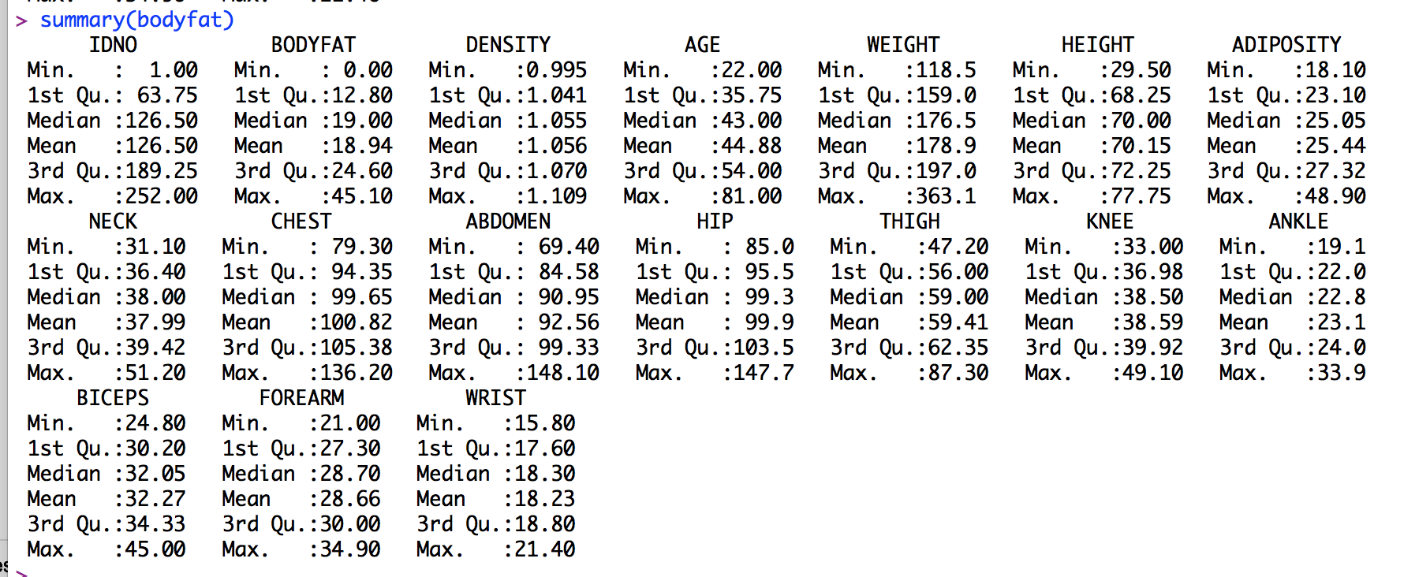
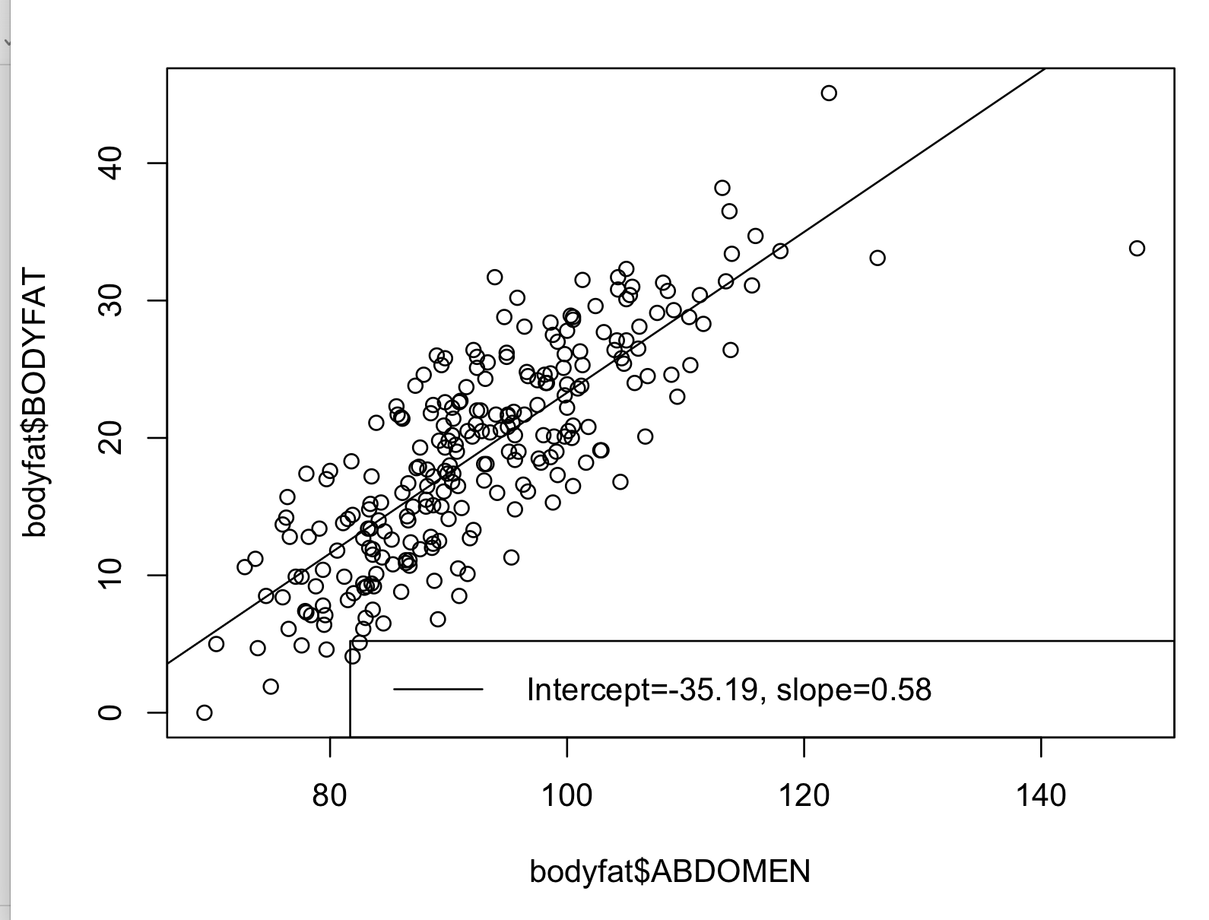
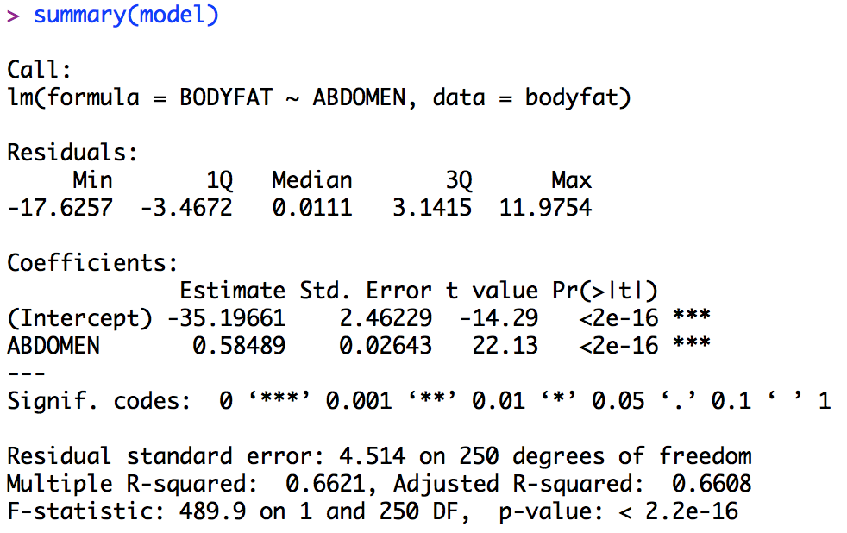
Tip 1: Readable Plots/Tables
These are all BAD examples.
It’s impossible to see
Too many numbers
Rounding issues
Solution: Create your own table highlighting exactly what you want to talk about

Slide 14
Tip 2: Duplicated/Redundant Plots
These residual plots tell the same story (of linearity and homoskedasticity)
This is Ab + Weight model
But do you know what the red line is????

Slide 15
Tip 3: Don’t Put Stuff You Don’t Know
You should know everything that’s on your slides/summary. Don’t put analysis that you don’t know.
Any idea what the dotted lines present?
Any idea what the x-axis actually is?
Or the solid red line?

Slide 16
Some Common Mistakes in Executive Reports
Tip 1: Do not spend a lot of pages/paragraphs on data cleaning
Data cleaning is very important and you should have these details in your Github.
But, for an executive summary, your model description and rationale behind it is far more important than how the data was cleaned.
Tip 2: Remove redundant or useless plots/tables/etc.
If you are not going to talk about number X in the table (or plot), don’t put X in the executive summary!!!!
Tip 3: Proofread your work!!

