Slide 1


Slide 2


Slide 3


Slide 4


Slide 5


Slide 6
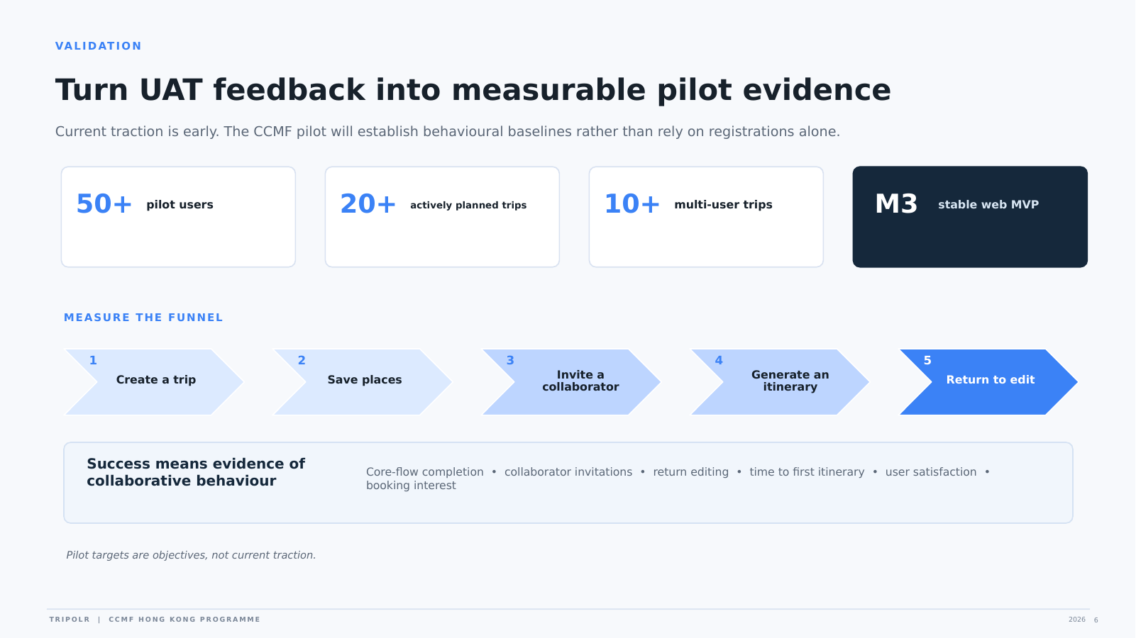

Slide 7


Slide 8


Slide 9
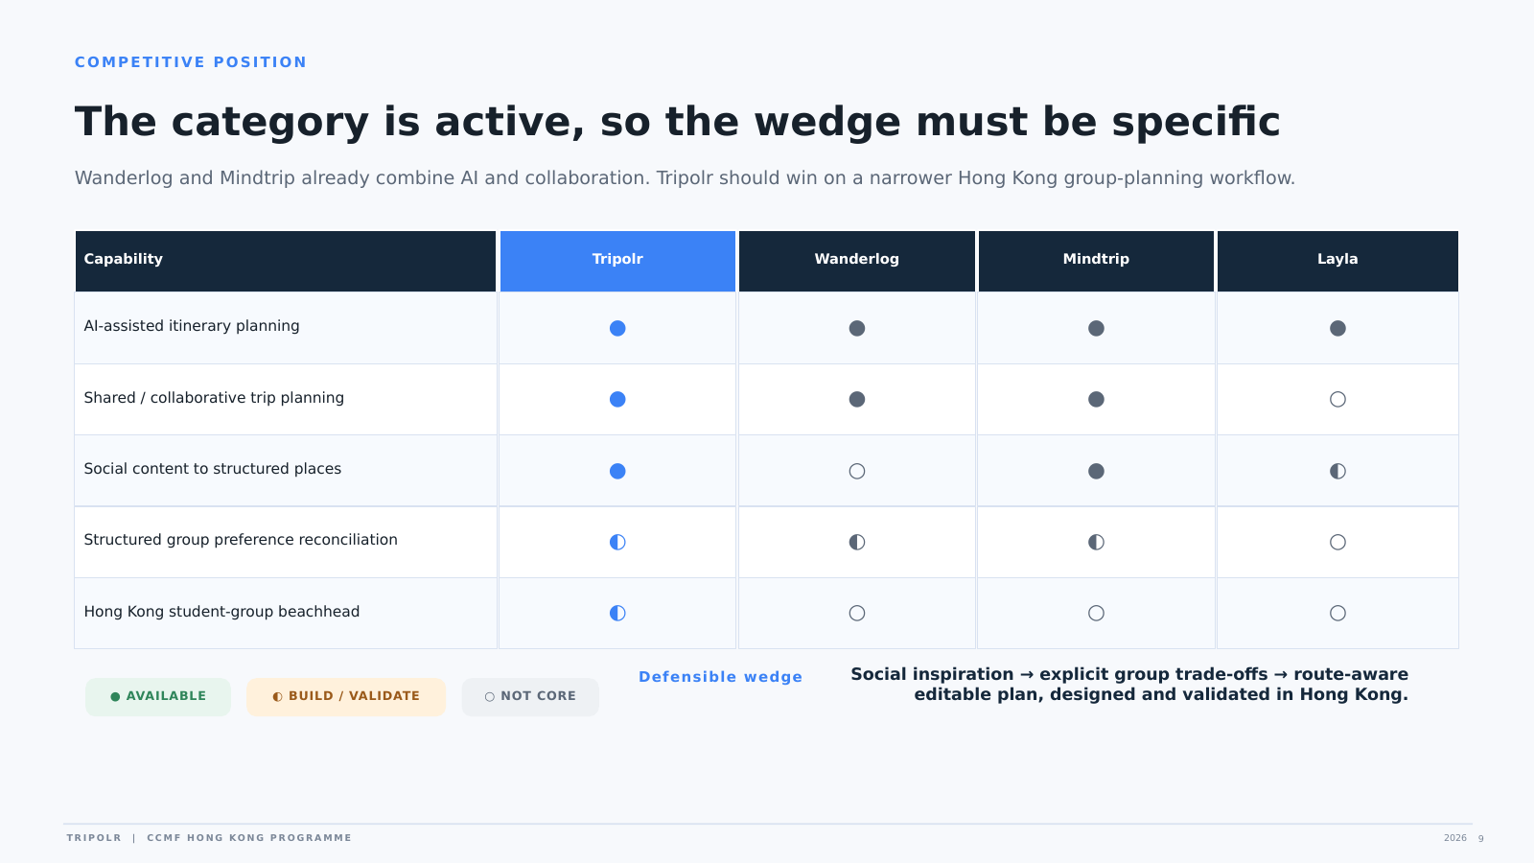

Slide 10


Slide 11
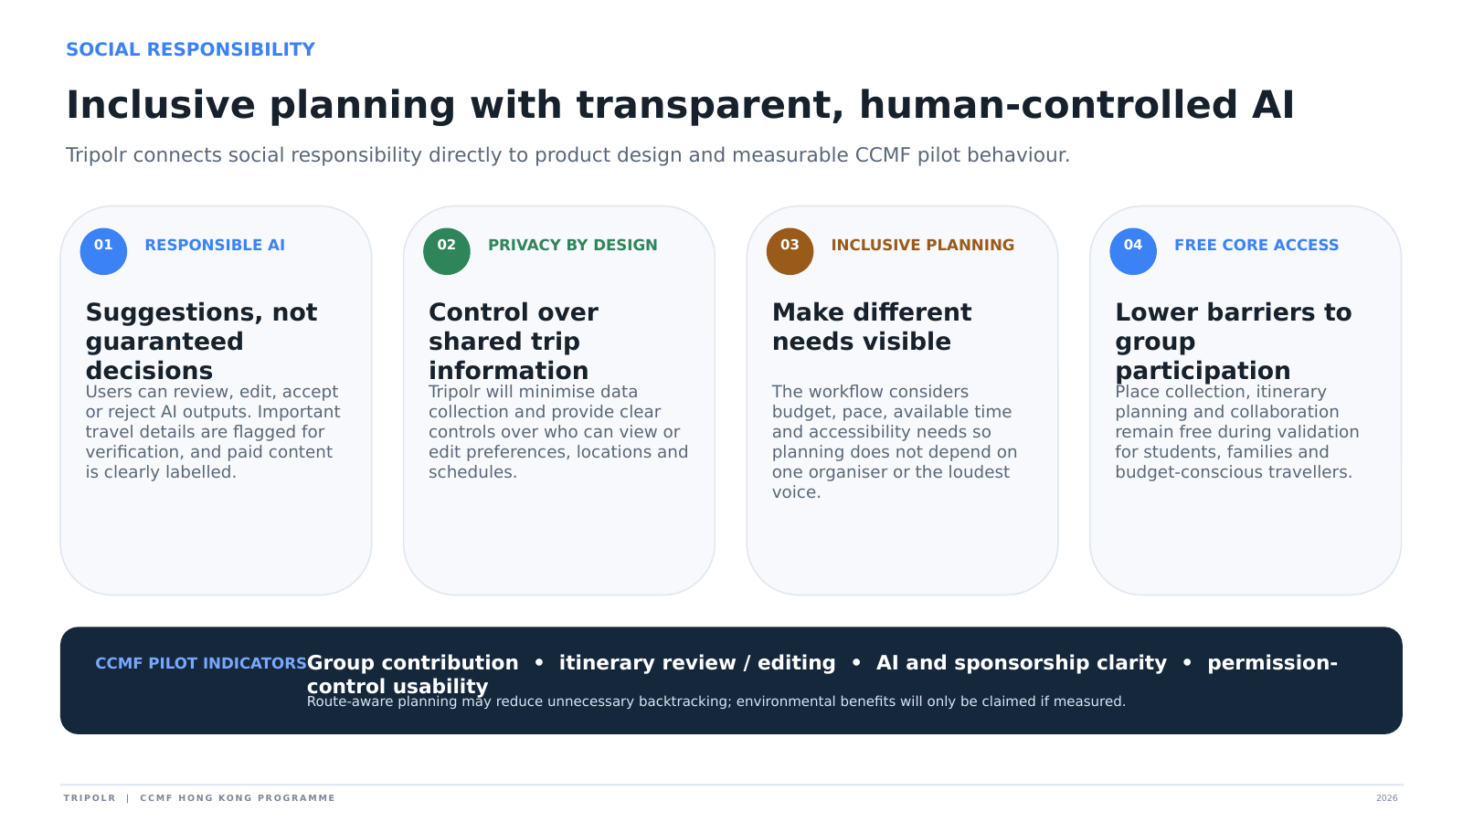
Notes:
[Sources] Social-responsibility commitments and pilot measures are based on the revised Tripolr CCMF application description. CCMF Social Responsibility is a formal vetting criterion weighted at 10%. [/Sources]

Slide 12


Slide 13
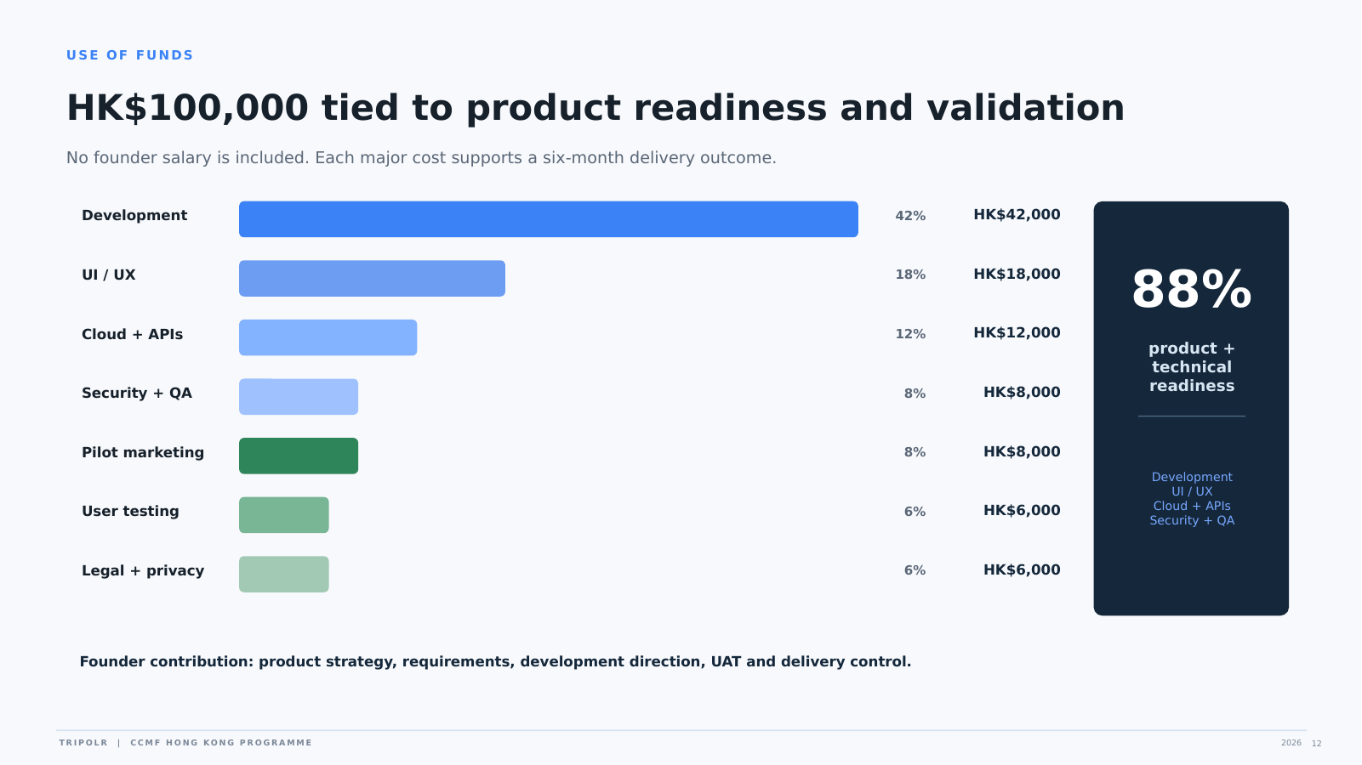

Slide 14


Slide 15


