Slide 1
Cyberport Creative Micro Fund
Cyberport Creative Micro Fund · PITCH DECK
Tripolr
.
Plan together. Book once. Travel better.
The collaborative AI travel planner — turning ideas into bookable, optimised itineraries for travelers.
Hadrian Yuen Chi Wang · Founder & CEO · chiwangyuen@gmail.com · +852 9707 1013

Slide 2
PROBLEM
Group travel planning breaks between inspiration and action
The issue is not a lack of travel content. It is the manual work required to turn scattered inputs into one agreed, workable plan.
1 DISCOVER
2 COORDINATE
3 BUILD
Ideas arrive everywhere
The group negotiates manually
Someone assembles the trip
Instagram, Threads, maps and booking sites each contribute different information.
Messages, notes and spreadsheets carry preferences, budgets and approvals.
Places must be checked, ordered and converted into a realistic itinerary.
SOCIAL • MAPS • BOOKING
CHAT • NOTES • SHEETS
VERIFY • ROUTE • EDIT
THE OPPORTUNITY
Connect discovery, group decisions and itinerary building in one shared workflow.
Notes:
[Sources] Problem framing is based on founder observations and initial UAT; further structured validation is planned during CCMF. [/Sources]

Slide 3
BEACHHEAD MARKET
Start with one reachable group-planning segment
University student groups first; family use cases follow after the core journey is simplified.
INITIAL BEACHHEAD
CURRENT EVIDENCE
SECOND SEGMENT
Hong Kong university students
planning outbound trips with friends
~10
Hong Kong families
initial testers
Validate after the core workflow is stable.
✓
Social-media-led discovery
✓
Collaborative decisions
Learning so far
Different ages and interests
✓
Budget and schedule constraints
Core functions work. The journey needs to be simpler and more intuitive.
Accessibility and travel pace
✓
Reachable through campus communities
Higher need for reliable schedules
CCMF validation question: Do groups return to plan and edit a real trip together?
Notes:
[Sources] Tester count and UAT learning supplied by Tripolr founder. Target segment and validation sequence are project strategy assumptions to be tested during CCMF. [/Sources]

Slide 4
MARKET EVIDENCE
Travel demand is large, while planning remains fragmented
Use market evidence to validate the problem, not to overstate Tripolr's obtainable revenue.
104.7M
5+ hrs
141
HK resident departures in 2024
average travel research time
pages viewed before booking
110.6% of the 2019 level. This measures departures, not unique trips.
Across seven surveyed markets during the 45 days before booking.
Average across seven markets. U.S. travellers reached 277 pages.
WHAT THIS SUPPORTS
A high-frequency outbound market and a research-heavy digital journey create room for a simpler collaborative workflow.
CCMF focus: prove adoption with Hong Kong student groups before making broader market-share claims.
Notes:
[Sources] Hong Kong resident departures: ITE Hong Kong, Hong Kong Outbound Report, 17 July 2025, citing UNWTO Tourism Barometer May 2025. https://www.itehk.com/travelexpo/doc/press/HK_Outbound_Report-Jul25_en.pdf Travel research time and page views: Expedia Group and Luth Research, Path to Purchase, 25 July 2023. https://www.expedia.com/newsroom/eg-path-to-purchase-research/ [/Sources]

Slide 5
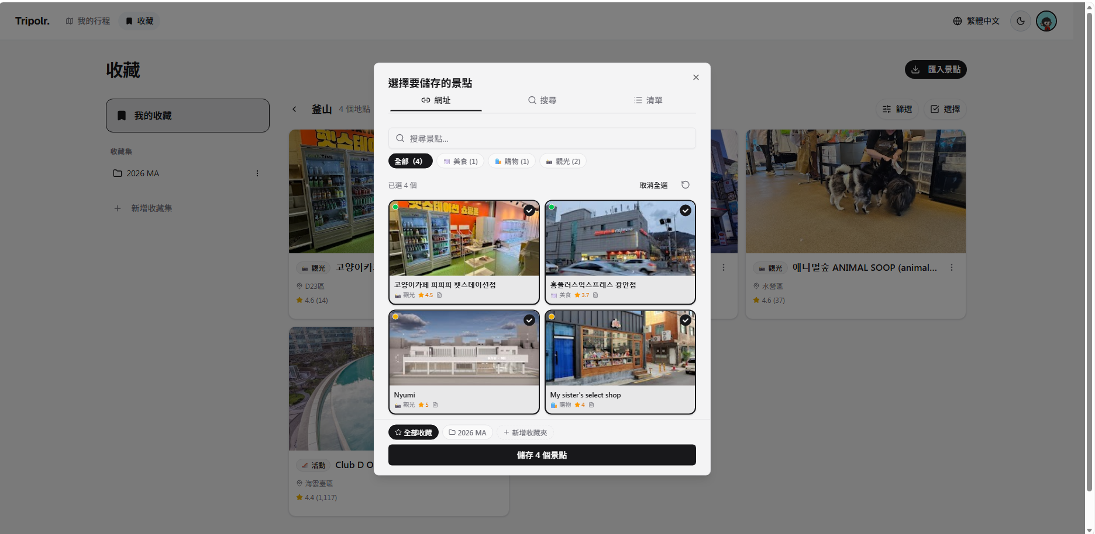
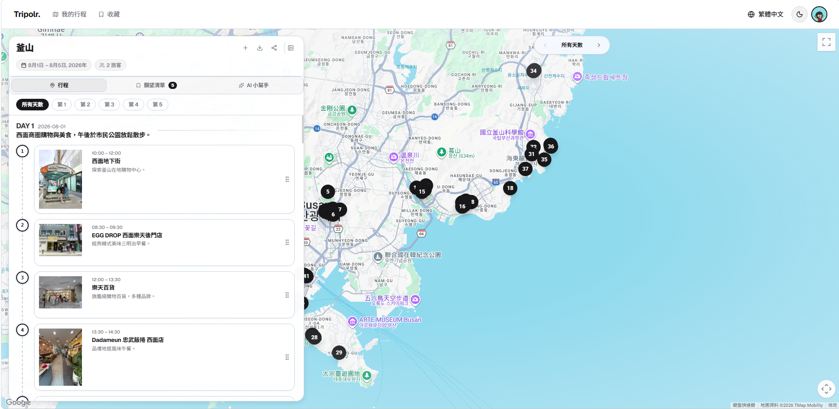
PRODUCT
Show the complete journey at presentation scale
Two full-width prototype views demonstrate the core value without shrinking interface text into small cards.
01
Capture travel inspiration
02
Create an editable itinerary
Extract a supported social post into structured place information.
Turn selected places into a practical plan that the group can review and edit.
AVAILABLE IN CURRENT PROTOTYPE
Place saving • social extraction • AI itinerary generation • real-time collection • collaborative editing
Notes:
[Sources] Product screenshots supplied by Tripolr founder. Current feature status supplied by Tripolr founder. [/Sources]

Slide 6
VALIDATION
Turn UAT feedback into measurable pilot evidence
Current traction is early. The CCMF pilot will establish behavioural baselines rather than rely on registrations alone.
50+
pilot users
20+
actively planned trips
10+
multi-user trips
M3
stable web MVP
MEASURE THE FUNNEL
1
2
3
4
5
Create a trip
Save places
Invite a collaborator
Generate an itinerary
Return to edit
Success means evidence of collaborative behaviour
Core-flow completion • collaborator invitations • return editing • time to first itinerary • user satisfaction • booking interest
Pilot targets are objectives, not current traction.
Notes:
[Sources] Pilot targets are proposed objectives in the revised CCMF application and are not current traction figures. [/Sources]

Slide 7
CREATIVITY & INNOVATION
AI for group decisions, not only itinerary text
Tripolr combines structured inputs, practical constraints and human-controlled collaboration.
INPUT
STRUCTURE
DECIDE
PLAN
ADAPT
→
→
→
→
Social links
Saved places
Manual entry
Extract + normalise
Match locations
Check data
Group preferences
Budget + pace
Time constraints
AI assistance
Route checks
Editable itinerary
Partial replanning
Alternatives
User approval
CURRENT
Social-to-trip extraction
CCMF BUILD
Preference reconciliation
Turns supported social content into reusable place data.
Makes group trade-offs visible and supports balanced decisions.
CCMF BUILD
Constraint-aware planning
CCMF BUILD
Partial replanning
Combines selected places with time, location and travel constraints.
Changes affected activities while preserving accepted choices.
Notes:
[Sources] Current and planned capabilities supplied by Tripolr founder and clarified in the revised CCMF application. [/Sources]

Slide 8
COMPETITIVE POSITION
Where Tripolr wins — the white space nobody owns.
AI-NATIVE GENERATION
ChatGPT
Tripolr
OUR WEDGE
Mindtrip
Multiplayer canvas
+ AI-native generation
+ Social-media extraction
+ APAC localisation
Layla
THE WHITE SPACE
Wonderplan
SINGLE-PLAYER
MULTIPLAYER
Wanderlog has multiplayer but no AI. Mindtrip & Layla are AI-first but US-centric and weak on group editing. Trip.com & Klook AI route only their own inventory. Nobody has all four.
Wanderlog
TripIt
MANUAL ENTRY
NOT COMPETITORS — CHANNEL PARTNERS: Klook · Trip.com · Booking.com · Agoda · GetYourGuide · Viator pay us 4–10% commission to send qualified, high-intent travelers.
Notes:
[Sources] Wanderlog official website and AI assistant page, accessed 22 July 2026: https://wanderlog.com/ and https://wanderlog.com/trip-plan-assistant/ Mindtrip official website, accessed 22 July 2026: https://mindtrip.ai/home Layla official website, accessed 22 July 2026: https://layla.ai/ Competitor capabilities can change. The table uses conservative public-feature descriptions and should be rechecked near submission. [/Sources]

Slide 9
COMPETITIVE POSITION
The category is active, so the wedge must be specific
Wanderlog and Mindtrip already combine AI and collaboration. Tripolr should win on a narrower Hong Kong group-planning workflow.
Capability
Tripolr
Wanderlog
Mindtrip
Layla
AI-assisted itinerary planning
●
●
●
●
Shared / collaborative trip planning
●
●
●
○
Social content to structured places
●
○
●
◐
Structured group preference reconciliation
◐
◐
◐
○
Hong Kong student-group beachhead
◐
○
○
○
Defensible wedge
Social inspiration → explicit group trade-offs → route-aware editable plan, designed and validated in Hong Kong.
● AVAILABLE
◐ BUILD / VALIDATE
○ NOT CORE
Notes:
[Sources] Wanderlog official website and AI assistant page, accessed 22 July 2026: https://wanderlog.com/ and https://wanderlog.com/trip-plan-assistant/ Mindtrip official website, accessed 22 July 2026: https://mindtrip.ai/home Layla official website, accessed 22 July 2026: https://layla.ai/ Competitor capabilities can change. The table uses conservative public-feature descriptions and should be rechecked near submission. [/Sources]

Slide 10
BUSINESS MODEL
Planning stays free. Revenue follows validated booking intent.
Tripolr will test one monetisation hypothesis before expanding into additional channels.
1
VALIDATE
2
REFER
3
INTEGRATE
4
EXPAND
Free planning + collaboration
Selected high-intent categories
Direct travel partnerships
Separately validated options
›
›
›
Measure usage, retention and booking interest
Affiliate or referral links
Deeper booking connections
Sponsored placements + B2B
FIRST COMMERCIAL HYPOTHESIS
Groups that complete a collaborative itinerary will show stronger intent to book relevant travel services.
All sponsored or paid content will be clearly labelled.
Notes:
[Sources] Business model and phased monetisation approach are project assumptions to be tested after core product validation. [/Sources]

Slide 11
GO TO MARKET & ROADMAP
Launch the stable MVP in Month 3, then validate behaviour
A focused, product-led pilot keeps acquisition costs low and learning speed high.
M1
M2
M3
M4
M5
M6
Research + scope
UX + quality
Stable web MVP
Collaboration
Focused pilot
Refine + plan
Prioritised UAT backlog
Core journey and bug fixes
Pilot-ready release
Preferences + partial replanning
50+ users and usage data
Evaluation and launch plan
PILOT CHANNELS
Student societies • university communities • personal and alumni networks • travel communities • user invitations
Milestone: market-testable web MVP within three months of funding commencement.
Notes:
[Sources] Roadmap and pilot channels are proposed in the revised CCMF application. CCMF prefers projects able to launch within three months after grant disbursement: Cyberport Hong Kong Programme webpage, accessed 22 July 2026. [/Sources]

Slide 12
SOCIAL RESPONSIBILITY
Inclusive planning with transparent, human-controlled AI
Tripolr connects social responsibility directly to product design and measurable pilot behaviour.
RESPONSIBLE AI
PRIVACY BY DESIGN
INCLUSIVE PLANNING
FREE CORE ACCESS
Suggestions, not guaranteed decisions
Control over shared trip information
Make different needs visible
Lower barriers to participation
Users review, edit, accept or reject AI outputs. Important details are flagged for verification and paid content is labelled.
Minimise data collection and provide clear controls over who can view or edit preferences, locations and schedules.
Consider budget, pace, time and accessibility so planning does not depend on one organiser or the loudest voice.
Core place collection, itinerary planning and collaboration remain free during validation.
CCMF PILOT INDICATORS
Group contribution • itinerary review • AI clarity • permission-control usability
Route efficiency is a potential practical benefit. Environmental impact will only be claimed if measured.

Slide 13
USE OF FUNDS
HK$100,000 tied to product readiness and validation
No founder salary is included. Each major cost supports a six-month delivery outcome.
Development
42%
HK$42,000
UI / UX
18%
HK$18,000
88%
Cloud + APIs
12%
HK$12,000
product +
technical readiness
Security + QA
8%
HK$8,000
Pilot marketing
8%
HK$8,000
Development
UI / UX
Cloud + APIs
Security + QA
User testing
6%
HK$6,000
Legal + privacy
6%
HK$6,000
Founder contribution: product strategy, requirements, development direction, UAT and delivery control.
Notes:
[Sources] Funding allocation supplied by Tripolr founder and converted from percentages into HKD amounts. CCMF grant amount of up to HK$100,000: Cyberport Hong Kong Programme webpage, accessed 22 July 2026. [/Sources]

Slide 14
FOUNDER & EXECUTION
The founder has already delivered the first deployed prototype
CCMF support adds specialist capacity without transferring product ownership.
1
Delivery discipline
2 years in business analysis across banking and insurance
YCW
2
Product practice
Requirements, stakeholders, UAT and process improvement
Yuen Chi Wang
Founder & Project Lead
3
Technical capability
Next.js, FastAPI, PostgreSQL, Docker and Cloudflare Tunnel
30 hours / week dedicated to Tripolr
Built and deployed the current web prototype with AI coding-agent support.
Founder-owned: priorities, requirements, product, UAT and acceptance
DELIVERY MODEL
Specialist-supported: UI/UX, security, QA and selected development deliverables
Notes:
[Sources] Founder background, technology stack, commitment and prototype status supplied by Tripolr founder. [/Sources]

Slide 15
TRIPOLR
From a working prototype
to validated group behaviour.
With CCMF support, Tripolr will release a stable web MVP within three months and complete a focused market-validation pilot within six months.
M3
M6
OUTCOME
AI-assisted itinerary generation
Stable web MVP
50+ user pilot
Evidence for launch
Yuen Chi Wang | Founder & Project Lead
uat.tripolr.com
Notes:
[Sources] Product screenshot supplied by Tripolr founder. Three-month MVP and six-month pilot targets are proposed outcomes in the revised CCMF application. [/Sources]

