Slide 1
QR Code Recognition Based On Image Processing
Yunhua Gu, Weixiang Zhang, IEEE

Slide 2
Outline
Introduction
Recognition Based On Image Processing
Experiment Results
Conclusion

Slide 3
Introduction
To solve the QR code recognition problem caused by ordinary camera collection, the recognition algorithm based on image processing is put forward in this paper.

Slide 4
Introduction
The whole process including image binarization, image tilt correction, image orientation, image geometric correction and image normalization allows images collected on different illumination conditions, different acquisition angles to be quickly identified.

Slide 5
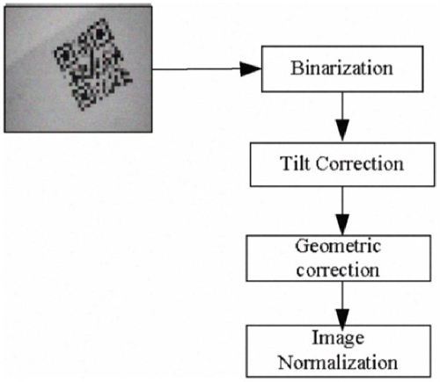
Recognition Based On Image Processing
Fig-1. Recognition Process

Slide 6
Image Binarization
The reference[7] points out that Niblack method is the best method comparing a variety of local threshold algorithm.
But it is very difficult to set an appropriate window size on the way, has great influence on the modules, and also takes too much time.

Slide 7
Image Binarization
The reference[8] used a block thresholds method combined SOM neural network with the Niblack algorithm for binarization.
The reference[9] proposes a binarization method based on surface fitting technology using two-dimensional second-order polynomial fitting way to make the QR code background image of the surface fitting, and image segmentation.

Slide 8
Image Binarization
The reference[10] advises to judge the light intensity by calculating the histogram of gray image bar code, removing noise by median filter and analyzing the peak feature of the histogram.
We choose the global threshold method(OTSU method) in ordinary light condition while a local threshold method(adaptive threshold) is used in the uneven light condition.

Slide 9
Tilt Correction
The reference[10] proposed algorithm that hollows out internal points of the bar code, then gets the edge information and peaks and slope detection of bar code with Hough transform over a known point.
The references[11] and [12] look for position detection patterns before decoding by using opening operation and closing operation in morphological image processing.

Slide 10
Tilt Correction
The reference[13] uses OTSU method for binarization, extracts edge of QR code via gradient method and uses the Hough transform to locate after decreasing image resolution.
The reference[14] proposes a quick location method for the QR code symbol using one-dimensional pattern match based on the specific mode of the position detection patterns of the code.

Slide 11
Tilt Correction
The reference[16] draws the concept of convex hull in computational geometry into locating bar code through in case of Data Matrix.
This algorithm can locate two-dimensional bar code effectively under the distorted or tilted situation.

Slide 12
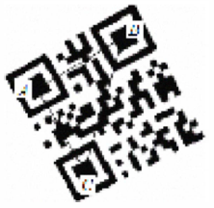
Tilt Correction
Fig-2. Position Detection
As shown in fig-2, QR code contains 3 detection patterns A, B, C with the same size and shape.

Slide 13
Tilt Correction
The detection pattern is composed of three overlapping concentric squares, the black and white of the module's ratio is 1:1:3:1:1.
The width of each module allows deviation of 0.5.

Slide 14
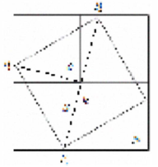
Tilt Correction
Fig-3. Rotation Correction
As shown in fig-3, S square area is the original QR code image.
N square is the area after interception.
P1, P2, P3 are the three feature points.

Slide 15
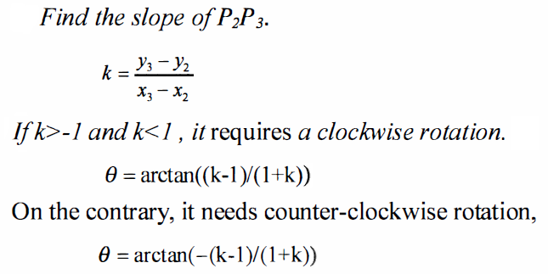
Tilt Correction
Assuming the rotation angle is θ.
Calculate Strike distance between three points and find the longest distance, suppose it is P2,P3.

Slide 16
Tilt Correction
After the center coordinate of QR code determined, to capture its square on the image center to ensure the QR code can all access.
The length of the intercepted side is at least
New Length = √2 * SourceLength * sinθ

Slide 17
Tilt Correction
Because the purpose of rotation coordinates is not necessarily integer coordinates, in order to ensure the image is not distorted, the gray value of purpose pixel needs for interpolation in the image rotation transformation.
The frequently-used methods include the nearest neighbor interpolation, bilinear interpolation and tri-linear interpolation.

Slide 18
Tilt Correction
Therefore, the bilinear interpolation is used in image rotation in this paper.
In addition, if the coordinates of QR code are not precise enough, the result is not very satisfactory, just as fig-4 shows.

Slide 19
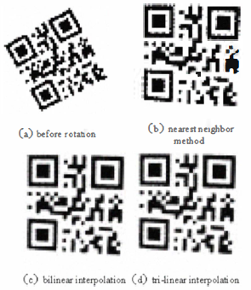
Tilt Correction
Fig-4. Comparison of Three Interpolation Methods

Slide 20
Image Geometric Correction
The image geometric distortion will emerge because of the shooting angle, image rotation and other issues.
QR code geometric distortion will bring great recognition errors and reduce the recognition rate.

Slide 21
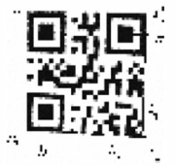
Image Geometric Correction
Distortion correction algorithm is as follows.
Obtain images of the four vertices of QR codes.
Determine the fourth vertex.
Fig-5. Calculate the Fourth Vertex

Slide 22
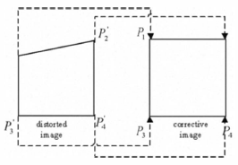
Image Geometric Correction
As shown in fig-6, P1, P2, P3, P4 are the four vertexes of the QR code image without distortion, P1’ ,P2’ ,P3’ ,P4’ are the four vertexes of the QR code for the actual image.
Fig-6. Control point transformation

Slide 23

Image Geometric Correction
By Jacobi iteration method can solve the 8 parameters a, b, c, d, m, n, p, q in above equations, and then it realizes the calibration transformation from the general quadrilateral to a square.

Slide 24
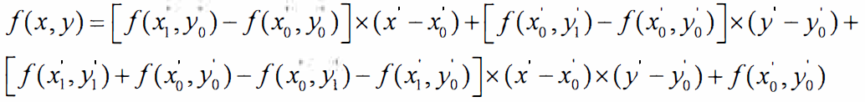
Image Geometric Correction
Then the bilinear interpolation formula is:

Slide 25
Image Normalization
Firstly, make sure the version number of the QR code based on the decoding algorithm given in the national standard and symbol structures of QR code itself.
Secondly, divide equally the QR image into n x n small grids according the version number, re-sample the center of each grid as the sampling point and get the normalized QR code symbol.

Slide 26
Image Normalization
Thirdly, decode the standard QR code symbol according the National Standard Method of Quick Response Code after image re-sampling.

Slide 27
Experiment Results
Algorithm | Average Time | Recognition Rate
OTSU | 0.005500s | 90%
Genetic algorithm use in threshold | 0.020440s
Bimodal histogram | 0.004540s | 80%
Niblack(Window size is 5) | 0.164254s

Slide 28
Experiment Results
In the same programming environment used for the time to determine the rotation angle.
As opposed to 0.104890s in general Hough transform and 0.002622s in hollowing algorithm, the time used in algorithm in this paper time 0.000427s, shortened by 245 times and 6.14 times.

Slide 29
Conclusion
In the rotation process, the QR code symbol was extracted and the surrounding noise information can be effectively eliminated.
In terms of the geometric correction, not using Hough transform, but using the coordinates of known points to infer the fourth vertex of QR code, and this method reduces the time complexity.
In terms of image normalization, using the principle of image scaling to reduce the error caused by average means.

