Slide 1


Slide 2
What You Thinking? By Organization of Programming Students
An Opinion Trivia Game

Slide 3
What is WUT?:
WUT is an opinion trivia game where there is no right or wrong answer
It is inspired by games like “Apples to Apples” and “Cards Against humanity”
3 -5 players
Make your own crazy questions!!
Choose an even crazier answer!!
Written in JAVA

Slide 4
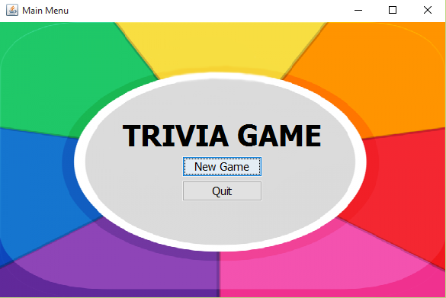
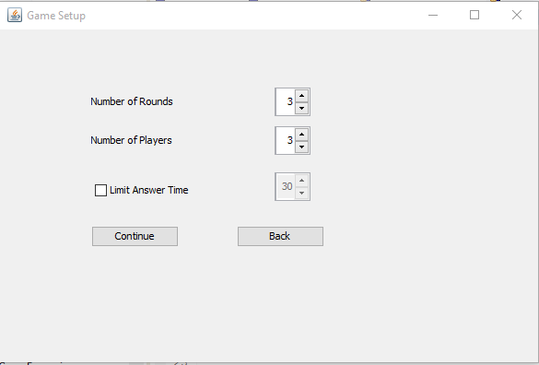
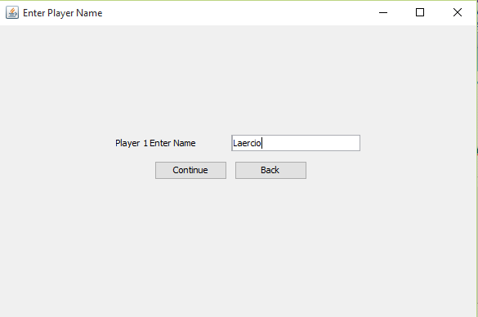
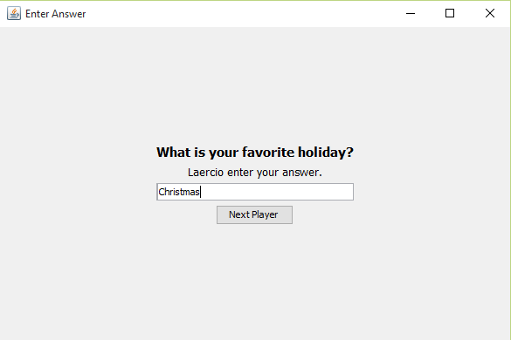
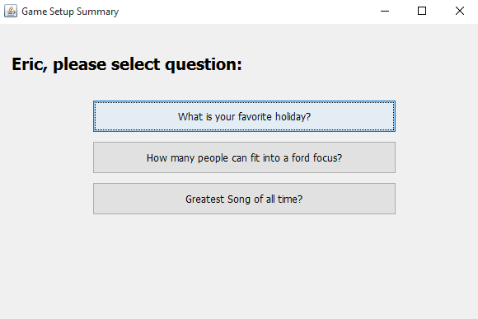
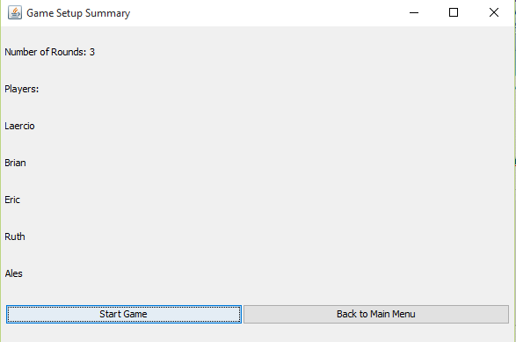
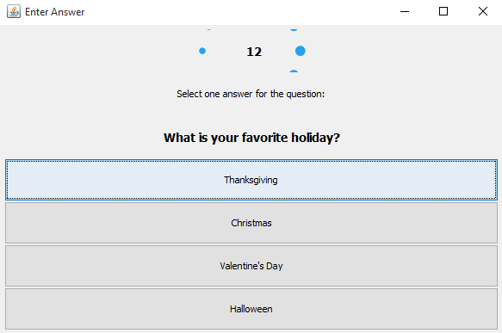
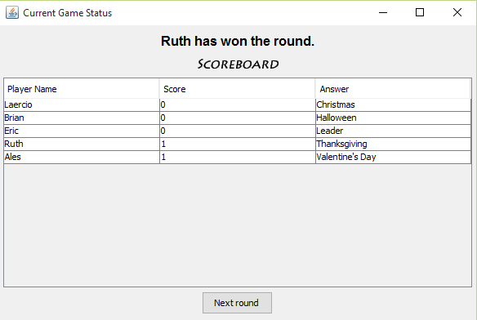
How does WUT work?

Slide 5
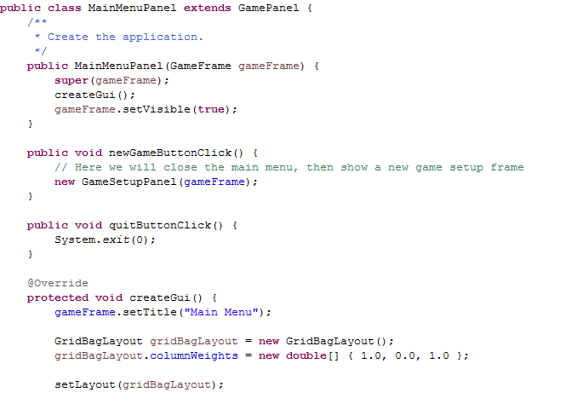
Main Screen

Slide 6
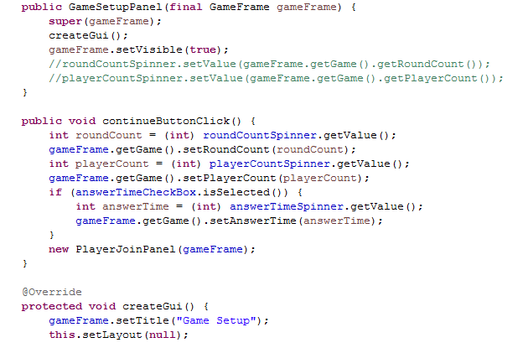
Game Setup
In the game setup screen, players can select the number of rounds (3-5), number of players (3-5), and they can limit the time they have to answer the question

Slide 7
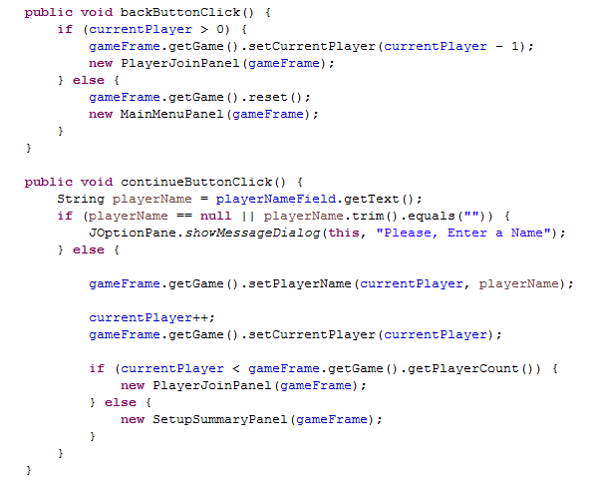
Enter Player Names
Each player is asked to enter their names,

Slide 8
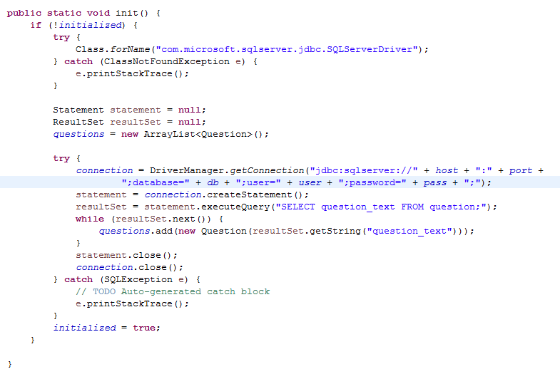
WUT? Database
Microsoft SQL Server
Database: Trivia
Table: question
Field: question_text
question_text contains all the opinion questions for the game.

Slide 9
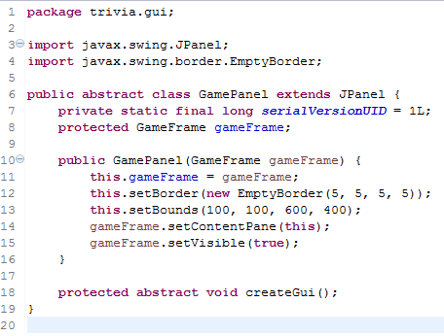
WUT? Seamless GUI Transitions
The Window and JFrame remains constant throughout the game.
The JPanels changes for each GUI screen.
Each GUI screen is a subclass of GamePanel, a subclass of JPanel.

Slide 10
WUT? Sound Effects and Graphics

Slide 11
WUT? The Organization of Programming Students
Pictures of students

Slide 12
WUT? What is Next?

