Slide 1


Slide 2
What You Thinking? By Organization of Programming Students
An Opinion Trivia Game

Slide 3
What is WUT?:
WUT is an opinion trivia game where there is no right or wrong answer
It is inspired by games like “Apples to Apples” and “Cards Against humanity”
3 -5 players
Make your own crazy questions!!
Choose an even crazier answer!!
Written in JAVA

Slide 4
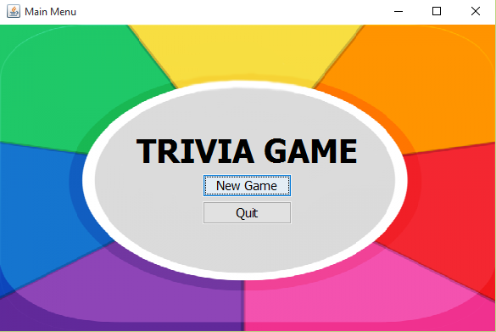
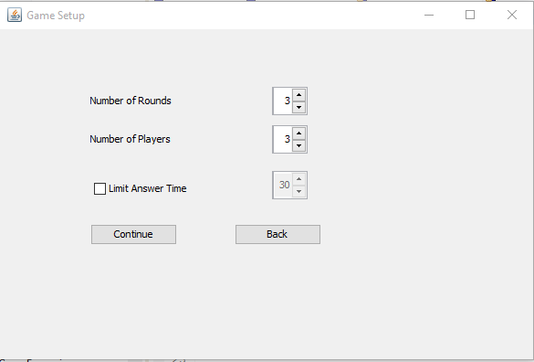
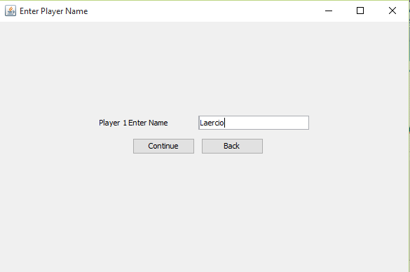
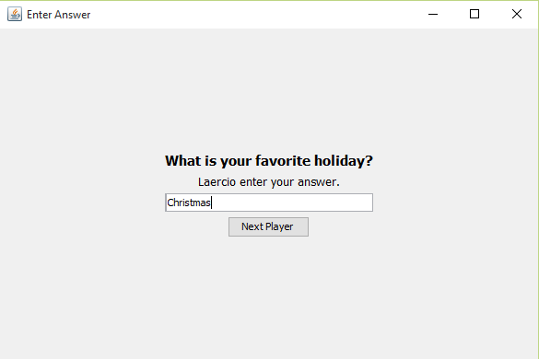
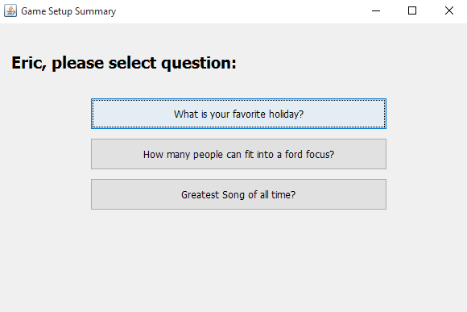
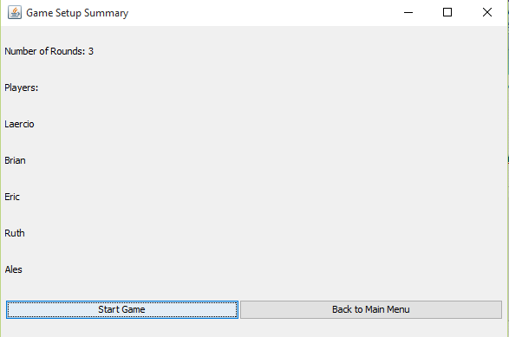
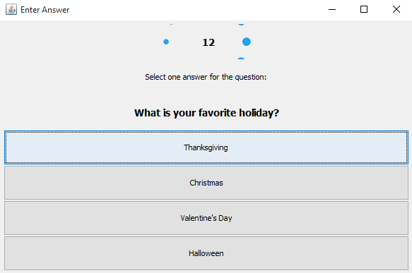
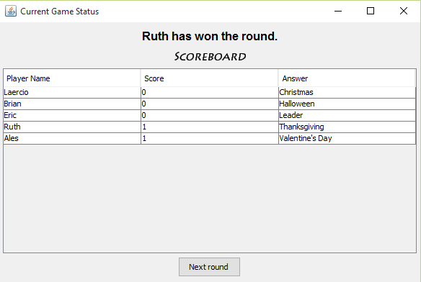
How does WUT work?

Slide 5
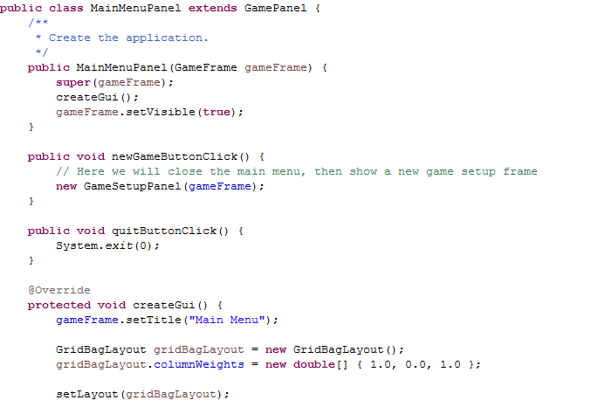
Main Screen

Slide 6
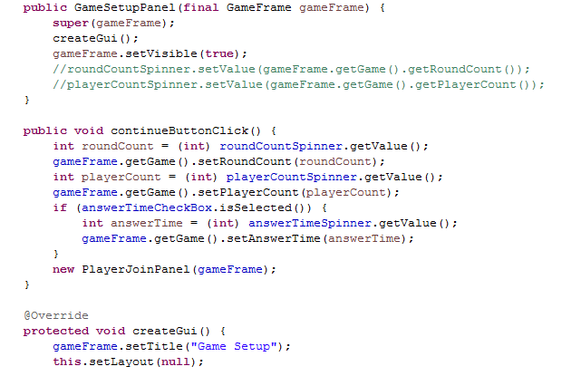
Game Setup
In the game setup screen, players can select the number of rounds (3-5), number of players (3-5), and they can limit the time they have to answer the question

Slide 7
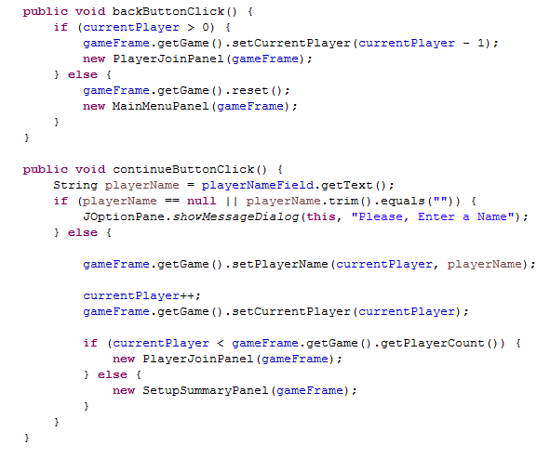
Enter Player Names
Each player is asked to enter their names,

Slide 8
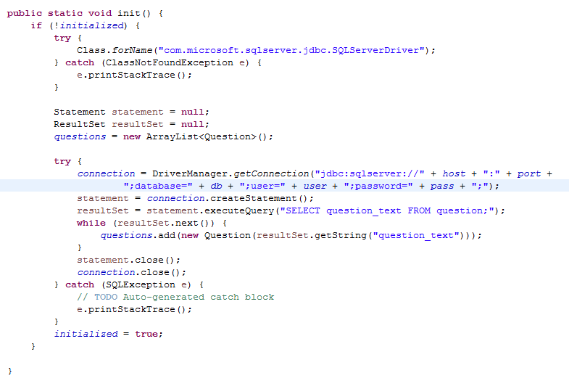
WUT? Database
Microsoft SQL Server
Database: Trivia
Table: question
Field: question_text
question_text contains all the opinion questions for the game.

Slide 9
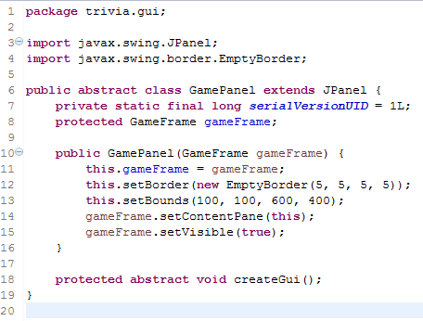
WUT? Seamless GUI Transitions
The Window and JFrame remains constant throughout the game.
The JPanels changes for each GUI screen.
Each GUI screen is a subclass of GamePanel, a subclass of JPanel.

Slide 10
WUT? Sound Effects and Graphics

Slide 11
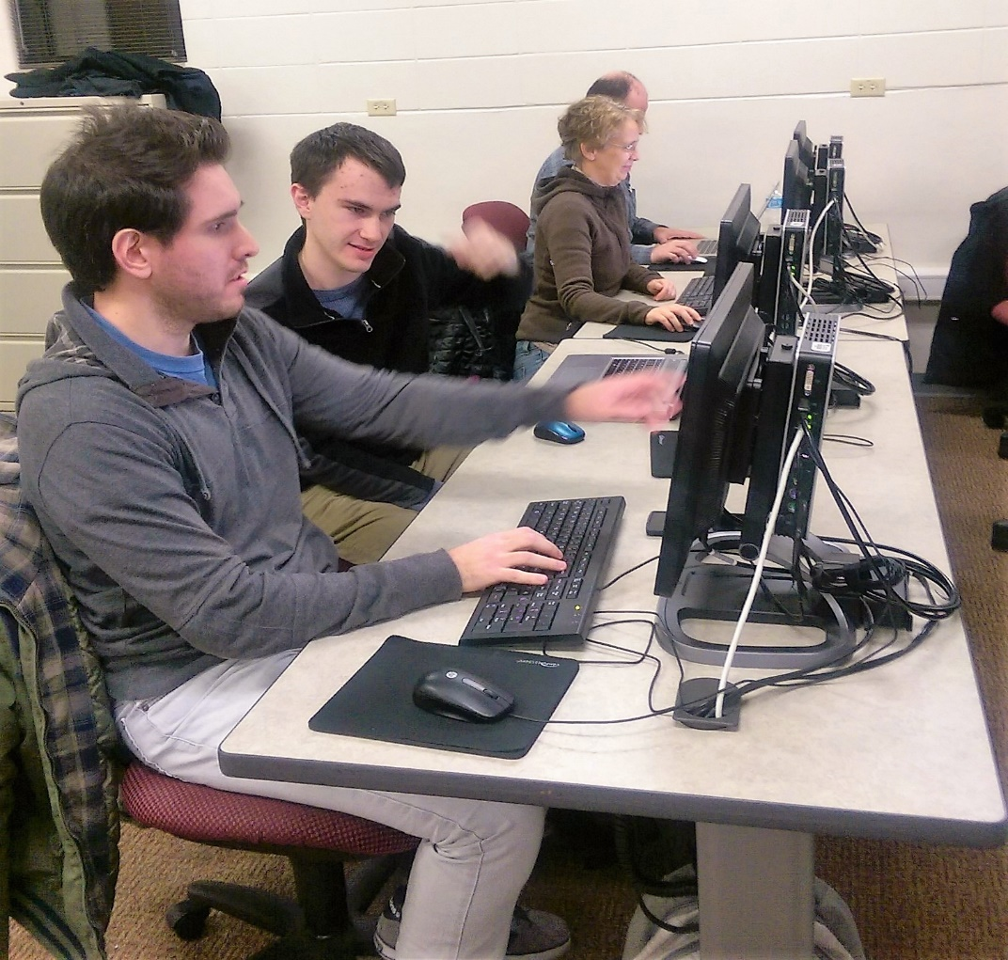
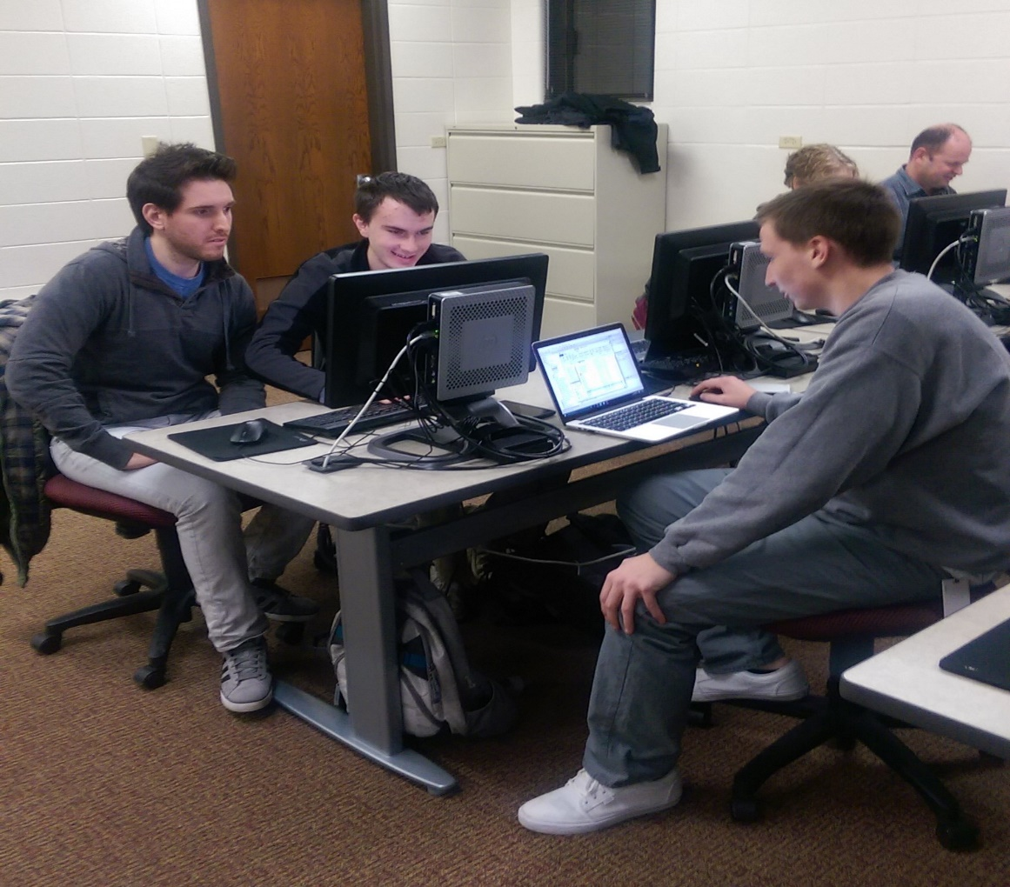
WUT? The Organization of Programming Students
Pictures of students

Slide 12
WUT? What is Next?
Expand the database
Create table for player login
Create table for answers to questions
Create table for proposed questions
Connect to the internet

