Slide 1
Project 3: Recurrent Events
1/6/25

Slide 2
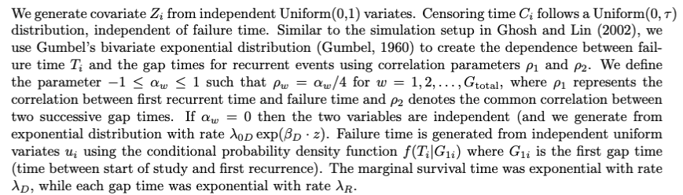
Simulation: Gumbel’s Bivariate Exp Dist

Slide 3
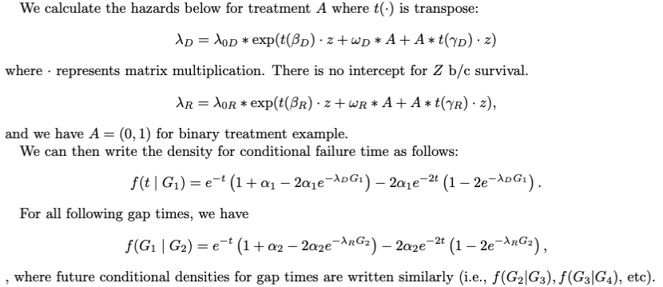
Simulation: Gumbel’s Bivariate Exp Dist

Slide 4
Parameters
tau = 5
Total Gap Times G = 5
5 covariates (mix of binary and continuous from N(0,1))
Action dependent parameters for: alpha1, alpha2, betaD, betaR, omegaD, omegaR, gammaD, gammaR (see R code)
tolerance: 0.1

Slide 5
Parameters
Number of Simulations: 50
Training Sample Size: 300
Testing Sample Size: 5000
Methods: itrSurv (us), zero-order, observed
Average training censoring rate across simulations: 27.2%
Average percentage going to phase 2 for itrSurv: 17.3%
Average percentage going to phase 2 for zom: 50%

Slide 6
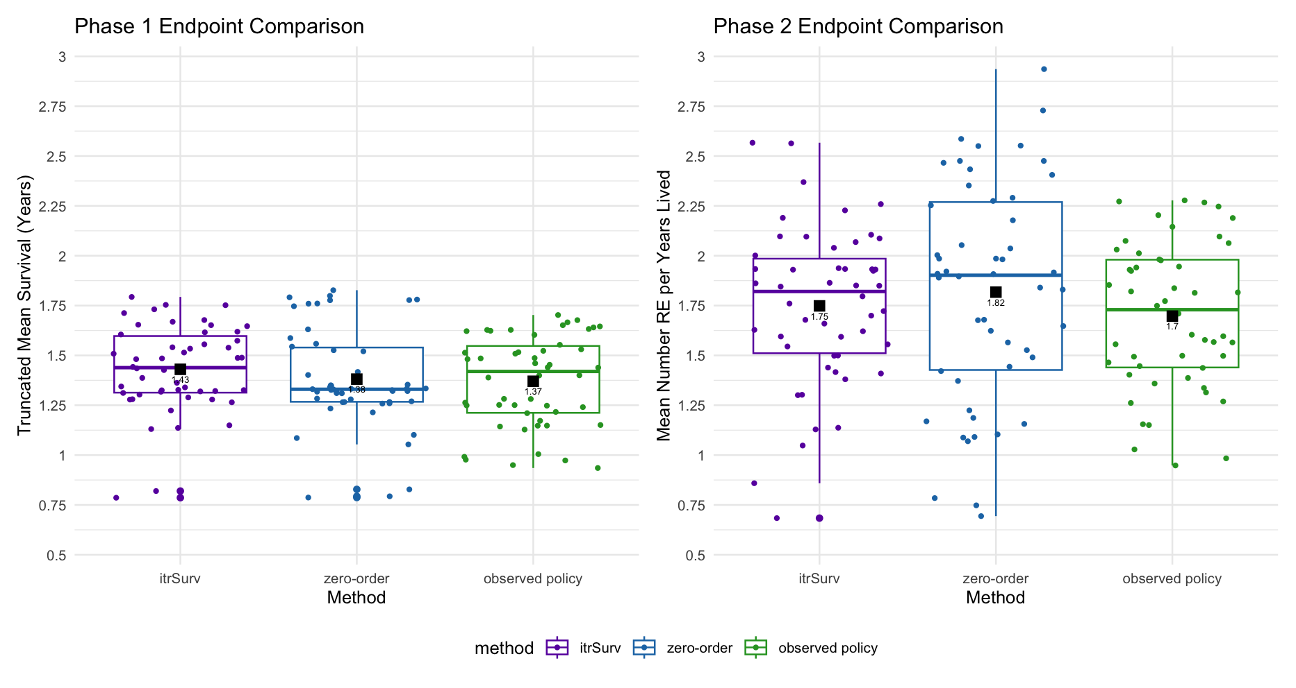
Survival Time Number of recurrent events per years lived
Notes:
# RE per year lived on right side of plot

Slide 7
Application to Bladder Cancer Recurrences
Data on recurrences of bladder cancer, originally from Wei, Lin, Weissfeld. Popular dataset to analyze for recurrences.
This dataset has 3 three treatment arms (placebo, pyridoxine, and thiotepa) and all recurrences for 116 subjects; the maximum observed number of recurrences is 9.
Covariates:
10-Fold CV analysis
MAJOR QUESTION: How to do propensity function for the evaluation/prediction? One propensity/censor weight per person? per recurrence?
How to calculate death for observed policy? recurrent events for testing dataset? Is it calculating observed failure time only for those who died?
number: | Initial number of tumours (8=8 or more)
size: | Size (cm) of largest initial tumour
recur: | Number of recurrences

Slide 8
Future Timeline
Devote Jan (30 min) meetings to Multi-Stage CR Theory, with new random draw method
DEFENSE Document put together by 2/20/25
DEFENSE Slides put together by 3/3/25
Defense: March 17, 2025 2-4pm
TO DO:
Proj2 theory
Proj2 description of what it can be applied to, example (even tho not actually applied for this project)
Proj3 sims
Proj3 rda
Proj2 write up
Proj3 write up
Defense slides
Defense document
Notes:
Get as far along as you can, and just take what u can
As close to submission when done with thesis
idea of what multistage CR could be used for, and describe.

