Slide 1
Future Timeline
Devote Jan (30 min) meetings to Multi-Stage CR Theory, with new random draw method
DEFENSE Document put together by 2/20/25
DEFENSE Slides put together by 3/3/25
Defense: March 17, 2025 2-4pm
TO DO:
Proj2 theory
Proj2 description of what it can be applied to, example (even tho not actually applied for this project)
Proj3 sims
Proj3 rda
Proj2 write up
Proj3 write up
Defense slides
Defense document
Notes:
Get as far along as you can, and just take what u can
As close to submission when done with thesis
idea of what multistage CR could be used for, and describe.

Slide 2
Project 3: Recurrent Events
1/8/25

Slide 3
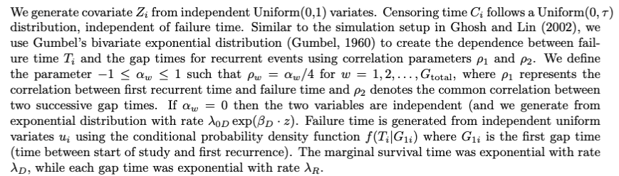
Simulation: Gumbel’s Bivariate Exp Dist

Slide 4
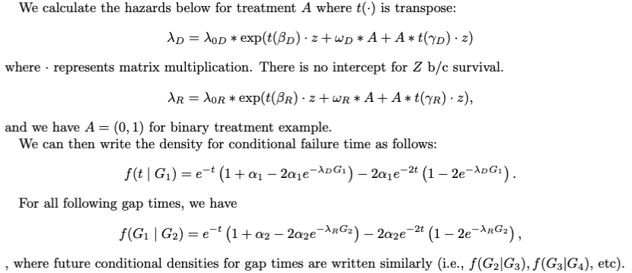
Simulation: Gumbel’s Bivariate Exp Dist

Slide 5
Setting #0
n.sim = 50

Slide 6
Parameters
tau = 5
Total Gap Times G = 5
5 covariates (mix of binary and continuous from N(0,1))
Action dependent parameters for: alpha1, alpha2, betaD, betaR, omegaD, omegaR, gammaD, gammaR (see R code)
tolerance: 0.1
Number of Simulations: 50
Training Sample Size: 300
Testing Sample Size: 5000
Methods: itrSurv (us), zero-order, observed
Notes:
Date: 2025-01-07

Slide 7
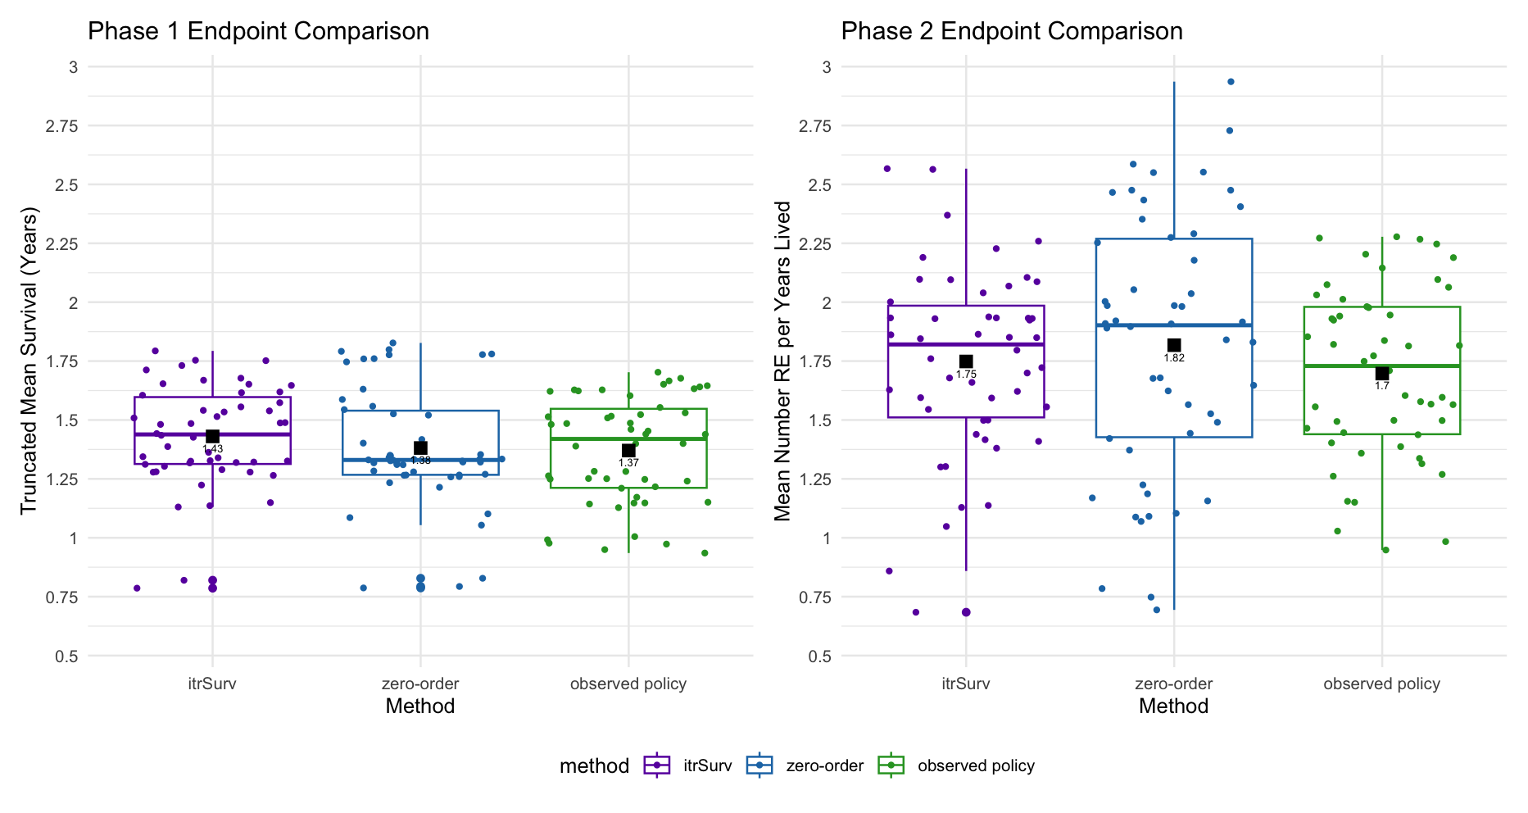
Survival Time Number of recurrent events per years lived
Notes:
# RE per year lived on right side of plot

Slide 8
Setting #1
G = 5

Slide 9
Parameters
tau = 5
Total Gap Times G = 5
5 covariates (mix of binary and continuous from N(0,1))
Action dependent parameters for: alpha1, alpha2, betaD, betaR, omegaD, omegaR, gammaD, gammaR (see R code)
tolerance: 0.1
Number of Simulations: 200
Training Sample Size: 300
Testing Sample Size: 5000
Average training censoring rate across simulations: 24.2%
Average percentage going to phase 2 for itrSurv: 15%
Average percentage going to phase 2 for zom: 31%
Notes:
Date: 2025-01-06

Slide 10
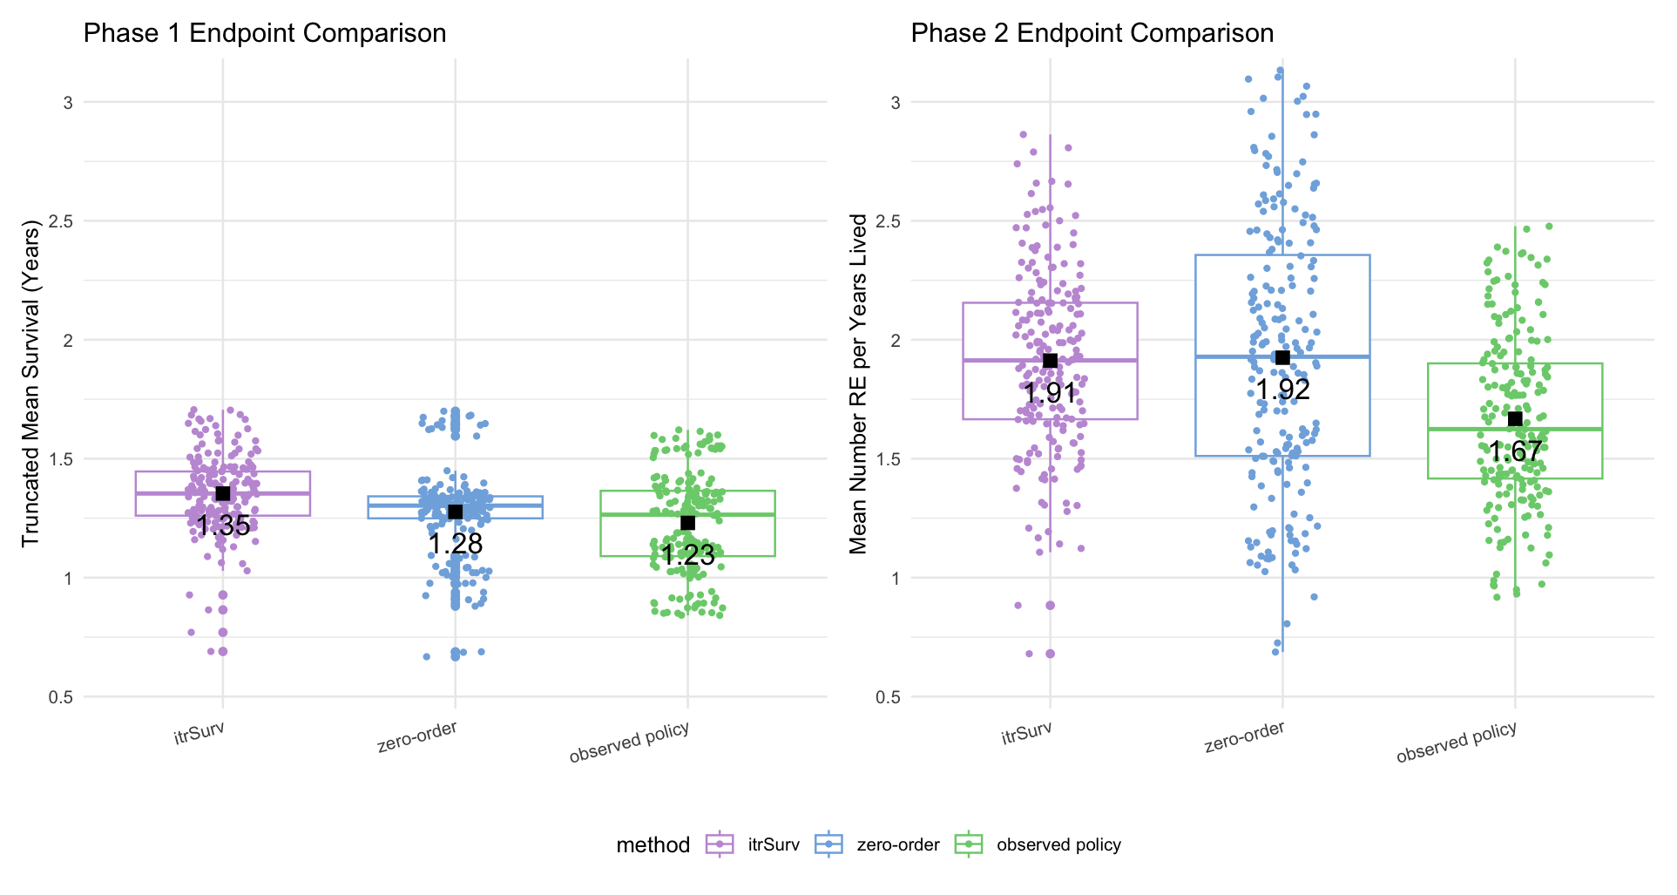
Notes:
# RE per year lived on right side of plot

Slide 11
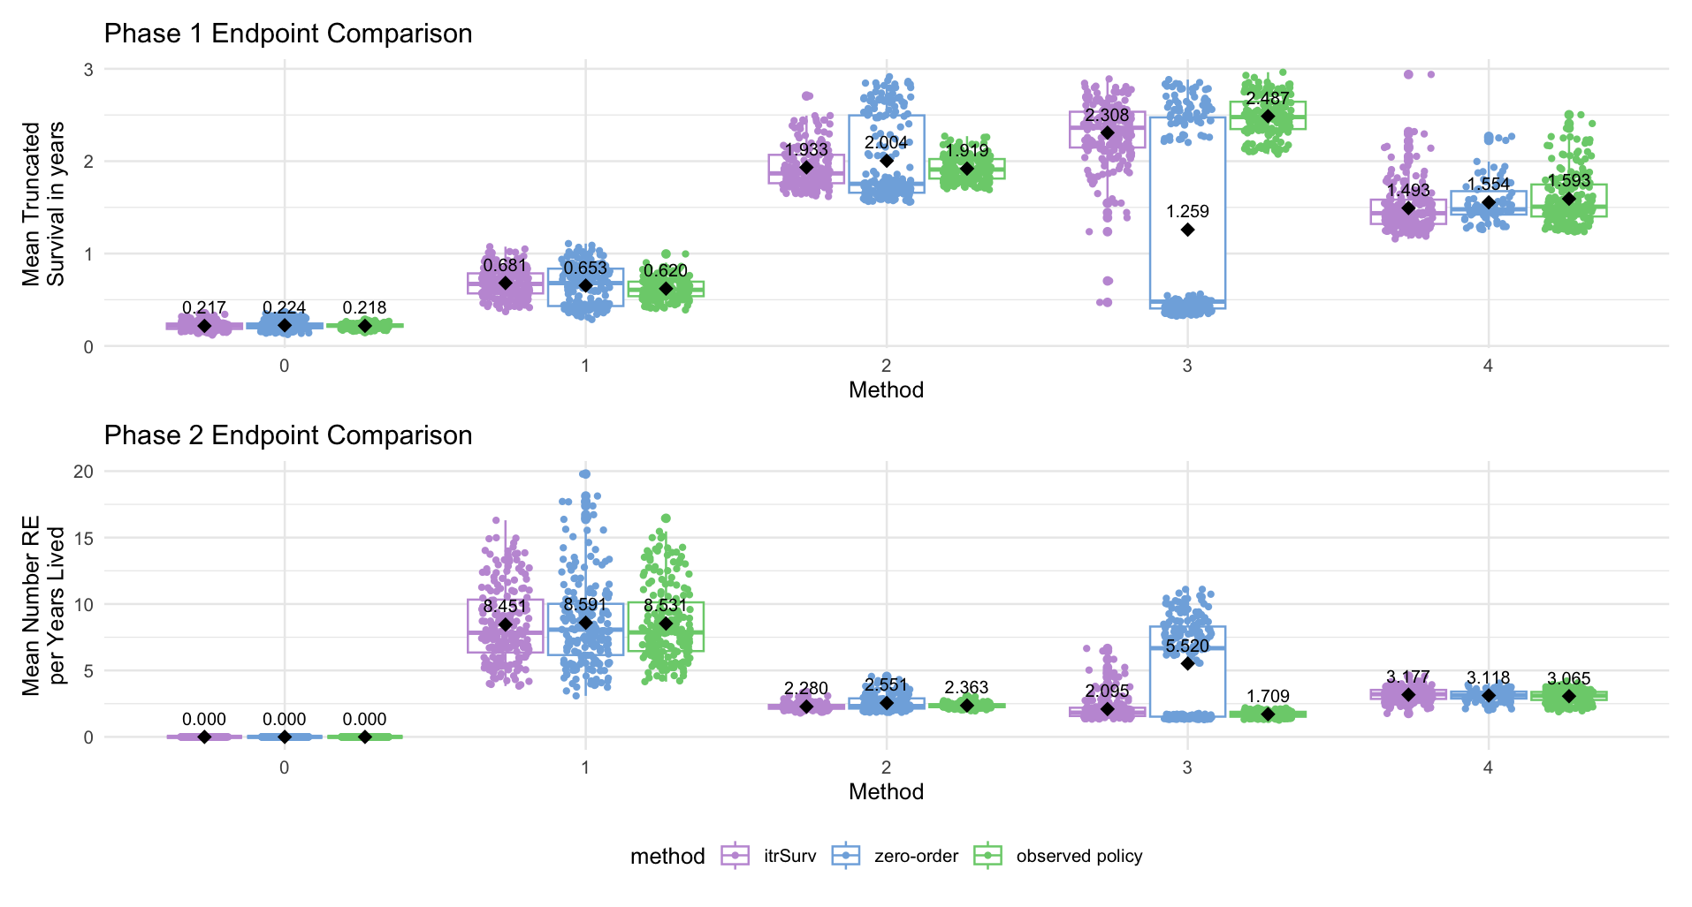

Slide 12
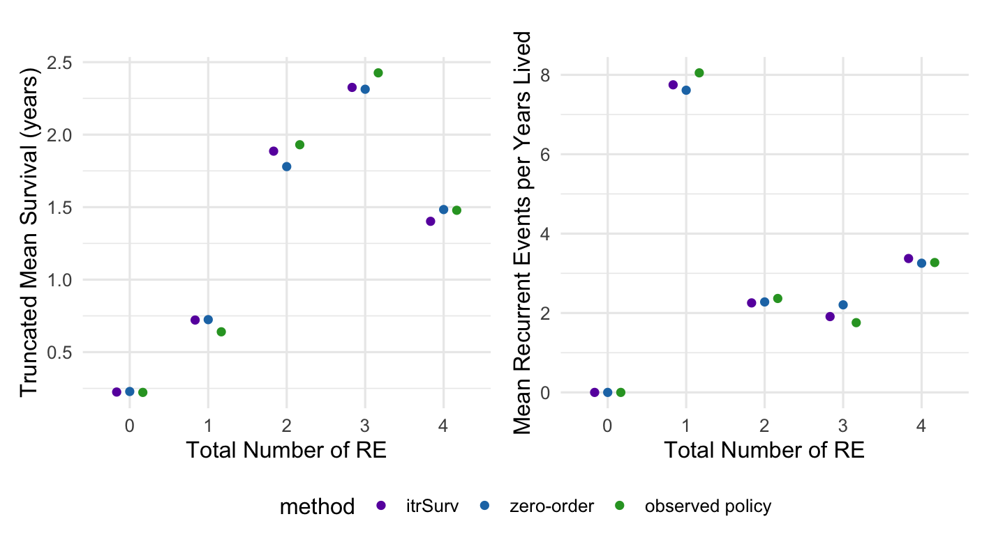
Mean across Simulations

Slide 13
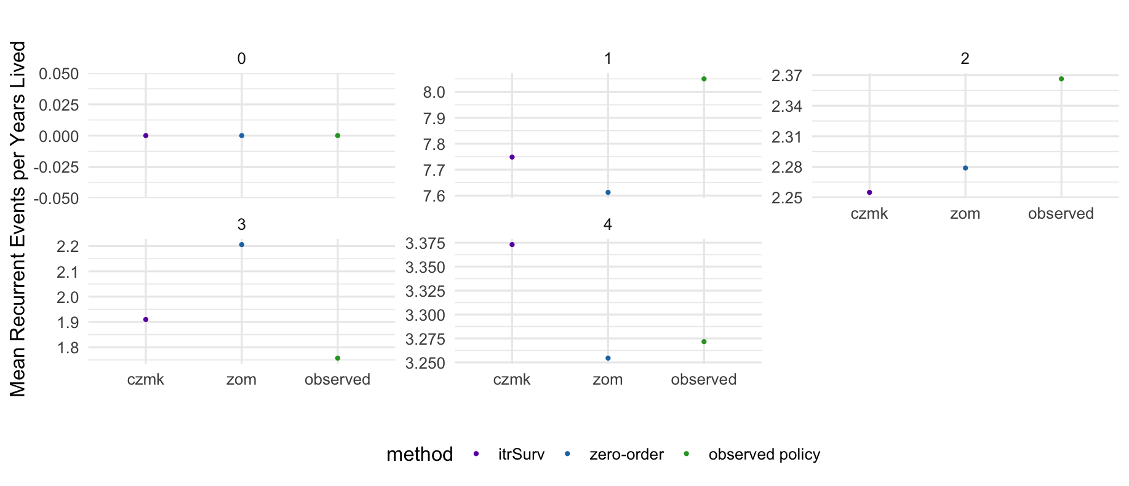
Mean across all Simulations

Slide 14
Setting #2
G = 10

Slide 15
Parameters
tau = 5
Total Gap Times G = 10
5 covariates (mix of binary and continuous from N(0,1))
Action dependent parameters for: alpha1, alpha2, betaD, betaR, omegaD, omegaR, gammaD, gammaR (see R code)
tolerance: 0.1
Number of Simulations: 200
Training Sample Size: 300
Testing Sample Size: 5000
Average training censoring rate across simulations: 24.2%
Average percentage going to phase 2 for itrSurv: 15%
Average percentage going to phase 2 for zom: 31%
Notes:
Date: 2025-01-07

Slide 16
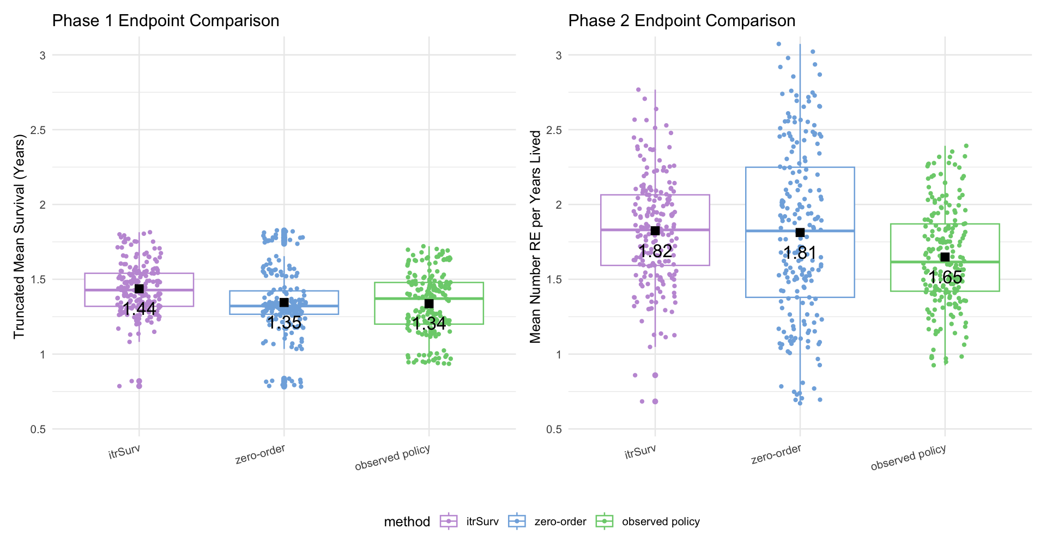
Notes:
# RE per year lived on right side of plot

Slide 17
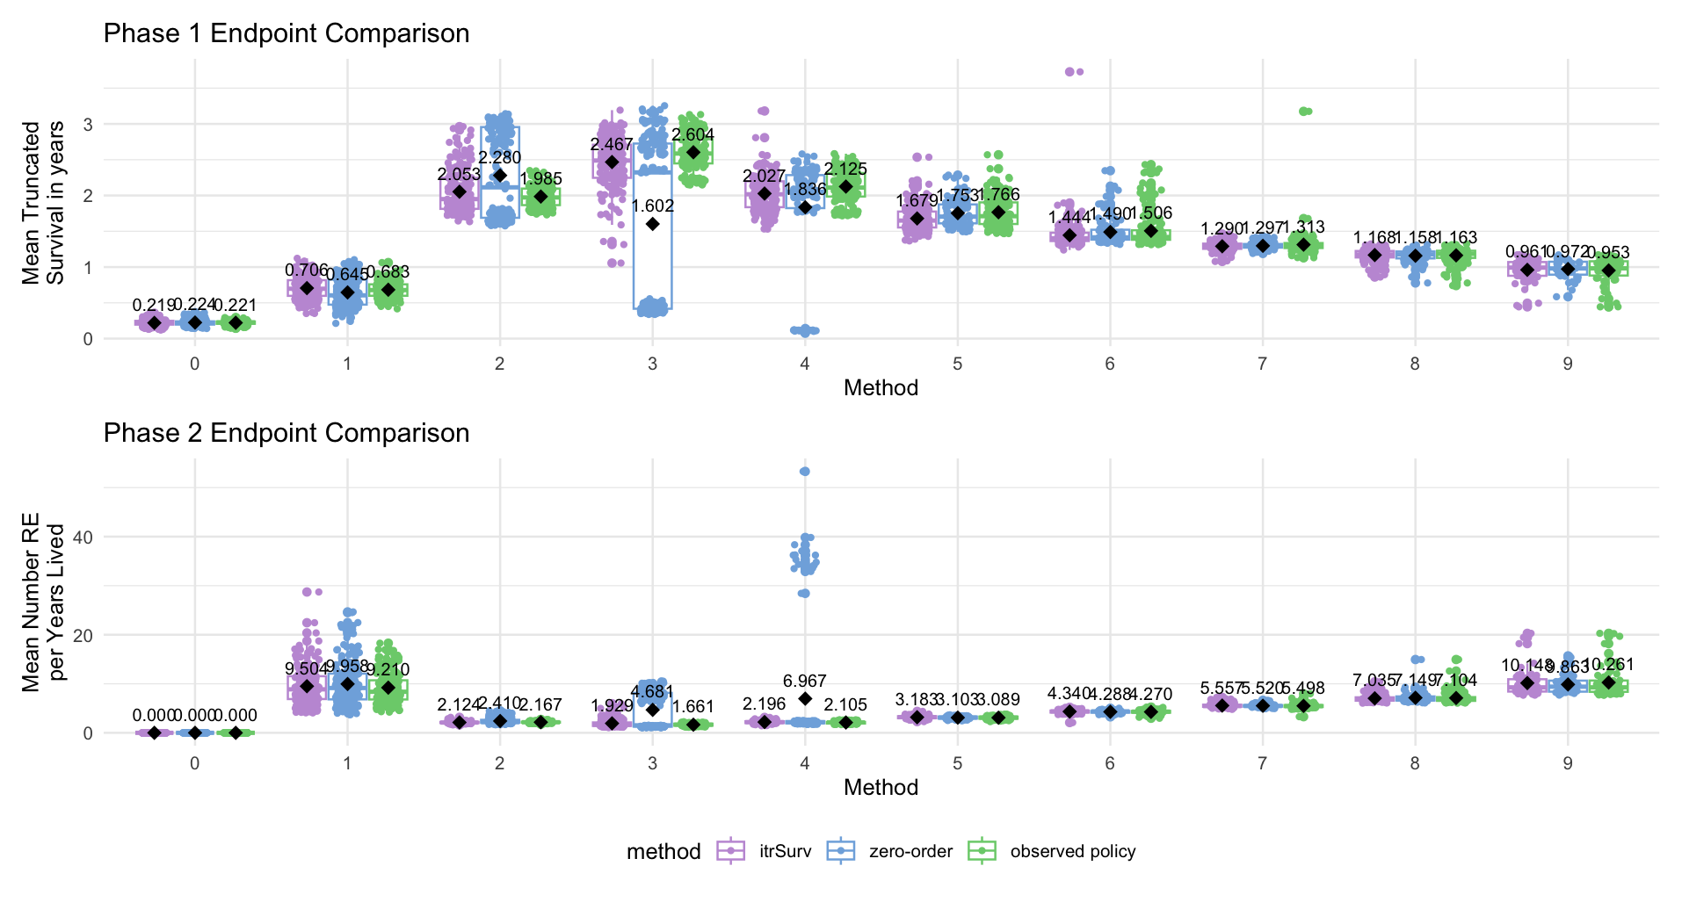

Slide 18
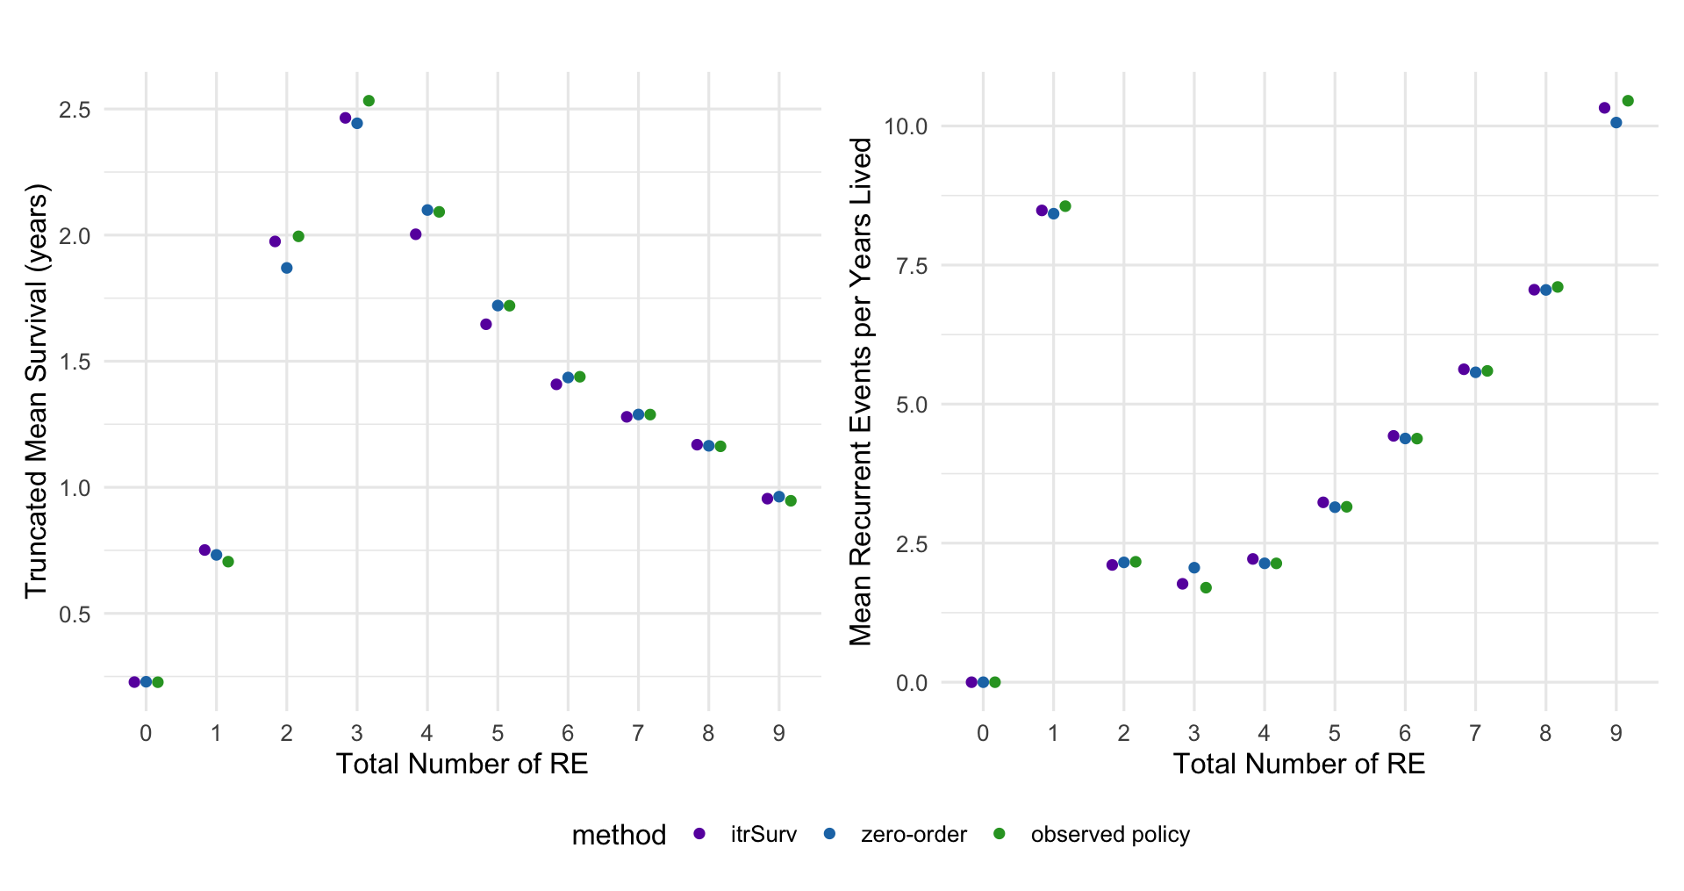

Slide 19
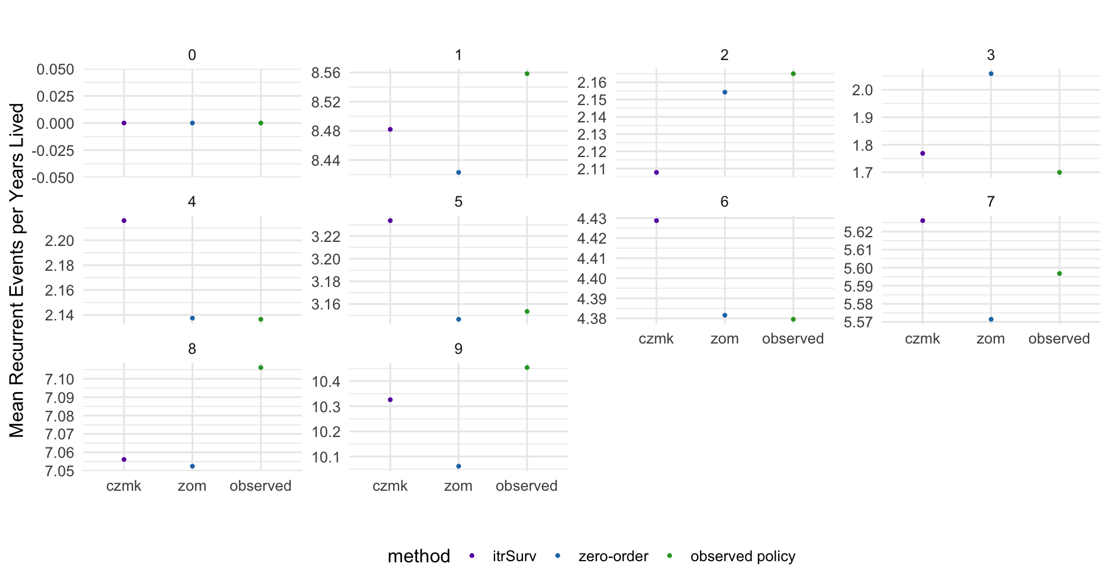

Slide 20
Application to Bladder Dataset

Slide 21
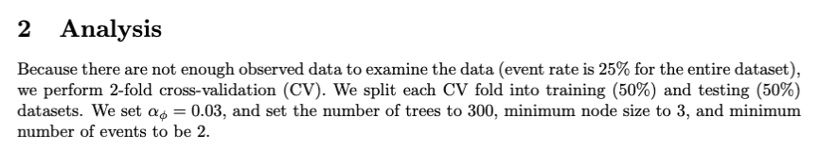
Application to Bladder Cancer Recurrences
Data on recurrences of bladder cancer, originally from Wei, Lin, Weissfeld. Popular dataset to analyze for recurrences.
This dataset has 3 three treatment arms (placebo, pyridoxine, and thiotepa) and all recurrences for 116 subjects; the maximum observed number of recurrences is 9.
Covariates
number: | Initial number of tumours (8=8 or more)
size: | Size (cm) of largest initial tumour

Slide 22
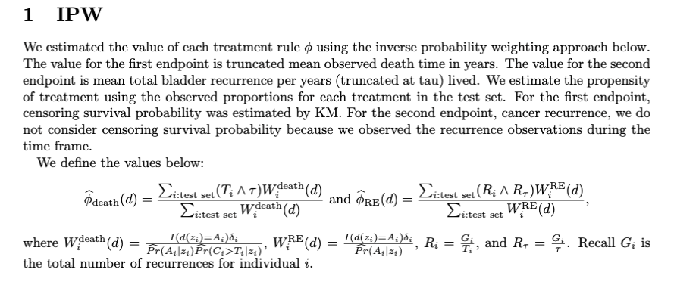

Slide 23
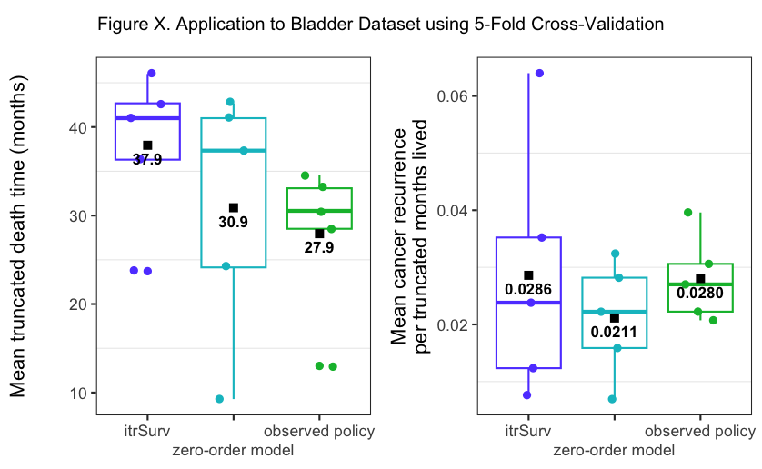
5-CV Bladder Analysis
NodeSize: 3 for both phases
MinEvents = 2
Tau = 54
Tolerance = 0.05
Ntree = 300
Training Fold | Censoring
1 |  | 0.75
2 |  | 0.739
3 |  | 0.739
4 |  | 0.783
5 |  | 0.783
Mean Proportion going to Phase 2
CZMK | 0.789
Zero-order | 1
Averaged across the 5-folds
Method | Mean Death (months) | Mean Cancer Recurrence per months lived
itrSurv | 37.94 | 0.0286
Zero-order | 30.88 | 0.0211
Observed policy | 27.94 | 0.0280
Notes:
1/12/25

Slide 24
Supplementary
OLD

Slide 25
RDA: A simpler attempt (single split)
Just cut dataset once.

Slide 26
Single Split Bladder Analysis
NodeSize: 3 for both phases
MinEvents = 2
50/50 Split
Training: 76% censored
Testing: 76% censored
Proportion going to Phase 2
CZMK | 0.86
Zero-order | 1
Method | Mean Death (months) | Mean Cancer Recurrence per months lived
itrSurv | 39.58 | 0.016
Zero-order | 37.26 | 0.015
Observed policy | 30.77 | 0.027

