Slide 1
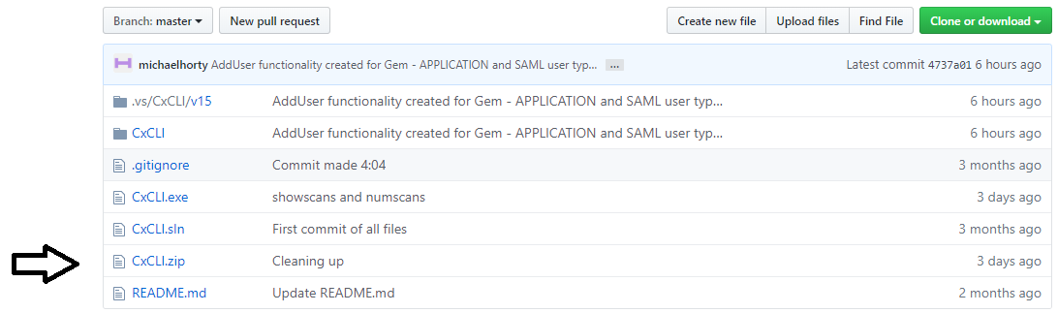

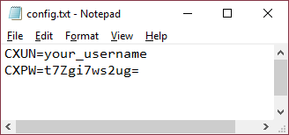
CxCLI: Setup Guide
CxSAST Automation using legacy SOAP APIs – versions 8.4.1 to 8.8 tested
Step 1: Download ZIP file from CxTS Wiki or GitHub
Step 2: Create a folder, unzip files into it
Step 3: Define your credentials in config.txt using CxCLI’s encrypt command
Step 4: Update the config.txt text file with your credentials (App or LDAP)
All files for execution
Contains username and password for CxSAST
The main executable
Binds the .exe with the SOAP WSDL of CxSAST server
This config file should be used if CxSAST is SSL
c:\CxCLI>cxcli encrypttext text=yourpassword
encrypted_text=t7Zgi7ws2ug=

Slide 2
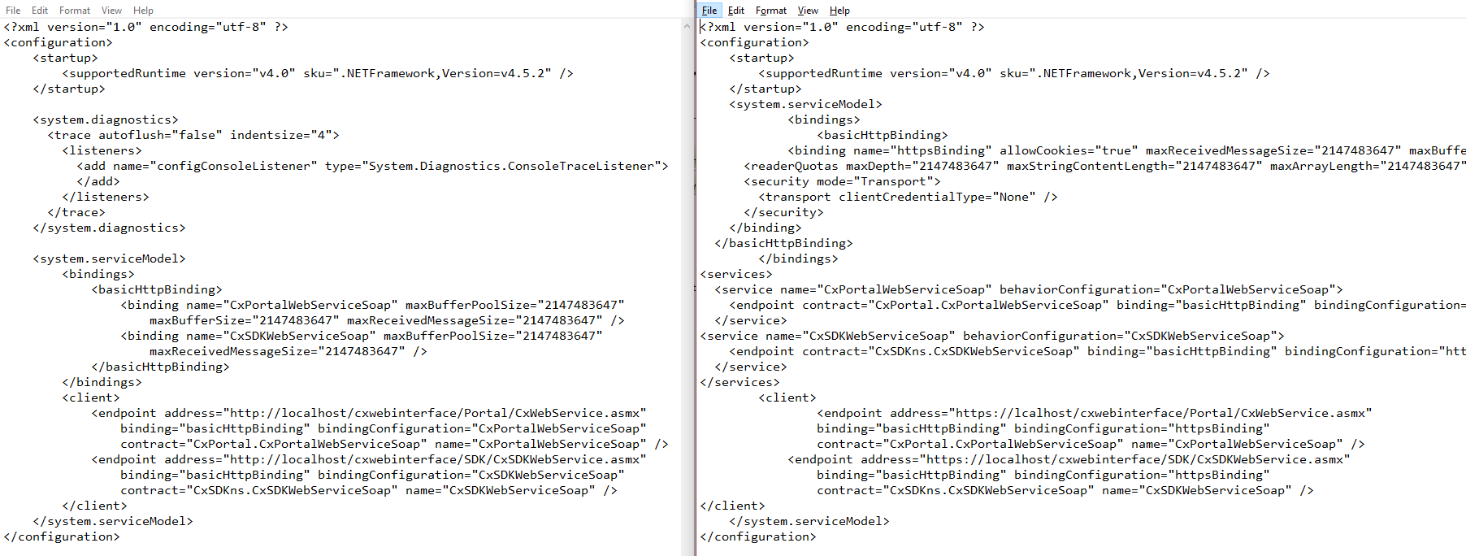
CxCLI: Setup Guide (page 2)
CxSAST Automation using legacy SOAP APIs – versions 8.4.1 to 8.8 tested
Step 5: If the CxSAST server uses SSL, rename CxCLI.exe.configSSLVERSION to CxCLI.exe.config
Step 6: Update the CxCLI.exe.config file with the URL of the CxSAST server
Step 7: Test it! CxCLI help (Help file shown on next pages)
Non-SSL CxCLI.exe.config
changes
SSL version of CxCLI.exe.config
changes

Slide 3
>CxCLI.exe help
Help file updated with each new CxCLI command
CxCLI allows SOAP interaction with CxServer via Windows Command Line
Submit KEY/VALUE (K/V) pairs in the form key=value, example user=mhorty
Optional - use quotes around values to preserve text with spaces
For all calls, loggingenabled=true details activity inside currutil_log.txt
COMMAND K/V Pairs DETAIL
help Produces this help file
encrypt text TEXT=text to encrypt - Returns encrypted data (ie for CxPassword in config.txt)
userexist user,match MATCH=username/mail, USER=user data - Returns true if user exists
getpresets Get list of Presets by ID
getpresetdef id id=[PresetID] - Returns details of Preset
addpreset name,queries Name of Preset,Queries separated by commas to Add Preset
cancelscans Cancels all active scans in Queued Status
showscans type,mins TYPE=queued/failed/completed, MINS(optional)=Summarize for past X minutes
numscans type,mins TYPE=queued/failed/completed, MINS(optional)=Summarize for past X minutes
enableusers file,match MATCH=username/mail, FILE=text file of users, 1 per line
disableusers file,match MATCH=username/mail, FILE=text file of users, 1 per line
deleteusers file,match MATCH=username/mail, FILE=text file of users, 1 per line
userexpire days DAYS=show users expiring within X days
setuserexpire days,newdate DAYS=Users expiring within X days,NEWDATE=MM/DD/YYYY
edituser addgroup,match MATCH=username/mail, ADDGROUP=group(s) to add user to
edituser subtractgroup,match MATCH=username/mail, SUBTRACTGROUP=group(s) to remove user from
edituser changerole,match MATCH=username/mail, CHANGEROLE=Scanner or Reviewer - Change role of user
edituser status,match MATCH=username/mail, STATUS=enable/disable/delete - Change status of user
adduser ** ADDUSER HAS MANY PARAMETERS **
---The following parameters are REQUIRED:
usertype - either APPLICATION,LDAP or SAML
username - Username of user *without* prefix (eg LDAP\ or SAML\)
role - ServerManager,CompanyManager,SPManager,Scanner,Reviewer
firstname - First name
lastname - Last name
team - Fully qualified team name(s) eg CxServer\SP\Company\Team1,CxServer\SP\Company\Team2
email - User email address
password - User password (required only if APPLICATION user type
---The following parameters are OPTIONAL:
activeuser - Boolean, Determines if user is active [DEFAULT=TRUE]
audituser - Boolean, Determines if user has CxAudit permission [DEFAULT=FALSE]
expiredays - Number of days before user expires [DEFAULT=365]
langlcid - Language type [DEFAULT=1033 (English/US)]
country - Country
phone - Phone
cellphone - Cellphone

Slide 4
******* USAGE EXAMPLES *******
Example, encrypt your password:
CMD>cxcli encrypt text=passwordtext
encrypted_text=yADi4Mkw3cUqC8mtiUOyh/dZ5TuzCl5i4Gx0hmVftw8=
Example, check user's existence:
CMD>cxcli userexist user=mhorty match=username
TRUE
--------------------------------------------------------
C:\>cxcli userexpire days=365
miketyson mt@cx.com expires in 76 days
jerryseinfeld jf@cx.com expires in -119 days *EXPIRED*
janedoe jd@cx.com expires in -119 days *EXPIRED*
C:\>cxcli setuserexpire days=-100 newdate=4/15/2019
For users expiring in <-100 days, set to 4 days (4/15/2019)
jerryseinfeld jf@cx.com now expires in 4 days: True
janedoe jd@cx.com now expires in 4 days: True
Examples, enable/disable/delete users from file:
------------------------------------------------
CMD>cxcli disableusers file="c:\Folder Name\some_file_1_username_per_line.txt" match=username
Matching username on 3 entries
User SAML\testuser1: testuser@cx.com disabled
User tnusertest: tnu@cx.com disabled
User miketyson: mt@cx.com disabled
CMD>CxCLI enableusers file="c:\Folder Name\some_file_1_email_per_line.txt" match=mail
Matching mail on 3 entries
User SAML\testuser1: testuser@cx.com enabled
User tnusertest: tnu@cx.com enabled
User miketyson: mt@cx.com enabled
Examples, various functions of edituser:
----------------------------------------
-------Roles
CMD>CxCLI edituser user=mt@cx.com match=mail changerole=Reviewer
changerole = reviewer miketyson: mt@cx.com
No change necessary
CMD>cxcli edituser user=miketyson match=username changerole=Scanner
changerole = scanner miketyson: mt@cx.com
Changing role from Scanner To Scanner
Submitting Role Change: True
------Groups
CMD>CxCLI edituser user=def111@cx.com match=mail addgroup=TeamA
Submitting change - True
CMD>cxcli edituser user=def111@cx.com match=mail subtractgroup=TeamA,ProjectComponent1
subtractgroup = teama,projectcomponent1 def111:def111@cx.com
Submitting change - True
CMD>CxCLI edituser user=def111@cx.com match=mail addgroup=NonExistTeam
addgroup = nonexistteam def111def111@cx.com
Submitting change - ERROR: def111 -General error occurred. Please refer to application admin - Could Not update groups

Slide 5
------Status
CMD>CxCLI edituser user=502752445 match=username status=delete
status = delete 502752445:Service.account@cust.com
User 502752445:Service.account@cust.com deleted
CMD>CxCLI edituser user=def111@cx.com match=mail status=enable
status = enable def111:def111@cx.com
User def111:def111@cx.com enabled
CMD>CxCLI edituser user=def111@cx.com match=mail status=disable
status = disable def111:def111@cx.com
User def111:def111@cx.com disabled
Examples, add users:
c:\>cxcli adduser username=testcxcli55 firstname=Test55 lastname=CxCLI role=Scanner email=testcxcli55@cx.com team=CxServer\SP\Company\Users usertype=application password=Password12345!
DEFAULT audituser=false
DEFAULT activeuser=true
DEFAULT langlcid=1033 (English)
DEFAULT expiredays=365
Adding user application testcxcli55 testcxcli55@cx.com Test55 CxCLI 0(Scanner) CxServer\SP\Company\Users 1 1033 False True 365
User added: True
c:\>cxcli adduser username=testcxcli66 firstname=Test56 lastname=CxCLI role=ServerManager email=testcxcli66@cx.com team=CxServer usertype=application password=Password12345!
DEFAULT audituser=false
DEFAULT activeuser=true
DEFAULT langlcid=1033 (English)
DEFAULT expiredays=365
Adding user application testcxcli66 testcxcli66@cx.com Test56 CxCLI 5(ServerManager) CxServer 1 1033 False True 365
User added: True

