Slide 1
Agent orchestration with Claude
Skills, subagents and parallel swarms, with measured cost
Notes:
[0:00 → 1:00] 1 min · you should be here at 0 min
Welcome. In 90 minutes we will put a swarm of agents to work building a game and then working on a real task of your own.

Slide 2



You'll leave the workshop with this
A swarm
Your task
A memory
that builds a security game with 15 agents, up to 8 in parallel
a real one, from Jira or GitHub, broken down and running
a graph of what you learned, ready to use tomorrow
Notes:
[1:00 → 2:30] 1.5 min · you should be here at 1 min
Three concrete outcomes. Everything stays installed on each laptop and keeps working after today.

Slide 3
Ground rules on cost
US$ 5
US$ 10
0
target per person, for everything you do today
safety cap, never the goal
sessions stopped because of cost
Project 1 measured over 16 real runs: average US$ 1.02, maximum US$ 1.12.
Notes:
[2:30 → 4:00] 1.5 min · you should be here at 3 min
The budget is backed by the benchmark, not by cuts. If someone goes over the target, a warning shows up and they keep working.

Slide 4

Install the kit
Do it now · 1.5 min
The commands are in Teams: copy them from there.
Already installed? Go to the next slide
Copy the command for your system
Paste it into a terminal and answer the questions
Mac (Terminal)
curl -fsSL https://github.com/cx-guilherme-pinto/workshop-claude/releases/download/v1.0.0-rc.1/setup-mac.sh | bash
Windows (PowerShell)
irm https://github.com/cx-guilherme-pinto/workshop-claude/releases/download/v1.0.0-rc.1/bootstrap-windows.ps1 | iex
Expected result: The setup summary table, with every step done
Notes:
[4:00 → 5:30] 1.5 min · you should be here at 4 min
Almost everyone installed beforehand (pre-work): for them this slide only shows where the command is. Anyone who has not installed yet runs it now and follows along with a neighbour while it installs (10 to 20 minutes). The same command installs on another machine. The commands are generated from repos.conf: they are always right for the published version (v1.0.0-rc.1). To update only the Agent Memory app: agent-memory update. Before this slide, post the commands in Teams so everyone can copy them.

Slide 5
Check your installation
Do it now · 3 min
The commands are in Teams: copy them from there.
Open a terminal
Run the command for your system
Wait for the summary table
Mac
bash ~/.workshop-claude/setup-mac.sh --check
Windows
powershell -NoProfile -ExecutionPolicy Bypass -File "$HOME\.workshop-claude\setup-windows.ps1" -Check
Expected result: "Check complete: everything is ready for the workshop."
Notes:
[5:30 → 8:30] 3 min · you should be here at 6 min
Everyone runs the check. It takes 2 to 3 minutes and installs nothing. Anyone who did not run the setup follows along with a neighbour and installs during the questions. The setup speaks English, but it detects the machine language and writes the Claude Code language setting (Portuguese, English, Hindi or Hebrew): the skills answer in that language. The Arena, the orchestrator tables and the docs come in Portuguese or English (any other language gets English). Before this slide, post the commands in Teams so everyone can copy them.

Slide 6
Did a step fail?
Do it now · 2 min
The commands are in Teams: copy them from there.
Run doctor mode
Read Claude's diagnosis (under US$ 0.01)
Follow the steps and run the install command again
Mac
bash ~/.workshop-claude/setup-mac.sh --doctor
Windows
powershell -NoProfile -ExecutionPolicy Bypass -File "$HOME\.workshop-claude\setup-windows.ps1" -Doctor
Expected result: What failed, why and how to fix it; the install only repeats what is missing
Notes:
[8:30 → 10:30] 2 min · you should be here at 9 min
Doctor checks everything and, if a step failed, asks Claude for a diagnosis: it sends the state of each step and the end of the log, with no secrets. It runs nothing. Running the install command again only repeats the missing steps; there, on each failure, Claude suggests commands and runs them only after you confirm, one by one. If Claude is not installed yet, the pre-written help from TROUBLESHOOTING is shown. Before this slide, post the commands in Teams so everyone can copy them.

Slide 7
Concepts
Skills, agents, graphs and money
Notes:
[10:30 → 11:00] 0.5 min · you should be here at 11 min
Fifteen minutes of ideas, one concept per slide.

Slide 8



Claude Code works in your project
Reads and writes
Runs commands
Connects to tools
project files, with permissions you control
tests, git, scripts: it reads the output and fixes what fails
Jira and your memory via MCP; GitHub with gh
Notes:
[11:00 → 12:30] 1.5 min · you should be here at 11 min
Claude Code is not a chat: it is an agent that acts on the repository. Everything it does goes through permissions. Plan mode (Shift+Tab) makes it only plan, without touching anything.

Slide 9
A skill is a recipe with a name
A SKILL.md file in a folder. You type /name and Claude follows the recipe.
---
name: demo-swarm
description: Runs the Arena swarm in waves
model: sonnet
allowed-tools:
- Bash(node tools/*)
- Agent
---
1. Run next-wave.mjs
2. Launch exactly the calls it returns
3. Repeat until STATE: DONE
Answer in the participant's language.
.claude/skills/ in the project · ~/.claude/skills/ for every project · written in English, they answer in your language
Notes:
[12:30 → 14:30] 2 min · you should be here at 13 min
Skills replaced the old slash commands. The frontmatter pins the model and the allowed tools. Today we use two sets: /demo-* in the Arena and /task-* for everyday work. The kit skills are in English and tell Claude to answer in the participant's language.

Slide 10



Subagents: their own context and model
Opus
Sonnet
Haiku
planning and review
integration and hard logic
the bulk of the swarm
US$ 4 / 20
US$ 2 / 10
US$ 0.10 / 0.50
Price per million tokens: input / output. Source: platform.claude.com/docs/en/about-claude/pricing (2026-10-16).
Notes:
[14:30 → 16:30] 2 min · you should be here at 15 min
A subagent is a Claude instance with a clean context, its own tools and the model we choose. It is defined in a .claude/agents/<name>.md file. The /agents command no longer opens a wizard: you edit the file.

Slide 11
The cost rule of thumb
20×
US$ 0.0017
50%
Haiku is 20 times cheaper than Sonnet
average cost of one small task done by a Haiku agent
of the cost goes to the main session, not to the swarm
As much as possible on Haiku. Sonnet only where Haiku fails. Opus only to think and review.
Notes:
[16:30 → 18:30] 2 min · you should be here at 17 min
A cheap swarm is many small agents with clear instructions. What costs money is coordination. That is why the orchestrator is a script and the workers answer with one line.

Slide 12
Task → graph → waves
Wave 1
Wave 2
Wave 3
Wave 4
Haiku
Sonnet
Sonnet
Opus
lib-hash and 15 tasks
categories and scoring
integration and test suite
review and verdict
lib-hash
the 3 crypto tasks
wait for lib-hash
Each square is a task:
waiting
agent working
test passed
test failed
Notes:
[18:30 → 20:30] 2 min · you should be here at 19 min
The plan is a dependency graph. We run it in waves: everything that is ready runs in parallel. The three cryptography tasks wait for lib-hash, a real dependency inside wave 1.

Slide 13



A script decides the graph
next-wave.mjs
The model
grade.mjs
reads the plan and the state and returns the next batch of calls (one wave can take several)
launches exactly those calls, all in the same message
runs the test of each task and decides: green or red
Notes:
[20:30 → 22:00] 1.5 min · you should be here at 21 min
With 8 calls in parallel, a model forgets dependencies or rewrites prompts. The script is reproducible: that is what makes the cost predictable and the benchmark comparable.

Slide 14
Measure, don't guess
1
2
3
4
5
The subagent finishes
The SubagentStop hook runs
Tokens × price
One line in usage.jsonl
Statusline and /demo-cost
every swarm agent, when it is done
a kit script (the Stop hook measures the main session)
the real transcript tokens, at the published prices
agent, model, time and cost
the live cost and the final report
Notes:
[22:00 → 23:30] 1.5 min · you should be here at 22 min
Hooks are commands that Claude Code runs on events. Ours only measures: it reads the real tokens from the transcript, multiplies them by the published prices and appends one line. It never blocks anything.

Slide 15
The cycle of every task
1
2
3
4
5
plan
swarm
review
cost
memory
the task becomes a graph, reviewed by Opus
Haiku agents build the pieces in parallel
Opus checks the tests and the security
what it cost, per agent and per model
the lessons stay for next time
Notes:
[23:30 → 24:30] 1 min · you should be here at 24 min
It is the same cycle in both projects: plan with Opus, run as a swarm, a security gate, measure and save what was learned.

Slide 16
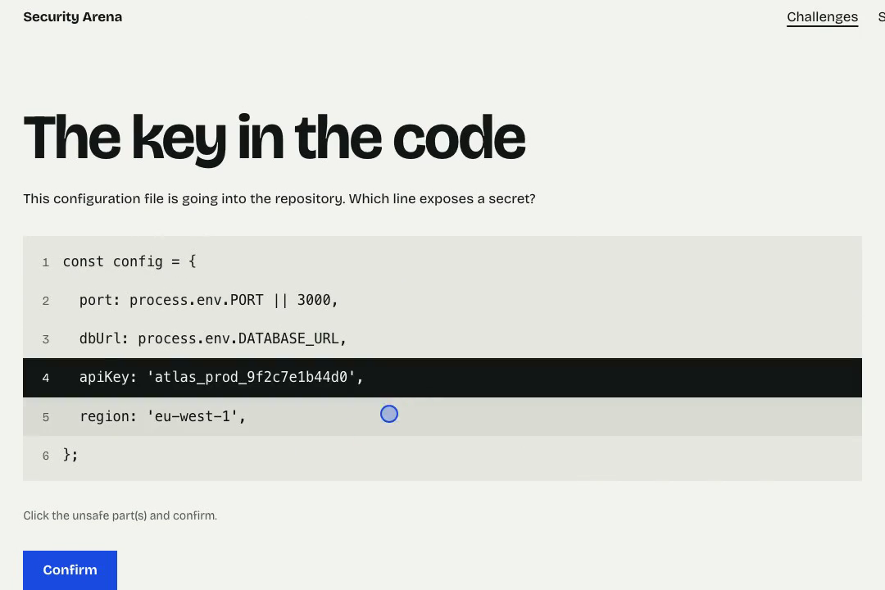


What we will build: the Security Arena
A mini-game, ready to play
Short security challenges, in the browser, across 10 categories: passwords, phishing, web, networks, cryptography and more.
Each task builds a challenge
In 4 formats: point at the insecure line, pick the answer, put the steps in order or type the answer.
One agent per task
Each agent does one task, and that task's test says whether it is right. In the video: 100 tasks. On your laptop: 15.
One challenge of the game: click the line that exposes the secret and confirm.
Each square is a task:
waiting
agent working
test passed
test failed
Notes:
[24:30 → 25:30] 1 min · you should be here at 25 min
Before the video, say what is going to be built. The Arena is a security mini-game: each task builds a small challenge (find the line that exposes a secret, pick the real website, order the parts of a URL, type an answer). The app shell and the tests already exist; the agents write the challenges, one task each. Explain the colours now, because they show up everywhere: each square is a task, grey while it waits, yellow while an agent works on it, green when its test passes, red when it fails.

Slide 17
The swarm in action
The Arena with 100 tasks, built by agents in parallel. Then you build yours, with 15.
Notes:
[25:30 → 26:00] 0.5 min · you should be here at 26 min
Bridge into Project 1. What they are about to see is the cycle from the previous slide (plan → swarm → review → cost → memory) in a real run with 100 tasks. Right after, each person does the same with 15.

Slide 18
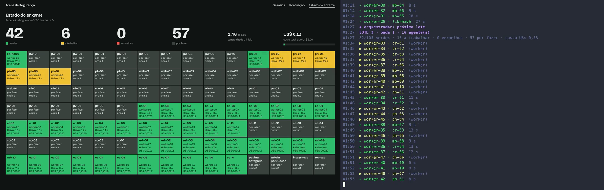
100 agents building the Arena
Each square is a task:
waiting
agent working
test passed
test failed
Real recorded session (plan, swarm, review and cost): 6.9 min · US$ 2.55 · 107 agents
Notes:
[26:00 → 28:30] 2.5 min · you should be here at 26 min
Sped-up video of a real run with 100 tasks. On the left, the /status page: each square is a task, yellow while an agent works on it and green when its test passes. On the right, the terminal with the agent batches. The time and cost are the real ones. Plan B if the video fails: open /status?replay=recording in the recorded Arena.

Slide 19
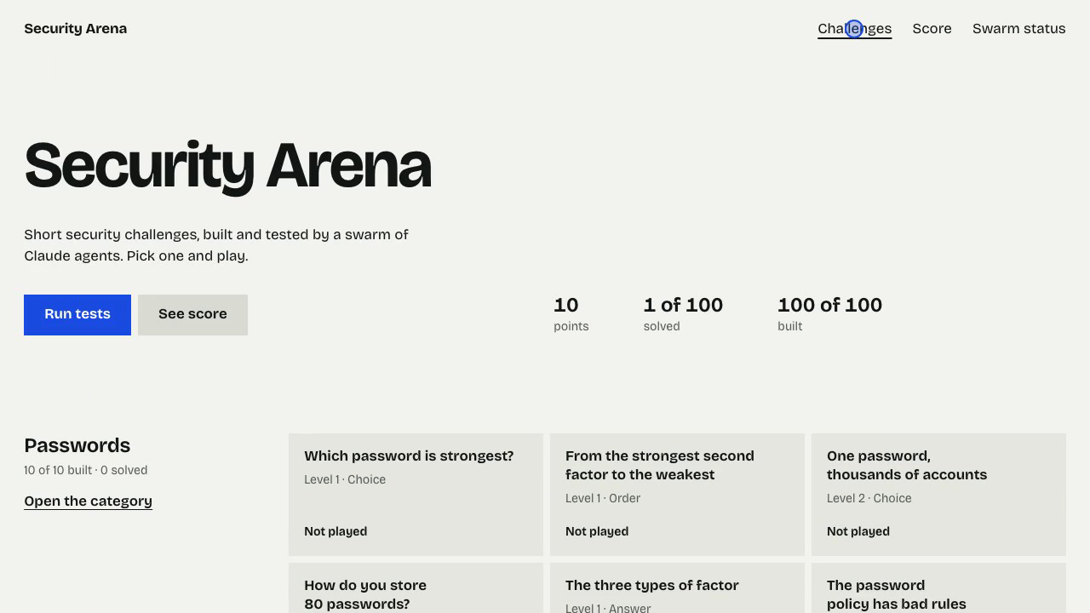
The result: the game, ready to use
The Arena the swarm built: security challenges in 4 formats, to play in the browser.
Notes:
[28:30 → 29:30] 1 min · you should be here at 29 min
Recording of someone playing the final Arena: point at the insecure line, pick the right answer, order the steps and type the answer. Each challenge explains the why at the end. At the end of Project 1 everyone plays their own.

Slide 20
Project 1
The Security Arena
Notes:
[29:30 → 30:00] 0.5 min · you should be here at 30 min
25 minutes of hands-on. In the benchmark, the 15-task swarm took 2 to 3 minutes (the full session, 3.5 to 5); in interactive mode and with new accounts it can take longer. We use that time to look at features.

Slide 21
What we will do in this project today
Ready
To do
Who does it
the app shell, 4 challenge formats and one test for each task
15 challenges, lib-hash and two pages: one task each
your swarm: Haiku, Sonnet and Opus
Notes:
[30:00 → 31:00] 1 min · you should be here at 30 min
The tests already exist: each agent only has to turn its test green. That is what lets Haiku do the bulk of the work safely.

Slide 22



What /demo-plan does
It is a skill
.claude/skills/demo-plan/SKILL.md (summary)
---
name: demo-plan
model: sonnet
allowed-tools: Read, Agent,
node tools/*, memory_search
---
1. Look up lessons in the memory
2. node tools/plan.mjs → the graph
3. The planner agent (Opus) reviews it
4. Show the waves, the diagram and the cost
A Markdown file with steps. You type /demo-plan and Claude follows the recipe, the same way every time.
What goes in and out
In: the Arena specs (summarised in TASKS.md). Out: plan.json and PLAN.md, the graph with the dependencies, the waves and the cost estimate.
In your project
/task-plan does the same for one of your Jira or GitHub issues.
Notes:
[31:00 → 32:30] 1.5 min · you should be here at 31 min
Explain before running it. A skill is not magic: it is a Markdown recipe that Claude follows. Here it calls a script that builds the graph (always the same, from the tasks) and an Opus agent that only reviews it. The result is in files they can open and read.

Slide 23
Plan the swarm
Do it now · 3 min
Go to the Arena folder
Open Claude Code and pick "Yes, I trust this folder" (↓ then Enter: the preselected option exits)
Run /demo-plan
Terminal 1
cd ~/workshop-claude/demo-project
claude
/demo-plan
Expected result: A Mermaid diagram, 4 waves and an estimate close to US$ 1.00
Notes:
[32:30 → 35:30] 3 min · you should be here at 33 min
The trust dialog matters: without it, the project permissions stay off. In recent Claude Code versions, because the Arena pre-approves permissions, the preselected option is "No, exit": pressing Enter quits. Show the down arrow. /demo-plan checks the memory, builds the graph and asks the planner (Opus) to review it.

Slide 24
Your plan: 4 waves
Wave 1
Wave 2
Wave 3
Wave 4
Haiku
Sonnet
Sonnet
Opus
lib-hash and 15 tasks
categories and scoring
integration and test suite
review and verdict
lib-hash
the 3 crypto tasks
wait for lib-hash
Each square is a task:
waiting
agent working
test passed
test failed
Notes:
[35:30 → 37:00] 1.5 min · you should be here at 36 min
Show someone's plan on the projector. In wave 1, lib-hash and the challenge tasks start together; the cryptography ones join as soon as hash turns green.

Slide 25
What /demo-swarm does
The script decides
.claude/skills/demo-swarm/SKILL.md (summary)
---
name: demo-swarm
model: sonnet
allowed-tools: node tools/*, Agent
---
Repeat until STATE: DONE
1. next-wave.mjs → the next batch
2. Launch the batch agents, in parallel
3. Each agent does 1 task and runs its test
4. Show the table: agent, model, cost
The graph says what can run now. Claude only launches the batch the script hands it: no improvising.
One agent, one task
Each agent starts with a clean context, gets one task and that task's test, and uses the right model: Haiku for the bulk.
In your project
/task-swarm does the same with the subtasks of your issue.
Notes:
[37:00 → 38:30] 1.5 min · you should be here at 37 min
Explain before running it. The key point: a script picks what runs, not the model. That is why cost and time are predictable. If a task fails, the script retries it with the error message and, on the third attempt, with Sonnet.

Slide 26
Release the swarm
Do it now · 2 min
Run /demo-swarm
Open a second terminal
Start the server and open the /status page in the browser
Terminal 1
/demo-swarm
Terminal 2
cd ~/workshop-claude/demo-project
node server.js
Expected result: http://localhost:3000/status: the squares turn yellow and then green
Notes:
[38:30 → 40:30] 2 min · you should be here at 39 min
From here the swarm works for a few minutes (2 to 3 in the benchmark; longer with new accounts). The next slides use that time; whoever finishes first plays the Arena.

Slide 27
Ask without interrupting
Do it now · 2 min
Go back to Terminal 1; leave the swarm running
Type /btw and your question
Terminal 1
/btw why does task cr-01 wait for lib-hash?
Expected result: An answer that does not enter the conversation or stop the swarm
Notes:
[40:30 → 42:30] 2 min · you should be here at 41 min
/btw answers on the side. It is the right way to ask questions during a long run.

Slide 28



Hooks: Claude Code signals, a script reacts
What it is
Event → command, in .claude/settings.json
SubagentStop ← an agent finished
└─ node tools/workshop/hooks/subagent-stop.mjs
reads the tokens that agent used
writes the cost to .workshop/usage.jsonl
Other events: PreToolUse, PostToolUse,
UserPromptSubmit, Stop, SessionStart
A command Claude Code runs on its own at the right moment: before or after a tool, when an agent finishes, at the end of the session.
What it is for
Measuring, checking, formatting or blocking, every time, without relying on the model to remember. Here it measures the cost of each agent.
Make your own
Ask Claude: "Create a PostToolUse hook that runs prettier on every file you edit." It writes it into settings.json; you review and approve it in /hooks.
Notes:
[42:30 → 44:00] 1.5 min · you should be here at 43 min
No code walkthrough. The idea: a hook is "when X happens, run Y", set up in settings.json. Claude writes hooks very well: just describe what you want. Show /hooks to see the active ones.

Slide 29

The statusline is a script
What it is
The line under the input box
Claude Code ── session JSON ──▶ statusline.mjs
statusline.mjs ──── one line ────▶ screen
Sonnet 5.5 · session US$ 0.42
· project US$ 1.10 of US$ 5.00
· swarm 12✓ 2… 1✗ · 3 min
A script that receives the session state (model, folder, cost) and returns one line of text.
In the kit
It reads what the hook recorded and shows the session and project cost, live, against the US$ 5 target.
Make your own
Type /statusline and say what you want to see, for example "the git branch and the session cost". Claude writes the script.
Notes:
[44:00 → 45:00] 1 min · you should be here at 44 min
Show the statusline changing as the agents finish. The hook records, the statusline shows: together they give the live cost. Claude Code's /usage may show more, because some versions do not know the latest prices yet; /demo-cost uses the published prices.

Slide 30
In a third terminal: three features
Do it now · 3 min
Open a third terminal in the Arena folder
Plan mode: Shift+Tab until "plan mode"
Headless: a question without opening a session
Rewind: Esc Esc to go back
Plan mode
claude
(Shift+Tab) How would you add an 11th category?
Headless
claude -p "Summarise PLAN.md in one sentence" --model claude-haiku-5-5
Expected result: A plan with no changes, one sentence in the terminal and a checkpoint to rewind to
Notes:
[45:00 → 48:00] 3 min · you should be here at 45 min
Plan mode only reads and proposes. claude -p is the basis for scripts and CI. Esc Esc opens rewind: it restores code and conversation to a checkpoint, but not what was done through Bash nor most of what the subagents did.

Slide 31



Worktrees and routines
claude -w experiment
isolation: worktree
Local routine
an isolated copy of the repository, on its own branch, to work in parallel
a subagent in its own worktree, when the tasks touch the same files
the system scheduler runs claude -p every day. The cloud /schedule needs a subscription
Notes:
[48:00 → 49:30] 1.5 min · CAN SKIP · you should be here at 48 min
Skip if running late. Example routine: a daily security review with node tools/routine.mjs --install --yes (without --yes it only shows what it would do), which registers a claude -p "/demo-review --auto" in launchd or in Task Scheduler.

Slide 32
Until everything is green
Do it now · 2 min
The command is in Teams: copy it from there.
At the end, look for red squares
If there are any, let /loop fix them
Terminal 1
/loop 2m run node tools/workshop/orchestrator/grade.mjs --all and fix the first red task with the implementer agent; stop when everything is green
Expected result: The loop stops by itself when the suite is green
Notes:
[49:30 → 51:30] 2 min · you should be here at 50 min
/loop repeats a prompt at each interval, while the session is open. Esc cancels.

Slide 33
The security gate
Do it now · 2 min
Run /demo-review
Read the Opus reviewer's verdict
Terminal 1
/demo-review
Expected result: GATE: APPROVED: tests green, CSP on, no eval or innerHTML, no secrets
Notes:
[51:30 → 53:30] 2 min · you should be here at 52 min
A security game with security flaws would be the worst example. The gate links each check to the OWASP Top 10.

Slide 34
How much did it cost?
Do it now · 2 min
Run /demo-cost
Compare the Haiku agents with the main session
Terminal 1
/demo-cost
Expected result: Cost per agent, model and wave, close to US$ 1.02
Notes:
[53:30 → 55:30] 2 min · you should be here at 54 min
The report uses real tokens and published prices. At the end it saves the lessons to the memory app.

Slide 35
Play what the swarm built
Do it now · 2 min
Open the gallery
Pick a challenge and play
Click "Run tests"
Browser
http://localhost:3000
Expected result: Challenges from green tasks are playable; the red ones show why they failed
Notes:
[55:30 → 57:30] 2 min · you should be here at 56 min
The tests also run in the browser. It is the same test that decided the colour of the square.

Slide 36
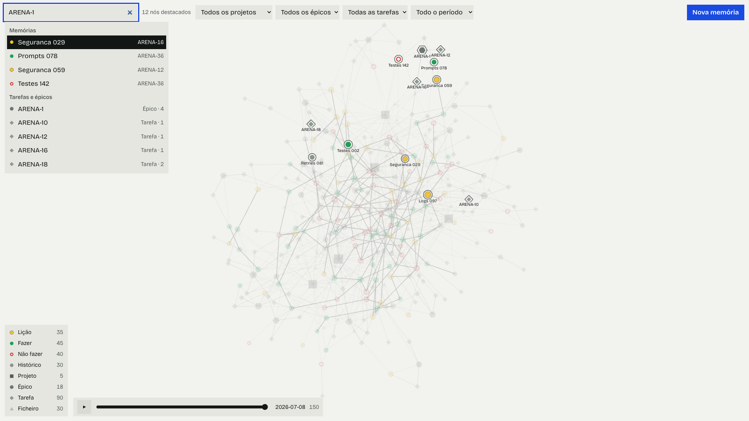
The memory of what you did
Search by project, issue or epic (e.g. arena or EX-1): lessons, "do", "don't" and history, linked to projects, epics, tasks and files
Notes:
[57:30 → 59:30] 2 min · you should be here at 58 min
They are Markdown files in ~/.agent-memory, with an SQLite index. Everything stays on your PC. Each memory is linked to the Jira or GitHub ticket and to its epic: searching ABC-123 brings everything for that ticket and the epic. /task-intake and /task-plan check it before planning ("last time in this epic, don't do X").

Slide 37
Open your first graph
Do it now · 3 min
Open the Agent Memory app
Click a node to read the lesson
Drag the time slider
Mac
open ~/Applications/"Agent Memory.app"
# or: agent-memory
Windows
Start menu → Agent Memory
# or: agent-memory
Expected result: The Arena session graph, with the lessons linked to the project
Notes:
[59:30 → 62:30] 3 min · you should be here at 60 min
The app opens in your native language and has a language selector. Routines, worktrees and headless mode were already covered while we waited.

Slide 38
Project 2
Your real task
Notes:
[62:30 → 63:00] 0.5 min · you should be here at 63 min
25 minutes. The task may not finish here: the goal is to leave with the orchestration running and to know how to continue.

Slide 39
The same cycle, in your repository
1
2
3
4
5
/task-intake
/task-plan
/task-swarm
/task-gate
/task-report
reads the Jira or GitHub issue
decides how many agents and why
the agents work in batches
tests, secrets and the Opus verdict
comments, worklog and PR, after you say yes
Notes:
[63:00 → 64:30] 1.5 min · you should be here at 63 min
The /task-* skills are installed at user level and work in any repository. Every write to Jira or GitHub asks for confirmation.

Slide 40
Bring your task
Do it now · 4 min
Open Claude Code at the root of your project
Give it the Jira (ABC-123) or GitHub (#42) issue
No access? Use the practice project
Your project
cd <your repository>
claude
/task-intake ABC-123
Practice project
cd ~/workshop-claude/practice-project
claude
/task-intake issues/EX-1.json
Expected result: Title, acceptance criteria and the test command of the project
Notes:
[64:30 → 68:30] 4 min · you should be here at 65 min
For Jira you need to have logged in via /mcp (atlassian). GitHub uses gh. Intake only reads; it writes nothing.

Slide 41
The planner decides how many agents
Do it now · 5 min
Run /task-plan
Read why it picked that number of agents
Approve or adjust
Terminal 1
/task-plan
Expected result: Small: 1–3 agents. Large: more, with a reason and an estimate
Notes:
[68:30 → 73:30] 5 min · you should be here at 69 min
The planner (Opus) proposes the graph and a script validates it: ids, dependencies, cycles and known agents. Tasks that touch the same files go in different batches, at swarm time. Integration and review are added automatically.

Slide 42
Put the swarm to work
Do it now · 10 min
Run /task-swarm
In another terminal, in the project folder, open the dashboard
Stop with Esc and resume whenever you want
Terminal 1
/task-swarm
Terminal 2
cd <your repository>
node "$HOME/.workshop-claude/kit/orchestrator/dashboard.mjs"
Expected result: Batches of agents finishing; never two on the same file at the same time
Notes:
[73:30 → 83:30] 10 min · you should be here at 74 min
The state lives in .workshop/. Running /task-swarm again resumes. Tasks that touch the same files go in different batches, or in git worktrees if the planner decides so.

Slide 43



Jira and GitHub
Jira (MCP + acli)
GitHub (gh)
Always with confirmation
MCP, logged in via /mcp; if it fails, the Atlassian CLI (acli auth login)
gh auth login: uses less context than an MCP and shares no tokens
comments, worklog and PR only after you say yes
Notes:
[83:30 → 84:30] 1 min · CAN SKIP · you should be here at 84 min
Skip if running late. The Atlassian MCP uses the company's Rovo credits and the admin can limit it. If the MCP fails, the skills use the official Atlassian CLI (acli), which the setup already installed: it reads the issue and posts the comments; hours are logged by hand.

Slide 44


After the workshop
/task-gate
/task-report
/memory
tests, secrets, dangerous code and the Opus verdict
Jira: one comment per subtask, plus the worklog. GitHub: the PR
the lessons from this task stay for the next one
Notes:
[84:30 → 86:30] 2 min · you should be here at 85 min
Example comment: agent ws-worker-07 · Haiku · 5 s · US$ 0.004.

Slide 45
Five ideas to take with you
1
Skills make work repeatable
2
Subagents bring a clean context and the right model per piece
3
A script decides the graph; the model executes
4
Measure with hooks; never guess the cost
5
Memory makes each task teach the next one
Notes:
[86:30 → 88:30] 2 min · you should be here at 87 min
A summary in five sentences.

Slide 46
Tomorrow
1
Run /task-intake on the next issue assigned to you
2
Write a skill for a task you repeat every week
3
Open Agent Memory before planning
Notes:
[88:30 → 89:30] 1 min · you should be here at 89 min
Three concrete actions.

Slide 47
Questions
No time limit
https://github.com/cx-guilherme-pinto/workshop-claude
Notes:
[89:30 → 90:00] 0.5 min · you should be here at 90 min
Questions can go past 90 minutes. Anyone who did not run the setup installs now.

