Slide 1
Last week's Lectures
Local illumination
- Much more simplified and non-physical
- No explicit account for inter-object reflections
- Hard shadows …
Global illumination
- Incorporate all lights in the scene
- About how to illuminate the whole scene dependently
- Physically-based rendering
Shading
- colors the whole scene after applying an illumination model at
a sparse set of point samples
- Flat shading / Gouraud shading / Phong shading
Notes:
Local IM: deals only with isolated surface points and direct light sources, e.g., Phong reflectance model
Global IM: takes into account the relationships between all surface points in the environment
Shading: colors the whole scene after applying an illumination model at a sparse set of point samples

Slide 2
Overview of local illumination
In a local illumination model with only reflected light:
reflected
Light
specular
Light
absorbed
diffuse
ambient – general brightness due to this light source
transmitted
Light = reflected + absorbed + transmitted (refracted)
Light/color seen = ambient + diffuse + specular

Slide 3

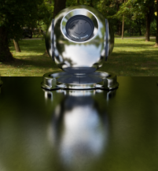
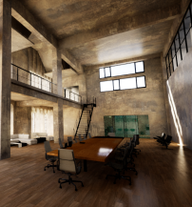
Why global illumination
Using local illumination couldn’t handle global effects well
- Soft shadows
- And especially when the light bounces more than once
Soft shadows
Glossy reflection
Indirect illumination
Notes:
光线追踪是对空间中光线传播过程的仿真

Slide 4
Basic Ray-Tracing Algorithm

Slide 5
Light Rays
Three ideas about light rays
Light travels in straight lines
Light rays do not “collide” with each other if they cross
Light rays travel from the light sources to the eye , but the physics is invariant under path reversal – reciprocity（可逆性）.

Slide 6
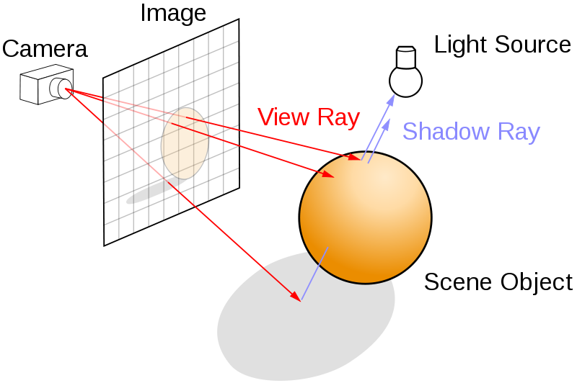
Ray Tracing

Slide 7
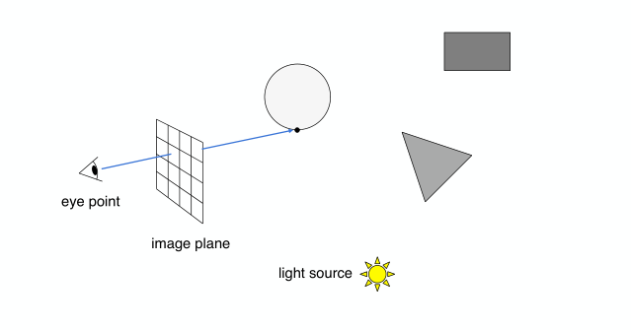
Ray Tracing

Slide 8
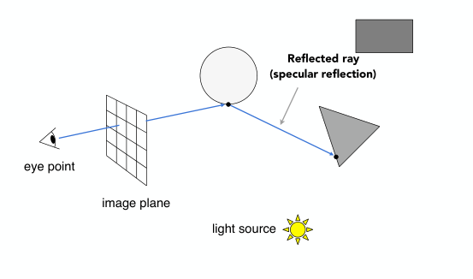
Ray Tracing

Slide 9
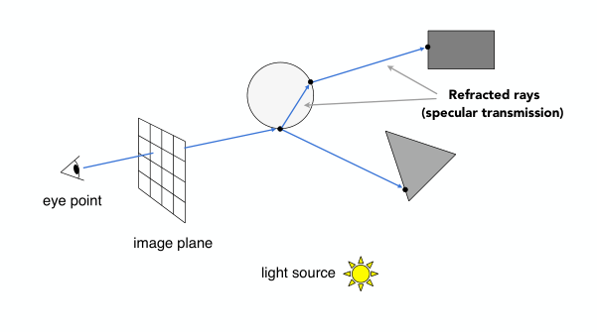
Ray Tracing

Slide 10
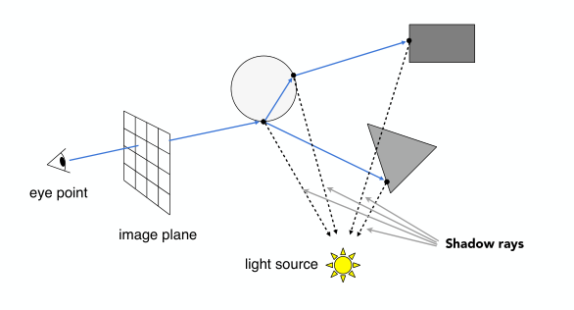
Ray Tracing

Slide 11
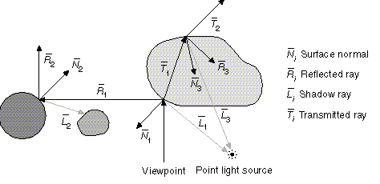
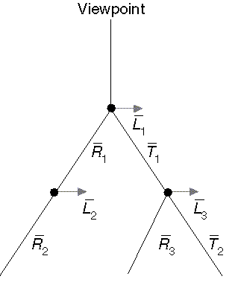
The ray tree
Follow rays recursively – recursive ray tracing

Slide 12
A simple recursive ray tracer
color c = trace (point p, vector d, int step) {
if (step > max) return (background_color);
point q = intersect (p, d, type); // the most expensive operation
if (type == light_source) return (light_source_color);
if (type == no_intersection) return (background_color);
vector n = normal (q, surface);
vector s = light - q; // shadow ray vector
vector r = reflect (q, n, d); // reflected ray vector
vector t = transmit (q, n, d, surface_material_1, surface_material_2);
color local = phong (q, n, d, s); // shadow ray
color reflected = trace (q, r, step+1); // recursive call
color transmitted = trace (q, t, step+1); // recursive call
return local + reflected + transmitted;
} // end of procedural
Notes:
Cast ray from eye through each pixel (so each pixel gets a color returned). Three cases:
If the ray hits light source: assign color of light
If the ray hits infinity: assign a background color
If the ray hits a surface: apply a LIM such as the Phong model to get a color for the pixel
This basically performs visibility

Slide 13
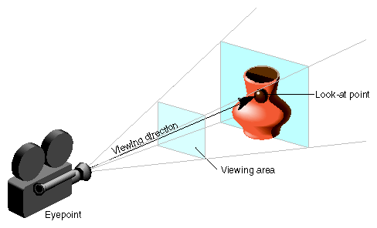
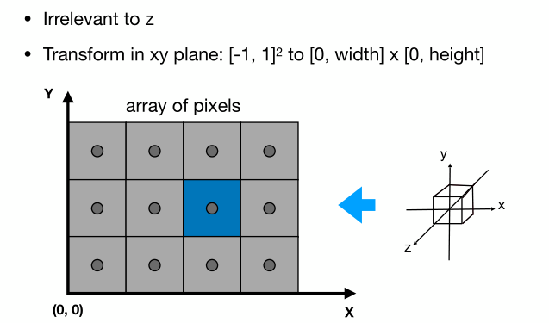
Ray casting

Slide 14

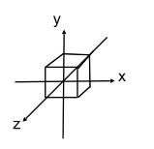
Ray casting
Screen
(0, W)
(0,0)
i
y
1
-1
1
x
-1
(H, 0)
j
x = ((i + 0.5) * 2 – W ) / W
y = (H - (j + 0.5) * 2) / H
Near plane

Slide 15
Ray casting
y = top
y
x = left
x = right
y = bottom
z
x
z = near
z = far
Perspective Projection Matrix
1/tan(fov * 0.5) * aspect_ratio 0 0 0
0 1/tan(fov * 0.5) 0 0
0 0 … …
0 0 1 0
x = ((i + 0.5) * 2 – W ) / W * aspect_ratio * tan(fov * 0.5)
y = (H - (j + 0.5) * 2) / H * tan(fov * 0.5)

Slide 16
Ray casting
https://www.scratchapixel.com/lessons/3d-basic-rendering/ray-tracing-generating-camera-rays/generating-camera-rays

Slide 17
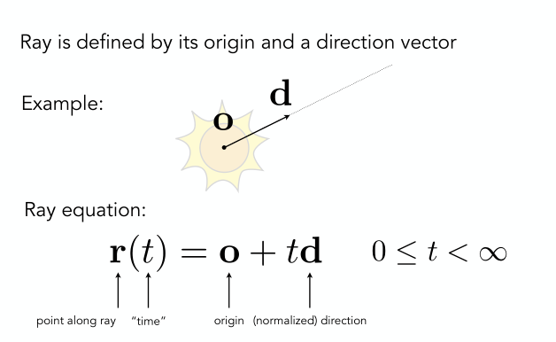
Intersection
Ray Intersection With Triangle
Ray Intersection With Sphere

Slide 18
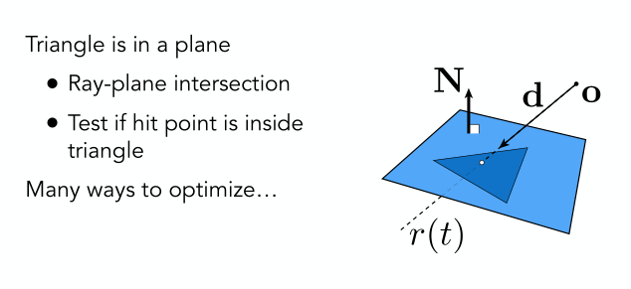
Ray Intersection With Triangle

Slide 19
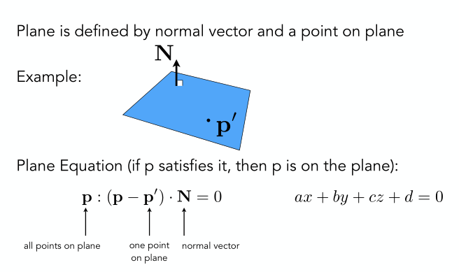
Ray Intersection With Triangle

Slide 20
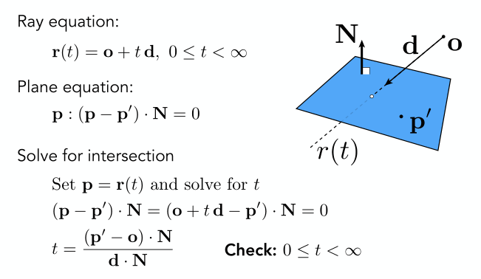
Ray Intersection With Triangle

Slide 21
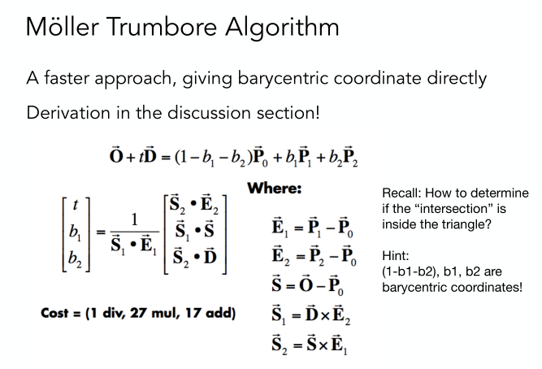
Ray Intersection With Triangle

Slide 22
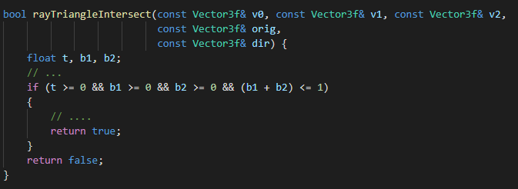

Ray Intersection With Triangle
实现

Slide 23
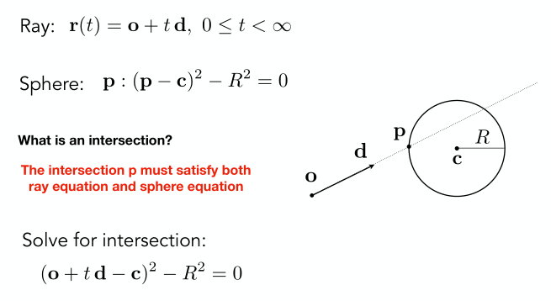
Ray Intersection With Sphere

Slide 24
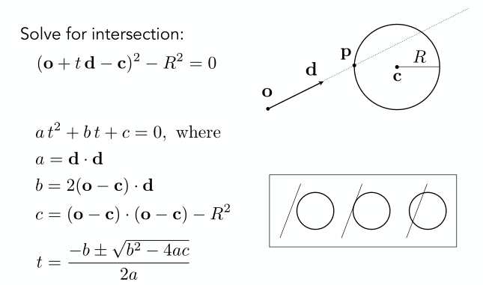
Ray Intersection With Sphere
Notes:
假设两个根是t1和t2， t1 <= t2
如果t2小于0，说明无交点
如果t1小于0， t2大于0, 说明光线射出点在球体内部，t2时与球体相交
如果t1大于0，说明光线在t1时与球体相交

Slide 25
A simple recursive ray tracer
color c = trace (point p, vector d, int step) {
if (step > max) return (background_color);
point q = intersect (p, d, type); // the most expensive operation
if (type == light_source) return (light_source_color);
if (type == no_intersection) return (background_color);
vector n = normal (q, surface);
vector s = light - q; // shadow ray vector
vector r = reflect (q, n, d); // reflected ray vector
vector t = transmit (q, n, d, surface_material_1, surface_material_2);
color local = phong (q, n, d, s); // shadow ray
color reflected = trace (q, r, step+1); // recursive call
color transmitted = trace (q, t, step+1); // recursive call
return local + reflected + transmitted;
} // end of procedural
Notes:
交点的法线的获取，如果是三角面，很简单，通过叉乘就能得到平面的法线；如果是球体，也和简单，交点坐标减去圆心坐标；
下面说光线在交点处，发生反射和折射的情形。

Slide 26
Reflection and Refraction

Slide 27
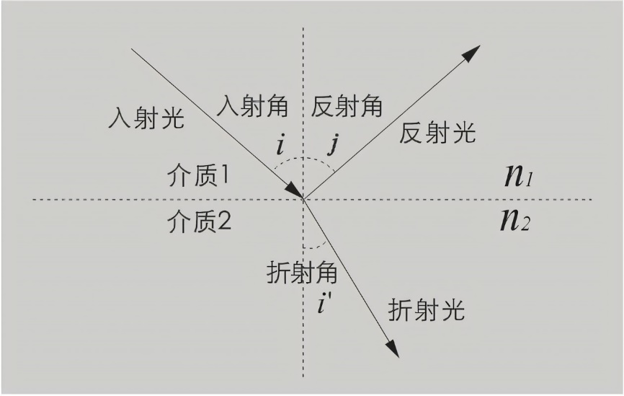
Reflection and Refraction
N
L
R
F
Reflection : R = L - 2 * L.dot(N) * N;
How about refaction ?

Slide 28
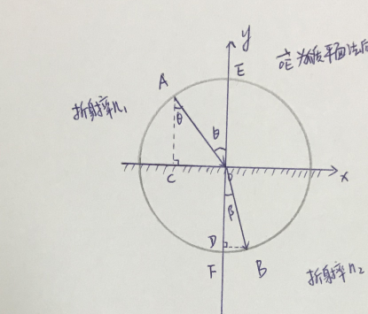
Refraction
Snell's law

Slide 29
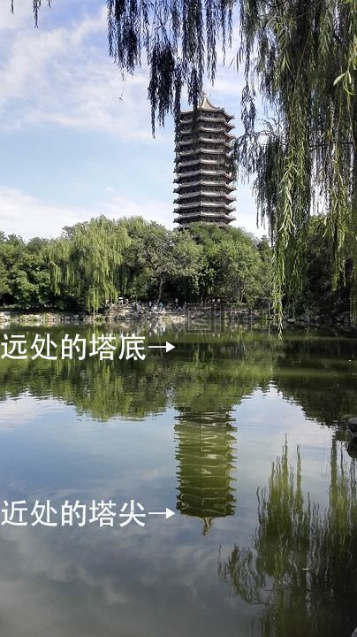

Fresnel effect
When the direction of the incident light is close to the vertical surface, most of the energy will be refracted
When the direction of the incident light is close to the parallel surface, most of the energy will be reflected
Notes:
so we can see the underwater things clearly.
so we will see the reflection in the distance.

Slide 30
Phong
How to deal with intersection points in shadows?

Slide 31
Phong
Ray casting once more
If the testing point is in shadows, the nearest intersection point is definitely closer to light source than the testing point!

Slide 32
作业框架中待实现的代码包括：
光线的生成 Render.cpp
三角形求交，使用Moller-Trumbore 算法 Triangle.cpp
交点处反射的处理 Render.cpp
交点处Phong模型着色 Render.cpp
修改模型材质参数、尝试增加场景中的物体
使用OpenGL实现加载自己的模型以及光线追踪实验（加分项、可选）
注意：所有待补充的代码处都标有: TODO，可通过该关键词查找
框架生成的结果是ppm文件，可以用下面的在线工具转成png图片
https://onlineconvertfree.com/zh/convert-format/ppm-to-png/

Slide 33
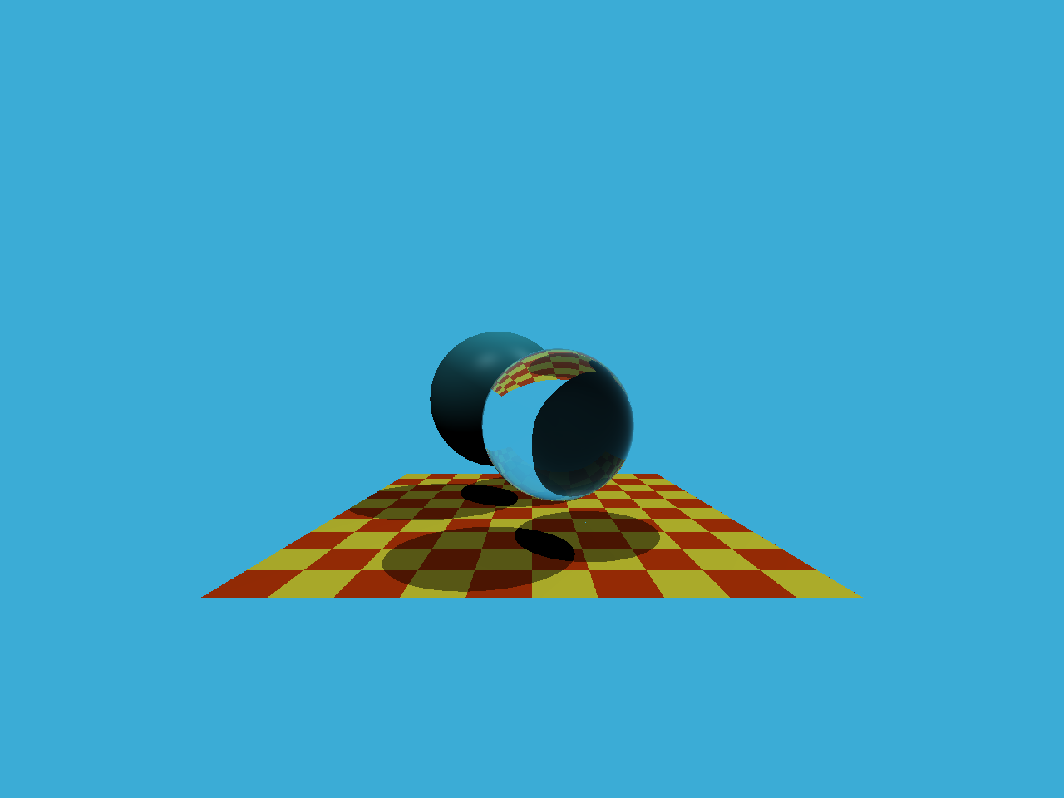

Slide 34
Thank you!
(And thank Prof. Lingqi Yan and Prof. Kai Xu for many of the slides!)

