Slide 1
Storage and Interpretation of Files
cx1111@mit.edu

Slide 2
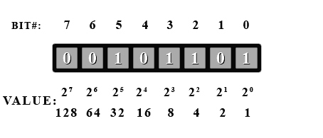
Bits and Bytes

Slide 3
File Contents
Files are one-dimensional arrays of bytes.
The format of a file is defined by its content since a file is solely a container for data.
[89] [111] [117] [114] ... [102] [101] [32]

Slide 4
File Contents
The file extension may indicate how the bytes should be interpreted, but interpretation is still up to the user or program.

Slide 5
Text Encoding - ASCII

Slide 6
Text Encoding - UTF

Slide 7
Binary Data
Binary data is usually stored in N byte blocks. ie. 1 byte, 2 byte, 4 byte, 8 byte.

Slide 8
Binary Data - Integers
Bear in mind the range of values you can store!
Int x or long x? Depends what you want it for...

Slide 9
Binary Data - Floating Point

Slide 10
Example – WFDB File
Data is stored in the dat file
Interpretation information is stored in the header file.
Sometimes, the header and data are stored in the same file.

