Slide 1
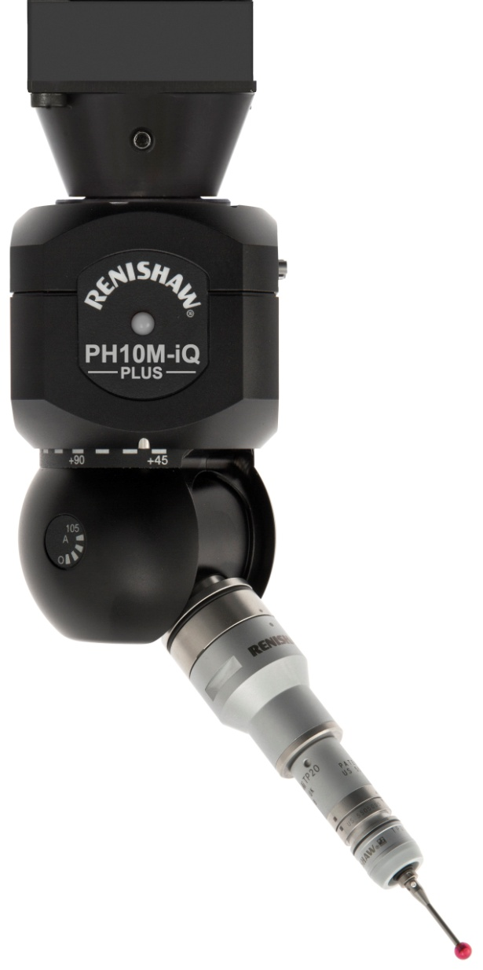
PH10M-iQ PLUS

Slide 2
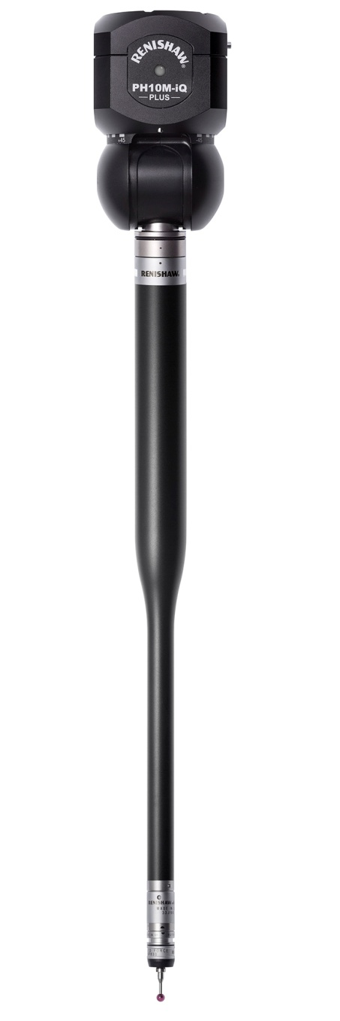
PH10M-iQ PLUS
Functionally identical to PH10M PLUS but with the addition of inferred qualification
Inferred qualification increases throughput by removing the need to qualify each head position used in a measurement program
PH10M-iQ PLUS allows the user to operate the head in all 720 positions without qualifying each one

Slide 3
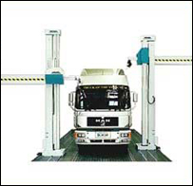
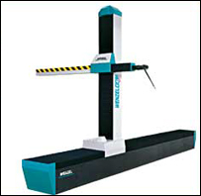
PH10M-iQ PLUS
Perfect for applications where throughput is desired over very high levels of accuracy
Body in white inspection for the automotive industry is the exact type of application that benefits most from using PH10M-iQ PLUS
Larger tolerances
Horizontal arm machines
Long extension bars
Multiple head angles

Slide 4
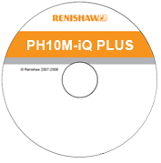
The head file
PH10M-iQ PLUS is functionally the same as a standard PH10 PLUS
The difference is that it undergoes an error mapping process that creates a calibration map that is saved to the head file
Each unique head file is shipped on a CD with the head

Slide 5
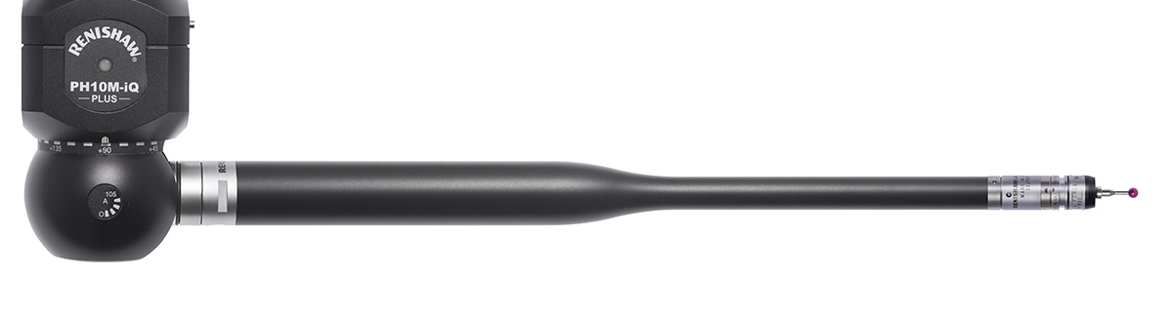
Key benefits and innovations
Increased throughput
PH10M-iQ PLUS provides all the functionality of Renishaw’s industry standard PH10M PLUS but with the addition of inferred qualification
Inferred qualification allows PH10M-iQ PLUS to measure in any head position without having to requalify each one
Two heads in one
PH10M-iQ PLUS can be used for any PH10M PLUS application but also gives touch-trigger probing routines a significant time saving advantage with inferred qualification

Slide 6
How accurate?
System accuracy can be optimised by increasing the number of positions during probe qualification
Horizontal arm machines
Bridge machines
Mounting | Positions | PLTI - Typical positional span
Vertical | 3 | 95 µm
Horizontal | 8 | 125 µm
 | 12 | 80 µm
 | 18 | 65 µm
Mounting | Positions | PLTI - Typical positional span
Vertical | 3 | 15 µm

Slide 7
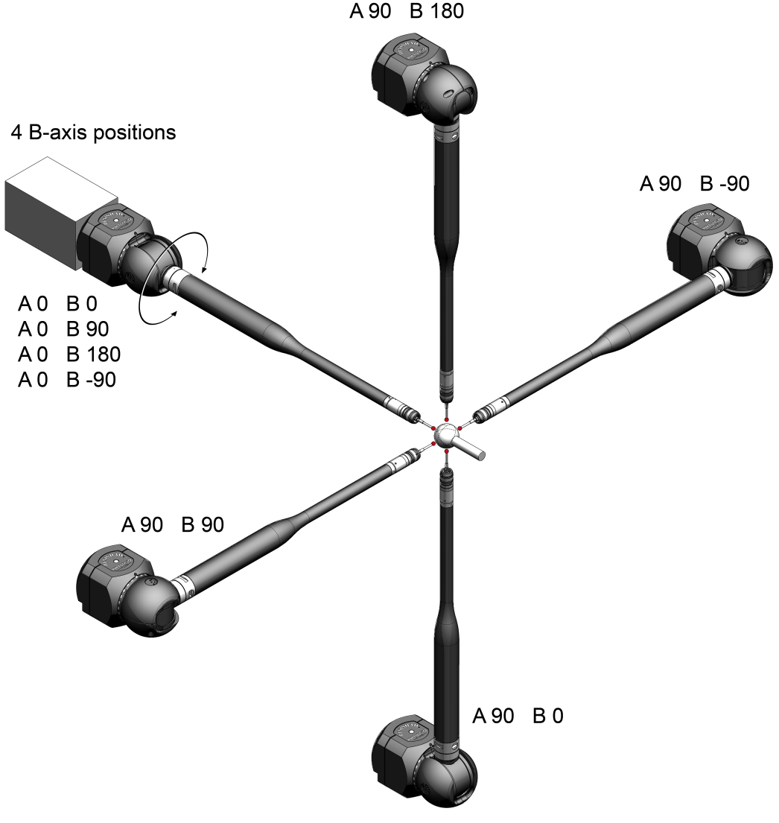
The inferred qualification procedure
Horizontal arm machine, horizontally mounted - Inferred probe qualification routine for 8 positions
Set 1 |  | Set 2
A angle | B angle | A angle | B angle
0 | 0 | 90 | 0
0 | 90 | 90 | 90
0 | -90 | 90 | -90
0 | 180 | 90 | 180

Slide 8
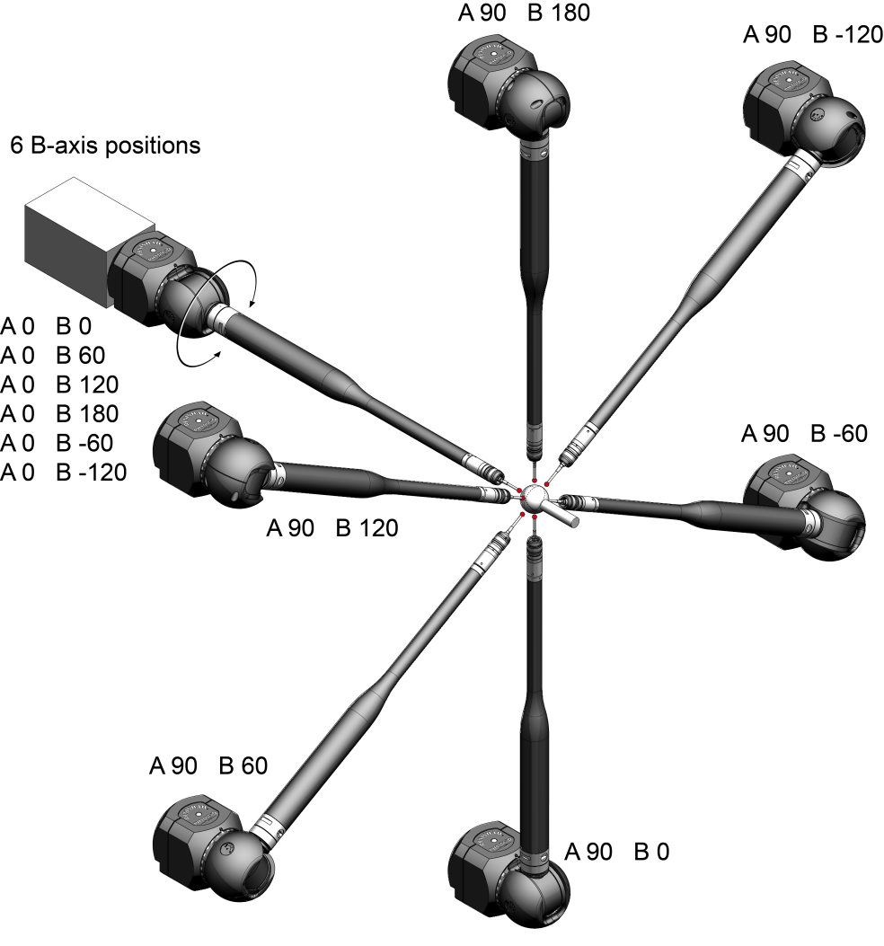
The inferred qualification procedure
Horizontal arm machine, horizontally mounted - Inferred probe qualification routine for 12 positions
Set 1 |  | Set 2
A angle | B angle | A angle | B angle
0 | 0 | 90 | 0
0 | 60 | 90 | 60
0 | -60 | 90 | -60
0 | 120 | 90 | 120
0 | -120 | 90 | -120
0 | 180 | 90 | 180

Slide 9
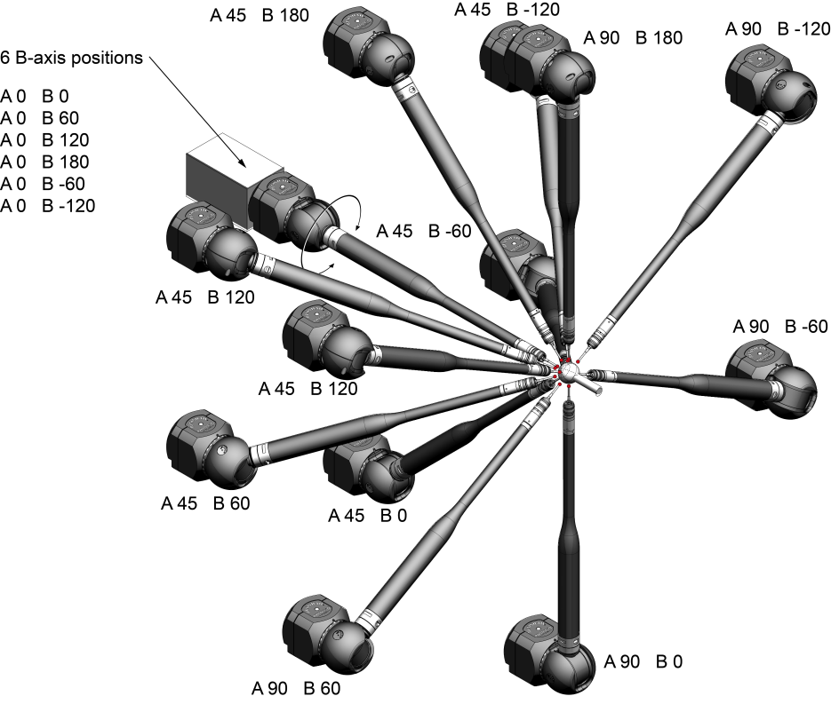
The inferred qualification procedure
Horizontal arm machine, horizontally mounted - Inferred probe qualification routine for 18 positions
Set 1 |  | Set 2 |  | Set 3
A angle | B angle | A angle | B angle | A angle | B angle
0 | 0 | 45 | 0 | 90 | 0
0 | 60 | 45 | 60 | 90 | 60
0 | -60 | 45 | -60 | 90 | -60
0 | 120 | 45 | 120 | 90 | 120
0 | -120 | 45 | -120 | 90 | -120
0 | 180 | 45 | 180 | 90 | 180

Slide 10
What is typical positional span?
Positional span of sphere location (PLTI) evaluated as per ISO 10360-5 (2010) but covering all 720 head positions
Horizontal arm machine test specification
Bridge machine test specification
PAA3 extension bar TP20 STD force module 10 mm x Ø 4 mm stylus | MPEe = ± (9 + L / 100) µm (L in mm) ISO 10360-2 (2009)
PAA1 adaptor TP20 STD force module 10 mm x Ø 4 mm stylus | MPEe = ± (1 + L / 750) µm (L in mm) ISO 10360-2 (2009)

Slide 11
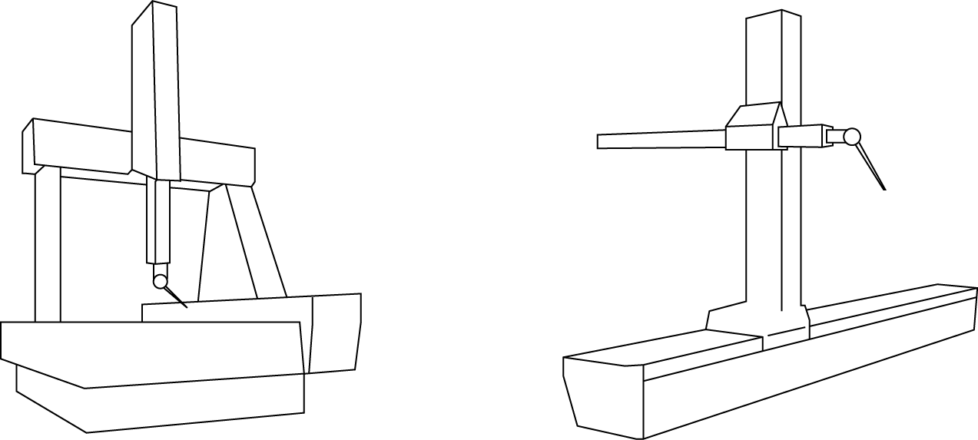
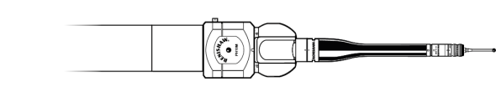
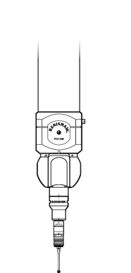
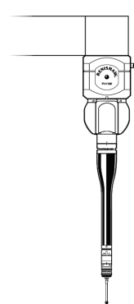
Mounting options
PH10M-iQ PLUS can be mounted vertically or horizontally on horizontal arm machines and vertically on bridge machines

Slide 12
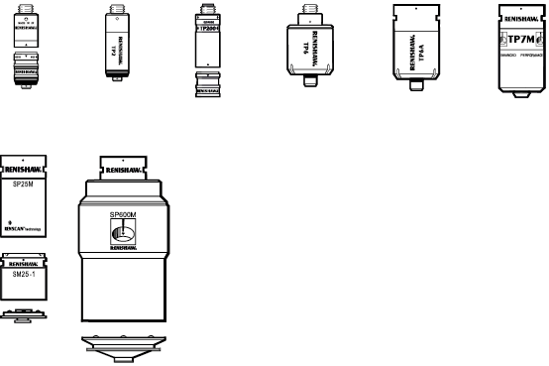
Two heads in one
PH10M-iQ PLUS works with all PH10M compatible probes
Only the following touch-trigger probes can utilise inferred qualification;
TP20
TP2-5W
TP200
TP6
TP6A
TP7M
The following scanning probes can only be used in traditional PH10 mode and cannot utilise inferred qualification;
SP25M
SP600M

Slide 13
Summary
PH10M-iQ PLUS head is supplied with a calibration file used by an inferred calibration algorithm
Following a quick qualification procedure, the user can measure in all 720 positions without requalifying
PH10M-iQ PLUS is aimed at horizontal arm CMM applications, vertically or horizontally, but can also be used on bridge machine
By reducing the time required for qualification, PH10M-iQ PLUS increases the time that the CMM is available for measurement
PH10M-iQ PLUS functions identically to PH10M PLUS but inferred qualification is usable with any touch-trigger probe application

Slide 14
PH10M-iQ PLUS
Now with 2 year warranty as standard

