Slide 1
PH10 PLUS motorised indexing heads

Slide 2
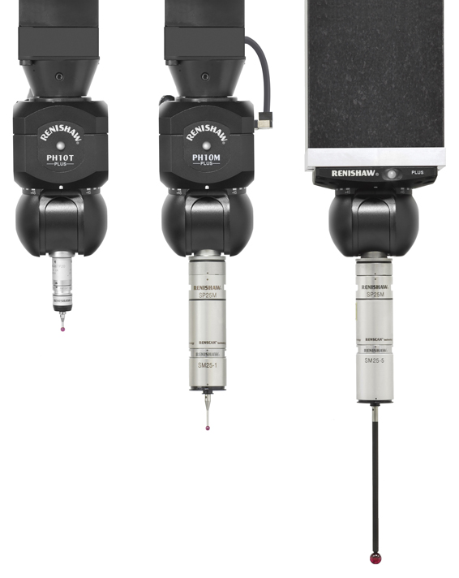
What is a PH10 PLUS?
The PH10 PLUS range of products are indexing probe holders which allow the probe to be orientated and locked in any of the 720 positions during the inspection cycle
Renishaw offers a family of PH10 PLUS heads that can be matched to your specific application

Slide 3
PH10 PLUS range differences
The table below shows the differences in the PH10 PLUS range:
Head type | Head mount | Probe mount
PH10T PLUS | Shank | M8 thread
PH10M PLUS | Shank | Multiwire autojoint
PH10MQ PLUS | Quill | Multiwire autojoint

Slide 4
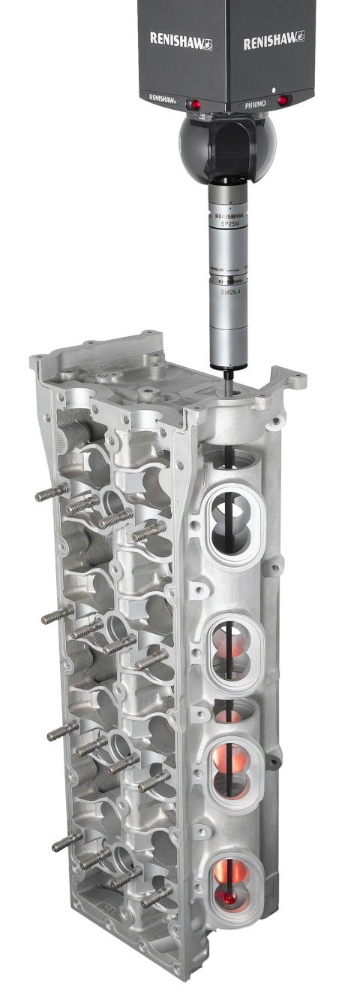
Where are they used?
The PH10 PLUS family gives DCC machines the added capability of probe reorientation, allowing the probe to inspect features at the optimum angle, considering access requirements and probing best practice
PH10 PLUS can be mounted to a variety of different sized bridge or horizontal arm machines for touch trigger, optical or scanning probing

Slide 5
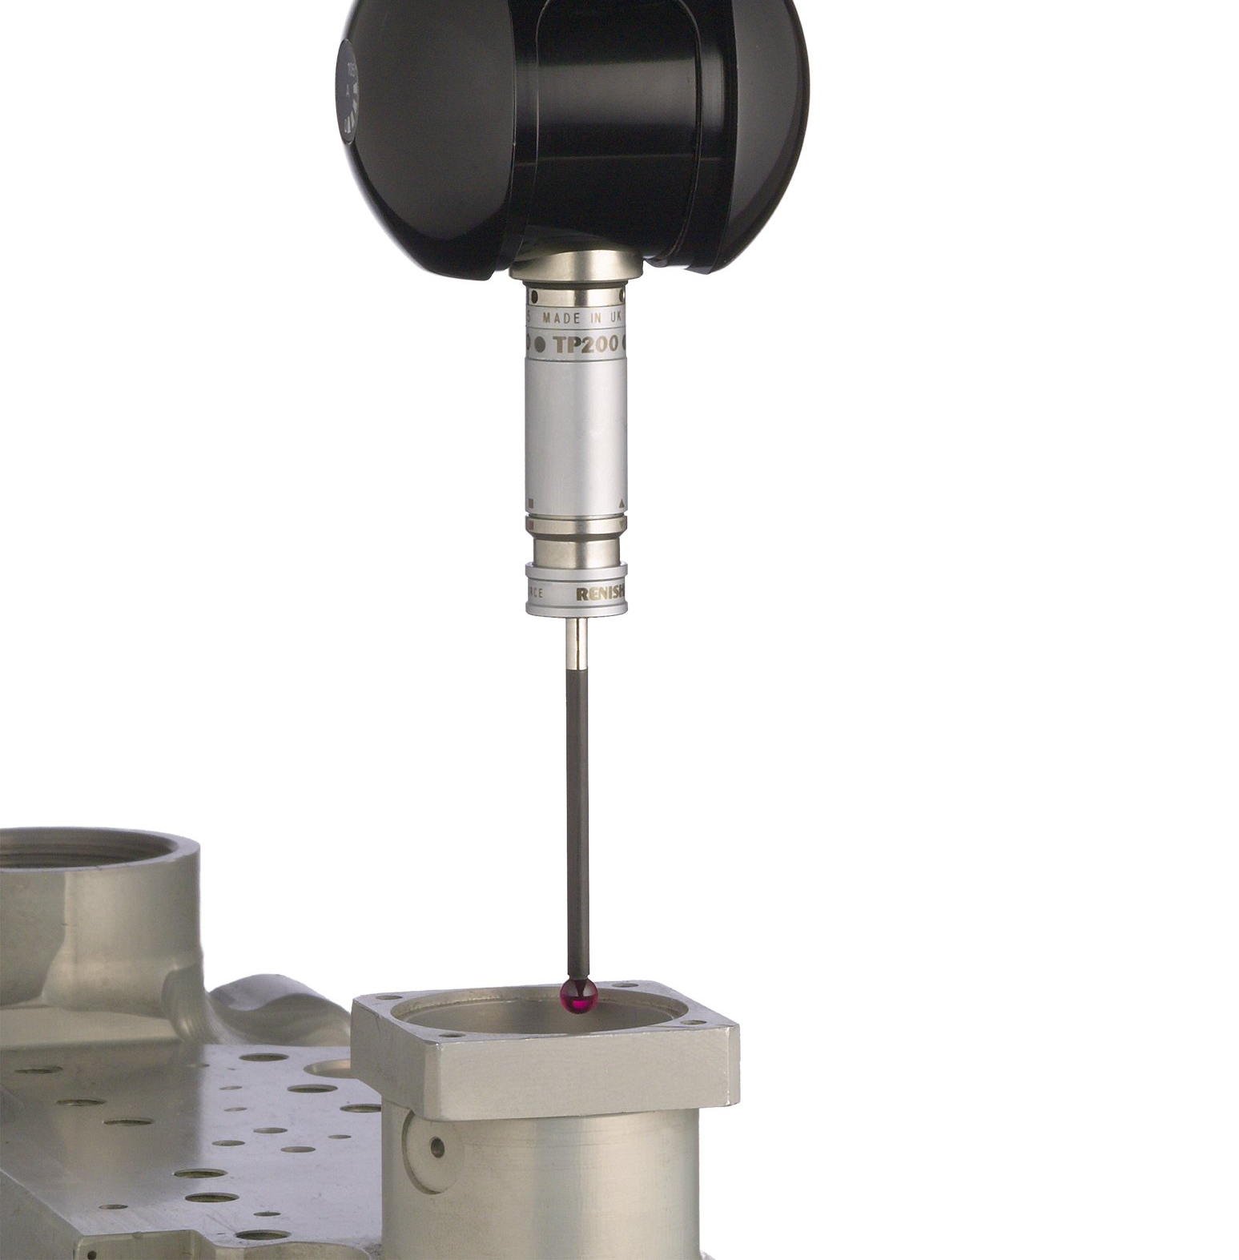
Where are they used?
The PH10 PLUS range is a universal family of products used in many industries including aerospace and automotive
Compatible with a full range of sensors and extensions, the position, size and form of high tolerance features can be determined
The PH10 PLUS range of heads are established and reliable products that provides a cost effective probing solution

Slide 6
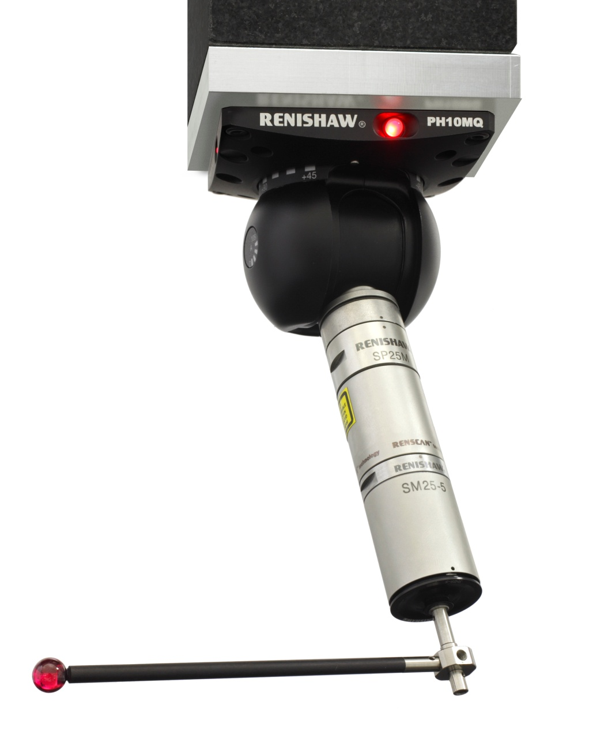
What are the benefits?
The PH10 family brings many benefits that will improve the way you inspect components and assemblies
These benefits include:
Flexibility
Increased throughput
Maximum accessibility
Improved accuracy
Minimal risk to head and CMM
Low cost of ownership

Slide 7
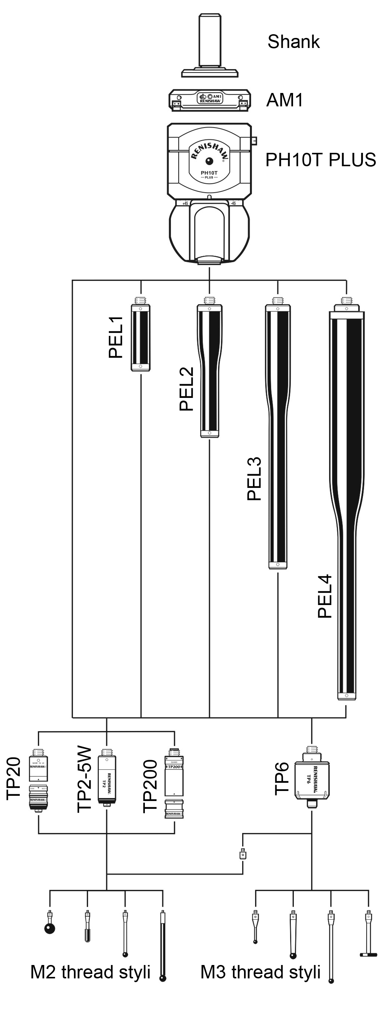
Flexibility
PH10T PLUS can be used with Renishaw’s range of M8 thread probes and extension bars

Slide 8
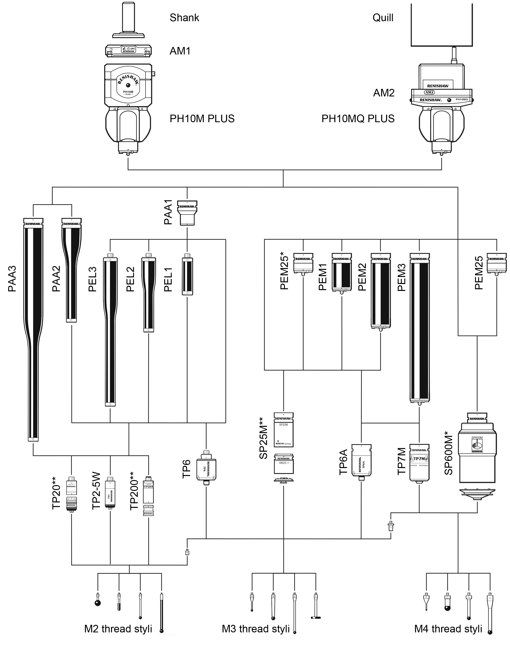
Flexibility
The PH10M and PH10MQ PLUS can be used with Renishaw’s range of autojoint probes and extension bars

Slide 9
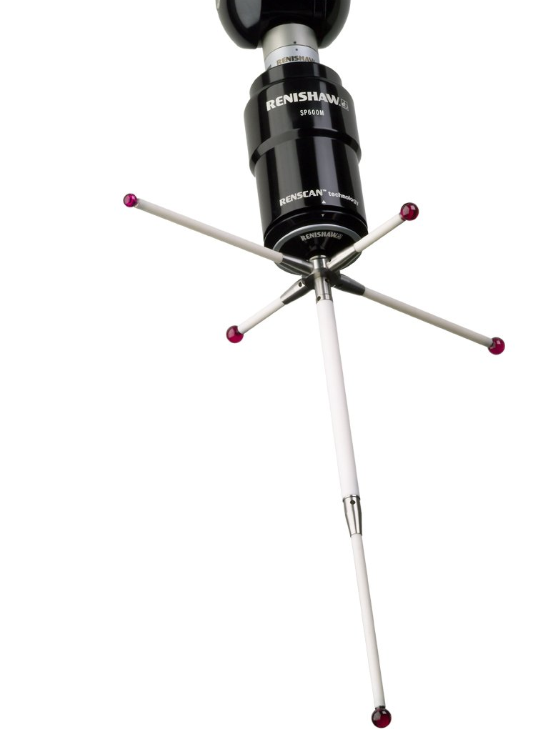
Increased throughput
The motorised indexing of PH10 PLUS reduces the number of stylus changes, increasing the throughput of your machine
The PH10 PLUS range can move through 90 degrees in 3.5 seconds keeping the time that you are not inspecting to a minimum
The repeatable kinematic autojoint on PH10M/MQ PLUS allows for DCC probe or extension bar changing with ACR3 rack
Re-qualification of the stylus tip is not needed, this reduces inspection time and allows un-manned inspection cycles

Slide 10
Accessibility
PH10s can articulate in 7.5 degree increments in both the A (105 degrees) and B (+/- 180 degrees) axes giving 720 repeatable positions
Long extension bars and a comprehensive range of styli increase the access range of the PH10 PLUS family
The PH10MQ PLUS increases the available working volume with its B axis housed within the quill of the CMM. An 80 mm quill is required

Slide 11
Accuracy
The PH10 family can achieve 0.4 µm repeatability at 62 mm radius providing accurate positioning even when using long extensions
The accuracy that the PH10 enables you to achieve improved inspection routines and can help to reduce the level of scrap experienced
Articulating heads with simplified styli configurations improve the accuracy and dynamics achieved
Repeatable extension bar and probe / module changing also enhances the accuracy and flexibility of the system

Slide 12
Minimal risk to head and CMM
The PH10 has a recommended maximum torque of 0.45Nm.This safety feature ensures that in the event of an accidental collision the head will overtravel protecting itself and the CMM from damage
The ACR3 autochange rack uniformly controls the changing of probes and extensions removing the element of human error and the possibility of damage when manually changing probes

Slide 13
Low cost of ownership
PH10 PLUS components are individually priced giving you the added flexibility of choosing and growing the best system for your application
Renishaw offers a wide range of service options for all products in order to minimise customers downtime
Cost of repair is based on an assessment and a consultation takes place before any work is undertaken
PH10 PLUS customers also have the option of purchasing a replacement from the Repair By Exchange (RBE) scheme in the interests of fast turn around and minimal downtime

Slide 14
Usage record and warranty
All PH10 PLUS heads are now able to store their usage history
All PH10 PLUS heads now come with 2 years warranty as standard

Slide 15
Summary
With PH10 PLUS, you can...
measure using touch trigger, optical or scanning probes depending on your application
index your stylus tip for increased accessibility
increase throughput by stylus changing without having to re-qualify
automatically change extension bars up to 300 mm long for increased accessibility
achieve accuracy of 0.4 µm at 62 mm radius
protect your investment through integral over travel protection
be assured that any machine downtime will be kept to a minimum through Renishaw’s expert service and support

