Slide 1
TUTORIAL LESSON Linux & Tools
Institute of

Slide 2
BIRTH of TUTORIAL LESSON
ICS introduces the Computer Systems, then WHO introduces ICS ?
A new environment: Linux
ICS Book does not contain them

Slide 3
OUTLINE
Tasks
Linux
Tools

Slide 4
Tasks
Linux
Tools

Slide 5
TASKS
Labs (25%)
1: Bits
2: Bomb
3: Buffer Overflow
4: Fuzzing
5: Android Reverse

Slide 6
HARD RULES
Deadline: No Extension
Multiple submissions
Plagiarism: No Tolerance
Forbid C&P
from Network
from Classmates
Punishment
0 point for ALL

Slide 7
Cheating will not be tolerated
…
All homework, labs and exams are to be done individually.
…
It is your responsibility to ensure that your passwords are well-guarded, directories protected, and printouts do not fall into other hands.

Slide 8
Tasks
Linux
Tools
Introduction
Installation
Shell

Slide 9


BACKGROUND
The History of Linux
Linus Torvalds, 1991
Unix-like Operating Systems
Heirs: Linux, BSD, Solaris, MacOS X, …
Principle: KISS
Keep It Simple, Stupid !

Slide 10
COMPARISON
Differences between Windows and Linux
One Kernel and Multiple Distribution
3.16.x kernel (latest stable: 4.13.2 2017.9.13)
RedHat / Fedora, Debian
Suse, Gentoo, Arch, Ubuntu, …
Powerful Command Line Interface
Directories Organization
…

Slide 11













Slide 12
Tasks
Linux
Tools
Introduction
Installation
Shell

Slide 13
INSTALL
Step 0: How to find it ?
Course ftp
ftp://10.132.141.33/classes/18/191%20%20%BC%C6%CB%E3%BB%FA%CF%B5%CD%B3%BB%F9%B4%A1(%C9%CF)/Materials/
Online: get the official web-site by google
e.g. Ubuntu

Slide 14
INSTALL
Tips: virtual machine
Definition
provides a complete system platform which supports the execution of a complete operating system
Java Runtime Environment
Step 1: Where to install it ?
on RAW machine
Cool !
on VIRTUAL machine
Safety!
Dangerous !
Recommendation !

Slide 15
INSTALL
Tips: VMware Workstation
Benefit
hosted, popular, graphic
easy, stable, checkpointed
Step 2: Create VM
Create VM from ISO file
e.g. ubuntu-16.04.3-desktop-amd64
Set name and location
Disk capacity
20G (engross on demand)
Network connection (customized)
Bridge (separate IP) or NAT (internal IP, default)
Done !

Slide 16
INSTALL
Step 3: Configure VM
Configure Hardware (Customized)
Memory Size
#CPU / #Core
Ethnet Mode
Power On
Let’s go !

Slide 17
Tasks
Linux
Tools
Introduction
Installation
Shell

Slide 18
SHELL
Operating System Shell
Provide access to the services of a kernel
Command-Line Interface (CLI)
Unix Shell
e.g. Bounce-Again Shell, bash
Non-Unix Shell
e.g. DOS
Graphical User Interface (GUI)
Windows, X Window (KDE, GNOME, Xfce), Mac OS

Slide 19
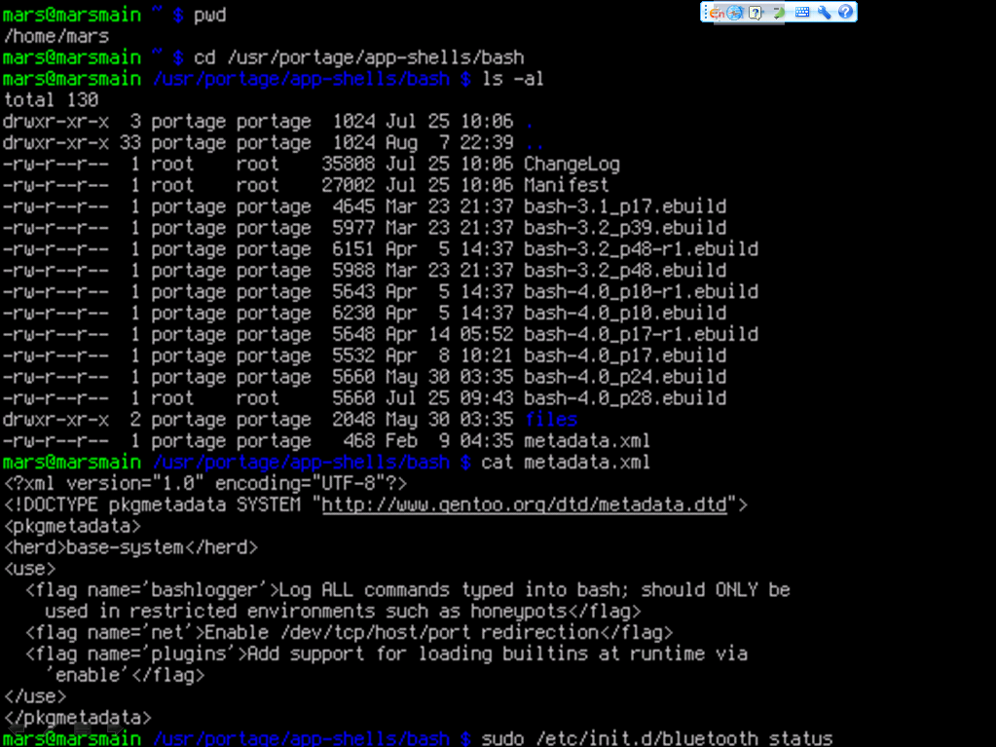

Slide 20
Commands
MOST IMPORTANT
Search Path: /bin, /usr/bin, ...
Command is case sensitive
man – display the manual pages e.g. >man man
whatis – search the whatis database for complete words e.g. >whatis passwd
ifconfig – ip address

Slide 21
Commands
File and Directory
ls - list files/dirs e.g. >ls -l
mkdir – create a dir e.g. >mkdir test
cd - change dir e.g. >cd test
rm - remove files/dirs e.g. >rm -f a.txt
cp - copy files/dirs e.g. >cp a.txt b.txt
mv – move files/dir s e.g. >mv a.txt c.txt
pwd – show current path e.g. >pwd
du – estimate files/dirs space usage e.g. >du -c -h test
df – report free disk space e.g. >df

Slide 22
Commands
File and Directory
chmod – change mode of file/dir e.g. >chmod 777 test
chown – change owner of file/dir e.g. >chown ics edit
chgrp – change group of file/dir e.g. >chgrp guest draft -R
$ ls -l
drwxr--r-- 1 peter admin 4096 Mar 1 2007 drafts
-rw-r--r-- 1 peter admin 30405 Mar 1 2007 edition-32
-r-xr-xr-x 1 terry admin 8460 Mar 1 2007 edit
duuugggooo C owner group size date name
C:(hard link count)

Slide 23
Commands
Search
whereis - locate special files for a command (binary, src and manual file) e.g. >whereis cp
find – search for files/dirs in a dir hierarchy e.g. >find . –name “c.txt”
locate – locate files/dirs by name in system based on a database e.g. >locate test
grep – text search utility e.g. >grep “abc” . -R

Slide 24
Commands
User Account
useradd – create a new user e.g. >useradd ics
userdel – delete a user account e.g. >userdel ics
passwd – set password for a user account based on a database e.g. >passwd ics
users – print name of user currently logged e.g. >users

Slide 25
Commands
Text
cat – concatenate and print files e.g. >cat b.txt
head – output the first part of files e.g. >head –n 4 b.txt
tail – output the last part of files e.g. >tail –c 50 b.txt
wc – print the number of newlines, words, and bytes in files e.g. >wc b.txt
cut – remove sections from each line of files e.g. >cut –c 4-10 b.txt

Slide 26
Commands
Misc
echo – display a line of text e.g. >echo $PATH
mount – mount a file system e.g. >mount /dev/sda3 /mnt
umount – unmount a file system e.g. >umount /mnt
ping – send ICMP ECHO_REQUEST to network hosts e.g. >ping 10.132.143.100
date – print or set the system date and time e.g. >date "+%m/%d/%y“
time – time a simple command e.g. >time locate mapreduce

Slide 27
Commands
Misc
; – join two command in one line e.g. >echo $PATH; whereis echo
< > >> – redirect input and output e.g. >cat b.txt >> c.txt
| – pipe the former output as the later input e.g. >cat b.txt | grep “abc”
& – do command in new process e.g. >cat b.txt &

Slide 28
Tasks
Linux
Tools
Software Installer
Compressing and Archiving
Remote Login
Text Editor

Slide 29
VERSION CONTROL
APT (Advanced Package Tools)
A management system for software packages
Package resource list for APT:
/etc/apt/sources.list
$ cat /etc/apt/source.list
...
deb http://mirrors.163.com/debian/ jessie main
dbe-src http://mirrors.163.com/debian/ jessie main
type URI of source dist comp
URI type: http, ftp, cdrom, file, ssh ...

Slide 30
VERSION CONTROL
APT (Advanced Package Tools)
apt-get: command-line tool
update e.g. >apt-get update
install e.g. >apt-get install htop
remove e.g. >apt-get remove htop
upgrade e.g. >apt-get upgrade htop
apt-cache: cache manipulator
search e.g. >apt-cache search htop
showpkg e.g. >apt-cache showpkg htop

Slide 31
VERSION CONTROL
APT (Advanced Package Tools)
example: install vim
>su root user
>apt-get update update apt list
>apt-cache search vim search in cache
>apt-get install vim install vim
>man vim manual of vim
$ apt-cache search vim
...
vim – Vi IMproved – enhanced vi editor
vim-doc - Vi IMproved – HTML documentation
...

Slide 32
Tasks
Linux
Tools
Software Installer
Compressing and Archiving
Remote Login
Text Editor

Slide 33
COMPRESSING
GZIP (Gnu ZIP)
gzip file format
Compress just single file
Replace the original file with .gz file
e.g. >gzip test.txt
>gunzip test.txt.gz

Slide 34
ARCHIVING
TAR (Tape ARchive)
tar file format
Suffix:
.tar e.g. >tar -cf src.tar src/
.tgz/.tar.gz e.g. >tar -zxf src.tar.gz
.tbz/.tar.bz2 e.g. >tar -jcf src.tbz src/

Slide 35
Tasks
Linux
Tools
Software Installer
Compressing and Archiving
Remote Login
Text Editor

Slide 36
REMOTE LOGIN
SSH (Secure SHell)
ssh username@ip
Remote Login from Windows
Command-Line Interface
PuTTY
act as a client for SSH and Telnet
Developed by Microsoft

Slide 37

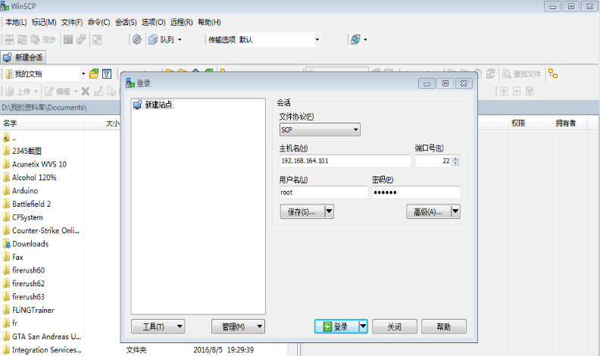
Transfer Files –widows
Winscp
Need install sshd
sudo apt-get install yum
sudo apt-get install openssh-server，
sudo ps -e |grep ssh
sshd

Slide 38
Transfer Files – Mac
SCP, A Replacement for FTP
e.g. >scp b.txt root@127.0.0.1:~/test/ >scp root@127.0.0.1:~/test/b.txt ./
ForkLift

Slide 39
Tasks
Linux
Tools
Software Installer
Compressing and Archiving
Remote Login
Text Editor

Slide 40

TEXT EDITOR
vi (Visual Editor)
/'viː'ai/, not /'siks/ ☺
Extension: vim, vile, xvi, …
Simple and Convenient
BOOK: “learning the vi editor”
http://www.china-pub.com/computers/common/info.asp?id=9208
Cheat Sheet (Chinese version)
http://jserv.sayya.org/misc/vi-vim-cheat-sheet.png
“>vimtutor” to get a simple tutorial

Slide 41
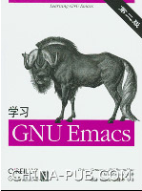
TEXT EDITOR
Emacs (Editing MACroS)
/'imæks/
More powerful than IDE !
Emacs List
BOOK: “Learning GNU Emacs”
http://www.china-pub.com/computers/common/info.asp?id=13395

Slide 42
Thanks

