Slide 1
DLC
Date Limite de Consommation?
Johann Bourcier – ESIR – IRISA – DiverSE

Slide 2
DLC
DevOps et Livraison Continue

Slide 3
Context
Cloud, virtualisation and virtually infinite resources available
Versatile consumers with high expectations of
Innovative functionalities
Quality of services : availability 365/7/24; performance immediate; …
Distributed system complexity and scale
An increasing non-determinism of
Hardware precision/bugs/faults and performance
Software bugs and performance

Slide 4
How will you organize your team to develop and operate a service in this context ?
Leveraging everything you have learn until now

Slide 5
Service
You want to operate a very simple service available from anywhere, operating 365/24/7, with high performances no matter the number of connected users, no matter the failures, no matter the pirate attacks, which may give approximate or partial answer,
Functionnality :
1st : Search films and display answer with poster, genre, duration and ratings. (DB should be intialized with 10^4 movies ((omdbAPI.com or Imdb or whatever you want) )
2nd : add the authors and actors
3rd : add the authors and actors photos and the list of films and the navigation see the details of the films
4th : add the possibility for users to add new films in the database

Slide 6
Time to work together

Slide 7
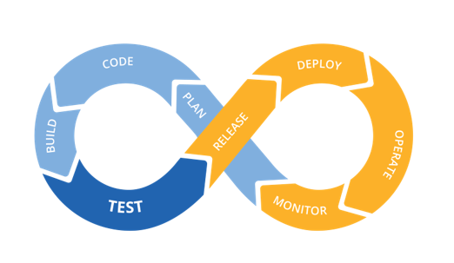
DevOps

Slide 8
