Slide 1
Lab 9 - Forecasting

Slide 2
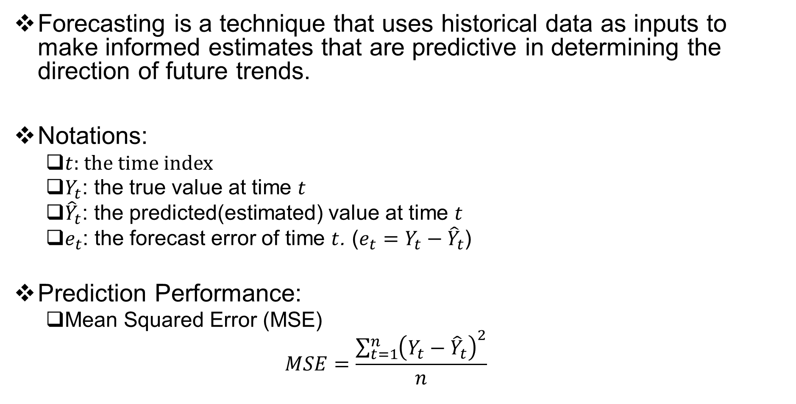
Forecasting
Forecasting is a technique that uses historical data as inputs to make informed estimates that are predictive in determining the direction of future trends.
Notations:
$t$: the time index
$Y_{t}$: the true value at time $t$
${\hat{Y}}_{t}$: the predicted(estimated) value at time $t$
$e_{t}$: the forecast error of time $t$. ($e_{t}=Y_{t}−{\hat{Y}}_{t}$)
Prediction Performance:
Mean Squared Error (MSE)
$$MSE=\frac{\sum_{t=1}^{n}{{\left(Y_{t}−{\hat{Y}}_{t}\right)}^{2}}}{n}$$

Slide 3

Naive Approach
The naive method for prediction is a simple forecasting technique that assumes that the future value of a time series will be equal to the present value.
$${\hat{Y}}_{t+1}=Y_{t}$$
Using naïve method to predict the values of week 6 - 10. Calculate the MSE of this prediction.
Week (t) | Y(t) | Y.hat(t) | e(t) | e^2(t)
1 | 275
2 | 291
3 | 307
4 | 281
5 | 295
6 | 268
7 | 252
8 | 279
9 | 264
10 | 288
Notes:
This slide introduces the naïve approach. Subsequent slides introduce other methodologies.

Slide 4
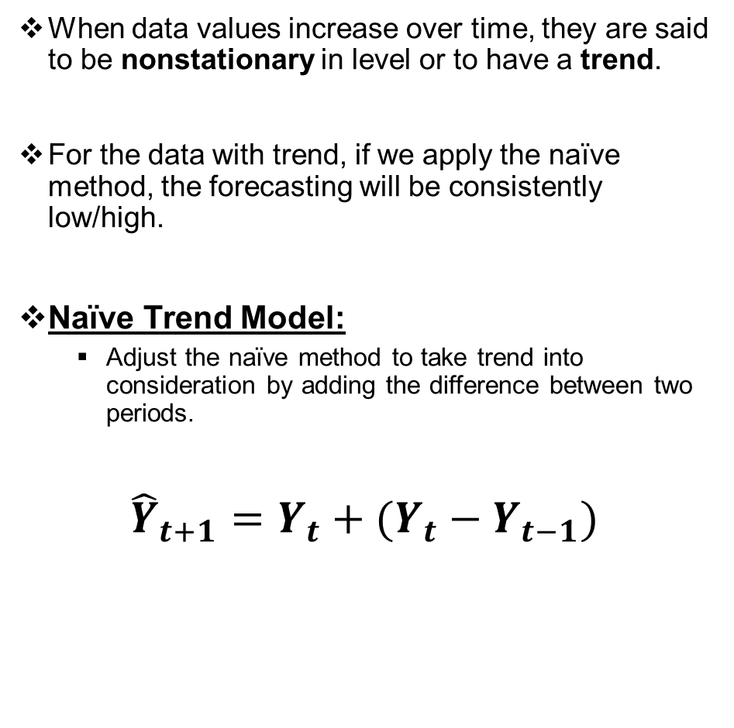
Naïve Trend Model
When data values increase over time, they are said to be nonstationary in level or to have a trend.
For the data with trend, if we apply the naïve method, the forecasting will be consistently low/high.
Naïve Trend Model:
Adjust the naïve method to take trend into consideration by adding the difference between two periods.
$${\hat{Y}}_{t+1}=Y_{t}+(Y_{t}−Y_{t−1})$$

Slide 5

Naïve Trend Model
$${\hat{Y}}_{t+1}=Y_{t}+\left(Y_{t}−Y_{t−1}\right)=2Y_{t}−Y_{t−1}$$
Using naïve trend method to predict the values of week 6 - 10. Calculate the MSE of this prediction.
Week (t) | Y(t) | Y.hat(t) | e(t) | e^2(t)
1 | 275
2 | 291
3 | 307
4 | 281
5 | 295
6 | 268
7 | 252
8 | 279
9 | 264
10 | 288

Slide 6
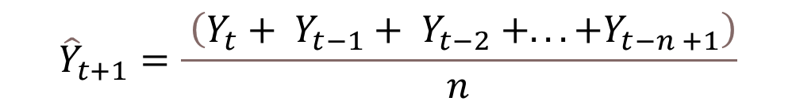
Simple Moving Average
Simple Moving Average is a commonly used technique for time series analysis and forecasting. It is a statistical method that calculates the average of a specified number of data points over a specific period of time.
Assumes an average is a good estimator of future behavior
Used if little or no trend
Used for smoothing
N-period moving average:
$${\hat{Y}}_{t+1}=\frac{ \left(Y_{t}+ Y_{t−1}+ Y_{t−2} +...+Y_{t−n +1}\right)}{n}$$
Notes:
15

Slide 7
Simple Moving Average
You’re manager in Amazon’s electronics department. You want to forecast ipad sales for months 4-6 using a 3-period moving average.
Sales
(1000)
Month
1
4
2
6
3
5
4
?
5
?
6
?

Slide 8
Simple Moving Average
You’re manager in Amazon’s electronics department. You want to forecast ipad sales for months 4-6 using a 3-period moving average.
Sales
(1000)
Moving Average
Month
(n=3)
1
4
NA
2
6
NA
3
5
NA
4
?
(4+6+5)/3=5
5
?
6
?

Slide 9
Simple Moving Average
What if ipad sales were actually 3 in month 4
Sales
(1000)
Moving Average
Month
(n=3)
1
4
NA
2
6
NA
3
5
NA
4
?
5
3
5
?
6
?

Slide 10
Simple Moving Average
Forecast for Month 5?
Sales
(1000)
Moving Average
Month
(n=3)
1
4
NA
2
6
NA
3
5
NA
4
3
5
5
?
(6+5+3)/3=4.667
6
?

Slide 11
Simple Moving Average
Actual Demand for Month 5 = 7
Sales
(1000)
Moving Average
Month
(n=3)
1
4
NA
2
6
NA
3
5
NA
4
3
5
5
?
4.667
7
6
?

Slide 12
Simple Moving Average
Forecast for Month 6?
Sales
(1000)
Moving Average
Month
(n=3)
1
4
NA
2
6
NA
3
5
NA
4
3
5
5
7
4.667
6
?
(5+3+7)/3=5

Slide 13
Exercise: Using MA to forecast week 6-10
Using 5-period Moving Average method to predict the values of week 6 - 10. Calculate the MSE of this prediction.
Week (t) | Y(t) | Y.hat(t) | e(t) | e^2(t)
1 | 275
2 | 291
3 | 307
4 | 281
5 | 295
6 | 268
7 | 252
8 | 279
9 | 264
10 | 288

Slide 14

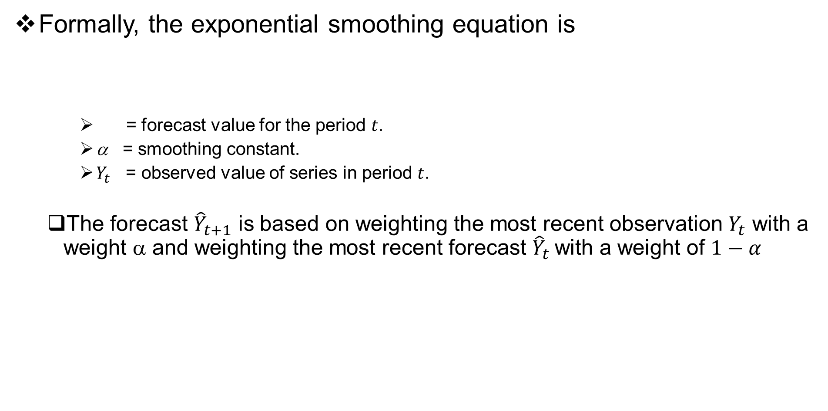

Simple Exponential Smoothing Method
Formally, the exponential smoothing equation is
= forecast value for the period $t$.
α = smoothing constant.
$Y_{t}$ = observed value of series in period $t$.
The forecast ${\hat{Y}}_{t+1}$ is based on weighting the most recent observation $Y_{t}$ with a weight α and weighting the most recent forecast ${\hat{Y}}_{t}$with a weight of $1−α$
$${\hat{Y}}_{t+1}=αY_{t}+(1−α){\hat{Y}}_{t}$$
$${\hat{Y}}_{t}$$

Slide 15


Simple Exponential Smoothing Method
The implication of exponential smoothing can be better seen if the previous equation is expanded by replacing ${\hat{Y}}_{t}$ with its components as follows:
$${\hat{Y}}_{t+1}=α Y_{t}+(1−α){\hat{Y}}_{t} \\ =αY_{t}+(1−α)[αY_{t−1}+(1−α){\hat{Y}}_{t−1}] \\ =αY_{t}+α(1−α)Y_{t−1}+(1−α)^{2}{\hat{Y}}_{t−1}$$

Slide 16
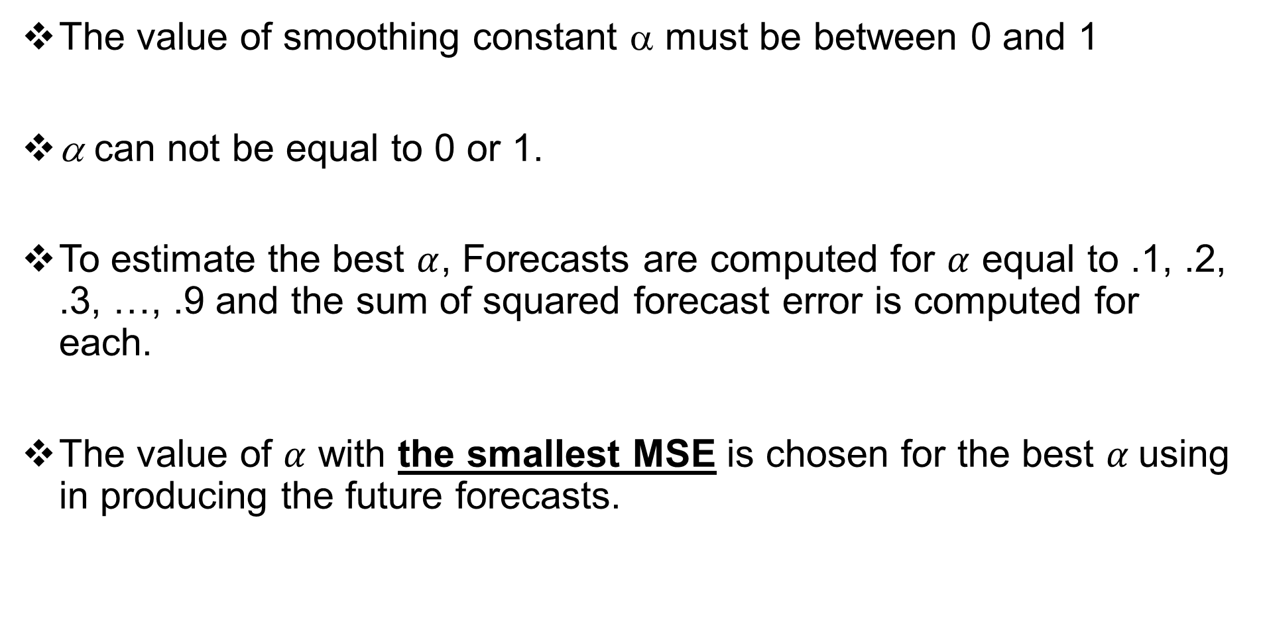
Simple Exponential Smoothing Method
The value of smoothing constant α must be between 0 and 1
α can not be equal to 0 or 1.
To estimate the best $α$, Forecasts are computed for $α$ equal to .1, .2, .3, …, .9 and the sum of squared forecast error is computed for each.
The value of $α$ with the smallest MSE is chosen for the best $α$using in producing the future forecasts.

Slide 17

Exercise: Using ES to forecast week 6-10
Using Exponential Smoothing method with ($α$=0.2) to predict the values of week 6 - 10. Use ${\hat{Y}}_{t}=Y_{t}$ for the initial forecasting. Calculate the MSE of this prediction.
Week (t) | Y(t) | Y.hat(t) | e(t) | e^2(t)
1 | 275
2 | 291
3 | 307
4 | 281
5 | 295
6 | 268
7 | 252
8 | 279
9 | 264
10 | 288

Slide 18

Exercise: Using ES to forecast week 6-10
Using Exponential Smoothing method with ($α$=0.3) to predict the values of week 6 - 10. Use ${\hat{Y}}_{t+1}=\frac{Y_{t}+Y_{t−1}+Y_{t−2}+Y_{t−3}+Y_{t−4}}{5}$ for the initial forecasting. Calculate the MSE of this prediction.
Week (t) | Y(t) | Y.hat(t) | e(t) | e^2(t)
1 | 275
2 | 291
3 | 307
4 | 281
5 | 295
6 | 268
7 | 252
8 | 279
9 | 264
10 | 288

