Slide 1

Predicting COVID-19 Using US Demographic Data
Caroline Clark
Feras Atwal
James Lee

Slide 2
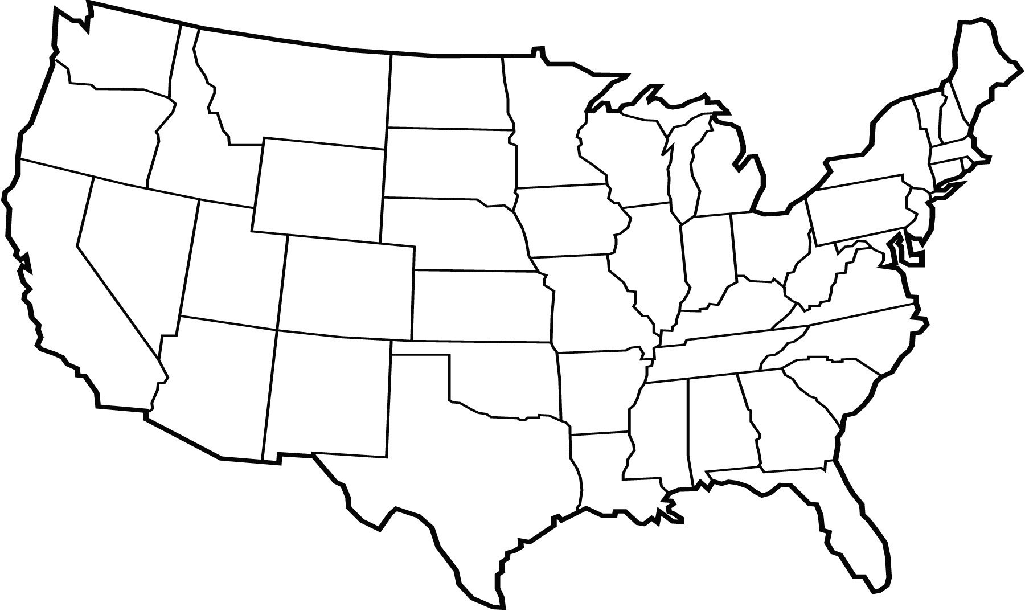
Examining Top 5 States

Slide 3
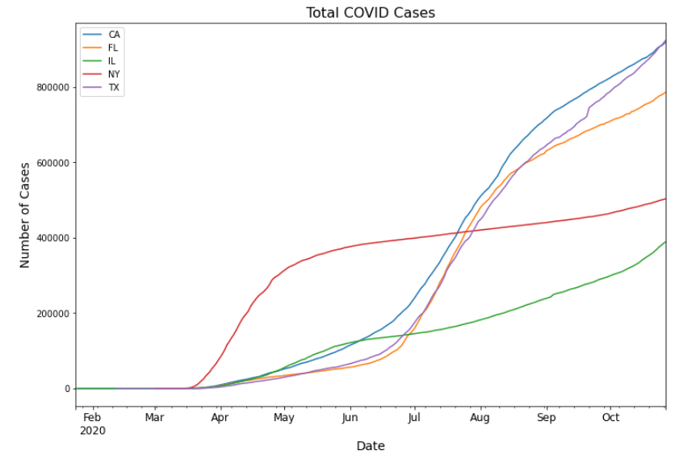
Total COVID Cases for CA, FL, IL, NY, TX

Slide 4
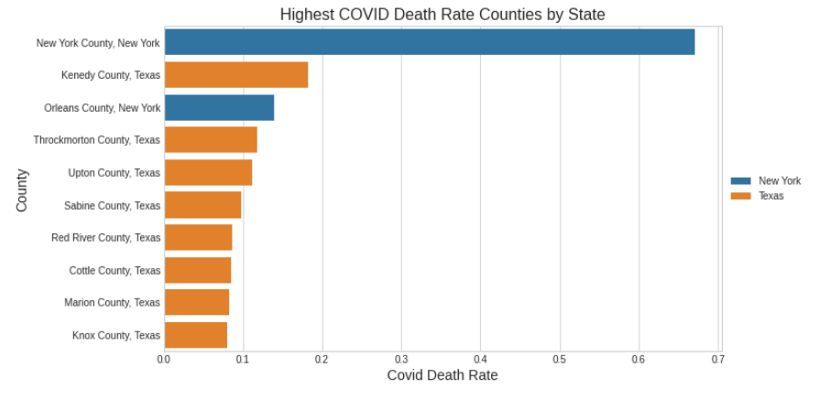
Highest Death Rate Counties by State

Slide 5
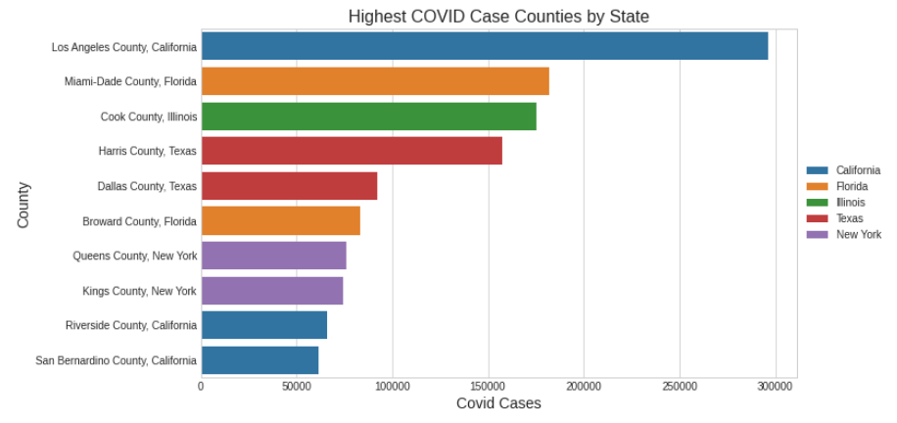
Highest Case Counties by State

Slide 6
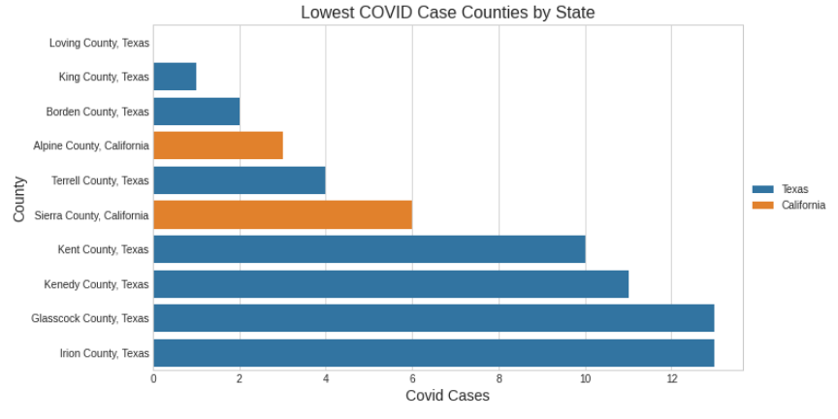
Lowest Case Counties by State

Slide 7
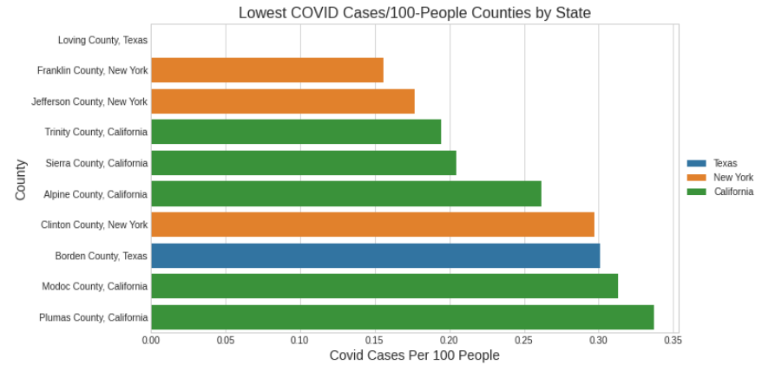
Lowest Cases/100 People Counties by State

Slide 8
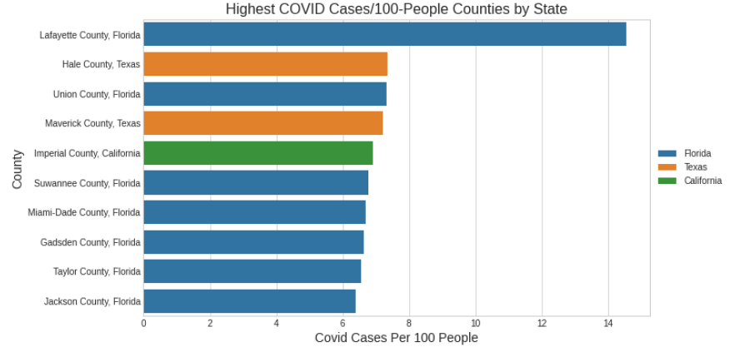
Highest Cases/100 People Counties by State

Slide 9
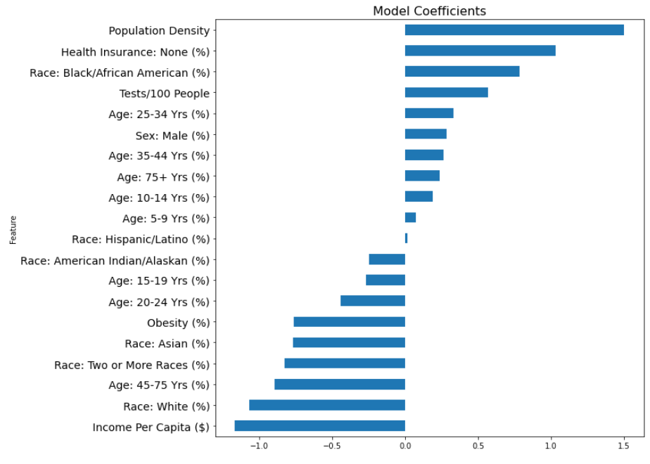
General Model Coefficients

Slide 10
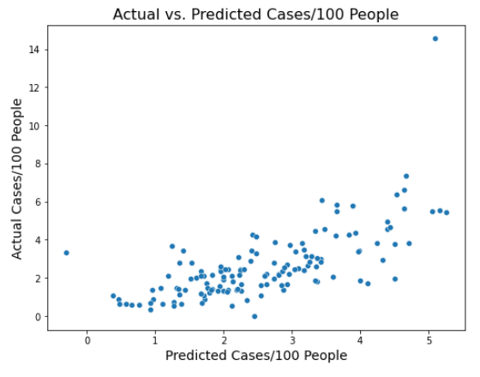
General Actual vs. Predicted Cases/100 People

Slide 11
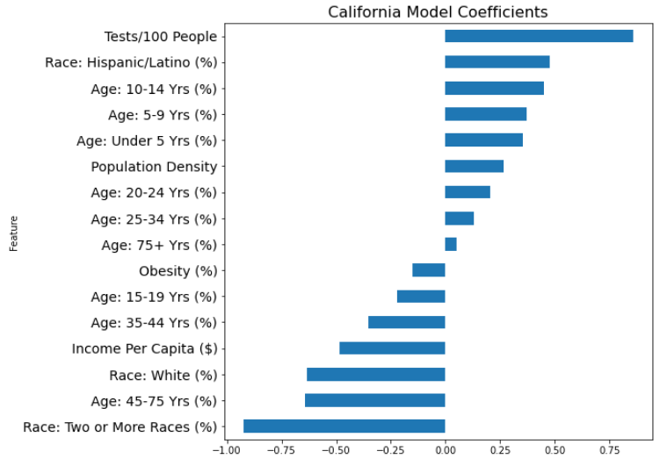
California Model Coefficients

Slide 12
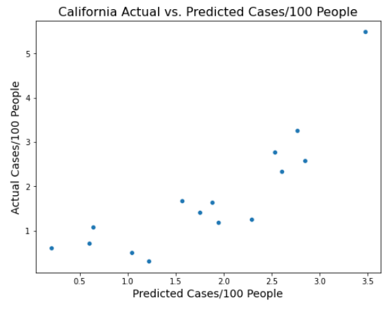
California Actual vs. Predicted Cases/100 People

Slide 13
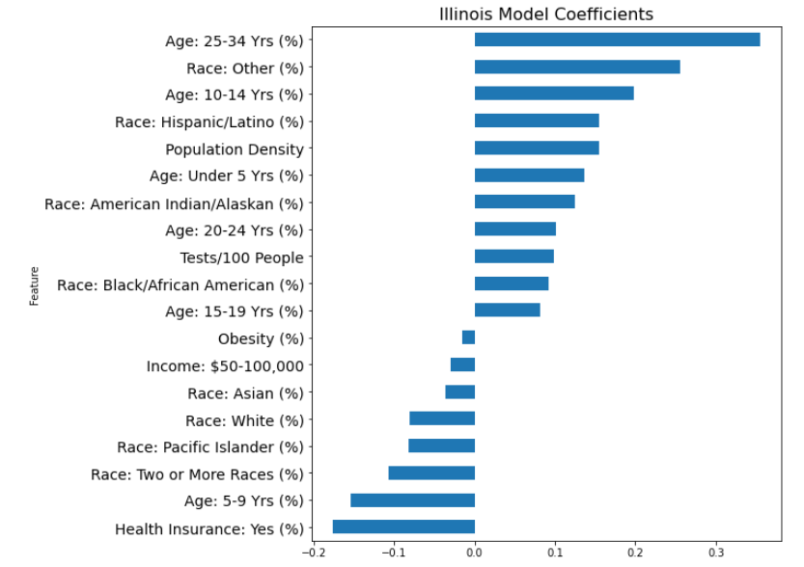
Illinois Model Coefficients

Slide 14
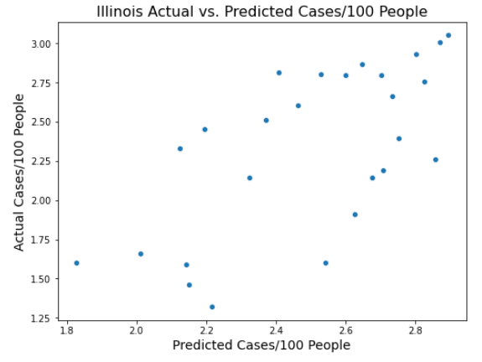
Illinois Actual vs. Predicted Cases/100 People

Slide 15
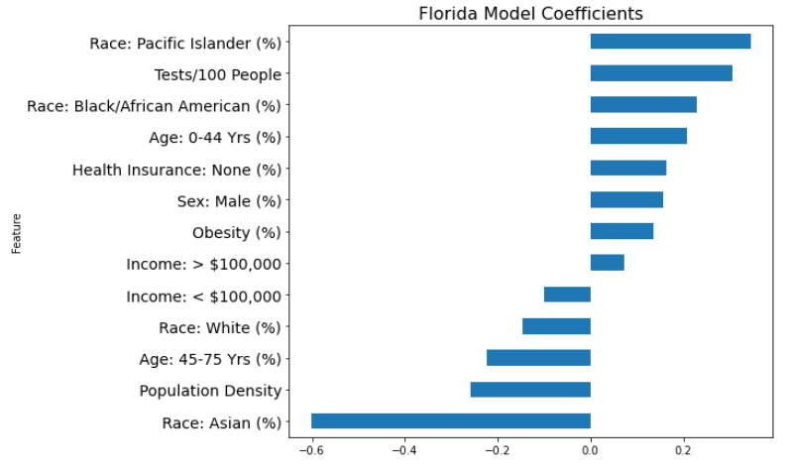
Florida Model Coefficients

Slide 16
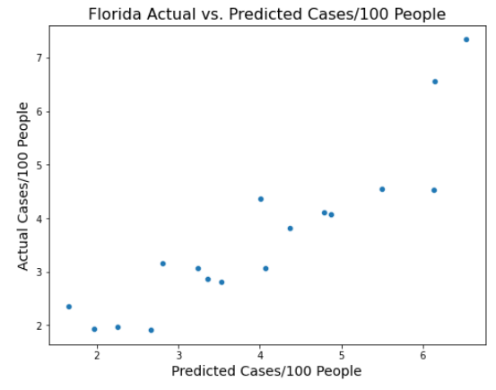
Florida Actual vs. Predicted Cases/100 People

Slide 17
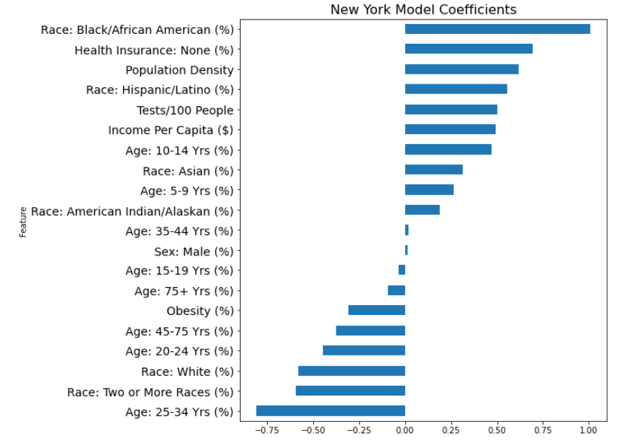
New York Model Coefficients

Slide 18
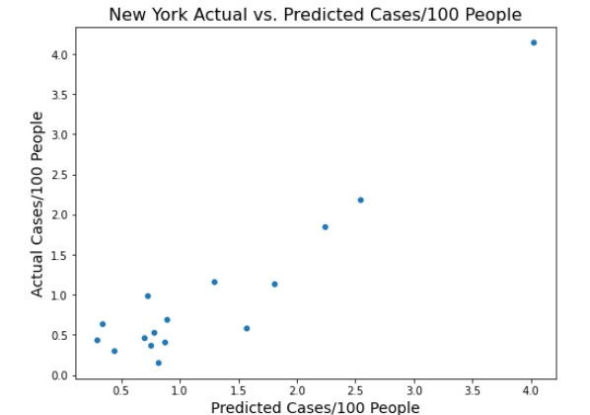
New York Actual vs. Predicted Cases/100 People

Slide 19
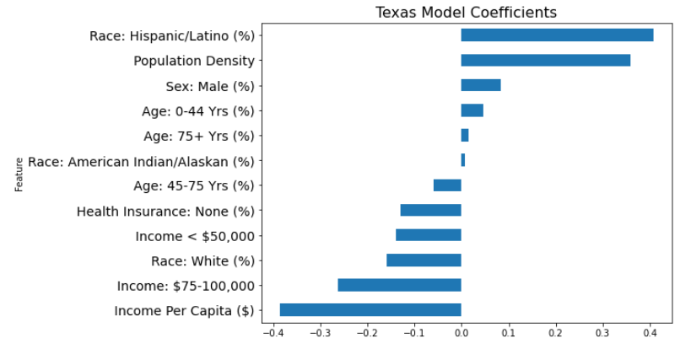
Texas Model Coefficients

Slide 20
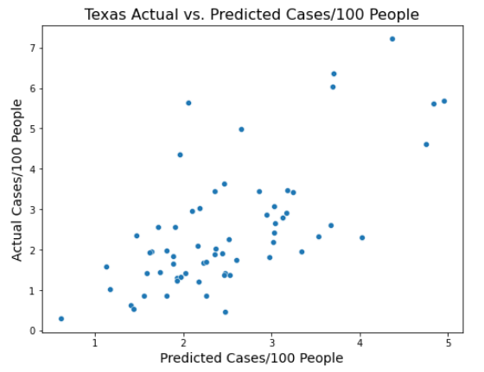
Texas Actual vs. Predicted Cases/100 People

