Slide 1

Predicting COVID-19 Using Demographic Data
Caroline Clark, Feras Atwal, James Lee
October 30th, 2020

Slide 2
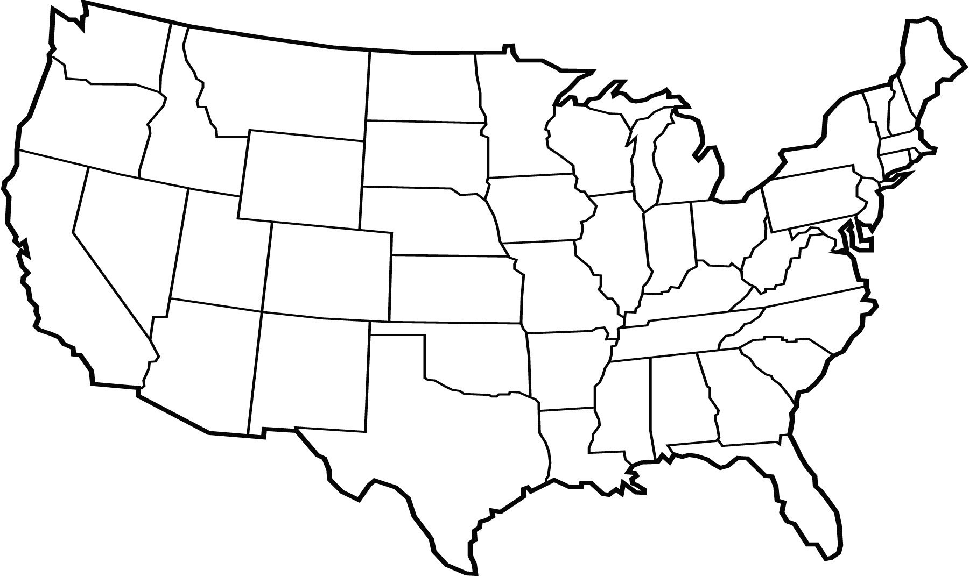
Can we predict COVID-19 severity using demographic data?

Slide 3
Project Pipeline
Data collection
Data pre-processing
Data visualization
Modeling
Making the data interactive

Slide 4


Data Collection
County-level
Area
Population Density
Demographics
Age
Gender
Race
Economic Indicators
Income Per Capita
Household Income
Median Worker Income
Health Indicators
Obesity Rates
COVID-19
Tests
Cases
Fatalities

Slide 5
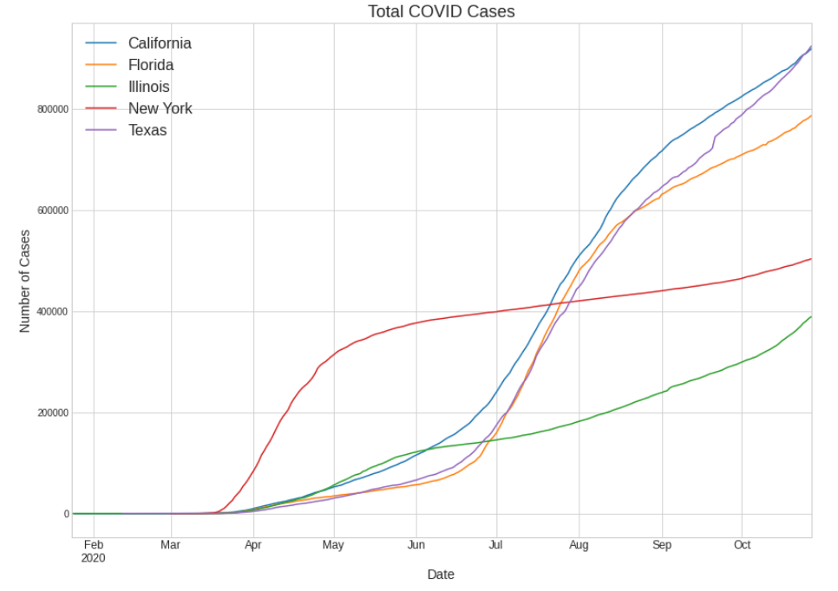
Five States with the Most COVID-19 Data

Slide 6
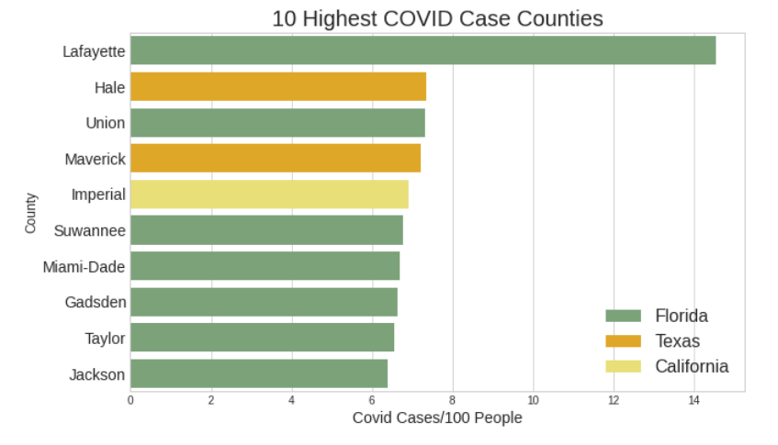
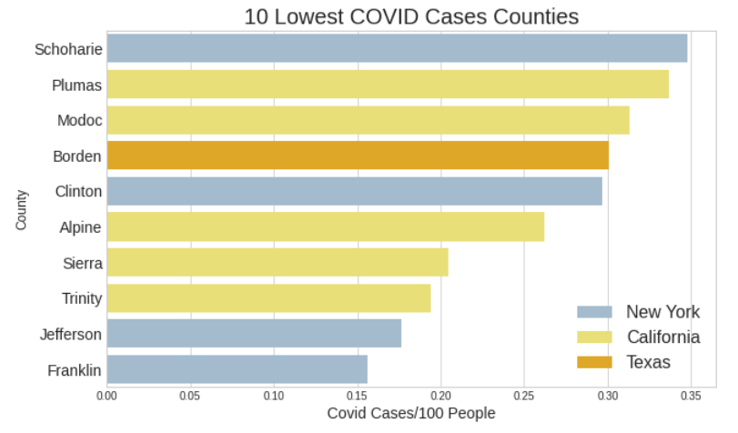
COVID-19 Statistics Vary Widely Among Counties

Slide 7
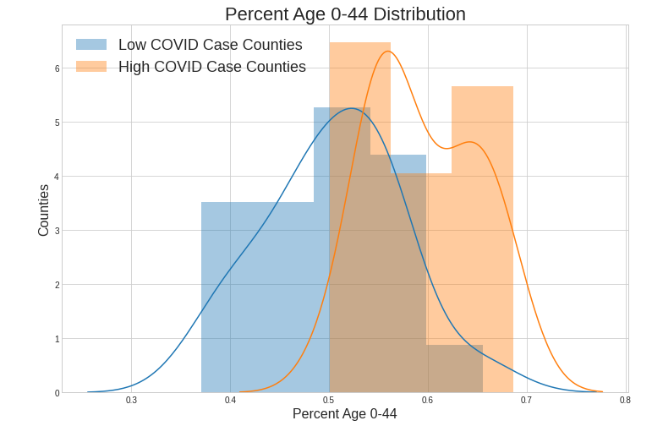
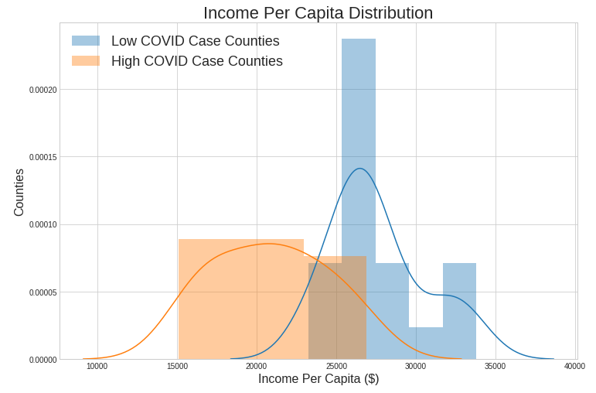
High COVID Counties Likely to be Younger, Have Lower Income Per Capita

Slide 8
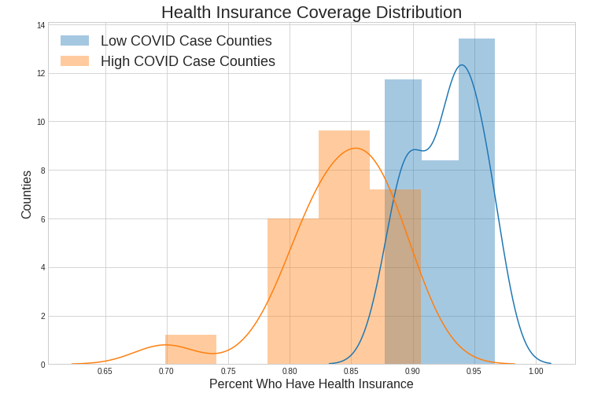
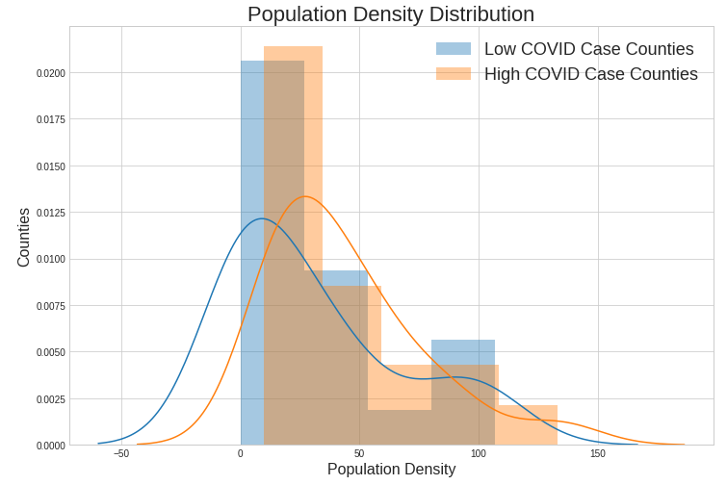
Low COVID Counties Likely to have Insurance Coverage, Lower Pop. Density

Slide 9
Modeling Successes and Challenges
Region | Best Regression R2 Score | Best Classification Accuracy Score | Classification Baseline
All Five States | 47% | 63% | 42%

Slide 10
Modeling Successes and Challenges
Region | Best Regression R2 Score | Best Classification Accuracy Score | Classification Baseline
All Five States | 47% | 63% | 42%
California | 75% | 93% | 66%
Florida | 76% | 71% | 71%
Illinois | 32% | 73% | 54%
New York | 81% | 94% | 81%
Texas | 49% | 59% | 40%

Slide 11
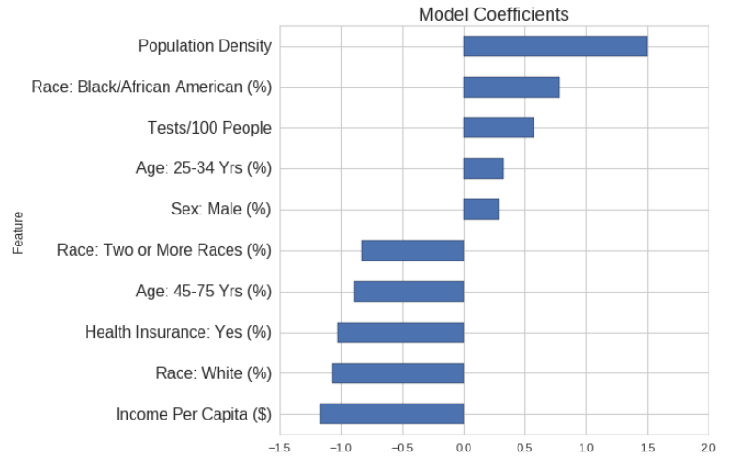
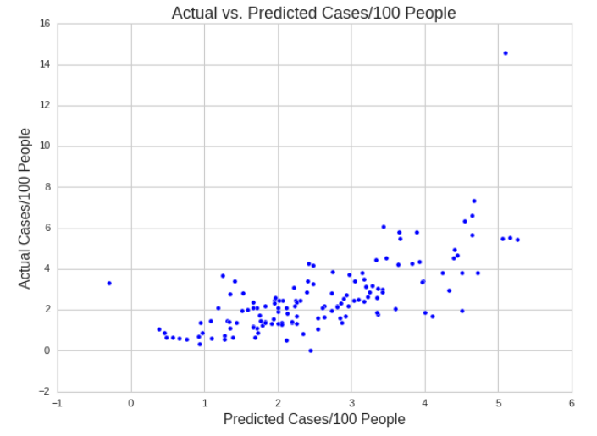
Population Density and Income Strongest Factors when Modeling All Five States

Slide 12
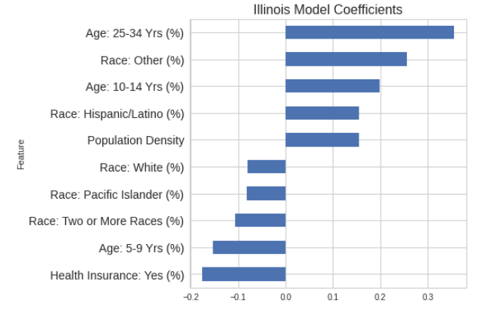
Predictors Varied in State-Level Models

Slide 13
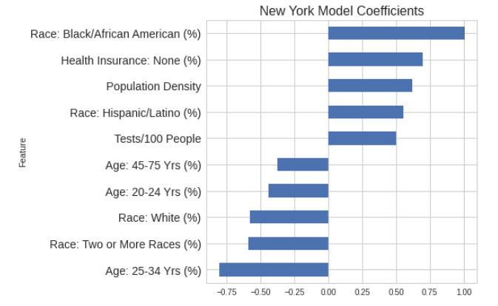
Predictors Varied in State-Level Models

Slide 14
Conclusions and Key Challenges
Ongoing event
Widely varying data
More features

Slide 15
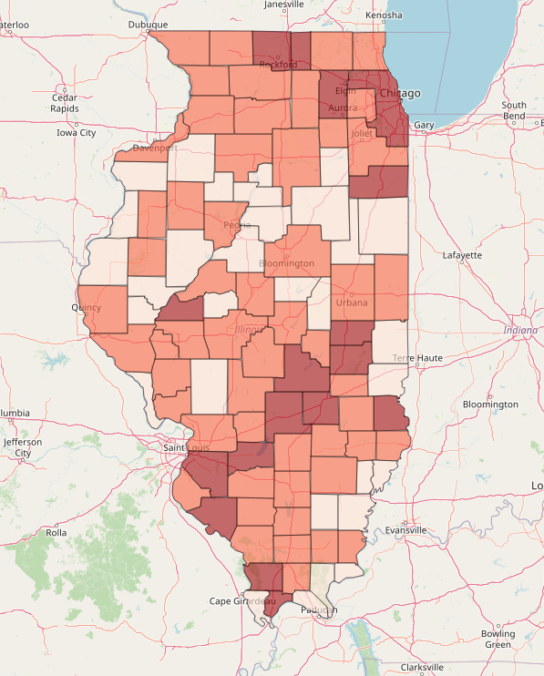
Demo: Interacting with Demographic Data and Classification Model

Slide 16
Thank you

Slide 17
Appendix

Slide 18
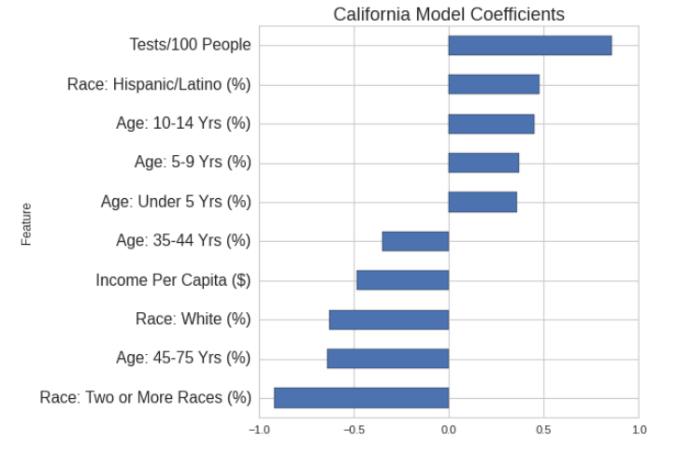
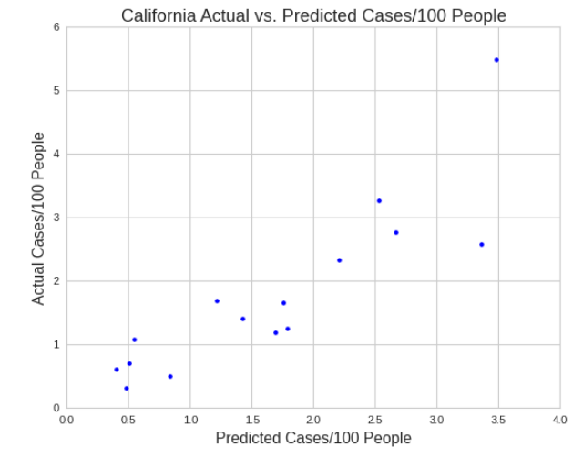
In California, Testing and Race Emerged as Strongest Predictors

Slide 19
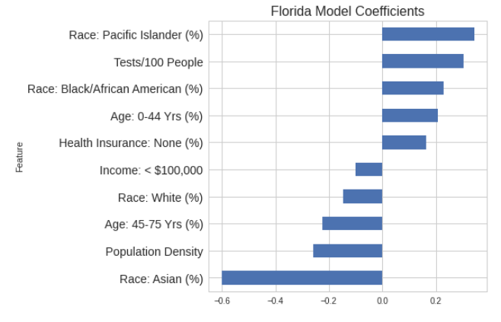
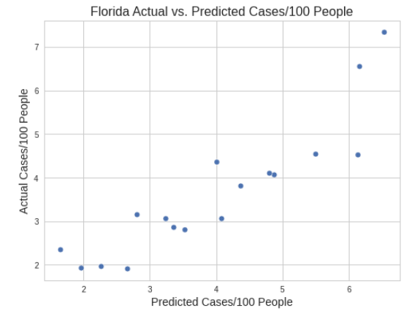
In Florida, Race Emerged as Strongest Predictors

Slide 20
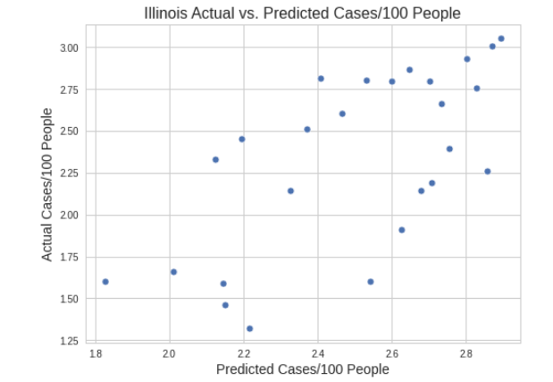
In Illinois, Age and Being Insured Emerged as Strongest Predictors

Slide 21
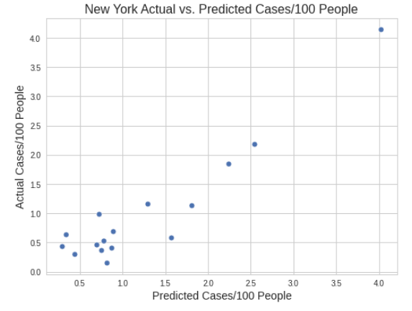
In New York, Race and Age Emerged as Strongest Predictors

Slide 22
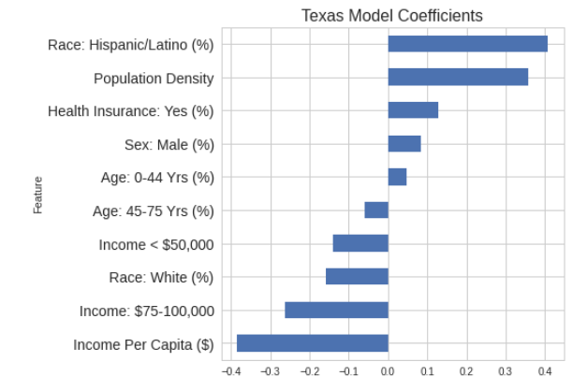
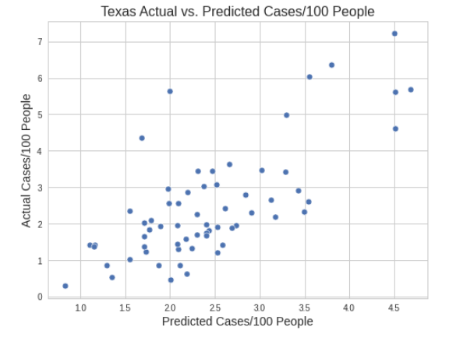
In Texas, Race and Income Emerged as Strongest Predictors

Slide 23
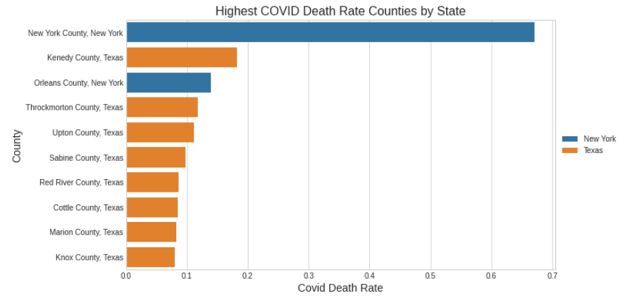
Highest Death Rate Counties by State

Slide 24
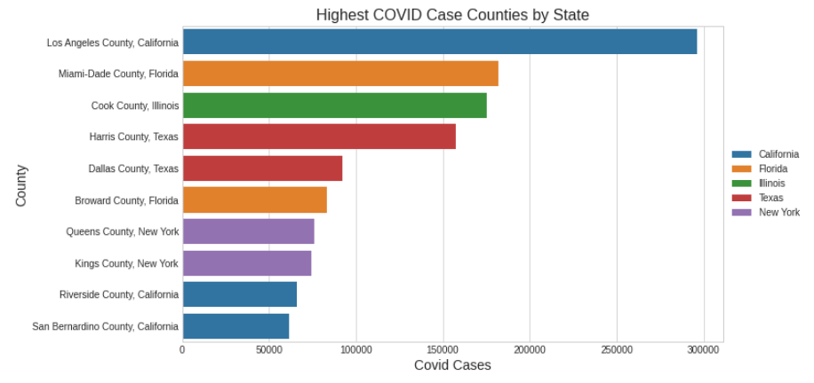
Highest Case Counties by State

Slide 25
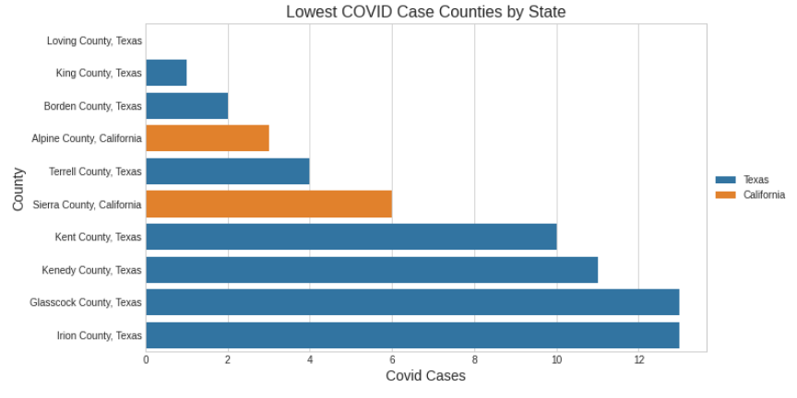
Lowest Case Counties by State

Slide 26
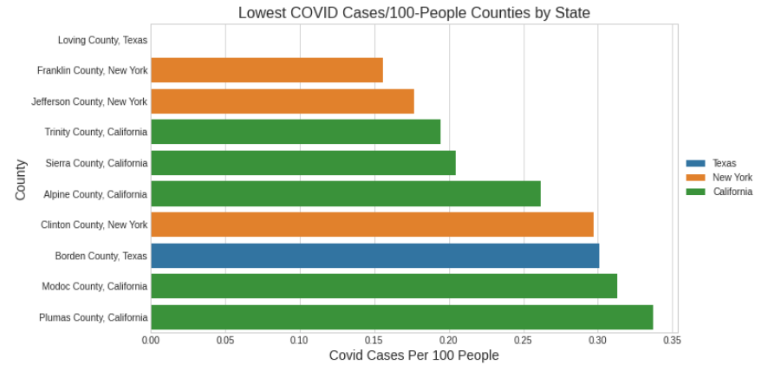
Lowest Cases/100 People Counties by State

Slide 27
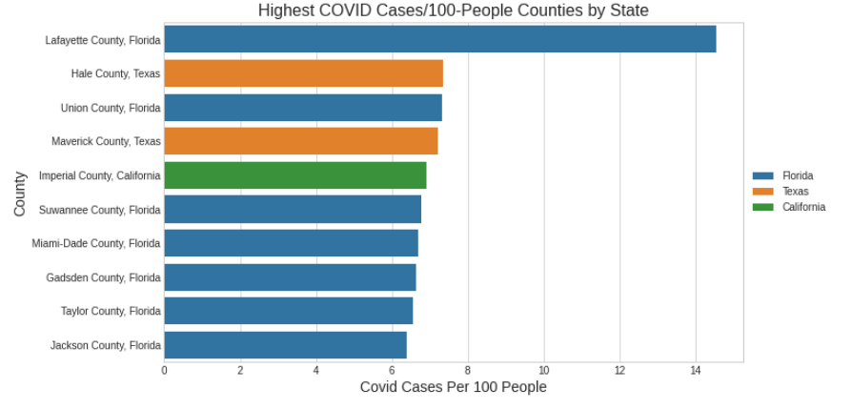
Highest Cases/100 People Counties by State

