Slide 1

Predicting COVID-19 Using Demographic Data
Caroline Clark
Feras Atwal
James Lee

Slide 2
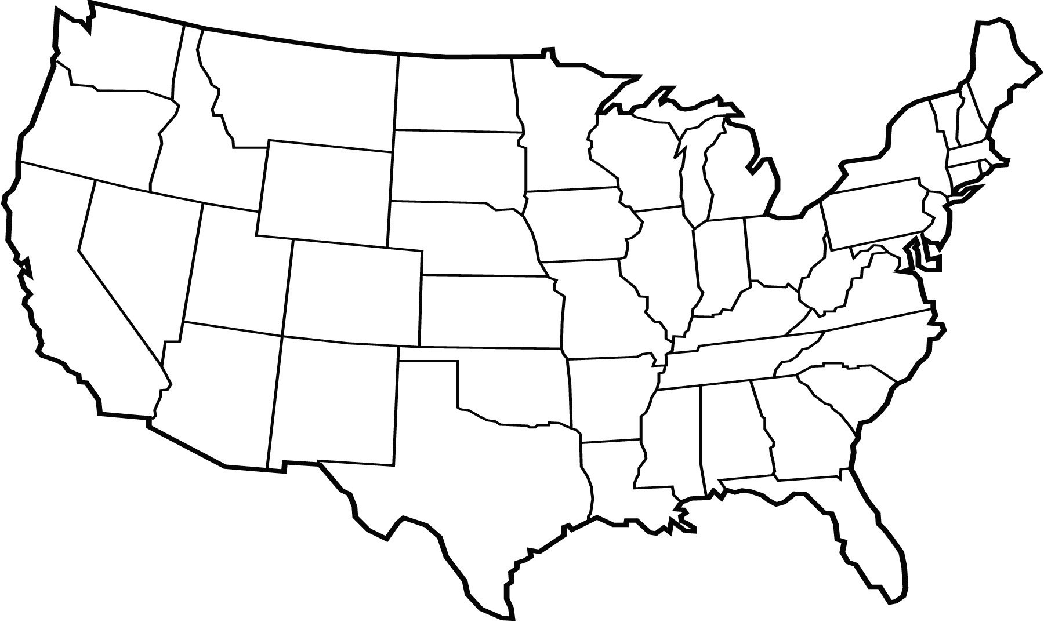
Can we predict COVID-19 severity using demographic data?

Slide 3
Project Pipeline
Data collection
Data pre-processing
Data visualization
Modeling
Making the data interactive

Slide 4


Data Collection
County-level
Area
Population Density
Demographics
Age
Gender
Race
Economic Indicators
Income Per Capita
Household Income
Median Worker Income
Health Indicators
Obesity Rates
COVID-19
Tests
Cases
Fatalities

Slide 5
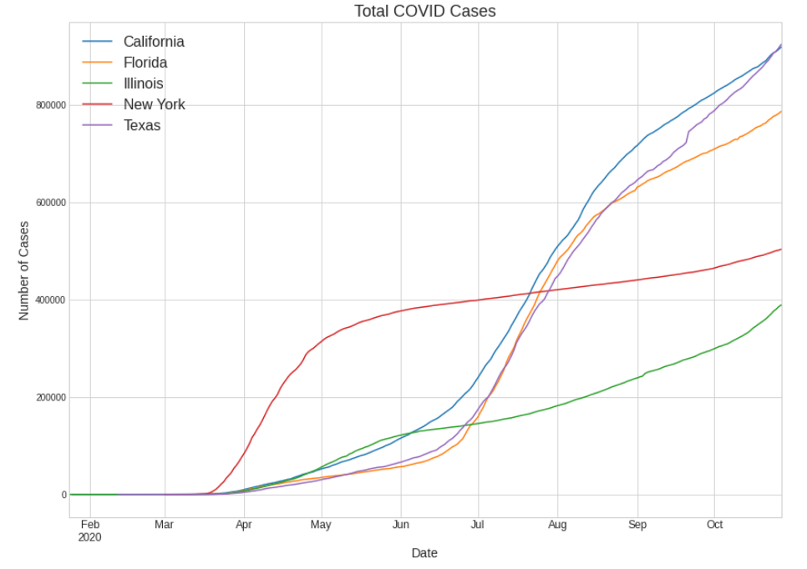
Five States with the Most COVID-19 Data

Slide 6
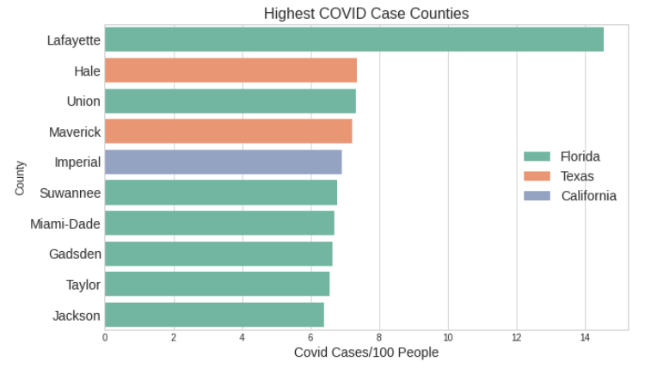
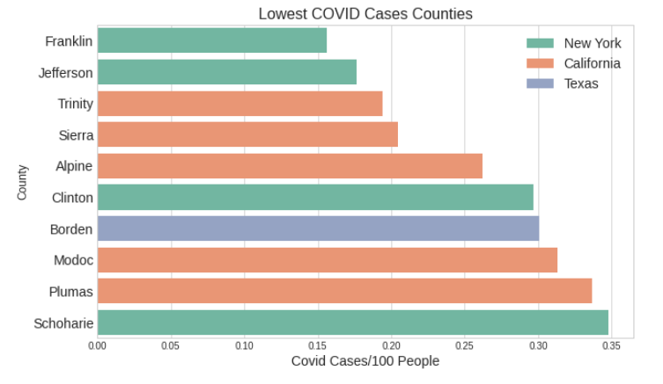
COVID Statistics Vary Widely

Slide 7
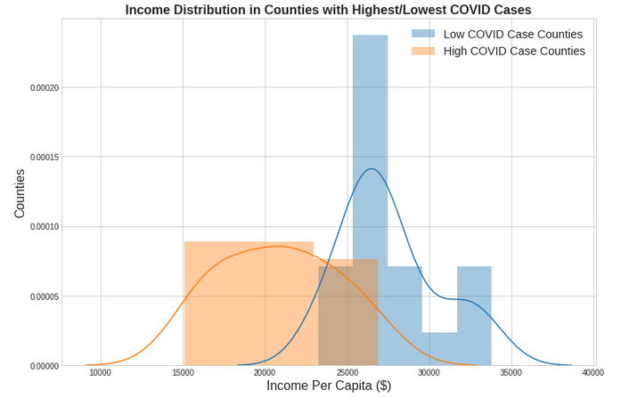
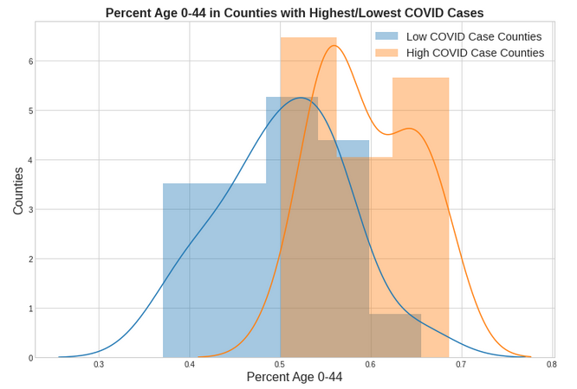
High COVID Case Counties Likely to be Younger, Have Lower Income Per Capita

Slide 8
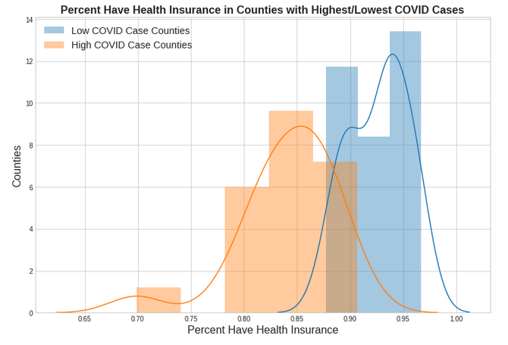
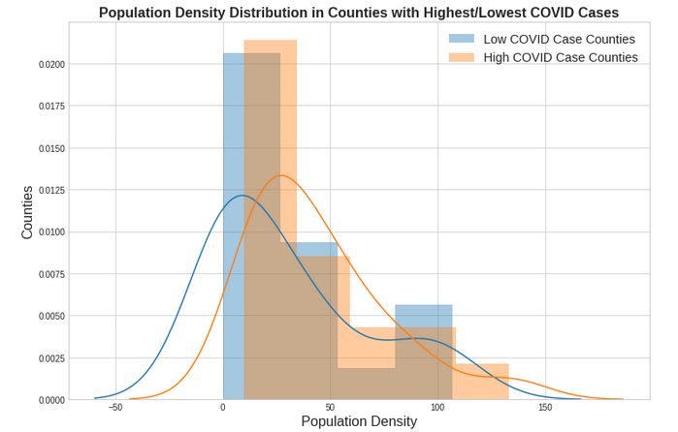
Low COVID Case Counties Likely to have Insurance Coverage, Lower Pop. Density

Slide 9
Modeling Successes and Challenges
Region | Best Regression R2 Score | Best Classification Accuracy Score | Classification Baseline
All Five States | 47% | 63% | 42%
California | 75% | 93% | 66%
Florida | 76% | 71% | 71%
Illinois | 32% | 73% | 54%
New York | 81% | 94% | 81%
Texas | 49% | 59% | 40%

Slide 10
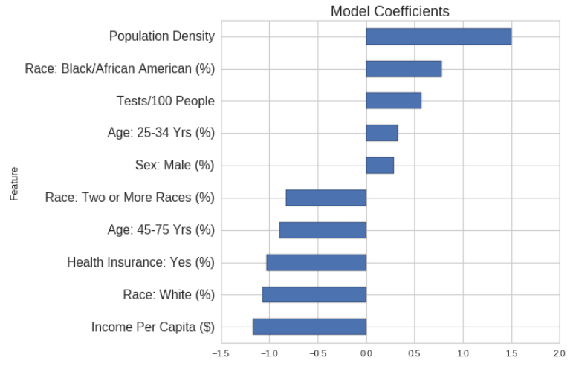
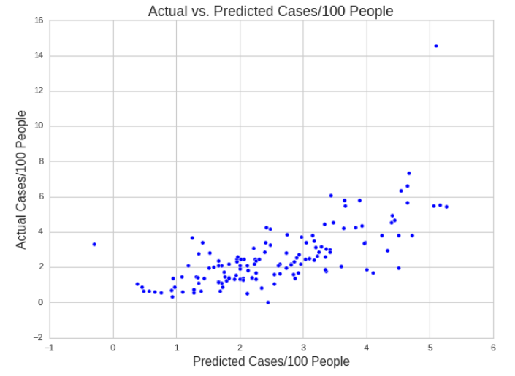
Population Density and Income the Strongest Factors for All Five States

Slide 11
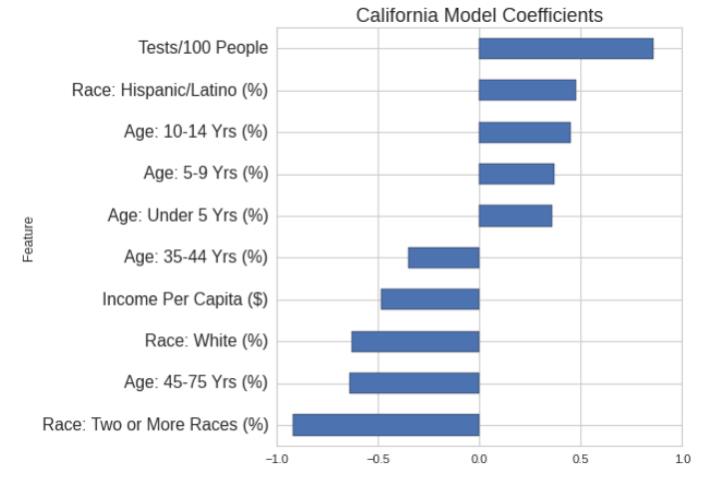
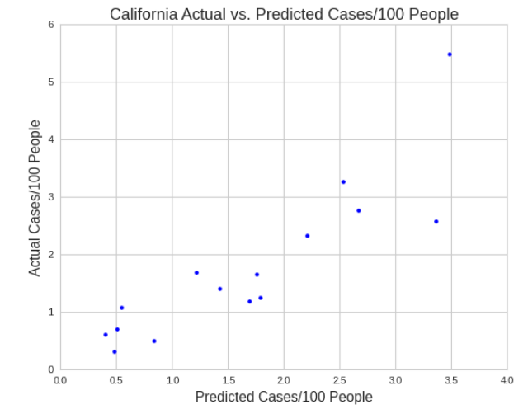
In California, Testing and Race Emerged as Strongest Predictors

Slide 12
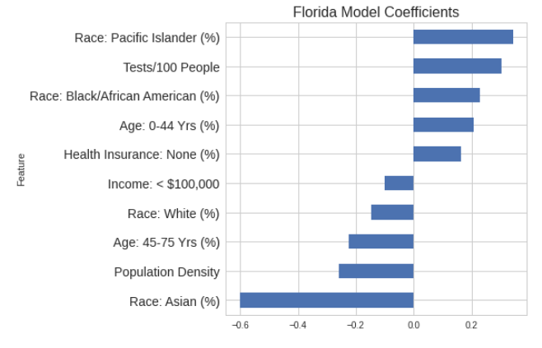
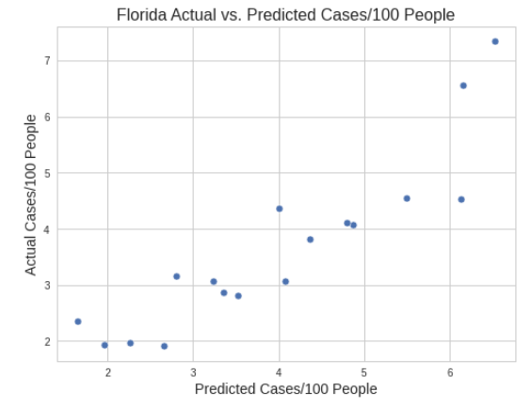
In Florida, Race Emerged as Strongest Predictors

Slide 13
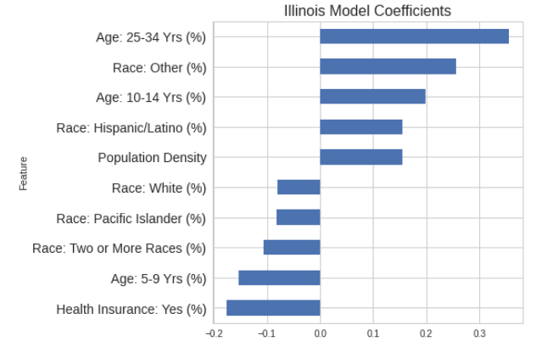
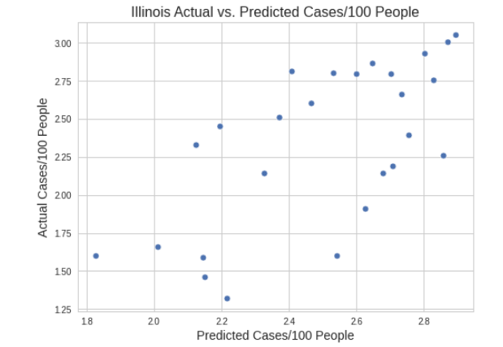
In Illinois, Age and Being Insured Emerged as Strongest Predictors

Slide 14
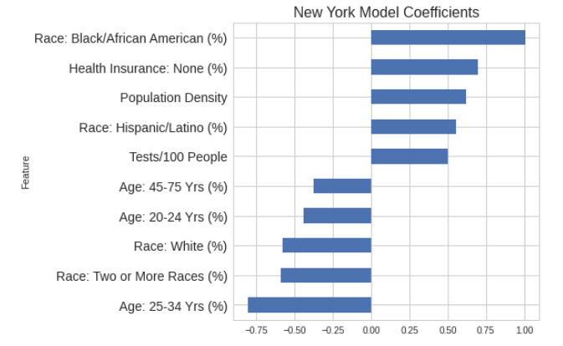
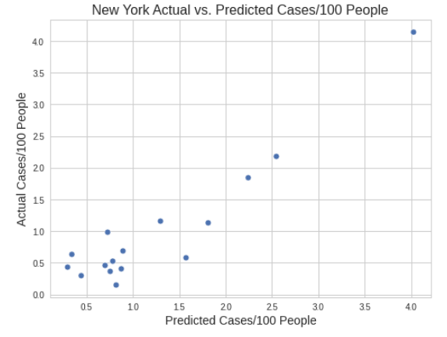
In New York, Race and Age Emerged as Strongest Predictors

Slide 15
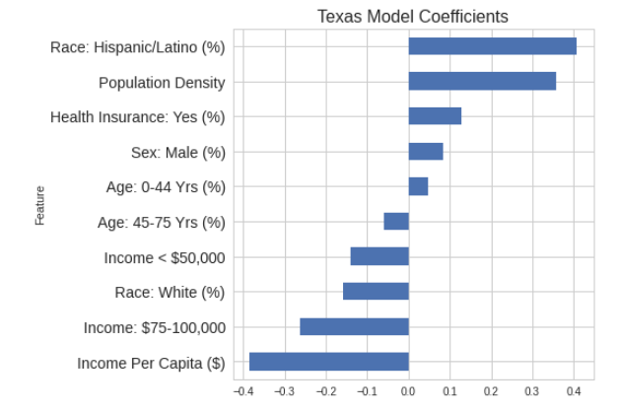
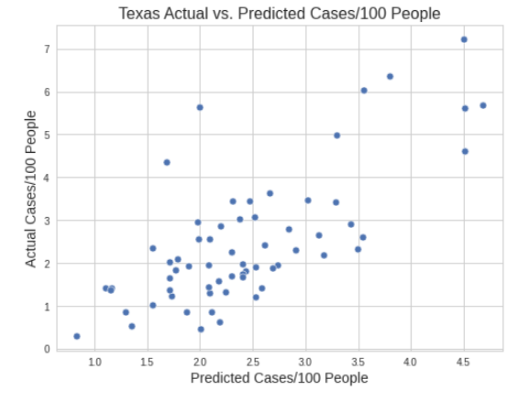
In Texas, Race and Income Emerged as Strongest Predictors

Slide 16
Conclusions and Key Challenges
Ongoing event
Widely varying data
More features

Slide 17
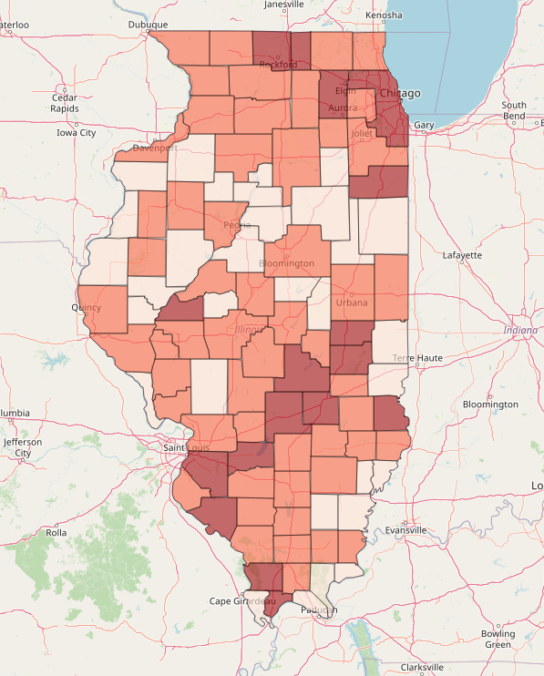
Demo: Interacting with Demographic Data and Classification Model

Slide 18
Thank you

Slide 19
Appendix

Slide 20
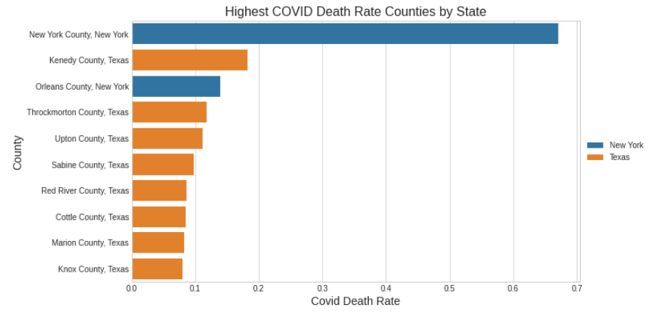
Highest Death Rate Counties by State

Slide 21
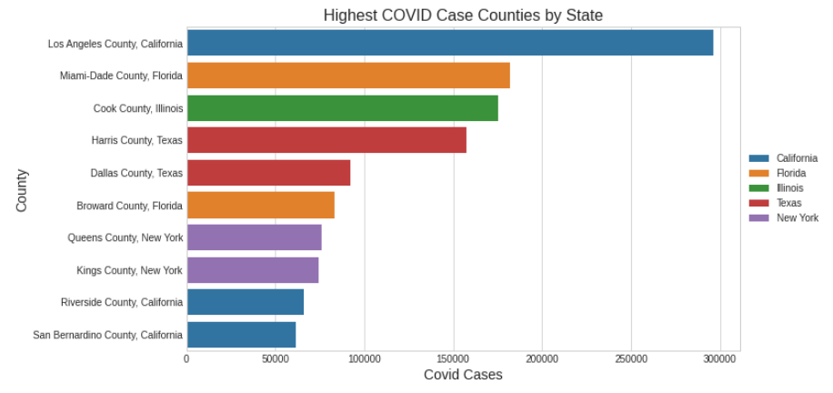
Highest Case Counties by State

Slide 22
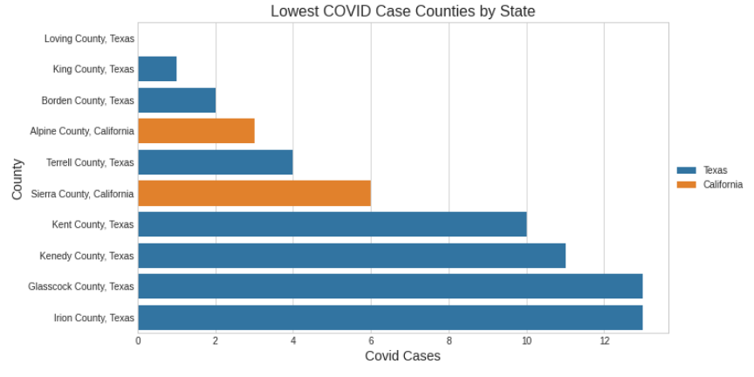
Lowest Case Counties by State

Slide 23
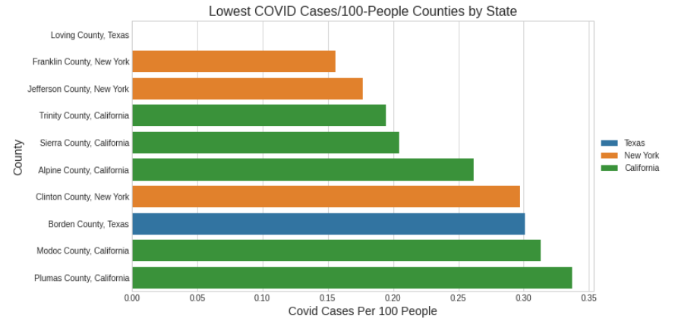
Lowest Cases/100 People Counties by State

Slide 24
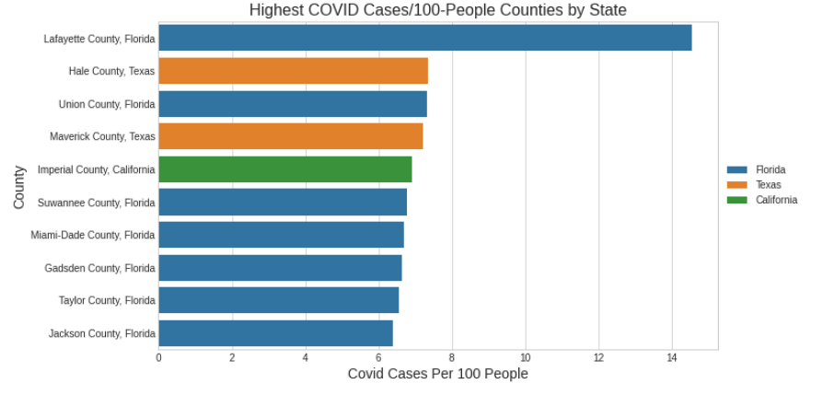
Highest Cases/100 People Counties by State

