Slide 1

What Is Eye Tracking
A Lesson on Eye Tracking

Slide 2

Explain your thoughts….
Have you ever wondered how their eyes move when they look at something or if they have noticed any patterns.

Slide 3
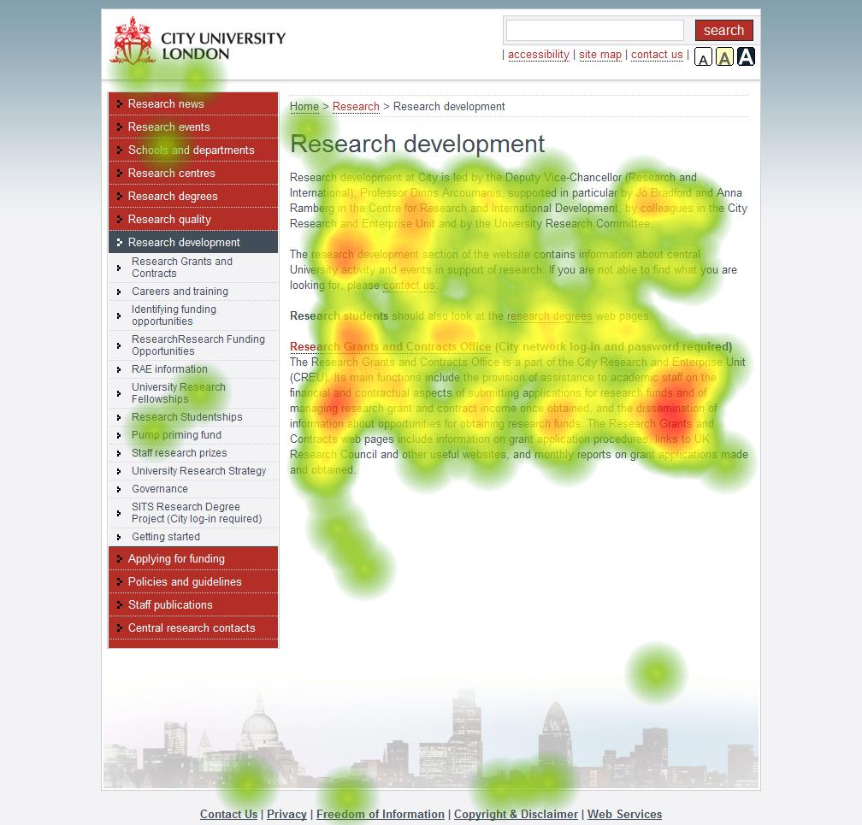

Definition of Eye Tracking
Eye tracking is the process of measuring and recording eye movements to understand and analyze human behavior.
It involves using specialized technology, such as eye trackers, to track and record where a person is looking and how their eyes move.

Slide 4
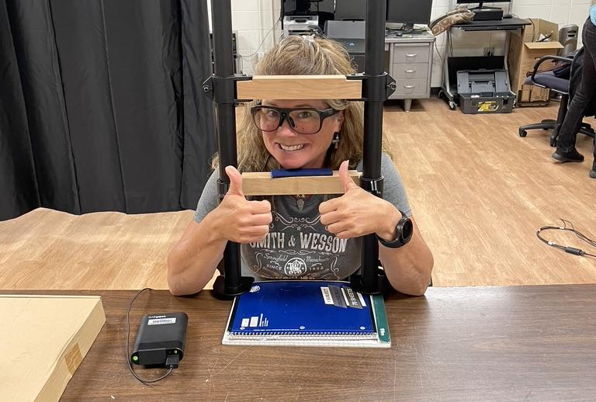
Applications of Eye Tracking
Eye tracking is used in various fields such as psychology, marketing, design, and user experience research.
In psychology, eye tracking helps understand cognitive processes and visual attention.
In marketing, eye tracking is used to study consumer behavior and optimize advertisements.

Slide 5

Eye Movement Tracking Explained:

Slide 6
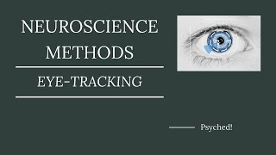
Additional Resources If Needed….

Slide 7

Multiple Choice Question
Which of the following fields uses eye tracking technology?
A) Medicine
B) Music
C) Finance
D) Psychology

Slide 8
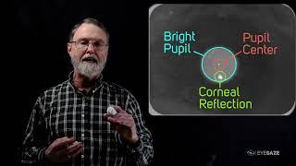
How Does Eye Movement Tracking Work?

Slide 9
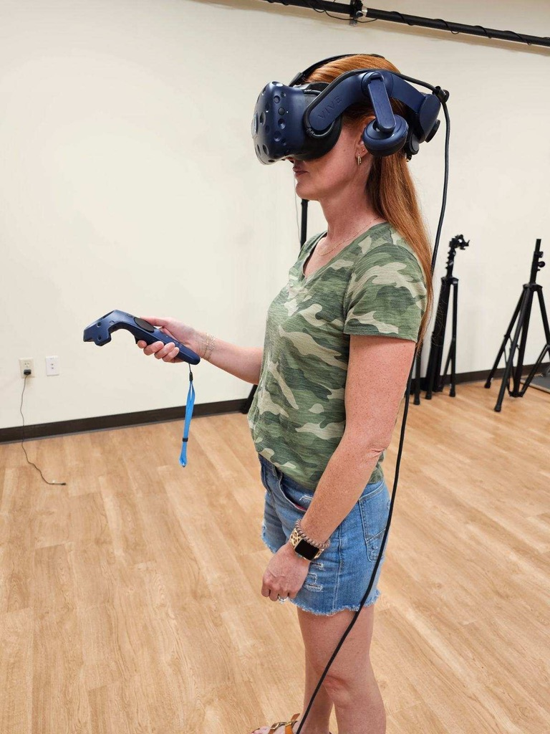
Fun Facts about Eye Tracking
Eye tracking studies have shown that people read in an 'F' pattern, starting with the top and left side of a page.
The average person makes approximately 4-5 eye movements per second.
Eye tracking technology can be used to detect signs of neurological disorders.
Some eye tracking systems use infrared light to track eye movements.
Eye tracking studies have helped improve website and user interface designs.

