Slide 1

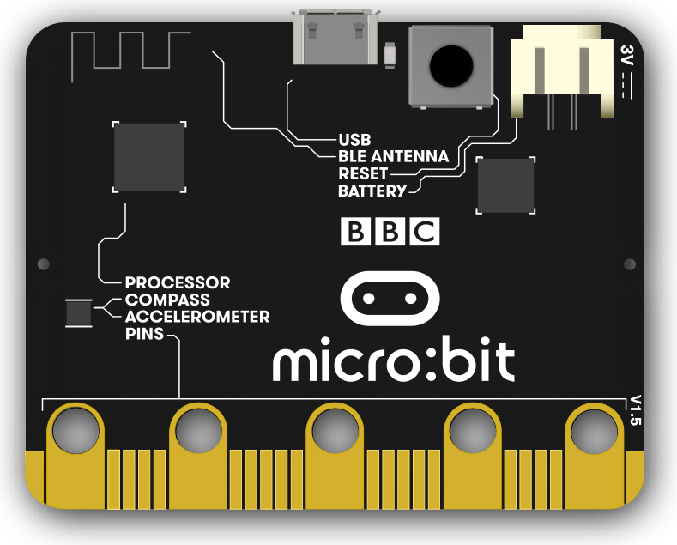
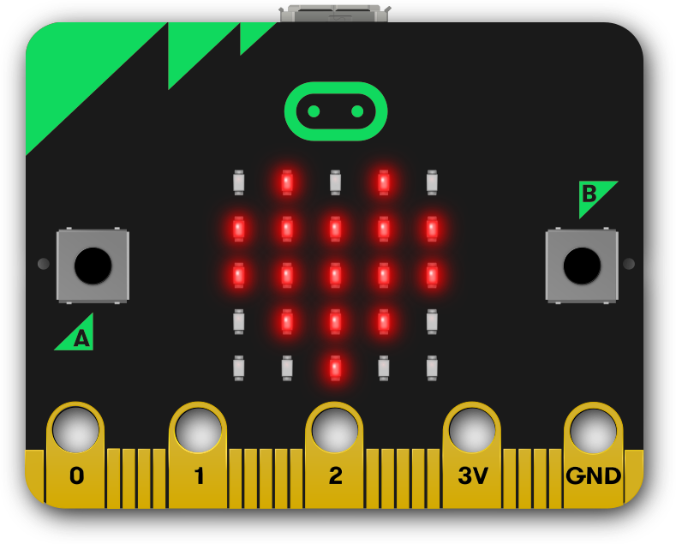
Year 6 – Sensing Lesson 1 – The micro:bit | Activity handout Save a copy
Parts of a micro:bit
On the images below, label the following parts of a micro:bit.
Button A
Button B
LED display
Accelerometer
USB port
This resource is available online at ncce.io/pg6b-1-a0-h. Resources are updated regularly — please check that you are using the latest version.
This resource is licensed under the Open Government Licence, version 3. For more information on this licence, see ncce.io/ogl.
Notes:
Last updated: 28-10-20

