Slide 1
Debugging!!

Slide 2
Debugging is the process of finding and fixing problems in code
1

Slide 3
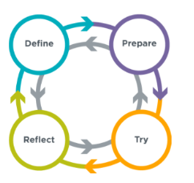

Slide 4
Define:
*When does it happen?
*What did you expect the program to do?
*What did it do instead?
*Are there any error messages?

Slide 5
Prepare:
*Why is the bug happening?
*What changed right before the bug appeared?
*How does this code compare to “correct” solutions?

Slide 6
Try:
*Commenting out code
*Print to the console
*change the starting values of variables
*Amplify small effects
*Work in chunks
*Work backwards in your code
*ask a fresh pair of eyes
*make small changes and test

Slide 7
Reflect:
*What caused the bug?
*How did you find the bug?
*What in your code made it easier or harder to debug?

Slide 8

Want big impact?
Use big image.
Notes:
Type in a list of debugging strategies to share

Slide 9
Code to debug
https://makecode.microbit.org/#editor
https://quizizz.com/admin/quiz/62d1ce9c5fcb08001eb0054f?source=quiz_page
https://makecode.microbit.org/#editor
https://makecode.microbit.org/#editor
https://makecode.microbit.org/#editor
https://makecode.microbit.org/#editor
https://makecode.microbit.org/#editor

