Slide 1

Communicating Through History
Micro:Bit Morse Code
Developed by:
Becky Junge
4th Grade Teacher, Journey Elementary
WySLICE 2022

Slide 2
Part 1: Historical Context

Slide 3
Lesson Summary
Materials Needed
Students will read articles and then construct a timeline of the progression of communication in the developing United States. Then, they will use the Micro:Bits to encode and decode messages sent in Morse Code via radio output.
-Micro:Bits (ideally, one per student)
- Chromebook/Computer/iPad (ideally, one per student)
-Access to Computer/Projector for Modeling/Presentations
-Google Slides
-Text Articles:
- https://kids.britannica.com/students/article/Pony-Express/274241

Slide 4
Skills & Concepts
ELA
RI.4.1 - Refer to details and examples in a text when explaining what the text says explicitly and when drawing inferences from the text.
RI.4.3 - Explain events, procedures, ideas, or concepts in a historical, scientific, or technical text, including what happened and why, based on specific information in the text.
W.4.4 - Produce clear and coherent writing in which the development and organization are appropriate to task, purpose, and audience.
SOCIAL STUDIES
SS5.3.1 - Give examples of needs, wants, goods, services, scarcity, and choice.
SS5.3.3 - Identify and describe how science and technology have affected production and distribution locally, nationally, and globally (e.g. trains and natural resources)
SS5.4.1 - Describe how small changes can lead to big changes (cause and effect).
SS5.4.2 - Describe how tools and technology make life easier; describe how one tool or technology evolves into another; identify a tool or technology that impacted history.
COMPUTER SCIENCE
5.CS.HS.01 - Model how information is translated, transmitted, and processed in order to follow through hardware and software to accomplish tasks.
5.AP.V.01 - Create programs that use variables to store and modify data.
5.AP.C.01 - Create programs that include sequences, events, loops, and conditionals, both individually and collaboratively.
5.AP.M.02 - Modify, remix, or incorporate portions of an existing program into one’s own work, to develop something new or add more advanced features
5.AP.PD.03 - Test and debug (i.e., identify and fix errors) a program or algorithm to ensure it runs as intended.
5.IC.C.01 - Give examples and explain how computing technologies have changed the world and how those technologies influence and are influenced by cultural practices.

Slide 5
Lesson Objectives
Students will be able to…
Construct a timeline of communication technology.
Describe the Pony Express, Transcontinental Railroad and telegraph role in communication history.
Describe the impact of technology on communication
Argue which communication form is the most effective and why?
Collaborate to encode and decode a message written in Morse Code using the Micro:Bit.

Slide 6
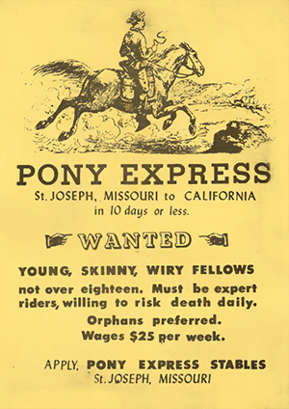
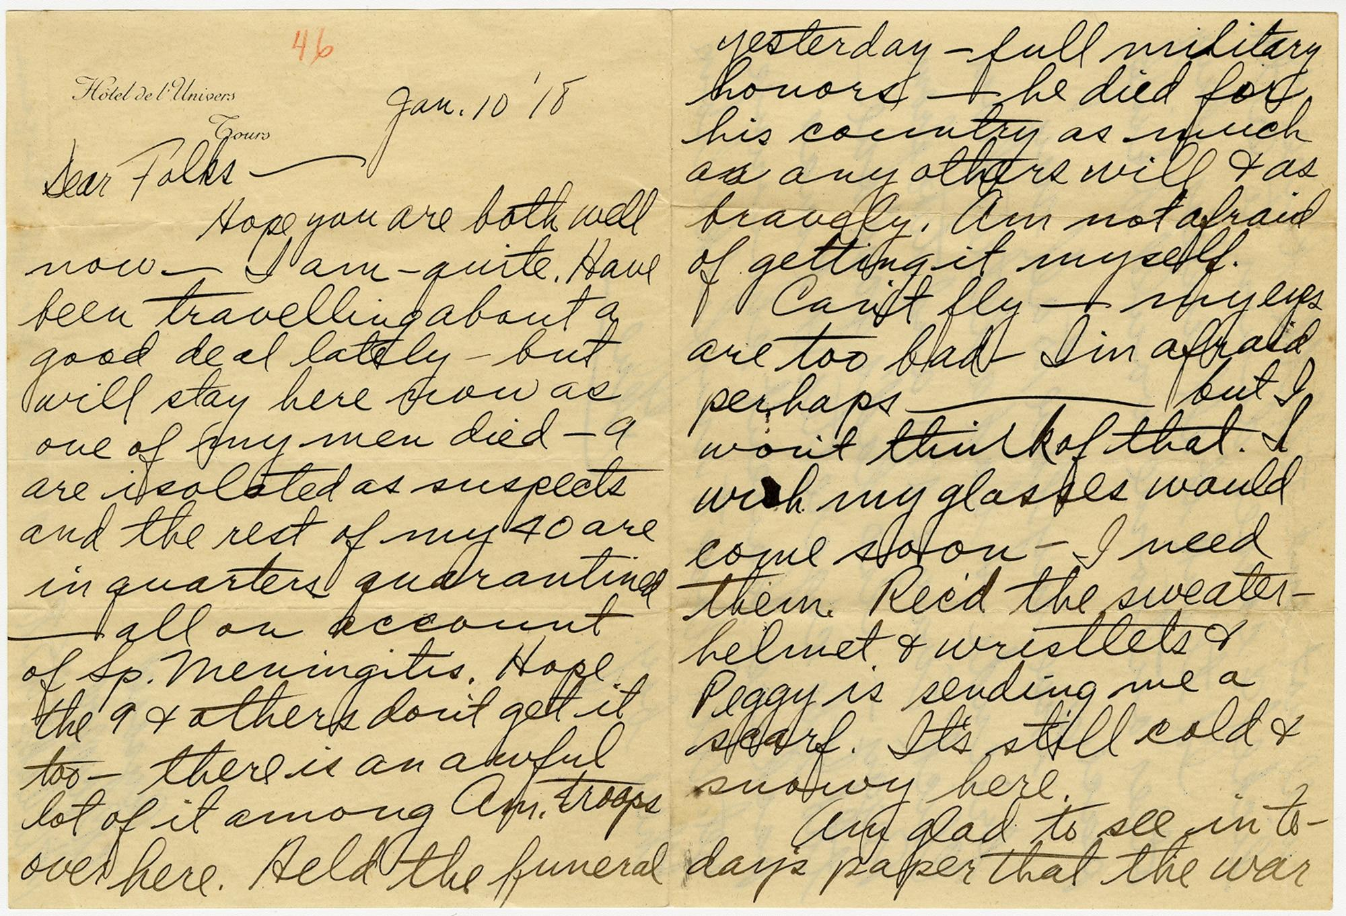
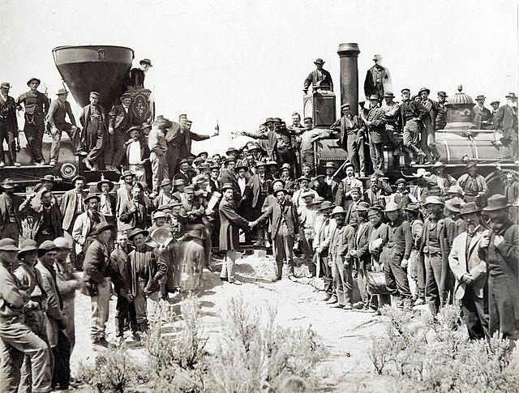

Slide 7
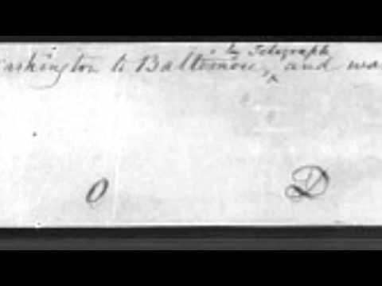

Slide 8
How are all of these images connected?

Slide 9

Time for Some Schema:
Pony Express:
https://kids.britannica.com/students/article/Pony-Express/274241
Transcontinental Railroad:
https://bedtimehistorystories.com/history-of-the-transcontinental-railroad-for-kids/
Telegraph:
https://kids.britannica.com/kids/article/telegraph/353841#:~:text=The%20first%20two%20working%20telegraphs,a%20part%20called%20the%20receiver.
Read each article. As you are reading, think about important events that happened in the change in communication technologies. Record them on your graphic organizer. You will be building a timeline of your events.

Slide 10

Use your notes to create a timeline using 5-8 key facts about the change in communication technology. Be sure to include a date, if known!

Slide 11
Part 2: Micro:Bit Morse Code

Slide 12
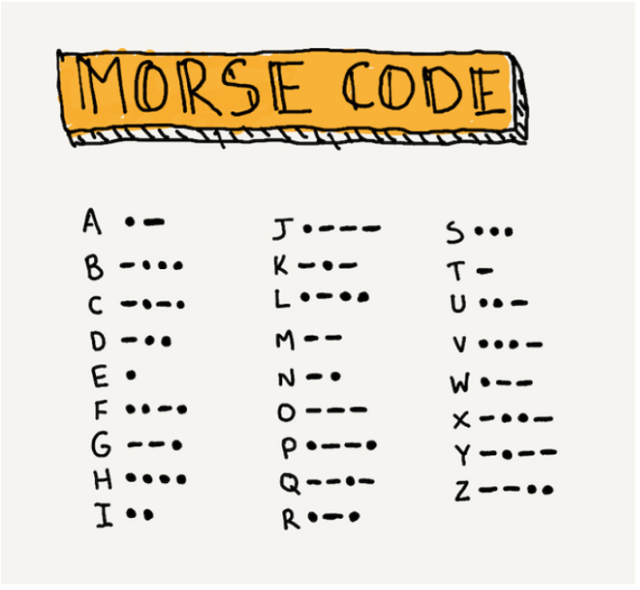

Slide 13
Challenge:
Write a secret word and encode it into Morse Code. Use the key on your worksheet to help you.

Slide 14

Let’s Program the Micro:Bit!
Get your computer and go to https://makecode.microbit.org

Slide 15


Partner A - Send your message to Partner B. Partner B, record the symbols on your worksheet.
Switch Roles - Partner B sends the message and Partner A receives and decodes.
Answer the questions at the bottom of your handout.
If you have time… try the Challenge!

Slide 16
Discussion Questions
Why did the Pony Express end?
How did the Railroad change communication?
How did the telegraph change communication?
How does the telegraph relate to how we communicate today?
Which historical form of communication do you think is best? Why?

