Slide 1
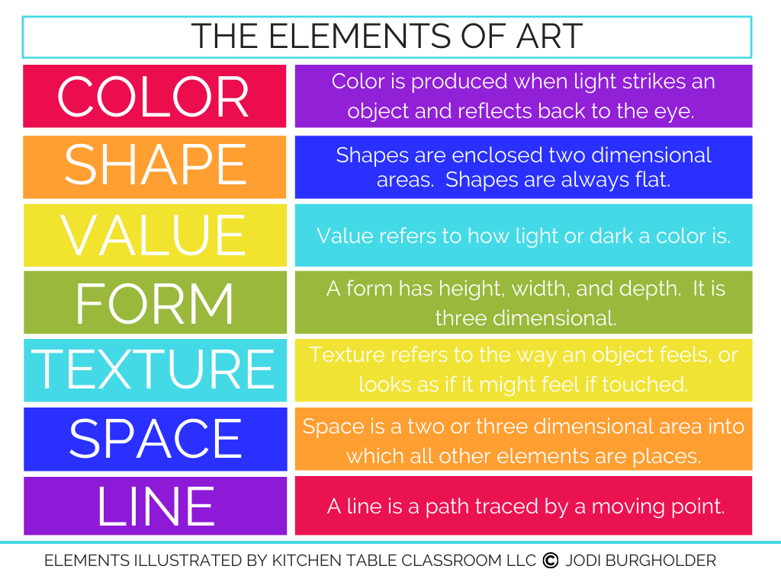

Slide 2
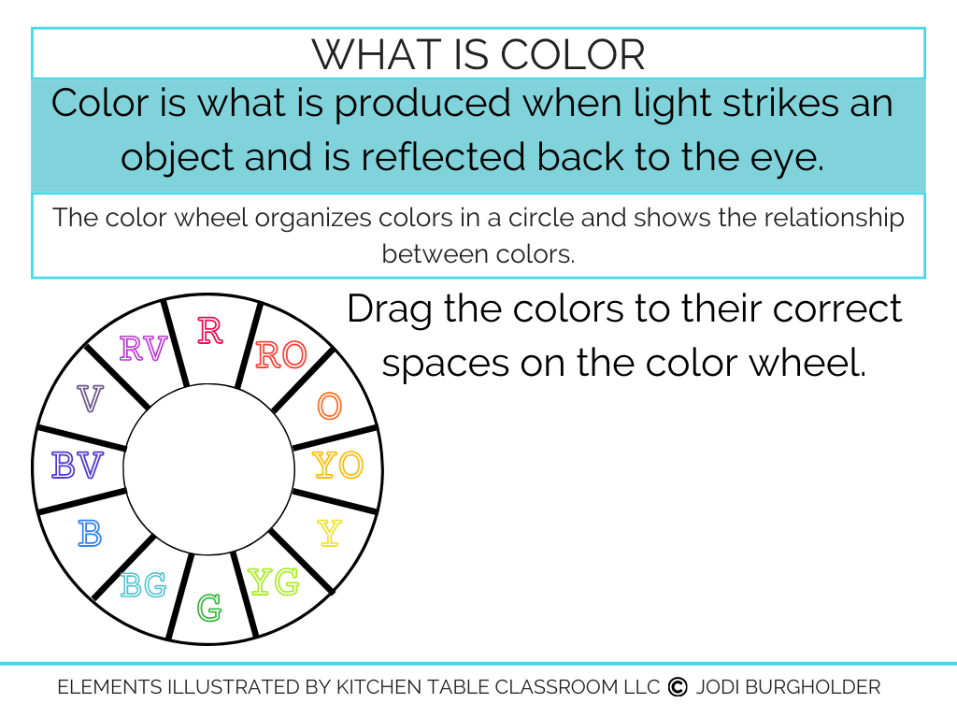

Slide 3
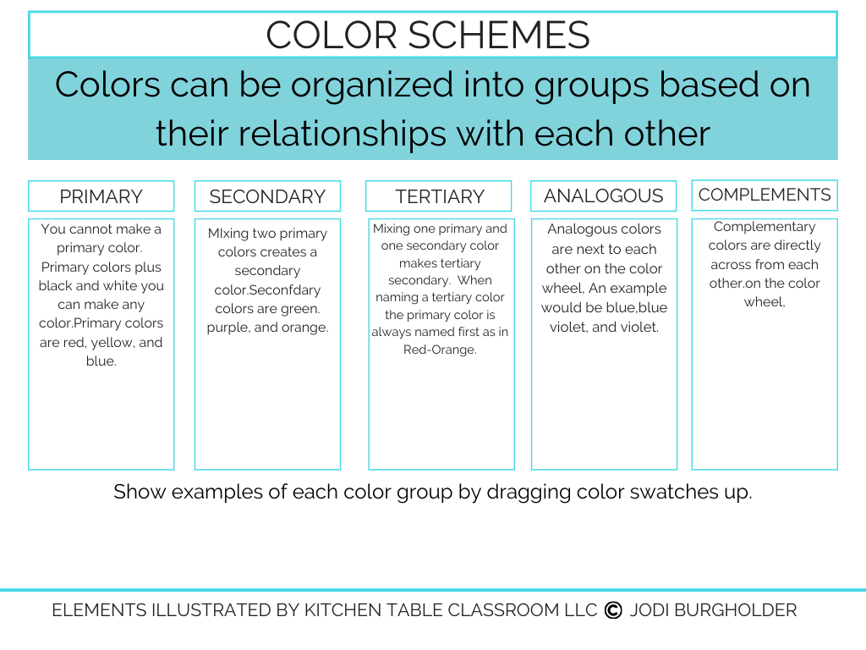

Slide 4
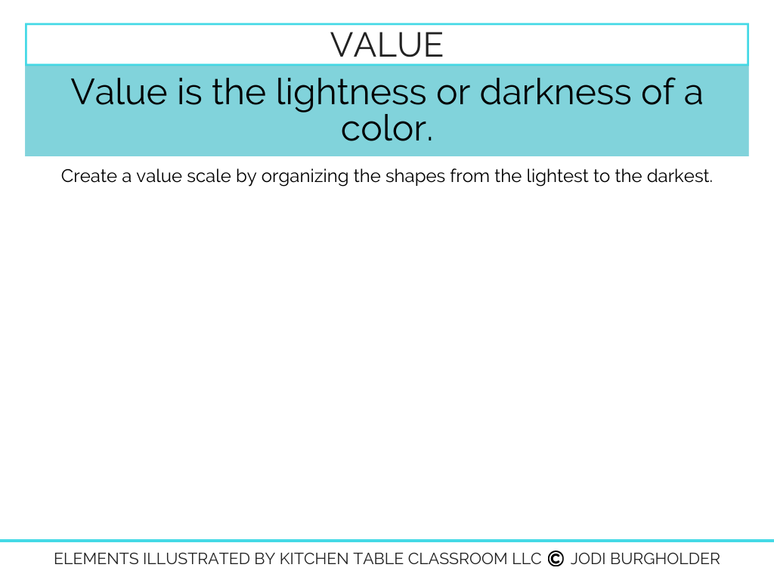

Slide 5
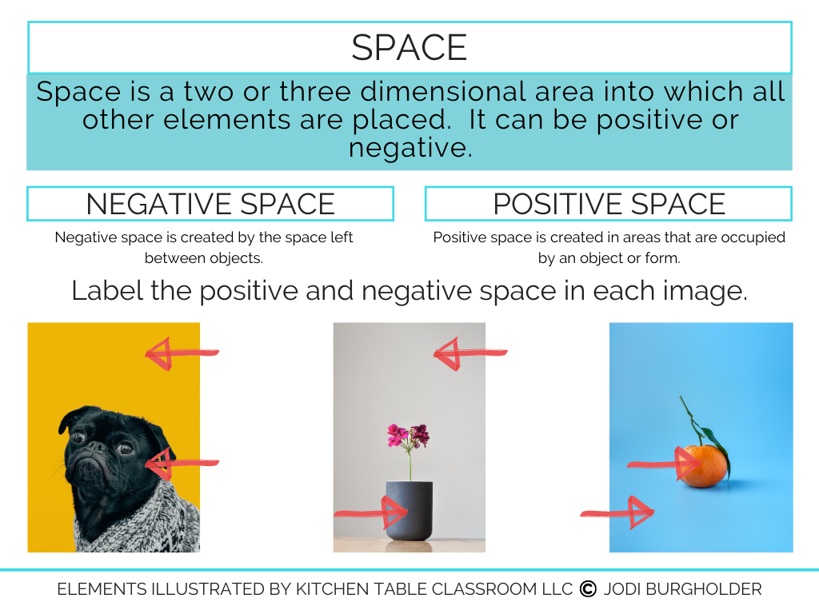
Type here
Type here
Type here
Type here
Type here
Type here

Slide 6
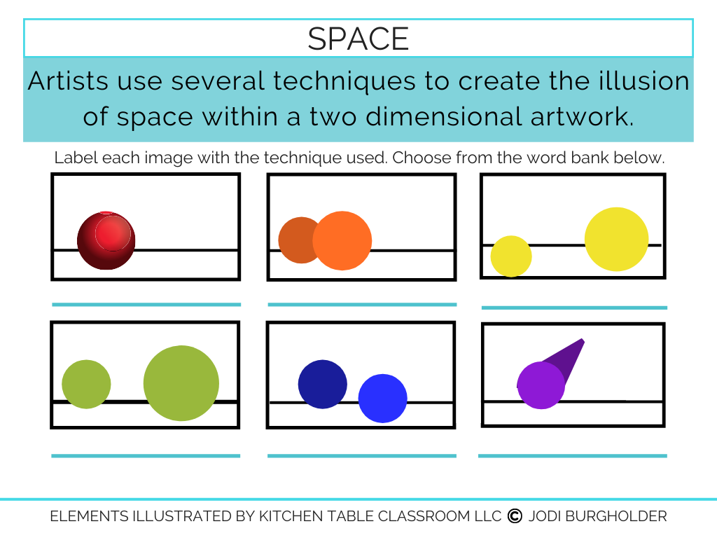
SHADING
OVERLAP
PLACEMENT
SIZE
VALUE/FOCUS
PERSPECTIVE

Slide 7
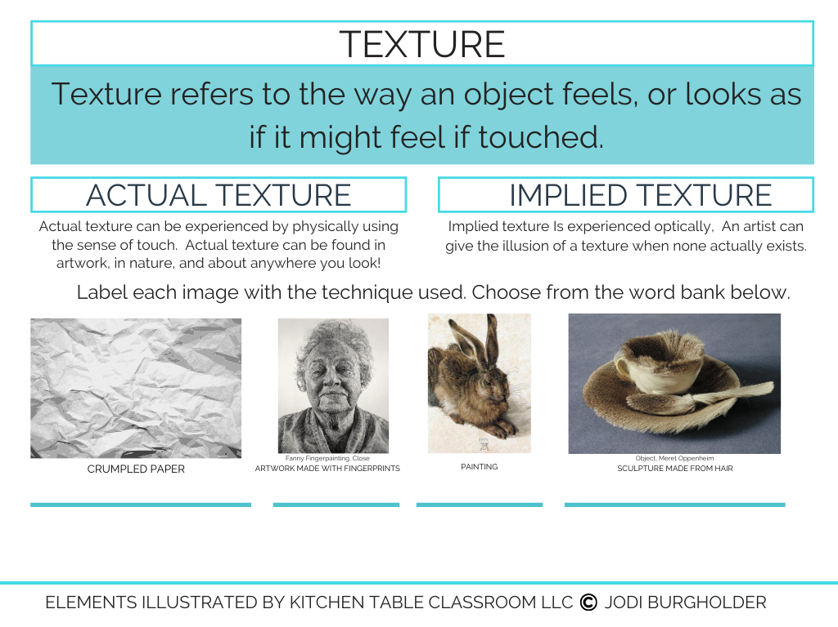
IMPLIED
TEXTURE
ACTUAL
TEXTURE
ACTUAL
TEXTURE
IMPLIED
TEXTURE

Slide 8
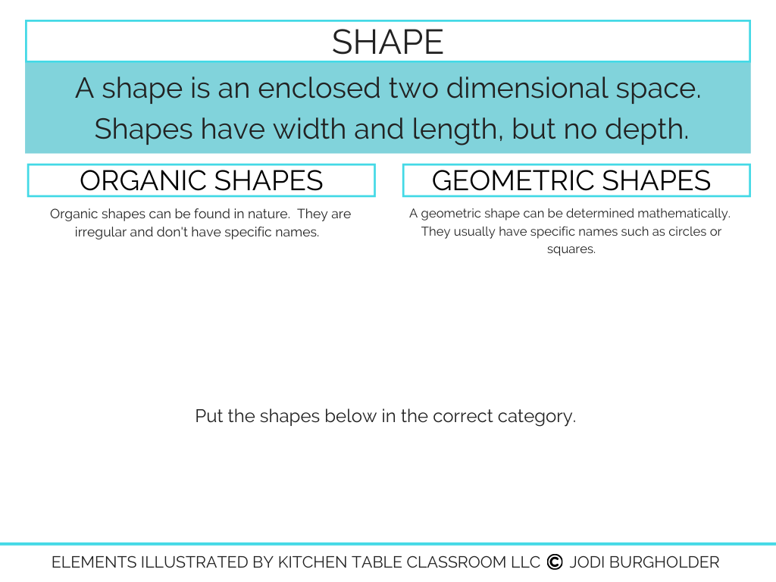









Slide 9
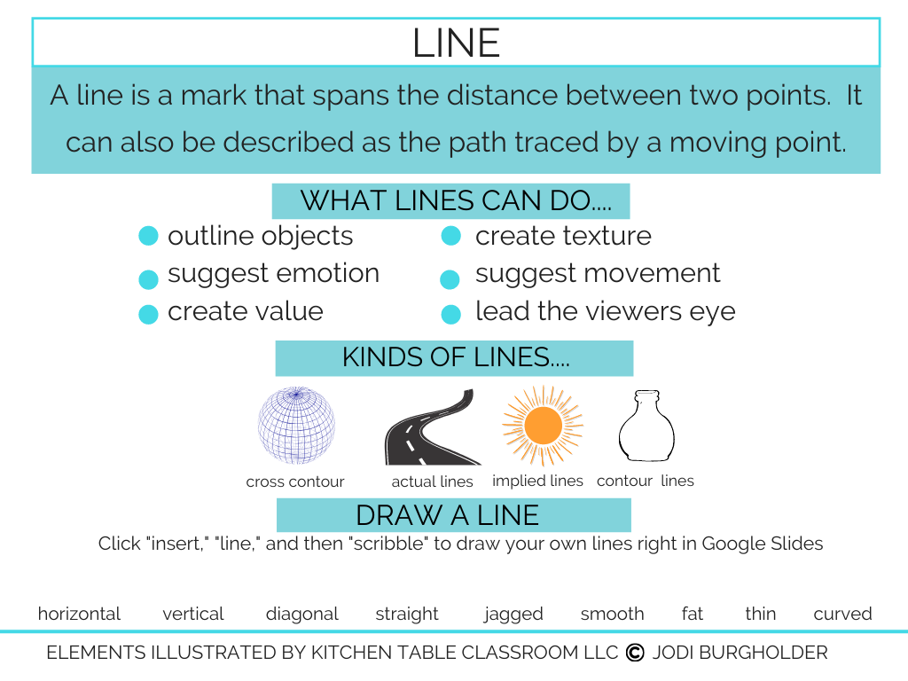

Slide 10
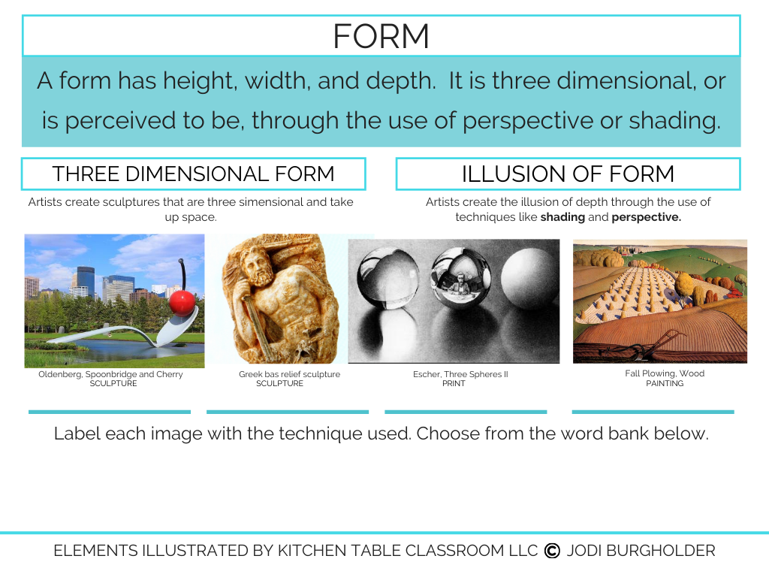
Three dimensional form
Illusion of form
Illusion of form
Three dimensional form

