Slide 1

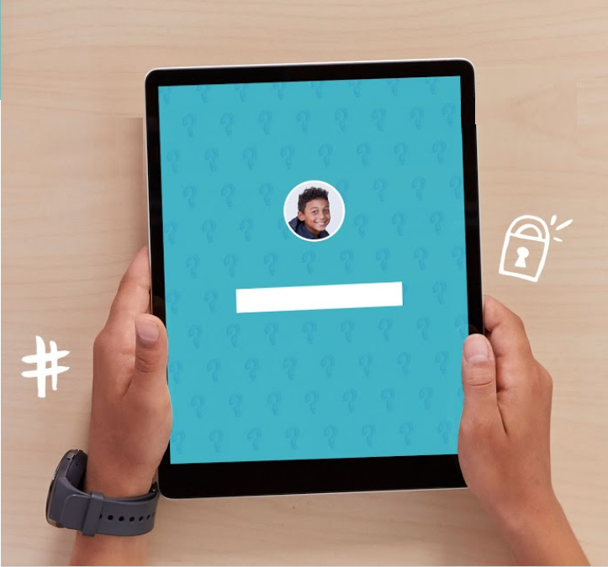
PRIVACY & SECURITY
We care about
everyone’s privacy.
Psssst…what’s your password?
DIGITAL CITIZENSHIP | GRADE 3
Password Power-Up
Enter Password

Slide 2

Essential Question
How can a strong password help protect your privacy?

Slide 3

Learning Objectives
l
Define the term "password" and describe its purpose.
Understand why a strong password is important.
Practice creating a memorable and strong password.
2
3

Slide 4

WARM UP: THINK–PAIR–SHARE
What is something in your life that you take steps to protect? Why and how do you protect it?
Directions:
Take a moment to think silently about these questions.
Then, take turns sharing your response with your partner.

Slide 5


KEY VOCABULARY
Password
A secret string of letters, symbols, and numbers that you can use to restrict who can access something digital

Slide 6

JIGSAW: UH-OH! IF … , THEN ...
Directions
In your "home" group, read your assigned scenario and discuss what could happen if a password were stolen. Jot down your group's answer, and then wait for the teacher's instructions to switch to your "expert" group.
In your "expert" group, take turns sharing your "home" group's response. Complete your handout by taking notes on what each presenter shares.

Slide 7
KEY VOCABULARY
Phrase
A group of words that go together and are easy to remember

Slide 8


WRAP UP: PASSWORD TIPS CLOZE NOTES
Directions
Complete each password tip on the handout by filling in the blank word.
Password Tips to Remember
 | Start with a memorable ______________________.
 | Only your _________________ should know your password.
 | Never use any __________________ identity information in your password.
 | Create passwords with at least _____________ characters.
 | Use letters, numbers, and ___________________ in your password.
phrase
parents
private
eight
symbols

Slide 9
We care about
everyone’s privacy.

