Slide 1


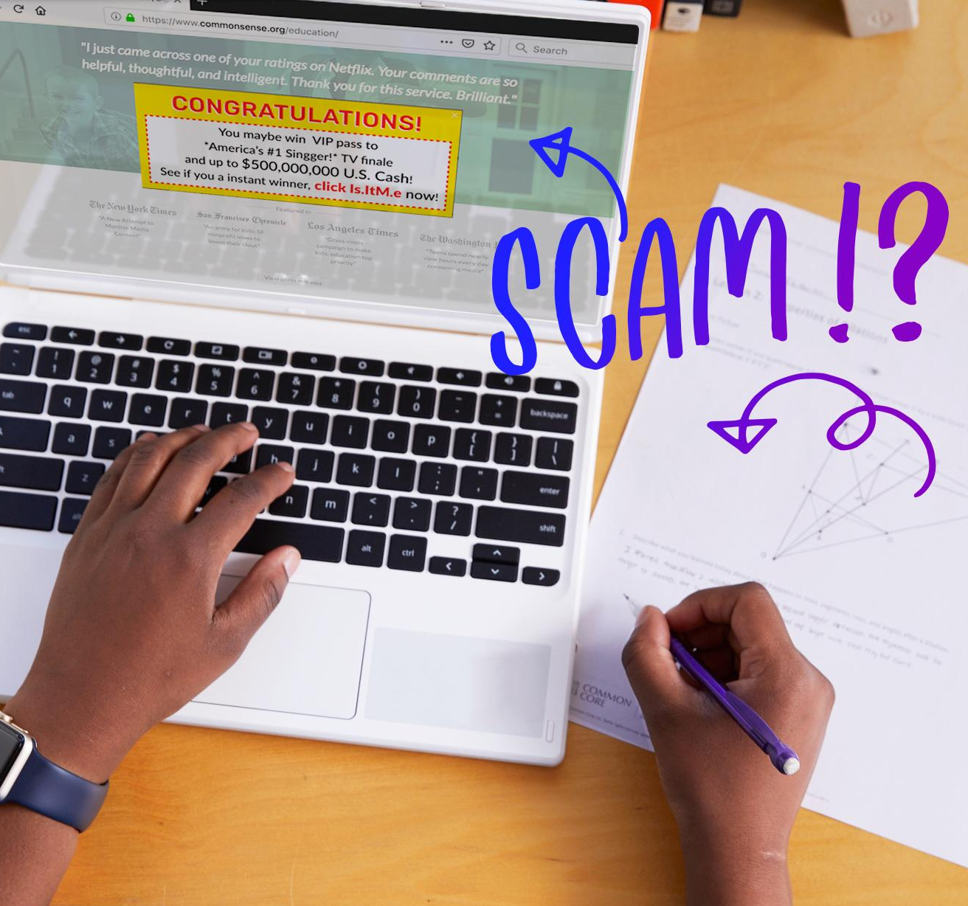
DIGITAL CITIZENSHIP | GRADE 6
Don't Feed the Phish

Slide 2

Essential Question
How can you protect yourself from phishing?

Slide 3

Learning Objectives
l
Compare and contrast identity theft with other kinds of theft.
Describe different ways that identity theft can occur online.
Use message clues to identify examples of phishing.
2
3

Slide 4

WARM UP: THINK-PAIR-SHARE
What's something you own that someone else might want to steal? Why? What would they do with it?
Directions:
Take a moment to think silently about these questions.
Then, take turns sharing your responses with your partner.

Slide 5


Identity theft
KEY VOCABULARY
A type of crime in which your private information is stolen and used for criminal activity

Slide 6
Private information
KEY VOCABULARY
Information that can be used to identify you because it is unique to you (e.g., your full name or your address)

Slide 7


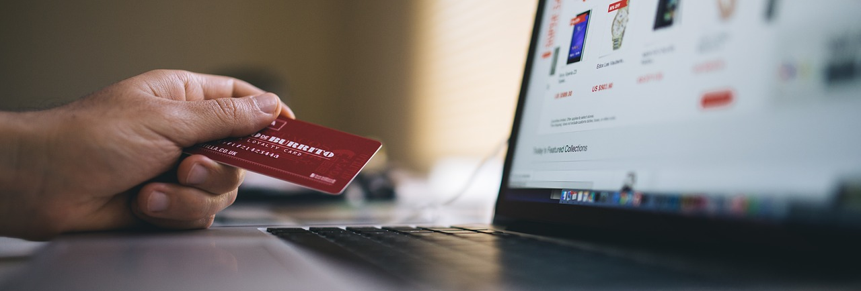
Thieves Use Others' Information To . . .
EXPLORE: CLASS DISCUSSION
cyberbully someone.
create false documents.
buy things with others' money.
get loans, jobs, or driver's licenses.
Notes:
<one photo opposite rows 3-4, e.g.
Shutterstock image of stealing a credit card through a laptop: ID: 293166725>

Slide 8
Internet scam
KEY VOCABULARY
An attempt to trick someone online, usually with the intention of stealing money or private information

Slide 9
Phishing
KEY VOCABULARY
When someone poses as an institution, like a bank or a school, and sends you a personalized message asking you to provide private information

Slide 10
Clues to Phishing scams
KEY VOCABULARY
Sense of urgency: When the sender says you only have a limited time to respond.
Spelling and grammar errors: A real company does not send out messages with such errors.
Alert! Alert!: The message sounds urgent, making you worry that something is wrong with your account.
"Friend" in trouble: You see a photo of someone you know, but the message isn't really from them.
Shortened URL: A web address that has been condensed and that could mislead a user into going into a risky website.
Too good to be true: Identity thieves often offer easy chances to win free money or prizes.
Generic or missing greeting: Real companies send messages that address customers by name.
Now, on the next page we will use these phishing clues to decide if we should “click it” or “skip it”

Slide 11

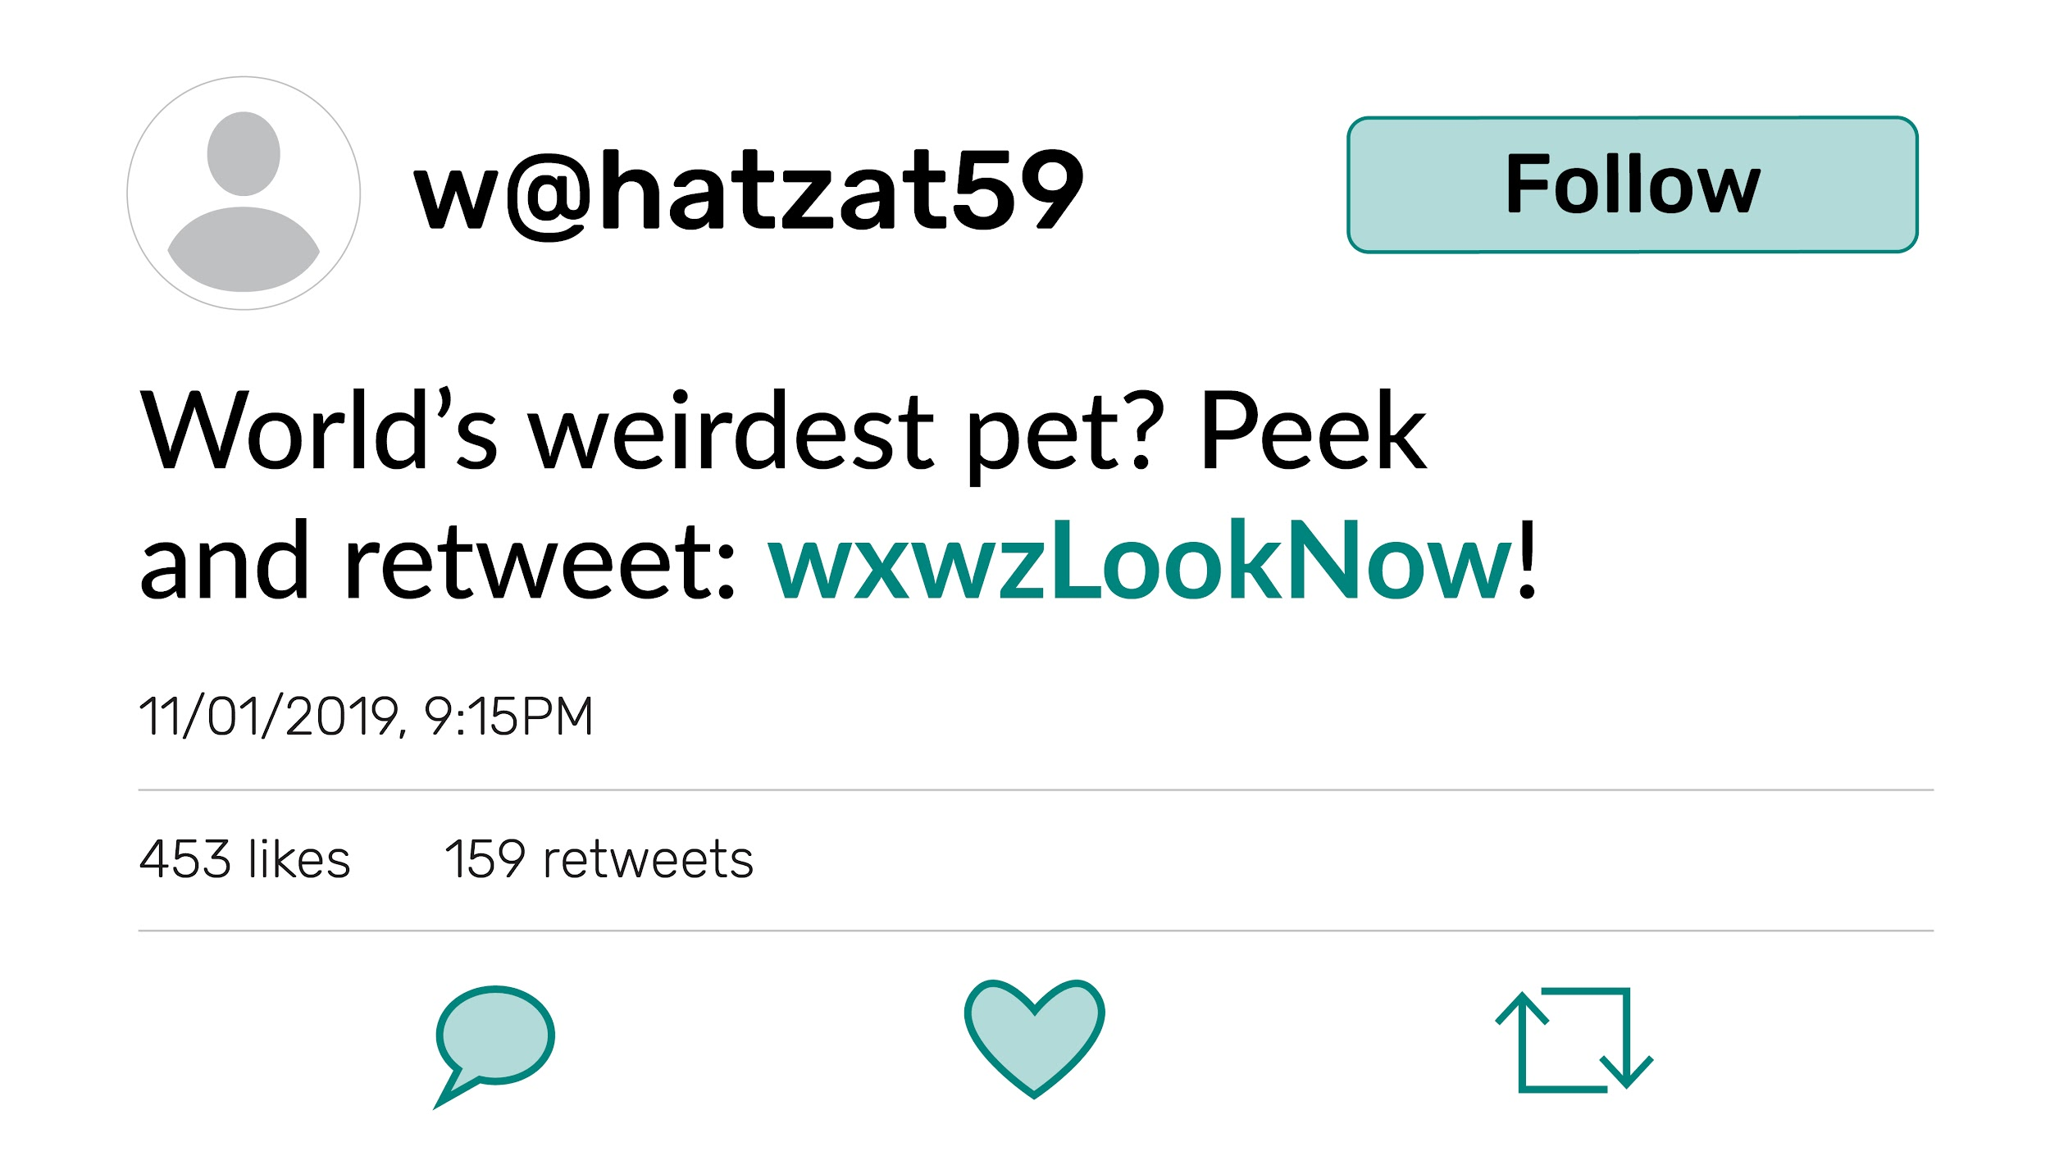

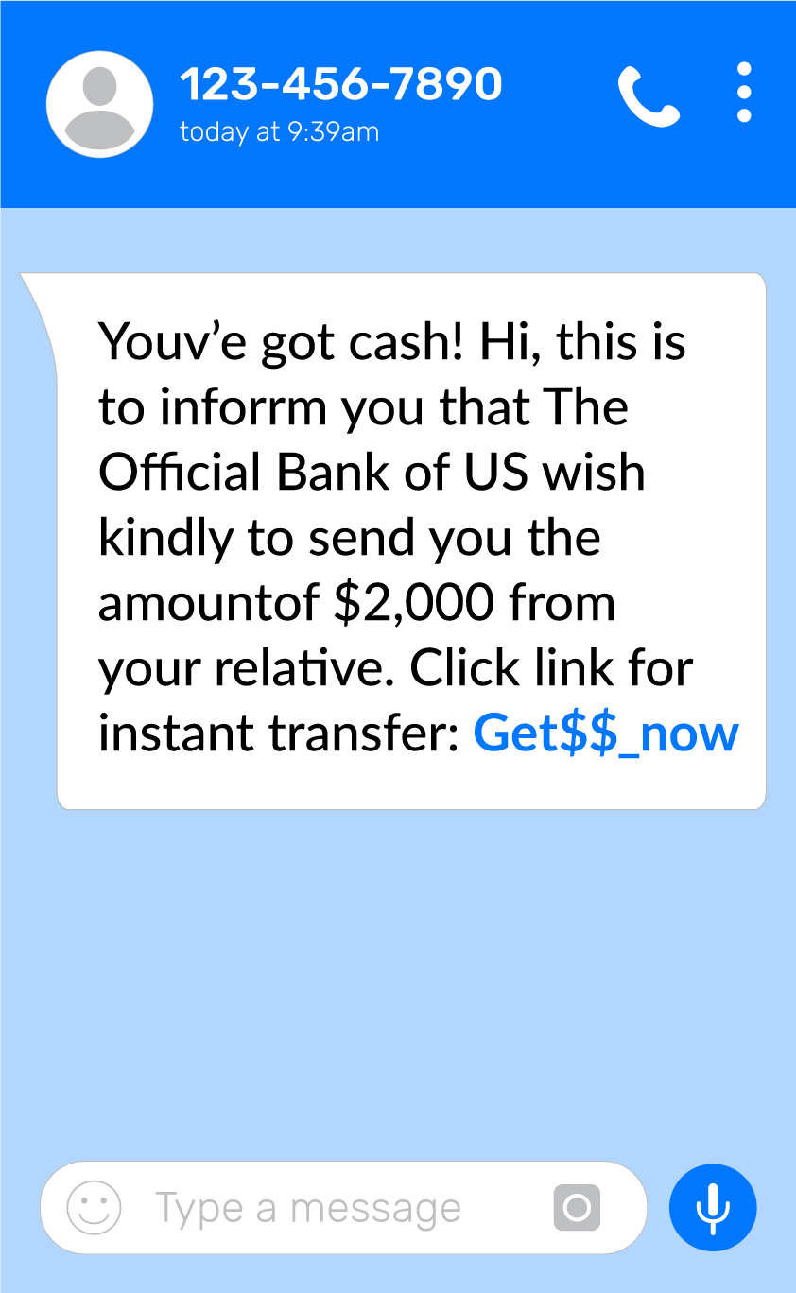
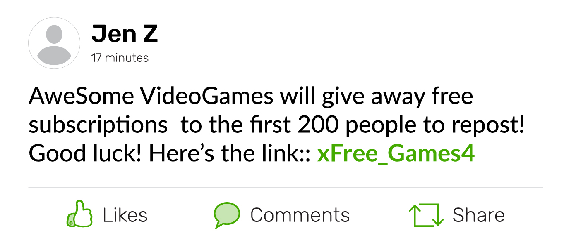
Click It or Skip It?
ACTIVITY: GROUP WORK

Slide 12
Shortened URL
KEY VOCABULARY
A web address that has been condensed and that could potentially mislead a user into going into a risky website

Slide 13

Stay Safe from Scams
ACTIVITY: EXIT TICKET
What is important to know about shortened URLs?
What else should you check for in a message? Give two examples.

Slide 14
Directions (optional handout)
ACTIVITY: THINK-PAIR-SHARE
Discuss the clues to messages that may be phishing scams.
Highlight clues in the messages.
Add a note about the clue in the box.

Slide 15


