Slide 1
Creating Nested Loops
Drawing with code
Michelle Black supplement to Code.org level E Lesson 8
Notes:
Design a snowflake lesson 8

Slide 2
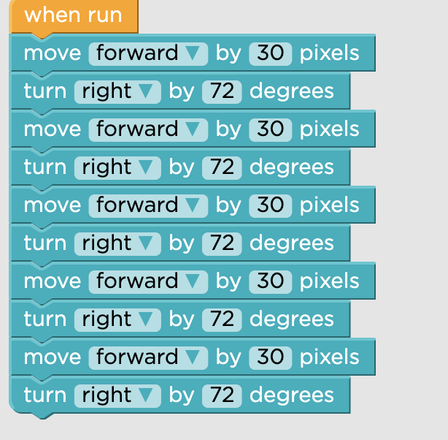
Create the shape
Notes:
This creates a pentagon

Slide 3
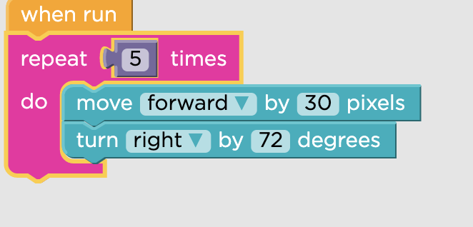
Put the shape into a repeat block
Notes:
This keeps the next code from influencing the shape

Slide 4
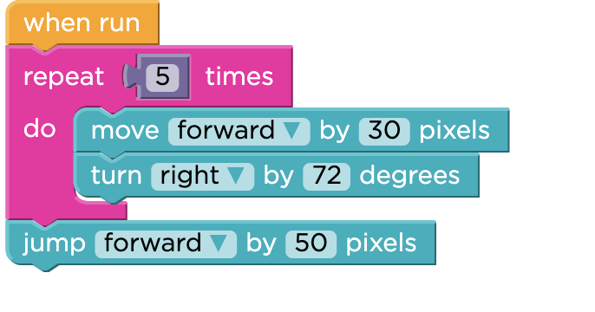
Special directions go AFTER the repeat block
Notes:
The special directions happen after the shape, each time it is run

Slide 5
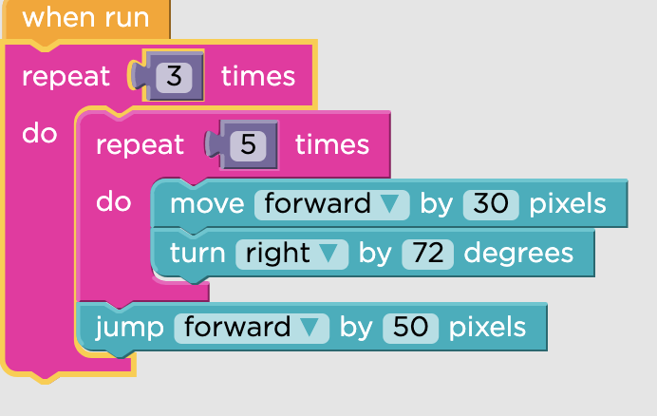
Now Create the First Nested Loop
Notes:
How many times do you want you shape to happen

Slide 6
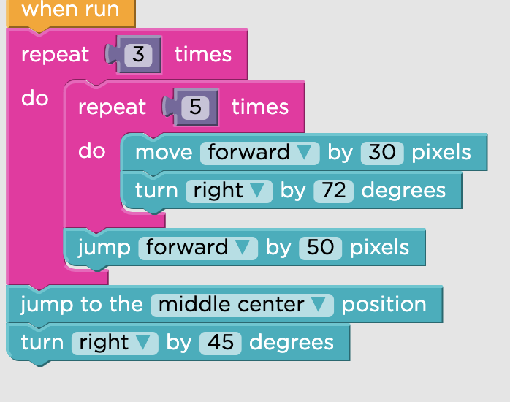
Do you need special directions again?
Notes:
What do you want to happen after you repeat the shape?

Slide 7
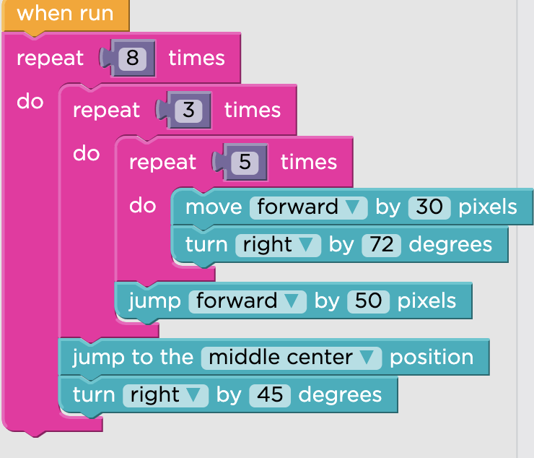
Create the next loop around these directions
Notes:
How many of these loops do you want to happen?

