Slide 1
“E” for Erosion!
By Ms. Cline-4th grade

Slide 2
Background Knowledge
Erosion is all around us! Turn to your partner and pair share what you think erosion is, be ready share.
Brainstorm List:

Slide 3
What is erosion?
Erosion
Erosion is the geological process in which earthen materials are worn away and transported by natural forces such as wind or water.
We’re going to check out some examples on the next slides, be ready to guess how these features on Earth were eroded.
Check out the video for a better explanation:
https://thesciencepenguin.com/2016/02/erosion.html

Slide 4
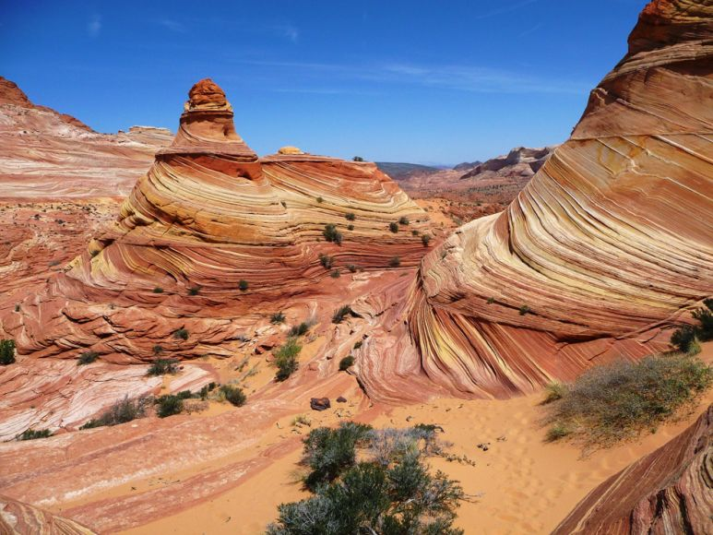
Guess that Erosion!

Slide 5
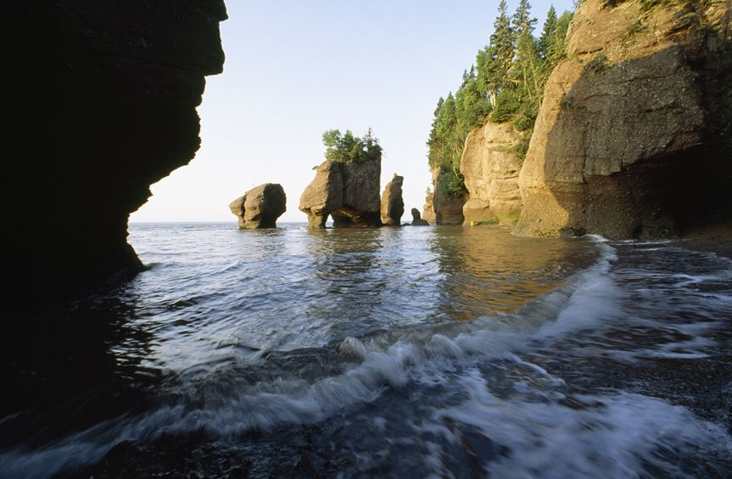
Guess that Erosion!

Slide 6
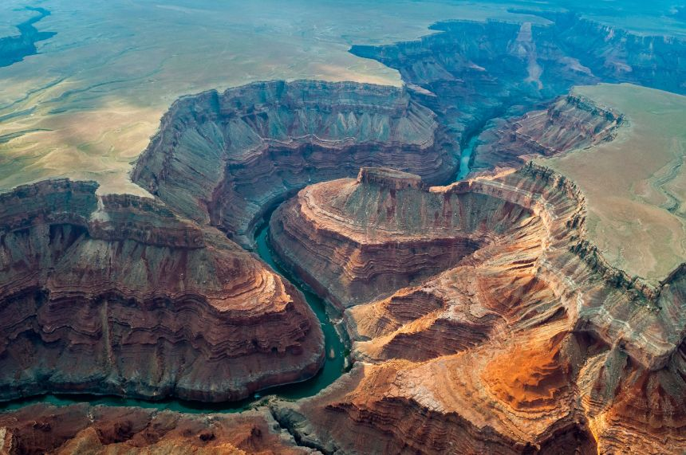
Guess that Erosion!

Slide 7
Problem Solving
We are going to build our own example of erosion. They are actually building a new water infrastructure from the mountains to Rawlins to help our water situation.
Each group will need:
A plastic tub
Sand/Soil
Toy plants, animals, people
Rocks, grass, shrubs collect outside
A full water bottle

Slide 8
Erosion Project
Each group of students will create a an example of landforms with soil, plants, rocks, plastic figurines. When it has been created, they will use water bottles to pour water through their landform to see how the landscape changes. Students will need to create a before and after picture.
Extension: add more water to see how the land changes, put structures near the water path to see if they survive.

Slide 9
“C” is for Cybersecurity
What is Cybersecurity?
https://www.cisa.gov/sites/default/files/publications/Kids%20Cybersecurity%20Presentation.pdf

Slide 10
Turn and talk
What are some things that you could do to be more cyber safe?

Slide 11
Turn and talk-
What are some real life examples of Cyber security?

Slide 12
WHAT IF…………………………………
What if there was a major cyber security breach at a bank?
-There would be a major domino effect
-People wouldn’t be able to access their money, they couldn’t make their house payment, car payment, then what happens?
-One breach could create many problems.

Slide 13
Uh-oh! Rawlins water system has been cyber attacked!
Thousands of gallons of water are disappearing from Rawlins overnight, it turns out that their water system has been cyber attacked because our security system needs to be updated.
The mayor of Rawlins has hired you and your security team to come up with a solution and plan to keep cyber threats away in the future.
Your mission should you choose to accept: Create a slideshow to present your plan on how to keep our cyber threats away.

Slide 14
Bonus: For Early Finishers-Data Defenders
https://mediasmarts.ca/sites/mediasmarts/files/games/data-defenders/

