Slide 1
“E” for Erosion!
By Ms. Cline-4th grade

Slide 2
Background Knowledge
Erosion is all around us! Turn to your partner and pair share what you think erosion is, be ready share.
Brainstorm List:

Slide 3
What is erosion?
Erosion
Erosion is the geological process in which earthen materials are worn away and transported by natural forces such as wind or water.
We’re going to check out some examples on the next slides, be ready to guess how these features on Earth were eroded.
Check out the video for a better explanation:
https://thesciencepenguin.com/2016/02/erosion.html

Slide 4
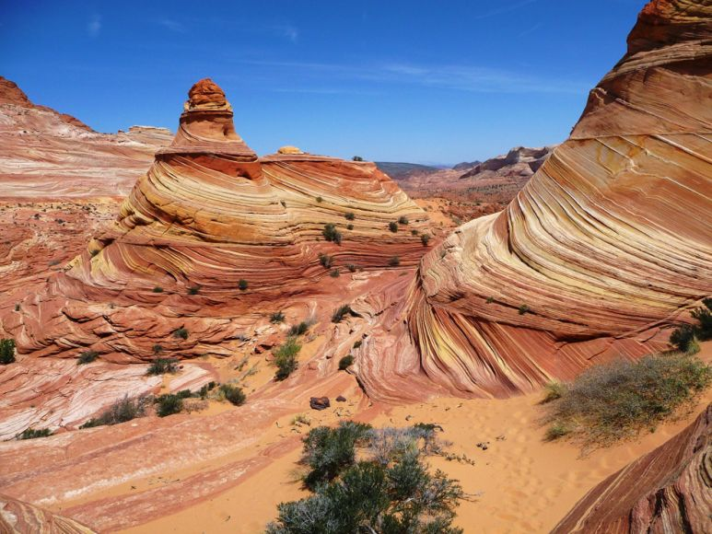
Guess that Erosion!

Slide 5
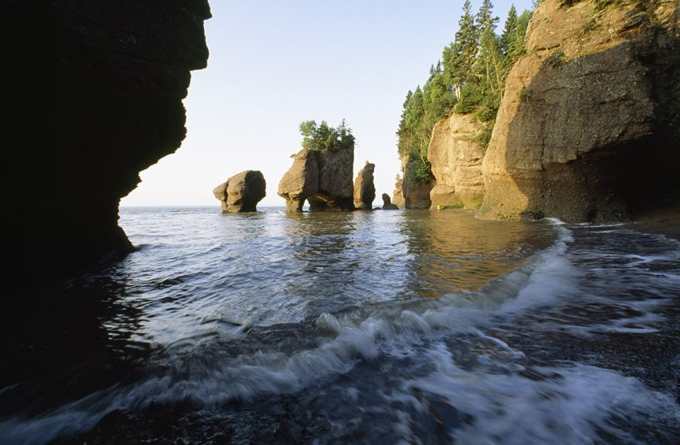
Guess that Erosion!

Slide 6
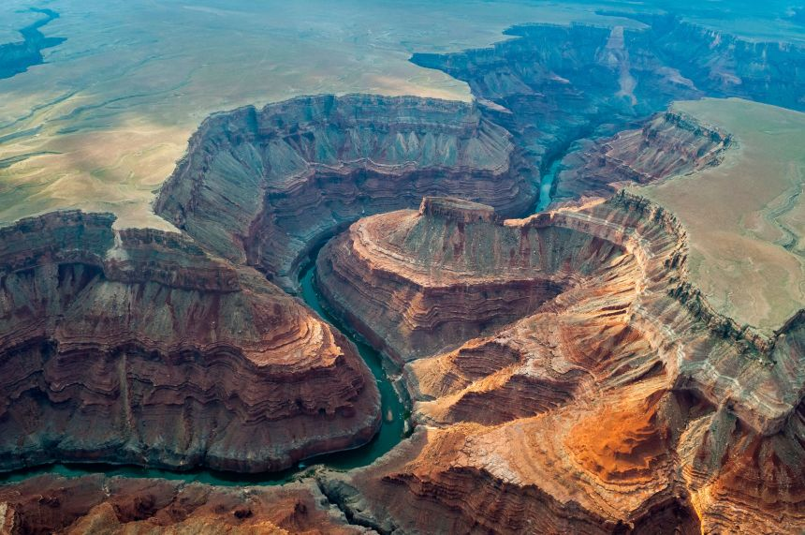
Guess that Erosion!

Slide 7
Problem Solving
We are going to build our own example of erosion. They are actually building a new water infrastructure from the mountains to Rawlins to help our water situation.
Each group will need:
A plastic tub
Sand/Soil
Toy plants, animals, people
Rocks, grass, shrubs collect outside
A full water bottle

Slide 8
Erosion Project
Each group of students will create a an example of landforms with soil, plants, rocks, plastic figurines. When it has been created, they will use water bottles to pour water through their landform to see how the landscape changes. Students will need to create a before and after picture.
Extension: add more water to see how the land changes, put structures near the water path to see if they survive.

Slide 10
Uh-oh! Rawlins water system has been cyber attacked!
https://mediasmarts.ca/sites/mediasmarts/files/games/data-defenders/

